Slide 1
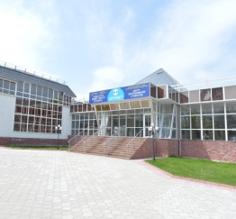
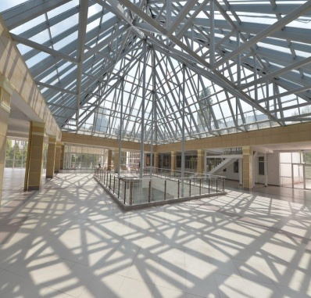
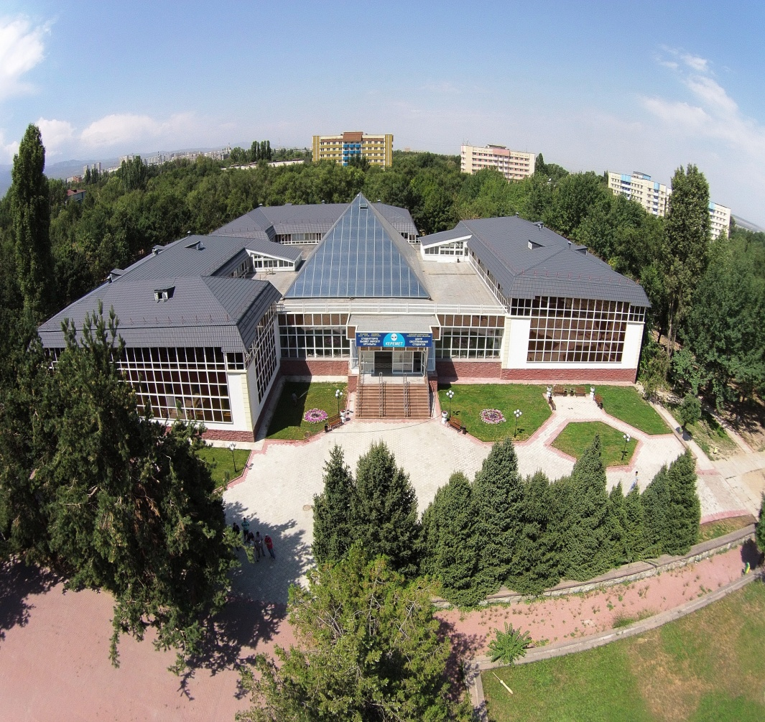
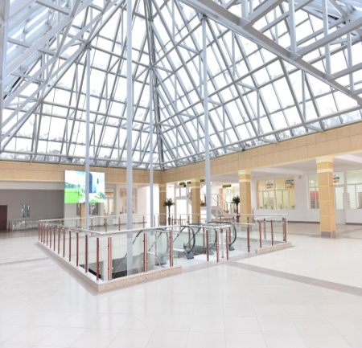
Students service centre «KEREMET»
keremet.kaznu.kz

Slide 2
Students service center «Keremet» «Аl-Farabi university smart city» –
Youth resource Centre for students
For the first time in the education system of the Republic of Kazakhstan to provide socially significant of educational, medical, legal, financial, cultural and entertainment services on the principle of one window was made the reconstruction of 1973 built building. The building of Students' Service Centre Keremet is located on 3 floors, with a total area of 7,300 sq.m. Visitors are offered the latest auto-disaggregated system of highly effective service designed for comfort and convenience of students.
The idea of establishing a center belongs to the rector of the University Mutanov Galymkair Mutanovich, based on the teachings of the great philosopher Abu Nasr al-Farabi’s "Treatise on the views of virtuous city residents."

Slide 3
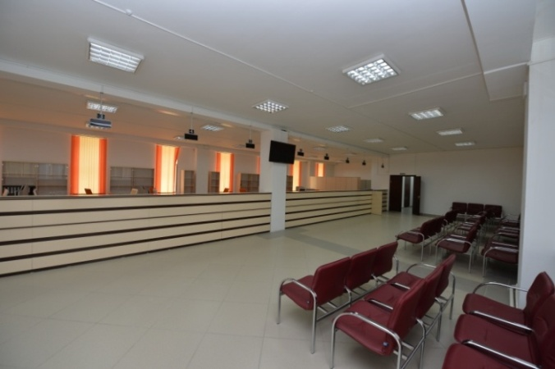
STRUCTURE OF STUDENTS SERVICE CENTRE «KEREMET»
Services on education process organization
Social and administrative services
Commerce and entertainment services
Youth Centre services
Diagnostic Centre services
Адрес: ЦОС "Керемет", каб.101
Тел.: +7 727 211-14-30

Slide 4
Services on education process organization
REGISTAR OFFICE – academic service, dealing with the registration of all history of educational achievements of students and providing the organization of all kinds of knowledge and calculation of its academic rating.
Restoration of transcript
Transcript issue
Credit and
disciplines
Transfer of services- recipient
Reregistration of discipline
Office registrar services
Additional type of training for services-receiver
Distinction or indebtedness of «Retake» discipline
Адрес: ЦОС "Керемет", каб.101
Тел.: +7 727 211-14-30
Registration of students for academic subjects
Summer term

Slide 5
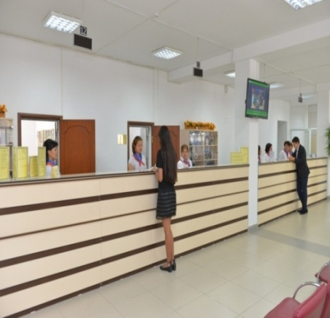
SERVICES ON EDUCATION PROCESS ORGANIZATION
STUDENTS OFFICE– provision of accounting and control movement contingent of students
Duplicate diploma issue
Issuing copies of students
documents
Issue of the response letter regarding the request of particular student
Internal and external transfers, restoration of students
Адрес: ЦОС "Керемет", каб.102
Тел.: +7 727 221 – 14 – 41 221 – 14 – 42

Slide 6
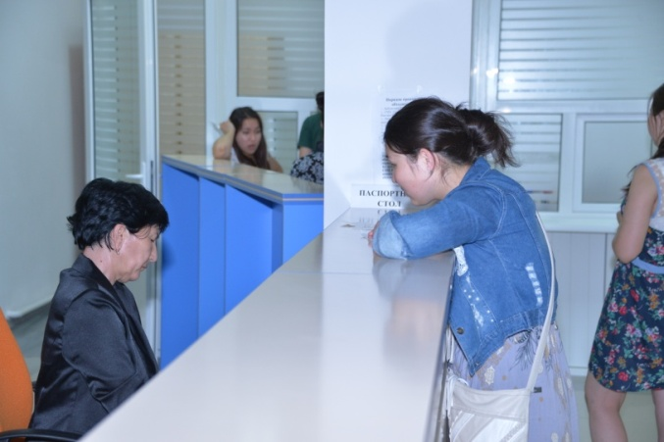
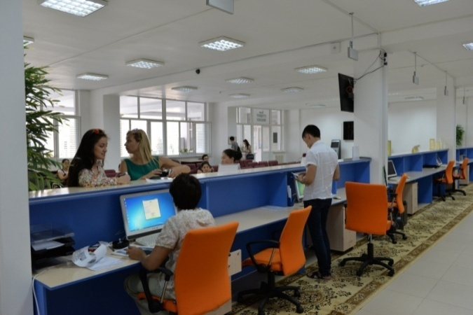
SERVICES ON EDUCATION PROCESS ORGANIZATION
Registration
PASSPORT OFFICE
Issue of certificates and
other documents
Deregistration
Text
Students registration office on
domiciliary
(in dormitories of KazNU)
Адрес: ЦОС "Керемет", каб.102
Тел.: +7 727 221 – 14 – 43
Режим работы: по четвергам работают в
ЦОНе Бостандыкского района

Slide 7
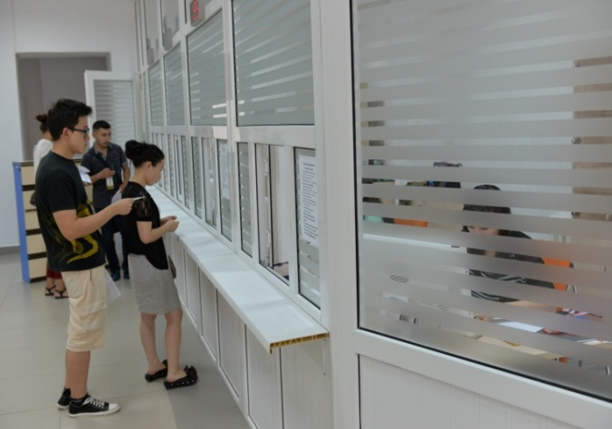
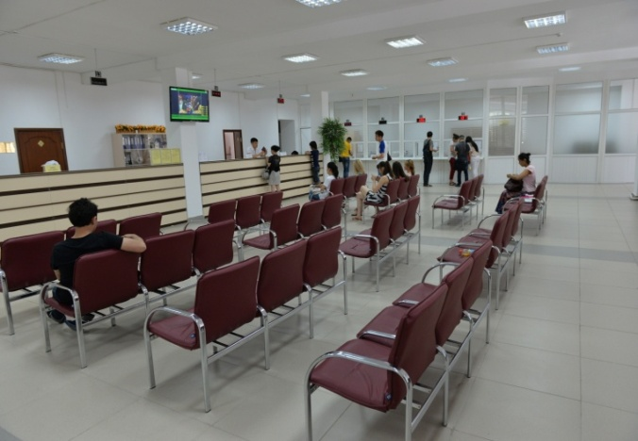
SERVICES ON EDUCATION PROCESS ORGANIZATION
DEPARTMENT OF ACCOUNTING AND REPORTING - advice on economic and financial issues to manage, control, analysis and planning of work with students
Scholarships
Practices abroad
Students trip
Paid tuition
Students house
Адрес: ЦОС "Керемет", каб.102
Тел.: +7 727 221 – 14 – 46
221 – 14 – 47

Slide 8
SERVICES ON EDUCATION PROCESS ORGANIZATION
Consultations on international academic mobility
Changing the date / cancel the order on trip abroad
Restoration after learning trips abroad
DEPARTMENT OF INTERNATIONAL ACADEMIC MOBILITY SUPPORT
Students trips abroad in the framework of the short / long-term academic mobility
Making temporary registration \ reregistration of foreign citizens
Заграничная командировка профессорско-преподавательского состава и сотрудников
The visa extension, issue of exit visa
Visa support
Адрес: ЦОС "Керемет", каб.102
Тел.: +7 727 221 – 14 – 48

Slide 9
SOCIAL AND ADMINISTRATIVE SERVICES
Lawyers, notaries
Air and railway ticket office
Travel agency
Career and business Centre
bank

Slide 10
SOCIAL AND ADMINISTRATIVE SERVICES
Informing students about current vacancies
Осуществление платных услуг частным лицам (employees)
CAREER AND BUSSINESS CENTRE– расширение баз практик и возможность дальнейшего трудоустройства студентов КаНУ им. аль-Фараби
Consulting students on summer and other internships
Consultations on making and constructing resumes of students and graduates of Al-Farabi KazNU
Address: SSC “Keremet", room.107
Tel.: +7 727 377-33-73
e-mail: career@kaznu.kz

Slide 11
Welfare Services
COMMERCE AND ENTERTAINMENT SERVICES
Beauty Saloon
Cafe
Book
shop
Copy centre
Photostudio
Cinema
Laundry
Ремонт обуви
Supermarket
Atelier

Slide 12
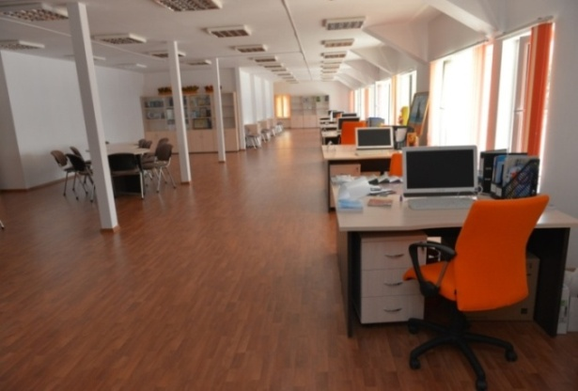
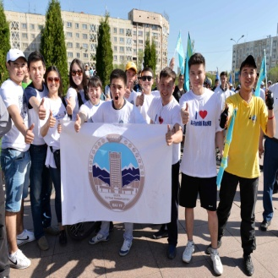
YOUTH CENTRE SERVICES
YOUTH CENTRE – Center of youth policy deals with the implementation of Al-Farabi Kazakh National University
students opportunities.
1
2
3
4
Registration of student organizations and interest clubs
Consultation on the implementation of youth projects
Acceptance of applications for membership in student organizations
Consultations on social package and provision of social assistance to orphans
Address: SSC “Keremet", room. 205
Tel.: +7 727 221 – 14 – 51

Slide 13
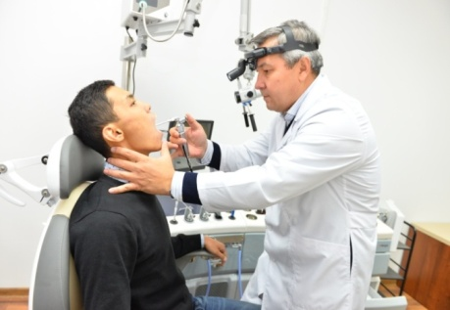
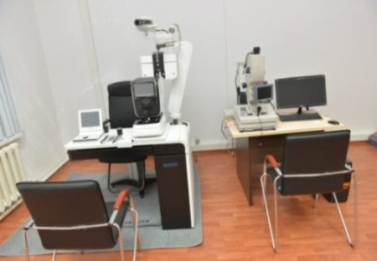
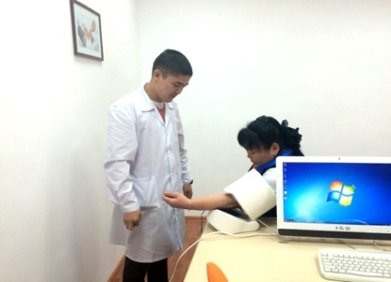
DIAGNOSTIC CENTRE SERVICES
The Center conducts screening tests, diagnosis and counseling of students and faculty members of the University
Heart rate Measurement
Investigation of sight sense: visual acuity, ocular fundus photograph, measurement of intraocular pressure
Direct chest X-ray
GYNECOLOGICAL EXAMINATION
colposcopy
ANTHROPOMETRIC RESEARCH
Measurement of height, weight, body mass index
RADIOLOGICAL EXAMINATION
CLINICAL RESEARCH
FUNCTIONAL RESEARCH
general analysis
LABORATORIAL RESEARCH
Blood Pressure Measurement
Electrocardiography
Spirography
Investigation of of hearing: audiometry, tympanometry
biochemical analysis of blood
immunochemical analysis of blood
urinalysis
Ultrasonography (liver and kidney)
gynecological smear
Determination of biological age
In Diagnostic Center of Al-Farabi Kazakh National University presented modern medical equipment that meets international quality of medical services.
Ambulatory diagnosis, treatment and advice:
Internist, pediatrician and GP
Surgeon: children and adults
Otolaryngologist: baby and adult
Ophthalmologist: children and adults
Neurologist: children and adults
Urologist: children and adults
Obstetrician-gynecologist
Gastroenterologist,cardiologist
Trauma orthopedist children and adult
Address: SSC “Keremet",
Tel.: +7 727 221 – 14 – 44
Website: smarthealth.kz

Slide 14
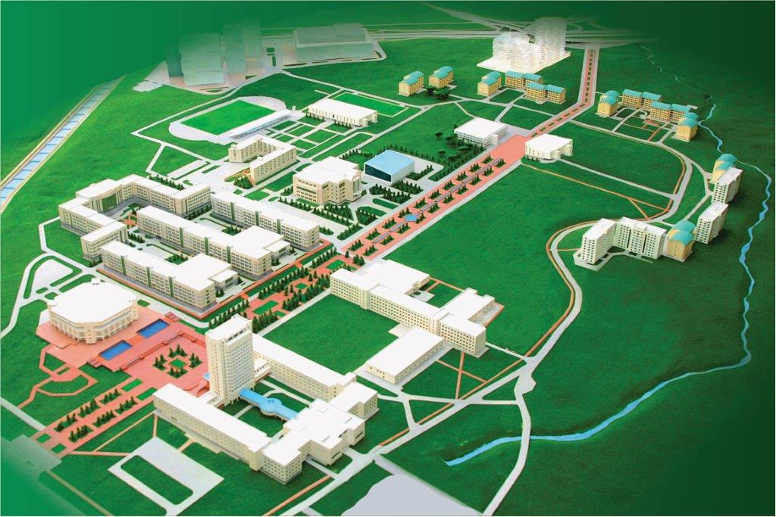
STUDENTS SERVICE CENTRE «KEREMET»
Address: Al-Frabi Ave, 71
Website: keremet.kaznu.kz
e-mail:
Contact number: +7 (727) 221 14 11
Working hours:
Mon 9⁰⁰–18⁰⁰
Tue 9⁰⁰–18⁰⁰
Wed 9⁰⁰–18⁰⁰
Thu 9⁰⁰–18⁰⁰
Fri 9⁰⁰–18⁰⁰
Sat 9⁰⁰–13⁰⁰
Sun выходной

