Slide 1

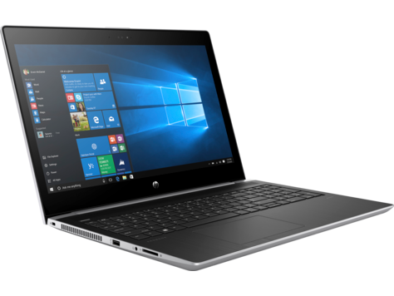

Cyber thieves
scam artists
identity thieves
hackers
mc.today
$
$
$
$
Personal information
www8.hp.com
iconfinder.com

Slide 2
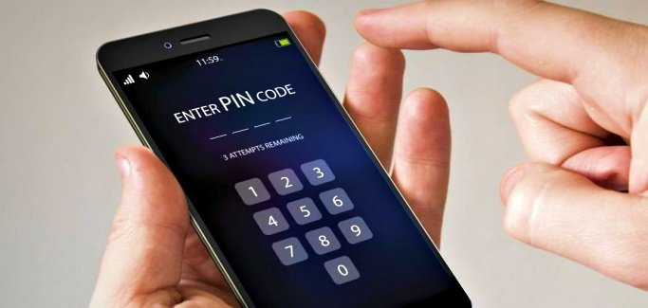
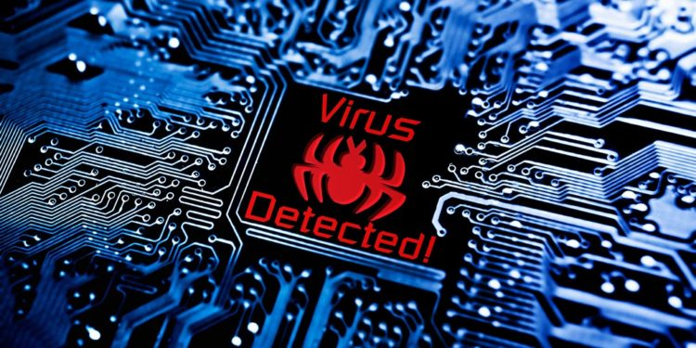
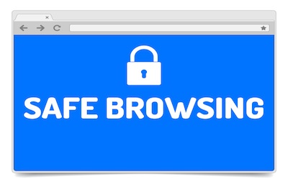

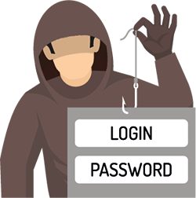

Ways of protection
1
Don’t leave any devices unattended;
Avoid computer viruses;
Use safe browsing;
Protect your private data.
hackread.com
2
3
intego.com
4
moneyinc.com
genlawgroup.com
trevorayers.com
thinkbroadband.com

Slide 3
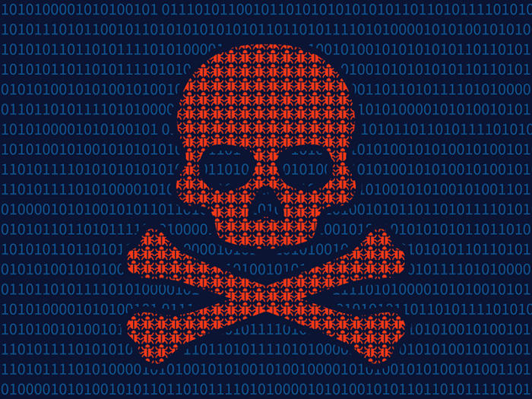
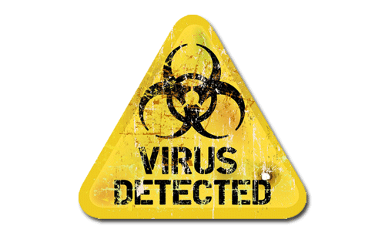
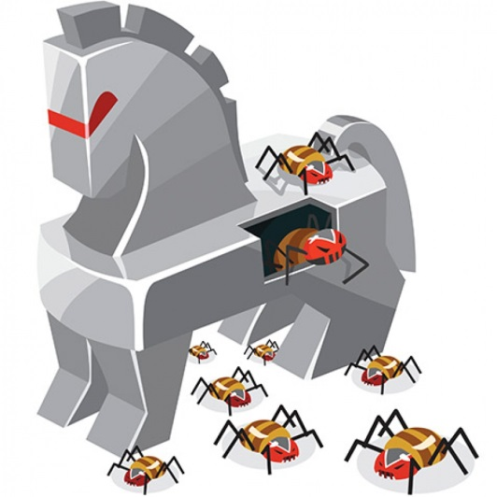



Malware
Malicious software (Malware) - any computer program designed to surreptitiously enter a computer, gain unauthorized access to data or disrupt normal processing operations.
1. Virus
3. Trojan
abcom.com.au
sayansystem.net
2. Worm
pcworld.com
4. Spyware
Jovi Umawing
blog.malwarebytes.com
imgpng.ru

Slide 4
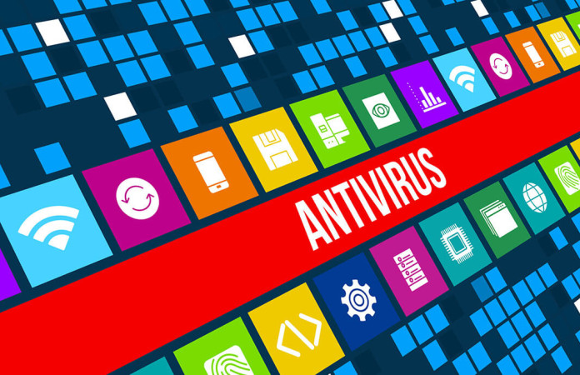


Antivirus
Antivirus software is a type of utility software that looks for and eradicates viruses, Trojan horses and other malware.
expressvpn.com
Firewall helps to protect you from worms.
vectra-corp.com
Antispyware helps to protect you from spy programs.
iconfinder.com

Slide 5
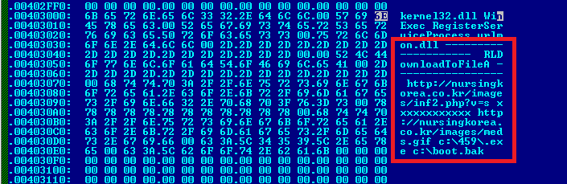
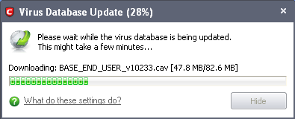
Antivirus database
Virus signature is section of program code that can be used to identify a known malicious program
kaspersky.com
Virus database - virus signatures and other information that antivirus software uses to identify and eradicate malware
help.comodo.com

Slide 6

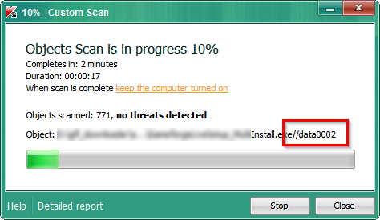
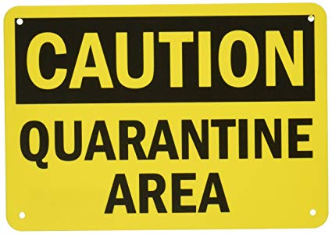
Virus scan
security.stackexchange.com
enterprise.comodo.com
Remove virus;
Put in quarantine;
Delete file.
amazon.com

Slide 7
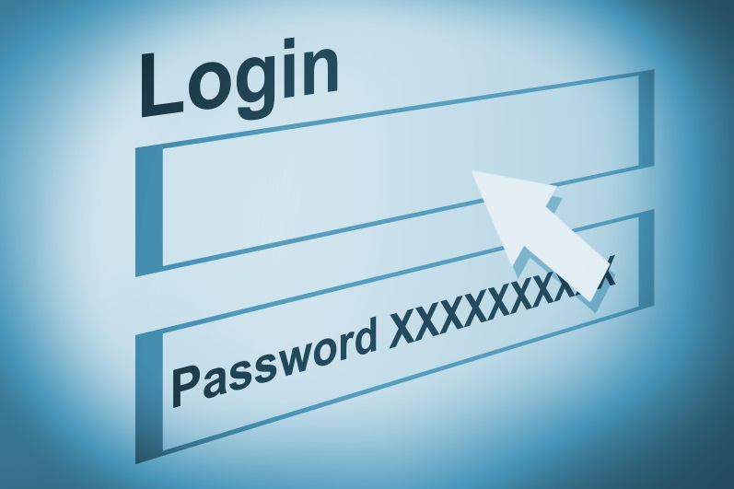
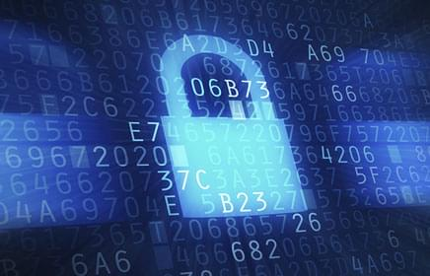
Protect private data
Authentication - any method that confirms a person’s identity.
Login (ID) - series of characters that becomes a person’s unique identifier
Password - a series of characters that verifies a user ID.
Safe password
Longer than 8 characters: *********;
Special symbols:!@#$%^&*;
Uppercase characters: ZZZ123zzz^;
Don’t tell it to anyone;
energy106.ca
verisign.com

Slide 8
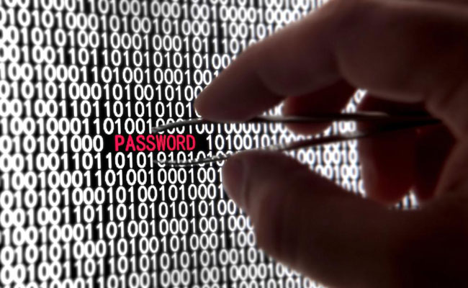
Methods for breaking password
hackingloops.com
Dictionary attack;
Sniffing;
Brute force attack.

