Slide 1


Office suits
harfordsmenswear.co.nz
businessmagazinegainesville.com
An office suite is a collection of software created by the same vendor and designed to be used for routine tasks within an organization.

Slide 2






Office suits modules
Main
Additional
Word processing
E-mail and contact managers
Spreadsheet
Project management
commons.wikimedia.org
Drawing
Presentation
Popular
Database
macworld.co.uk
support.apple.com

Slide 3


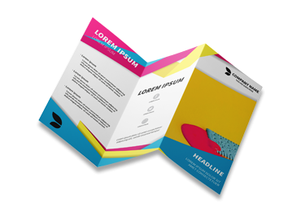


Writing with computer
antenam.net
dynafile.com
Word processing
beeprinting.com.au
digitaltrends.com
pixelsquid.com

Slide 4
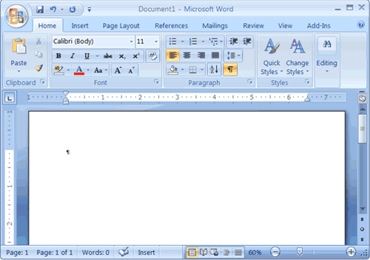

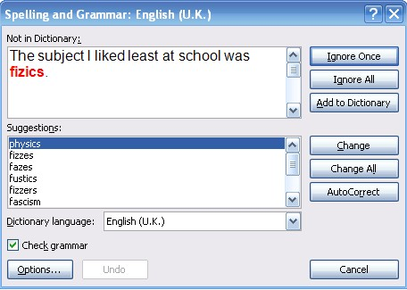
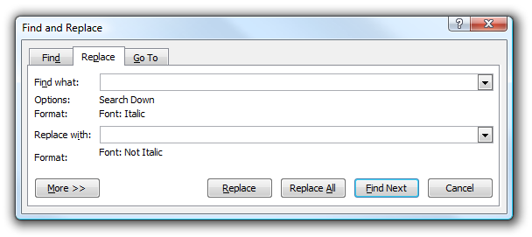
Word processing
baycongroup.com
Controls
Word wrap
Workspace
Search and replace
Grammar and spelling check
howtogeek.com

Slide 5


Spelling dictionary
if words in
capstonepaper.net
dadavan.com

Slide 6
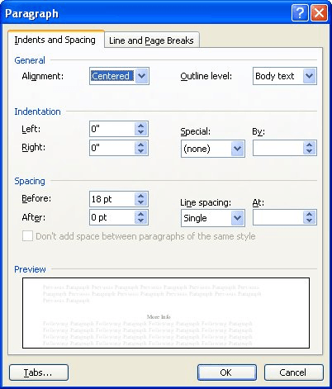
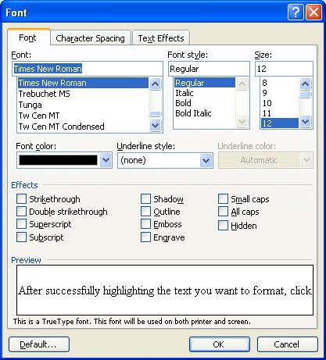
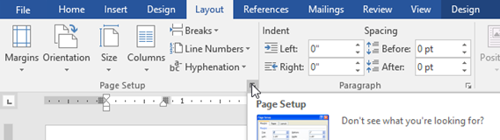
Formatting a document
Paragraph style includes the alignment of text within the margins and the space between each line of text
Font – a set of letters that share a unified design
word.tips.net
Layout - position of elements on a page
edu.gcfglobal.org
hubpages.com

Slide 7




Spreadsheets
eea.europa.eu
devero.com
groupon.com
alternance-professionnelle.fr

Slide 8
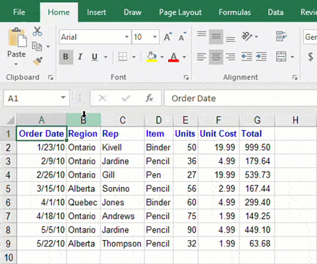


Spreadsheets elements
Relative reference
pro-spo.ru
pro-spo.ru
Column
Line
Absolute reference with $-sign
Cell A6
value - a number that you use in a calculation;
label - any text used to describe data;
formula - tell the computer how to use the contents of cells in calculations

Slide 9
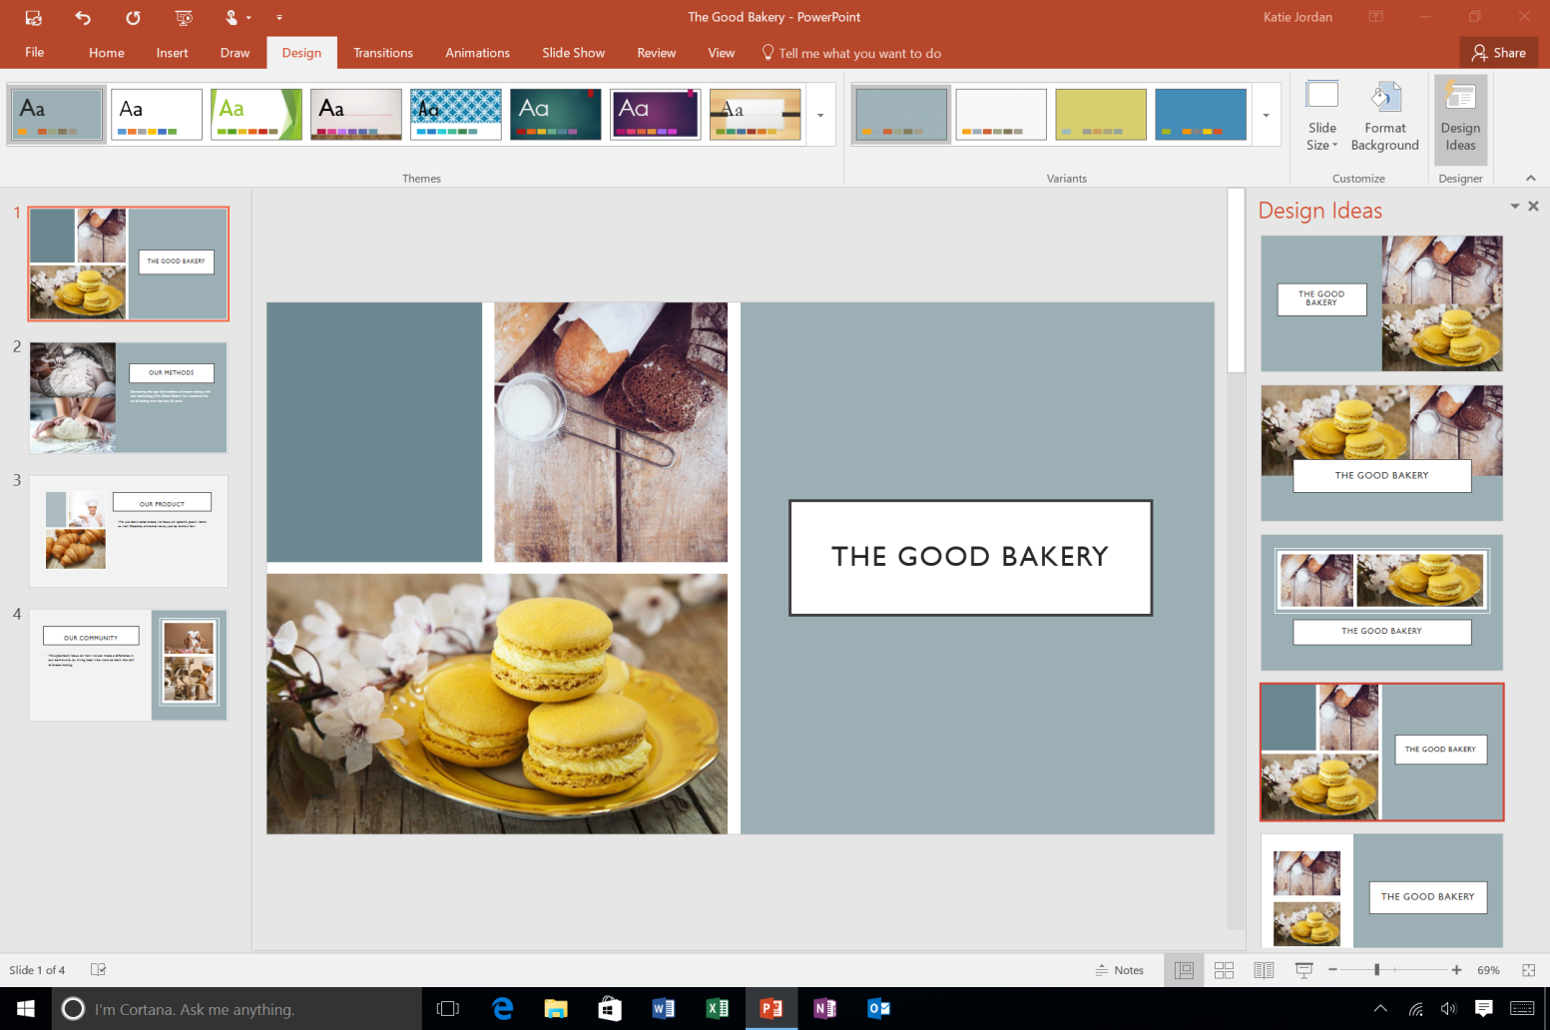
Presentations
Presentation software helps to combine text, photo, animation, sound to create series of electronic slides.
microsoft.com

Slide 10


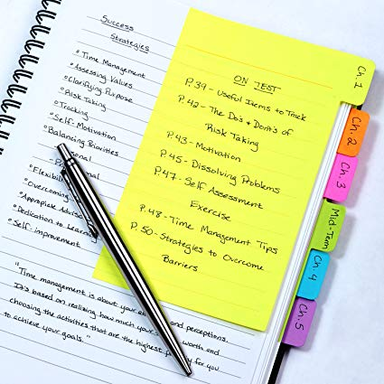

Benefits
1. Combine music, text, images, videos
2. Use graphics
enettechnologies.com
powtoon.com
3. Use notes
4. Keep attention
amazon.com
incplan.net

Slide 11

Key to success
techrepublic.com

