Slide 1
Part 1
Digital devices and data representation

Slide 2
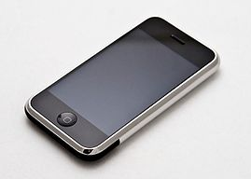
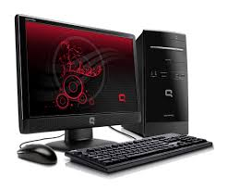
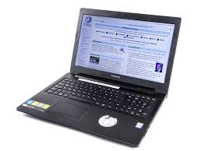
Categories of computers
om.wikipedia.org
en.wikipedia.org
Desktop
Mobile

Slide 3
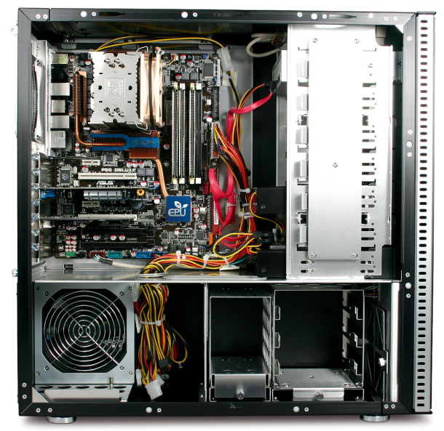
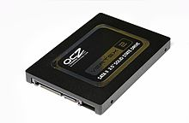
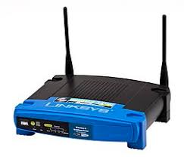
Parts of desktop computer
om.wikipedia.org
System unit
Output
Coderdojokilkenny
wordpress.com
Storage
ru.wikipedia.org
Network
Input
ru.wikipedia.org

Slide 4
Portable computers
Slate
Input + Output + Storage
Light weight
en.wikipedia.org
Clamshell
Easy to carry
en.wikipedia.org

Slide 5
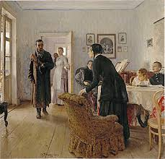

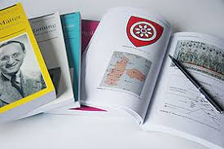

Data representation
ru.wikipedia.org
ru.wikipedia.org
en.wikipedia.org
Pictures
Songs
Info
Digitalization
0s and 1s
Arno Pienaar
theeventchronicle.com

Slide 6
Data types
Digital data is text, numbers, graphics, sound, and video that have been converted into discrete digits.
0
1
1
0
0
1
0
0
Analog data has infinite scale of values

Slide 7

Digital data
1
1
0
0
+5 V
+5 V
+0.2 V
+0.2 V
= A
0s and 1s used to represent digital data are referred to as binary digits = bit is a basic unit of information.

Slide 8
Digital data
On
Off

Slide 9
Digital data
1
1
0
0
1100
A

Slide 10


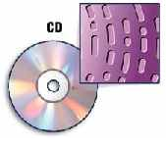
Digital data
1
+5 V
www.tonkka.com
elektrikov.net
0
+0.2 V
1
0
0
1
jkca.org
1
0
BIT
- basic unit of information

Slide 11
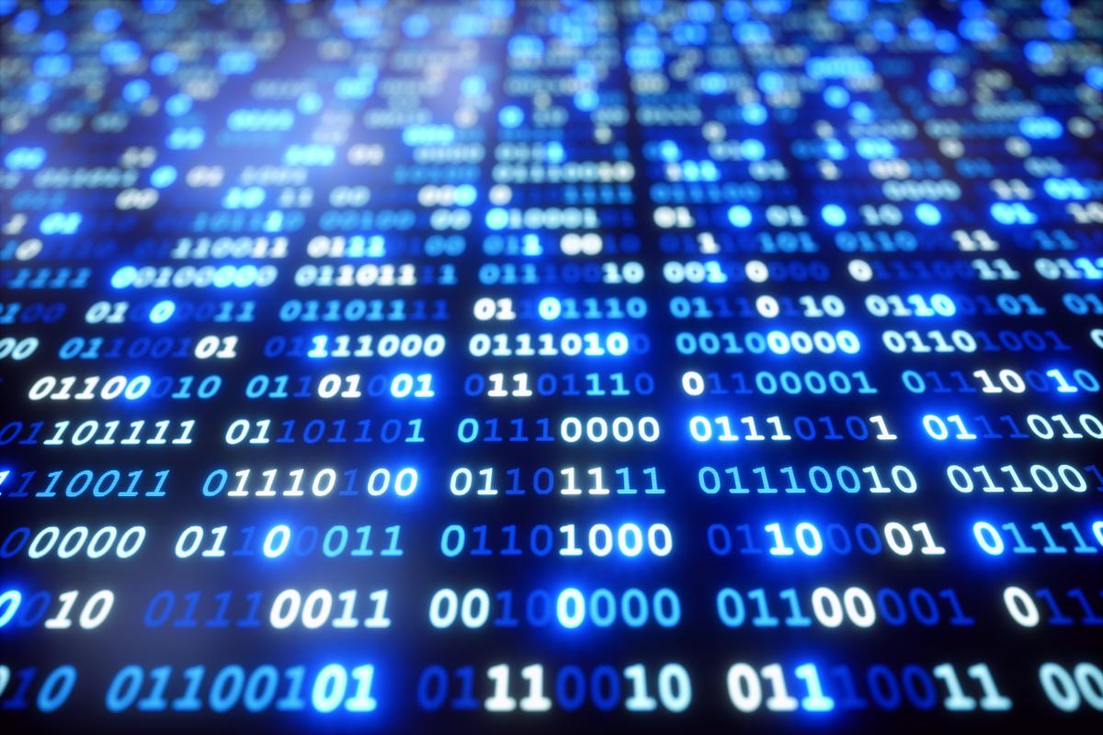
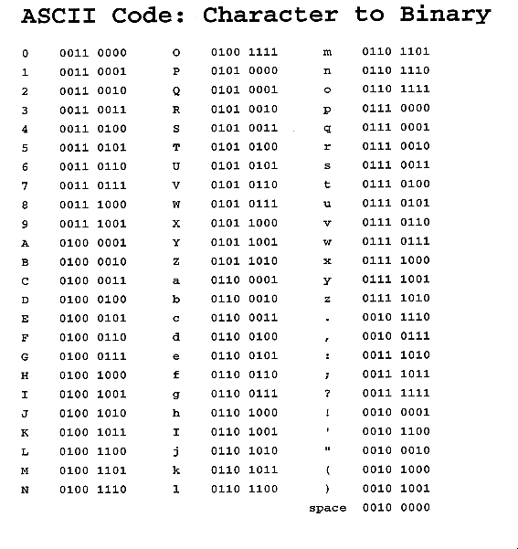
Data representation
Numbers: using binary number system.
Example: 11.01=$2^{1}+2^{0}+0×2^{−1}$ $+2^{−2}=3.25$.
techspirited.com
Letters: using ASCII, Unicode and other coding systems.
commons.wikimedia.org
Example: Lowercase letter x in ASCII will be coded as 0111 1000.

Slide 12


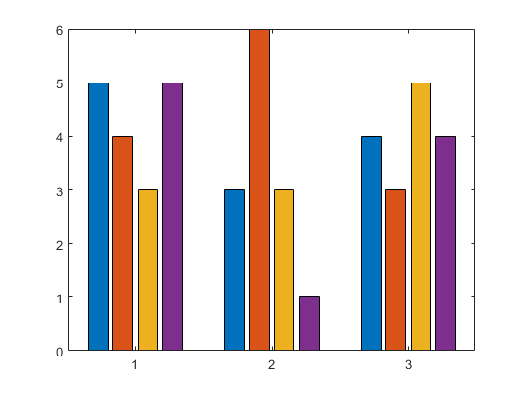
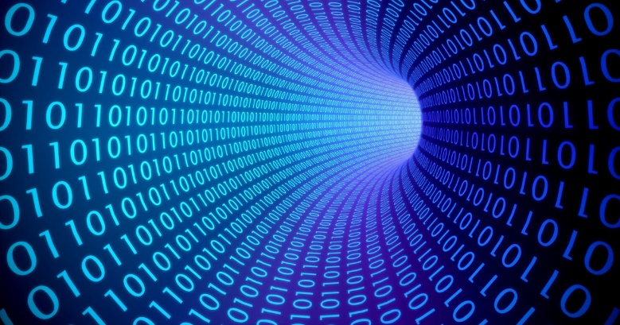
Data representation
hadkhanong
creativemarket.com
Wallpapers13.com
Digitization
mathworks.com
newsroom.cisco.com

Slide 13


Data representation
Image: by treating it as a series of colored dots.
Example:
red dot can be coded as 1010
Sound: by sampling sound wave.
Example:
youtube.com
sound wave
digitized

Slide 14
Prefixes
Prefix | Number of bits/bytes
Bit | 1
Byte | 8
Kilobit | $2^{10}$bits
Kilobyte | $2^{10}$bytes
Mega- | $2^{20}$-
Giga- | $2^{30}$-
Tera- | $2^{40}$-
Peta- | $2^{50}$-

Slide 15

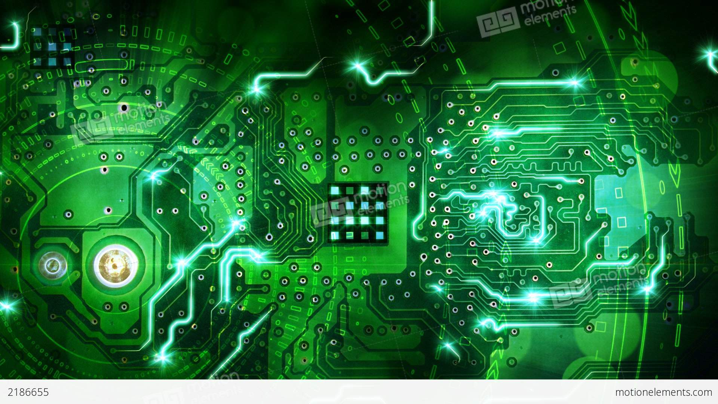
Electric circuits
brainpop.com
backgroundcheckall.com

Slide 16

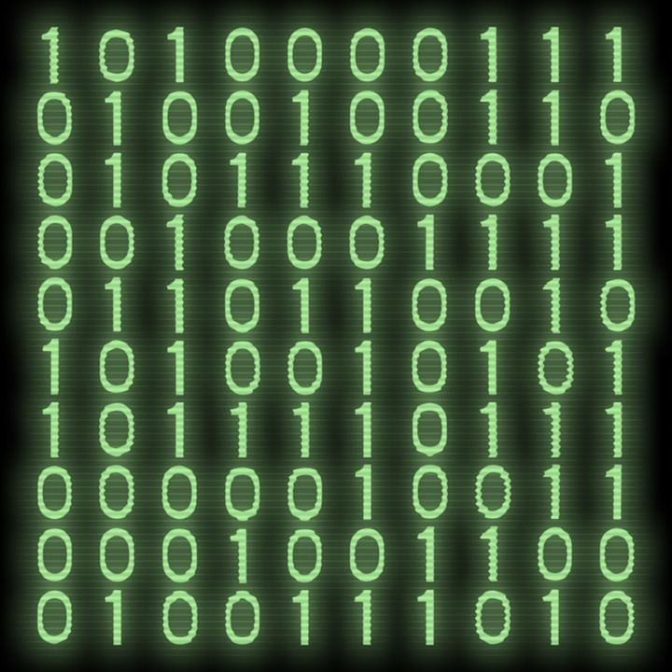

Electric circuits
pixabay.com
bethsnotesplus.com/
PVeducation.com

Slide 17
Part 2
Hardware

Slide 18
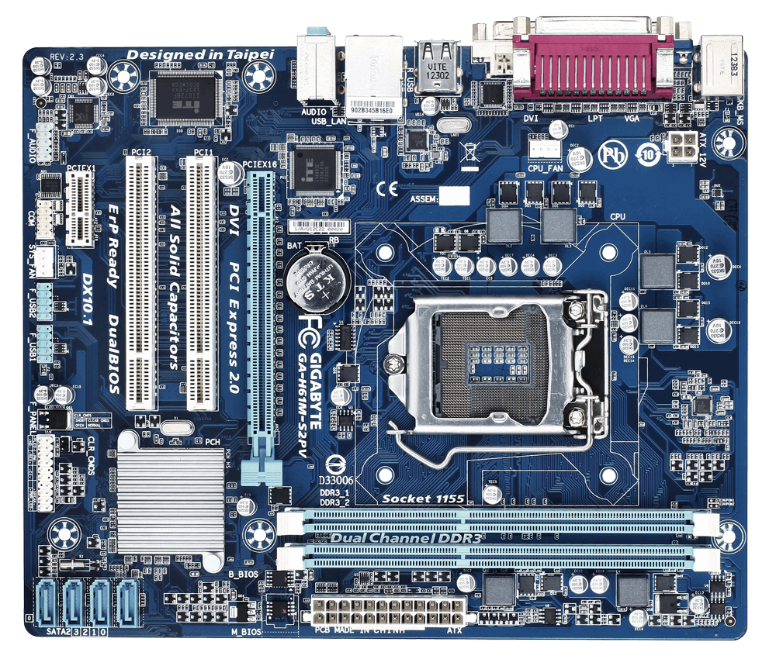
Motherboard
Motherboard allows communication and power to flow throughout the computer system.
www.gigabyte.com

Slide 19
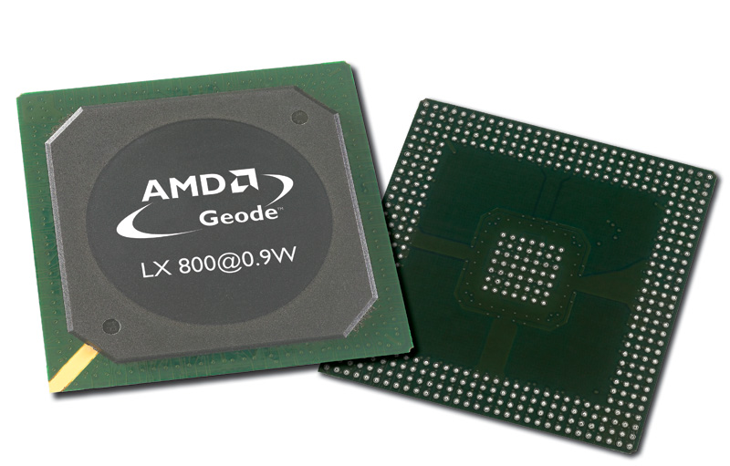
CPU
Microprocessor –
brain of computer.
Microprocessor clock - timing device that sets the pace for executing instructions.
Front side bus - allows the processor to work at full capacity.
CPU cache is special high-speed memory that allows a microprocessor to access data more rapidly than from memory located elsewhere on the system board.
ru.wikipedia.org

Slide 20
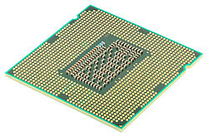
CPU
Word size refers to the number of bits that a CPU can manipulate at one time.
Processing techniques:
c) parallel processing
a) serial processing
Instruction 4
Instruction 3
Instruction 3
Instruction 2
b) pipelining
Instruction 2
ru.wikipedia.org
Instruction 3
Instruction 1
ru.wikipedia.org
Instruction 2
Instruction 1
Instruction 1
ru.wikipedia.org

Slide 21
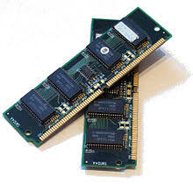
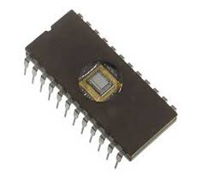
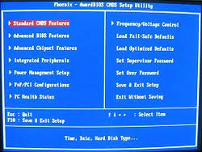
RAM and ROM
RAM (random access memory)- holds raw data waiting to be processed.
Address: M1
10001001
Address: M2
01000001
en.wikipedia.org
RAM
Address: M3
00001101
bank of capacitors
ROM (read-only memory) - contains a small set of instructions and data called the bootstrap loader.
ROM
BIOS
tutorialspoint.com
sq.wikipedia.org

Slide 22
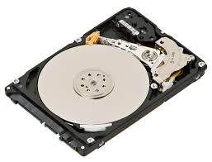
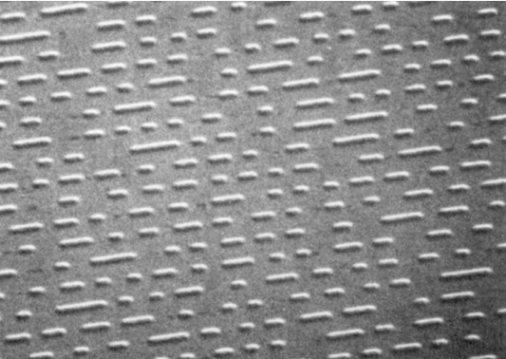
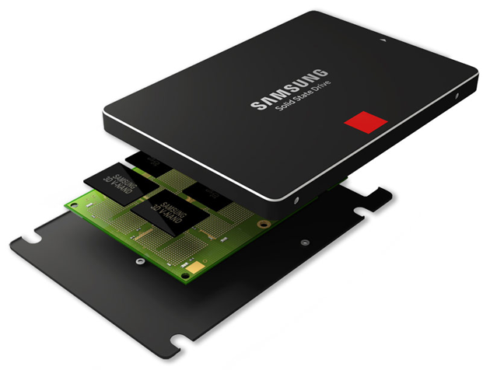
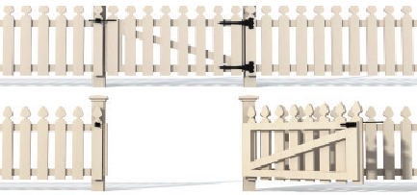
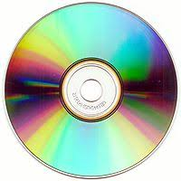
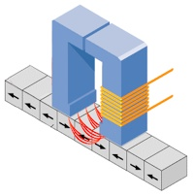


Storage devices
Magnetic
SSD
researchgate.net
gunnar.com
en.wikipedia.org
pit
land
en.wikipedia.org
Shutterstock.com
igcseict.info
Optical

