Slide 1


Became a professional
E-resources
winpure.com
Search engines
ekonomski.mk

Slide 2




New possibilities
Evolution
pluspng.com
boltonlams.co.uk
singularityhub.com
E- resources is a distribution of information in any electronic form.
Up to date
pngkey.com

Slide 3



Combines benefits
Multimedia
arenamalda.com
thedailystar.net
Coding
courses.telegraph.co.uk

Slide 4




E-resources
Easy to
carry
Read in
browser
xoticpc.com
nikhilsmagicshop.com
mozilla.org
Examples:
e-documents: HTML, Pdf;
e-Books;
e-Journals;
specialized data bases.
blog.tcea.org

Slide 5

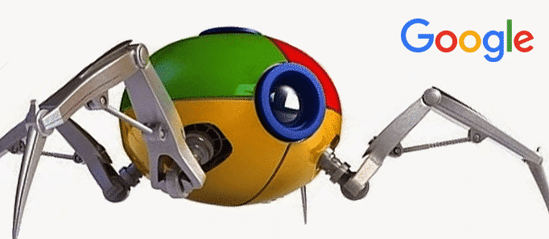


Search engine
find
Search engine is a tool that allows a user to enter keywords and retrieve information on websites contained in its catalog or database.
Spider - program that visits websites, reads webpages and places them into catalogue.
yourconcept.nl
Catalogue contains a copy of each page that was collected by the spider.
riccarton.school.nz
Search engine – software system that searches for information on the WWW.
makeuseof.com

Slide 6


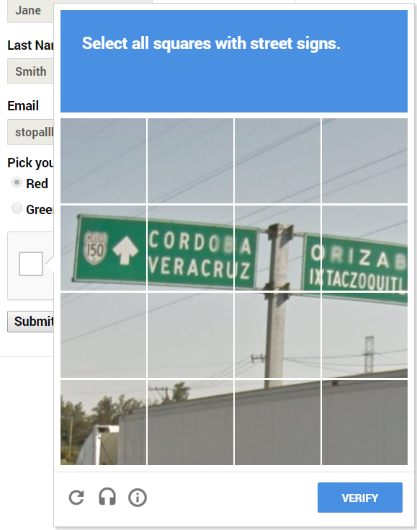

Artificial Intelligence
AI is an attempt of reproduction of human reasoning and intelligent behavior by computational methods.
geospatialworld.net
Examples of use: finance, healthcare, education, transportation.
ReCaptcha
Turing test
blogs.nature.com
xakep.ru
wsimag.com

Slide 7
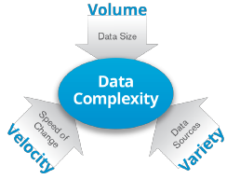
Big Data
Big data is a term used to refer to data sets that are too large or complex for traditional data-processing application software to adequately deal with.
Volume - large
amounts of data.
Velocity - high
refresh speed and short time
to react .
Variety - different
data sources
Xiaomeng Su
Introduction to Big Data

Slide 8


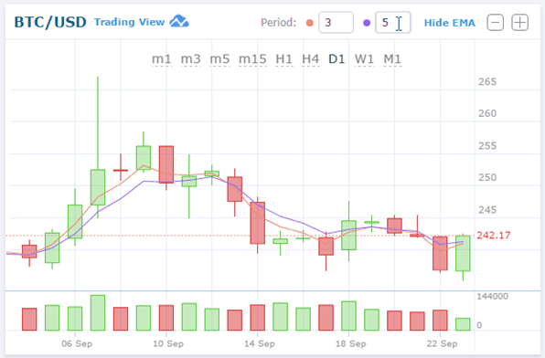
Big Data applications
securityintelligence.com
bitdegree.org
Fast
giphy.com
classification;
prediction;
analysis.

