Slide 1

E-learning
E-learning is all forms of electronic supported learning and teaching.
E-learning technologies:
Assessment and survey tools;
Asynchronous communication;
Digital repositories;
Photo and document sharing;
Podcasts, vodcasts and streaming;
Social networking;
Synchronous communication;
Virtual worlds.
peoplepng.com

Slide 2
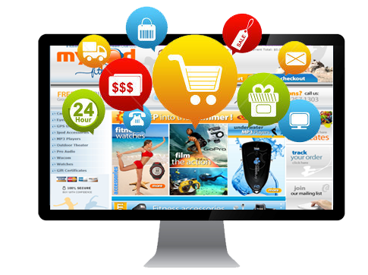
E-business
E-business - any kind of business or commercial transaction that includes sharing information across the internet.
E-commerce:
selling
buying
transferring
E-business:
servicing customers
collaborating with partners
conducting e-learning
Concerns:
greater security risks;
confidentiality;
e-transactions;
data integrity.
pngall.com

Slide 3
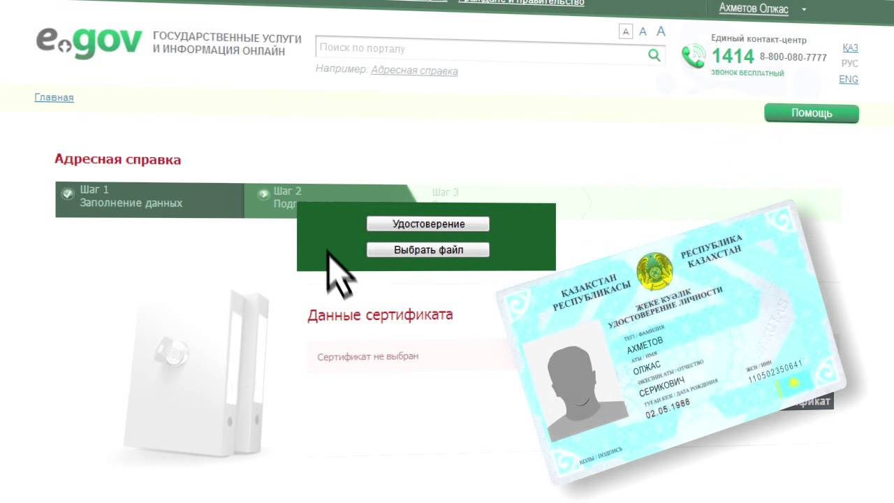
E-government
E-government is the use of electronic communications devices, computers and the Internet to provide public services to citizens and other persons in a country or region.
Positive sides:
transparency;
electronic access;
no papers;
access 24/7;
no lines.
Negative sides:
lack of equality in public access to internet;
safety and reliability.
youtube.com

