Slide 1
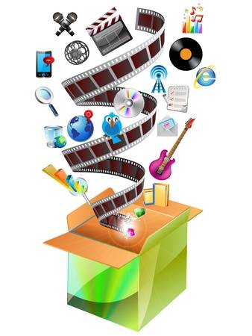
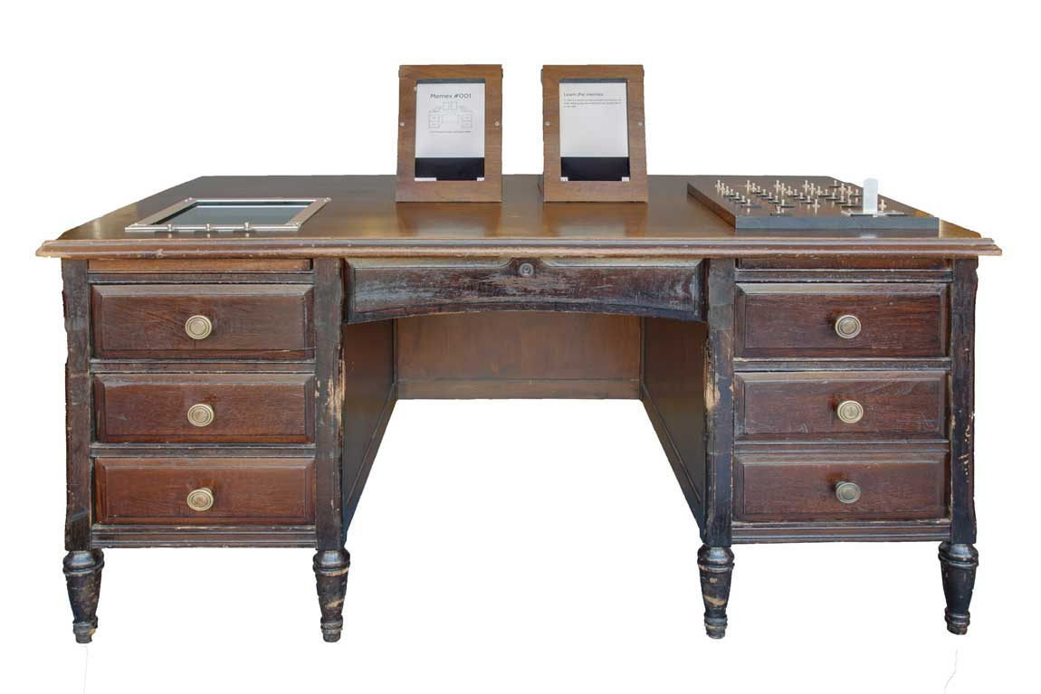
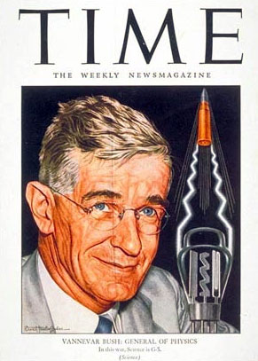
The birth of multimedia
Multimedia is a technology engaging a variety of media including text, audio, video, graphics and animation.
MEMEX
trevor.smith.name
jp.123rf.com
Memex was invented In 1945 by Vannevar Bush.
Multimedia
history-computer.com

Slide 2
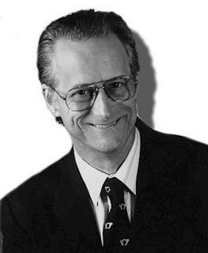
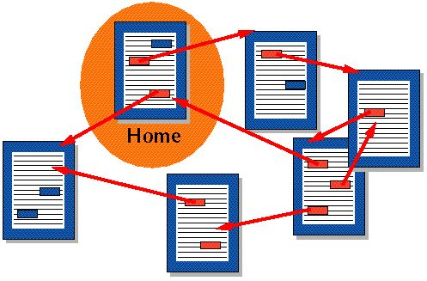

Hypertext
In 1965 Theodor Nelson designed Hypertext which means a non sequential reading and writing with use of links.
arquitectojuan.blogspot.com
en.wikipedia.org
Hypertext allows:
Link information;
Create paths;
Annotate text;
Create notes.
lifewire.com
Navigate quickly and intuitively

Slide 3
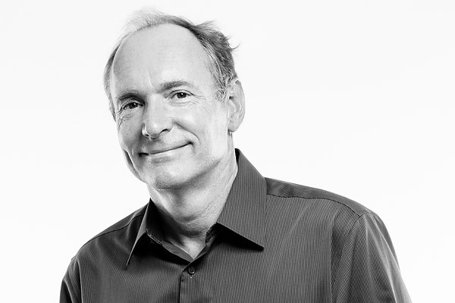


World Wide Web
In 1991, Tim Berner Lee developed a global hypertext project known as World Wide Web. With it started the era of Multimedia.
k-actus.net
thinglink.com
subr.libguides.com

Slide 4





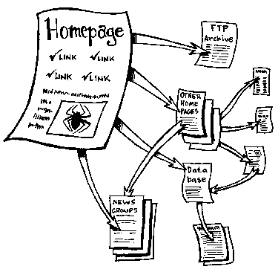
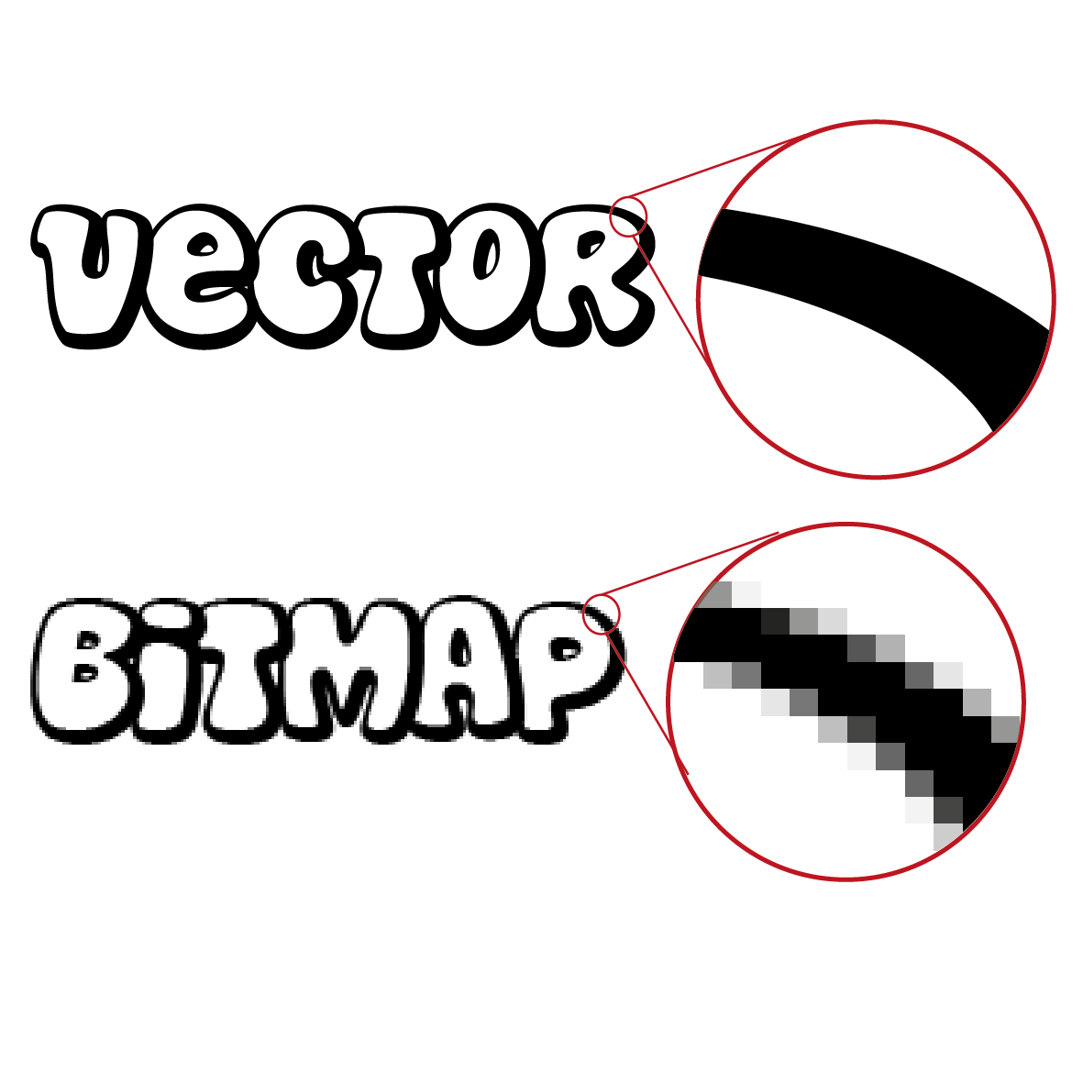
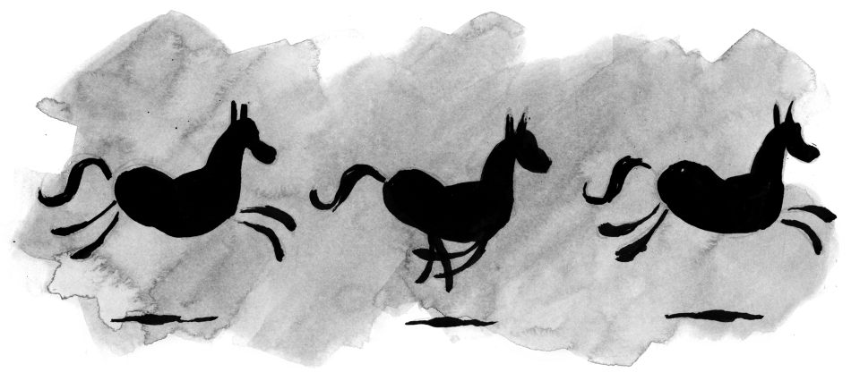
Components of multimedia
Multimedia
Text
Video
Image
yogi.centerblog.net
Sound
pngpix.com
scarpato.net
iconfinder.com
Animation
>16 fps
alistapart.com
wordpress.susqu.edu
mindmeister.com

Slide 5
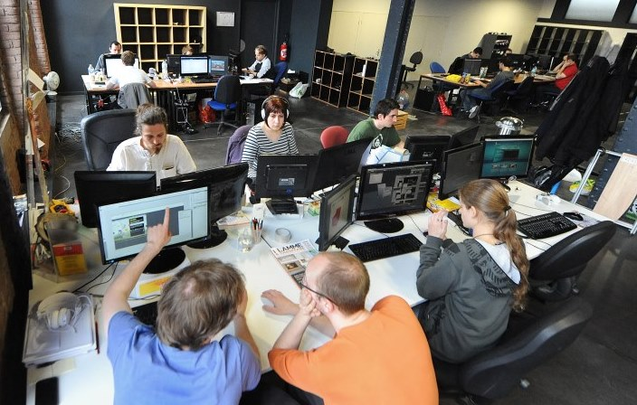

Multimedia production process
Conceptual analysis and planning;
Project design;
Pre-production;
Budgeting;
Creating a team;
Preparing the structure and production;
Testing the product;
Delivering.
nordfranceinvest.com
ec.europa.eu

Slide 6


Multimedia capabilities
saraniecki.weebly.com
Multimedia app – app which uses a collection of multiple media sources.
ontabs.com

Slide 7
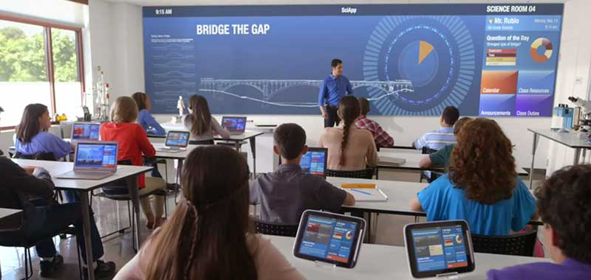
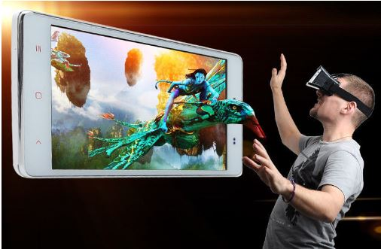

Multimedia capabilities
Education
Entertainment
blog.blackbox.eu
Business
filmora.wondershare.com
durhamcollege.ca

