Slide 1






Brief story of internet
pluspng.com
1960’s – invention of Internet.
1991 – invention of WWW.
1994 – first browser (Netscape).
mozilla.org
ru.halo.wikia.com
HTML - defines the content of web pages;
CSS - specifies layout of web pages;
JavaScript - programs the behavior of web pages.
Client
Database
Server
Response
Request
zdnet.com
accelerasolutions.com
effortz.com

Slide 2
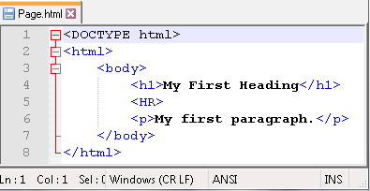
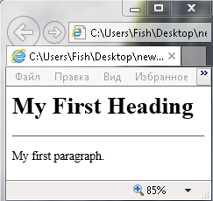
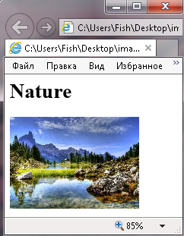
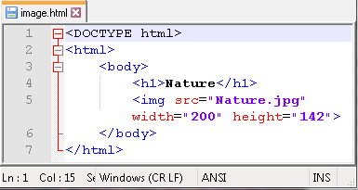
HTML
Tag
Notepad
Browser
HTML -HyperText Markup Language.
natworld.info

Slide 3
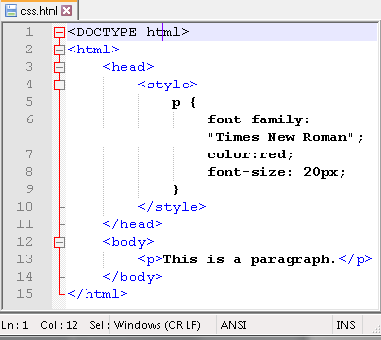
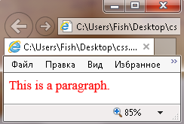
CSS
Notepad
Browser
CSS - Cascading Style
Sheets
Insert CSS:
Inline;
internal sheet;
external sheet.
Syntax
Selector
Declaration
Declaration
p
{color: red; font-size: 20px;}
Property Value

Slide 4
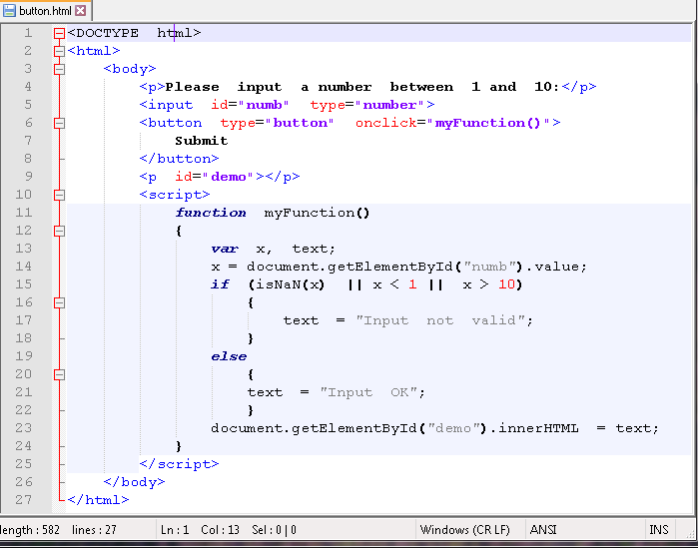
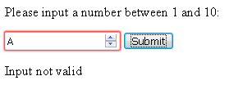
JavaScript
Notepad
Browser
JavaScript – programming language of the web

Slide 5

E-mail
e-mail address:
Peter.Jenkins@gmail.com
username
domain name
protocols:
fast
POP3 (Post Office Protocol version 3) is used to download the emails to a local email client.
IMAP (Internet Message Access Protocol)
is used for downloading email headers while actual email message contents are left on the server.
SMTP (Simple Mail Transfer Protocol) is used to communicate with the remote server in order to send the email from a local client to the remote server
easy
differencebetween.net
track
multi user

Slide 6




E-mail flow
azure.microsoft.com
DNS
Send
smtp.gmail.com
Search
pngimage.net
indiamart.com
example.com
Access
Send
apptractor.ru
smtp.example.com

Slide 7





Social networks
Social network service - a virtual platform that connects people to networked communities through software via WWW.
schmoozd.com
wikipedia.org
1. People's classifiers
3. Wikis
store.steampowered.com
5. VR
financialexpress.com
youtube.com
2. Blogs
4. SM storage

