Slide 1




Need in communication
For individuals:
Talk to friends, families, colleagues;
For business:
locate suppliers and buyers;
negotiate contracts ;
provide better, and faster services;
trurating.com
pixabay.com
freeiconspng.com
echalk.com

Slide 2
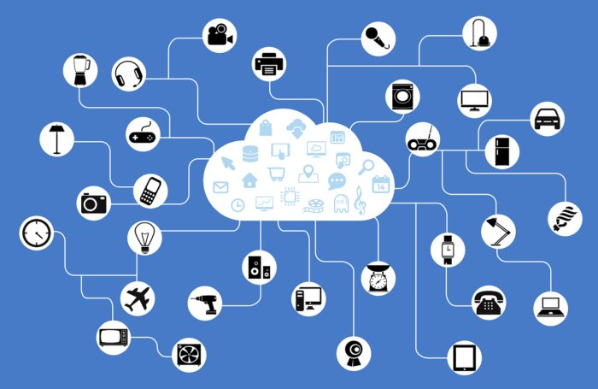
Introduction to networks
A network is a communications system created by linking devices and establishing methodology for their communication.
networkworld.com

Slide 3

Internet
The world’s largest and most widely used network is the Internet.
weforum.org

Slide 4
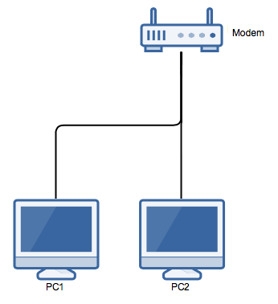
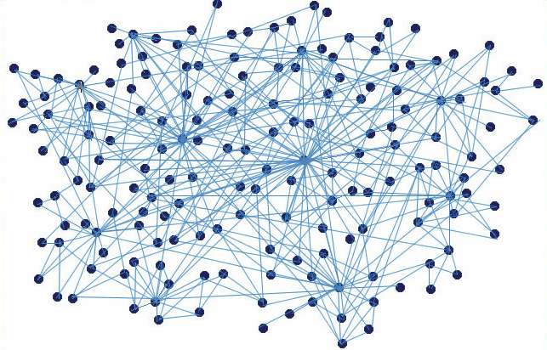

Networks
Small
Large
networkengineering.stackexchange.com
digitalanalogues.wordpress.com
Benefits:
ability to communicate;
ability to share.
ideaz4india.com

Slide 5
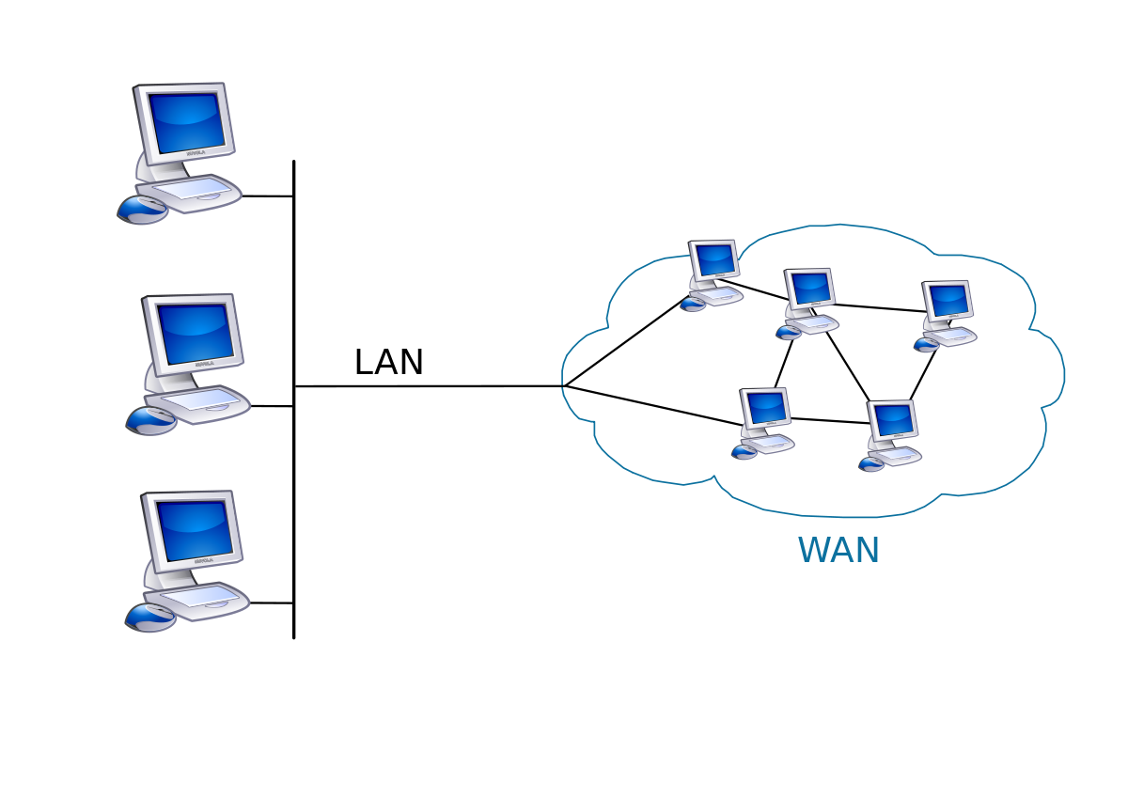
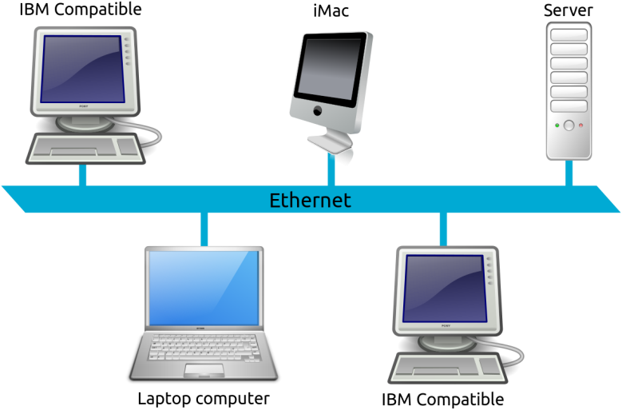


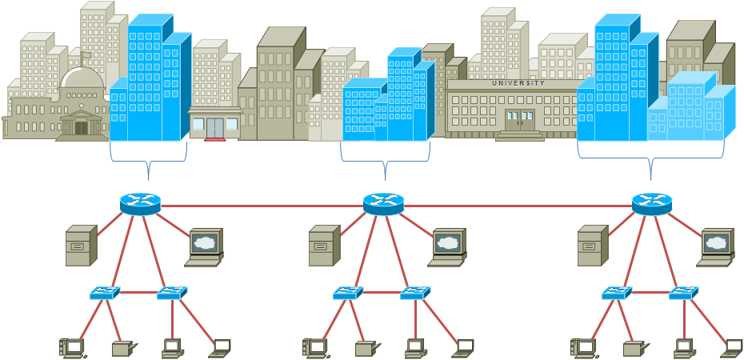
Types of digital networks
LAN
WAN
en.wikipedia.org
en.wikipedia.org
ru.hello-bob.wikia.com
icon-icons.com
MAN
ttpnetwork.wordpress.com

Slide 6

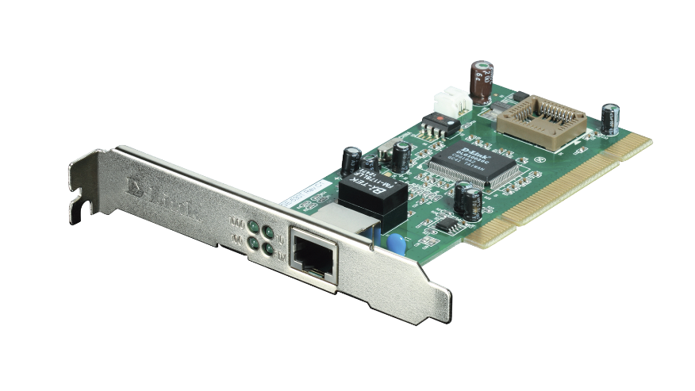

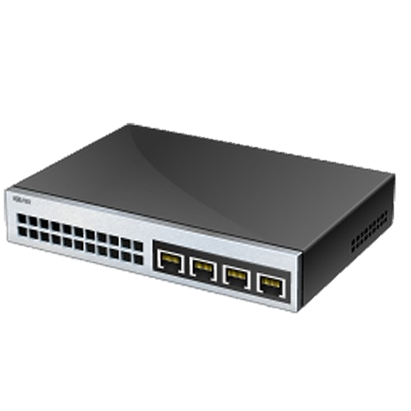
Network composition
A network typically includes 4 things:
Protocol - a set of communication rules to make
sure that everyone speaks the same language;
Network interface card - card that
lets a computer to send and
receive messages;
Cable - the medium to connect
all of the computers together;
Hub (switch or router) —hardware
to perform traffic control.
users.iit.demokritos.gr
us.dlink.com
peoplepng.com
ru.pngtree.com

Slide 7
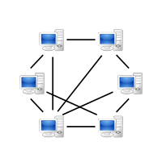

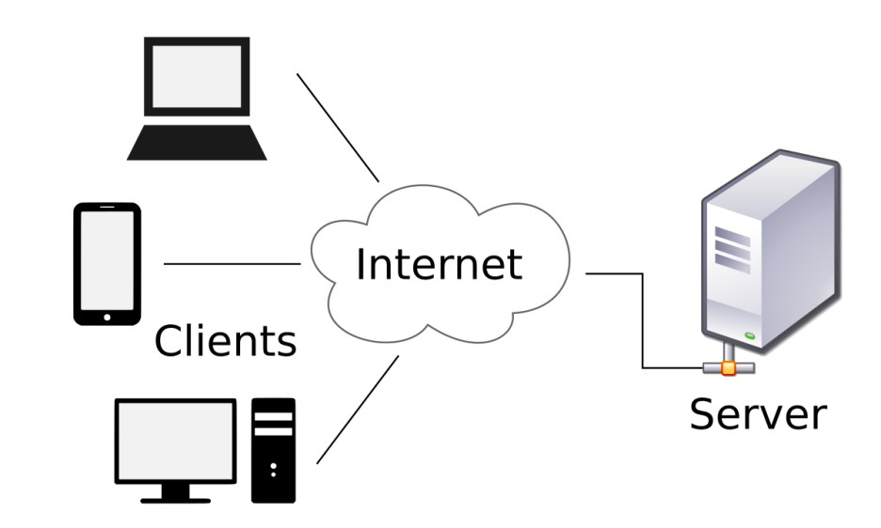

Architecture of network
A peer-to-peer network (P2P) relies
on the computing power and bandwidth
of participants.
stickpng.com
ru.wikipedia.org
A client/server network – all back-end processing takes place on a server and front-end processing is handled by the clients.
ru.wikipedia.org
A server is a computer that provide information in response to requests
serverguy.com

Slide 8
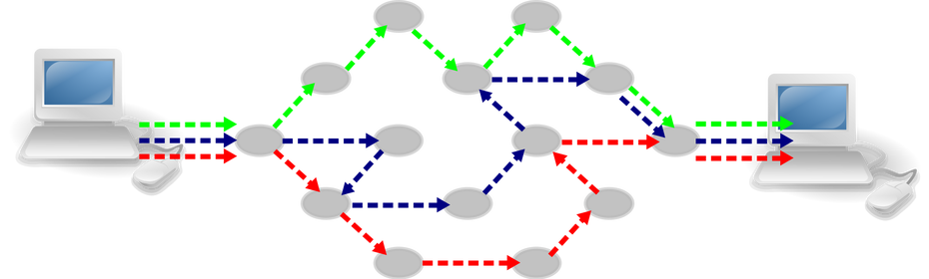
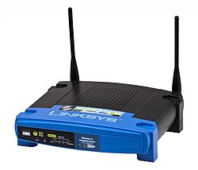
Network technologies
Packet switching – process when sending computer divides a message into smaller packets containing address of the destination computer.
apposite-tech.com
Router connecting device that receives and examines incoming data and sends it onward toward its destination.
ru.wikipedia.org

Slide 9
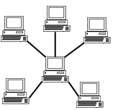
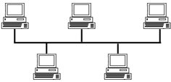
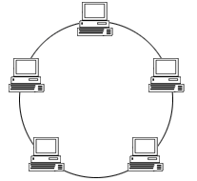
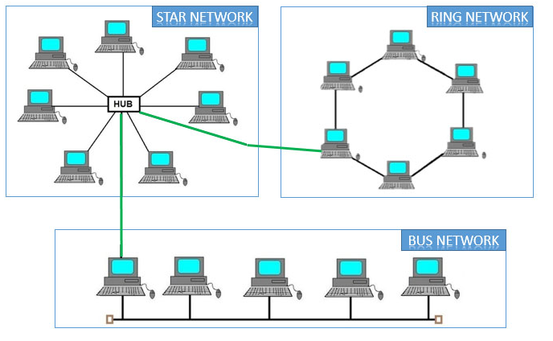
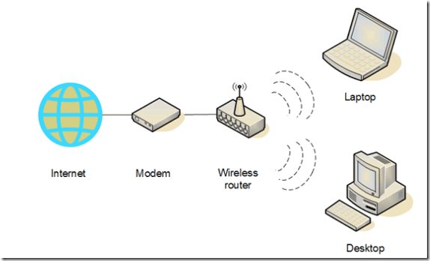
Topology of network
Topology is the geometric arrangement of the actual physical organization of the computers in a network.
Bus
Star
Ring
computerhope.com
computerhope.com
computerhope.com
Hybrid
Wireless
swissen.in
makeuseof.com

Slide 10
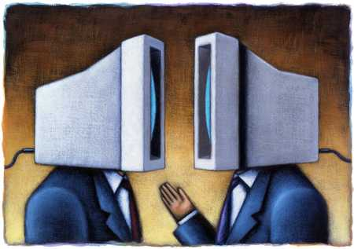

Protocols
A protocol is a standard that specifies the format of data as well as the rules to be followed during transmission.
A protocol is based on agreed-upon and established standard.
users.iit.demokritos.gr
teamnineuncc.blogspot.com
An Interoperability is the capability of computer systems to share data and resources.
connectedcarewatch.com

Slide 11

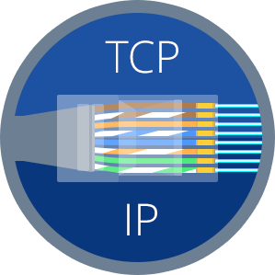
Common protocols
Ethernet
rohde-schwarz.com
TCP/IP
geekbrains.ru

Slide 12
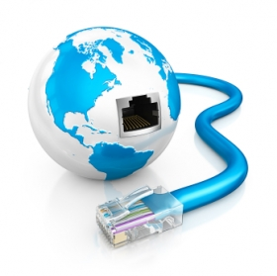


Ethernet
It is a physical and data layer technology for LAN networking.
skyline.od.ua
gts.cz
easy to implement, manage, and maintain;
allows low-cost network implementations;
provides extensive flexibility.
prosportexpress.com

Slide 13

TCP/IP
Defense.gov
Key achievement - flexibility with respect to lower-level protocols.
transport functions
geekbrains.ru
addressing and routing mechanism

Slide 14




TCP/IP Four-Layer Reference Model
cloud.google.com
data.gov
its.unl.edu
Applications
FTP, SMTP, Telnet, HTTP
Transport
TCP
Internet
IP
Network interface
Ethernet
rohde-schwarz.com

Slide 15

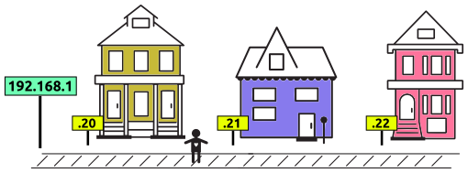
IP
IP provides the addressing
and routing mechanism
prtut.ru
commotionwireless.net

Slide 16


Network transmission media
ece.ucsd.edu
indiependentmusic.net
Transmission media is a pass at is used to carry a signal between a signal transmitter and a signal receiver.
Media
Wire
Wireless

Slide 17
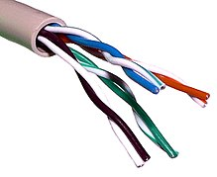
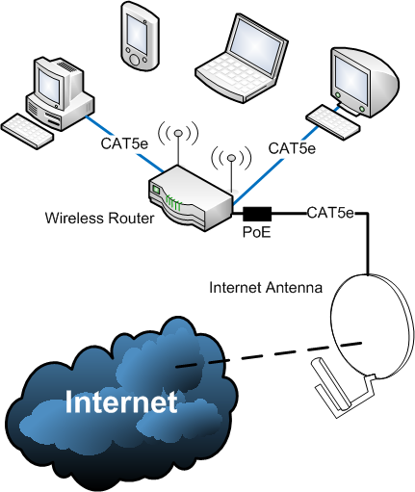
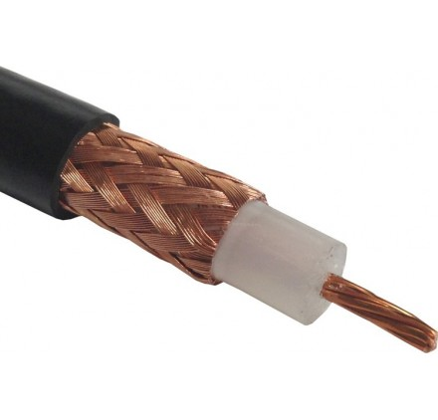
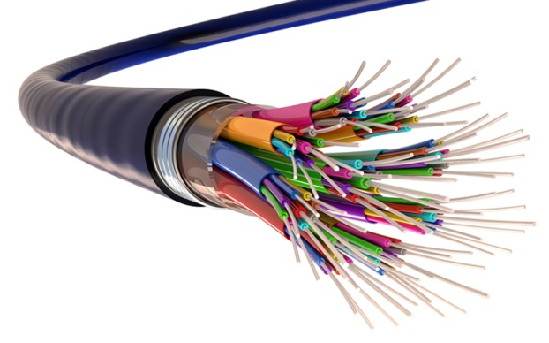
Media
Wire
Wireless
Twisted-pair cable
Coaxial cable
Fiber optic
en.wikipedia.org
rivemsaj.com
castles.com
peakoptical.com

