Slide 1
Start of data management
Database is specially organized information, in which it is easy to search for the necessary materials.
Data is a representation of facts, concepts, or instructions.
Program 1
Data management
Data set 1
Program N
Data management
Data set N

Slide 2
File processing
Data is stored in ﬁles with interface between programs.
Access methods: sequential, indexed, random.
Program 1
Data management
File
system
services
Program N
Data management
File 1
File N

Slide 3

Database approach
Program 1
DBMS
Integrated Database
Program N
bris.ac.uk
Database Management System (DBMS) - a set of programs that manages details related to storage and access for a database.

Slide 4

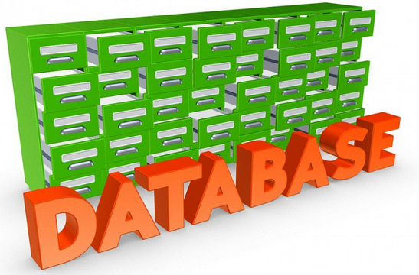



Types of databases
Decentralized
kisspng.com
smallbiztrends.com
Part 1
joint database
Part 2
Part N
Centralized
Entire database
kisspng.com
kisspng.com

Slide 5
Structural elements
№ | Field 1 Name | Field 2 Name | Field 3 Name
Record - a collection of logically related fields
Field - an elementary unit of
the logical organization of data
1 | Ivanov | Ivan | Ivanovich
2 | Putin | Vladimir | Vladimirovich
N | Donald | Trump
File – is the collection of instances of records of the same structure
Record instance – implementation of a record that contains the specific values of its fields

Slide 6

Data models
Data model - a set of data structures, integrity constraints and data manipulation operations.
Models:
Hierarchical;
Network;
Relational;
Object-oriented.
talend.com

Slide 7
Hierarchical structure
Vertex of the tree
University
al-Farabi KazNU
Level 1
Faculty
Biological
IT
Physical
Level 2
Student (ID, Surname)
111111
Sagatov
111112
Egorov
Level 3
Node is a collection of data attributes that describe an object

Slide 8


Development of structures
Network
Object-oriented
Level 1
A1
A2
Different object types with same organization
Level 2
B1
B2
B3
shelbystore.com
Level 3
C1
C2
C3
Relational
Student ID | Surname | Name | Birth date
11123 | Ivanov | Ivan | 03.05.89
11124 | Usmanov | Alisher | 04.12.95
11125 | Esenaliev | Arman | 08.06.90
commons.wikimedia.org

Slide 9
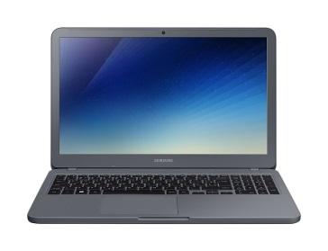
Three-level schema
samsung.com
Users
External schema
External view
External view
External view
Conceptual schema
Conceptual view
Internal schema
Internal view
DBMS
Database

