Slide 1
Introduction
Human-Computer interaction (HCI) - is the study of how people design, implement and use interactive computer systems and how computers affect our society.
Human
HCI
Interaction
Computer

Slide 2
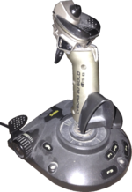
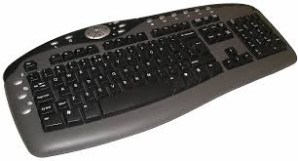
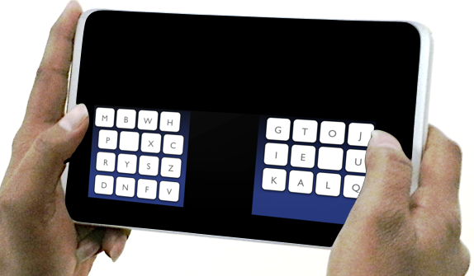
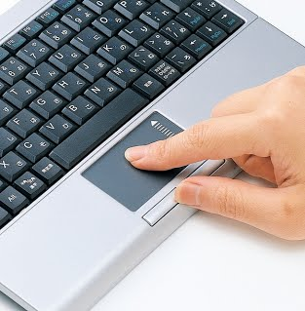
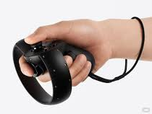
Computer system
Input: Keyboard, mouse, joysticks
Dic.academic.ru
Text entry
en.wikipedia.org
Pointing
users.comnet.aalto.fi
3D/VR
sites.google.com
roadtovr.com

Slide 3

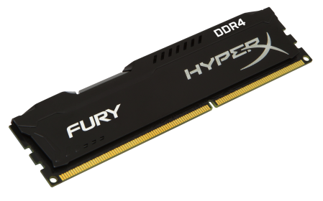
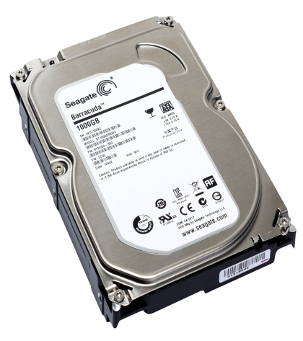
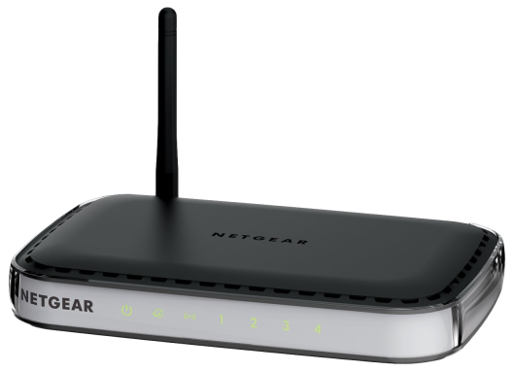
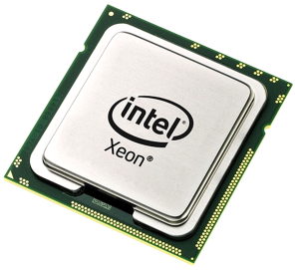
Computer system
Input: Keyboard, mouse, joysticks
Dic.academic.ru
en.wikipedia.org
Output: Screens, e-paper
puarepng.com
imgpng.ru
Memory: Short-term memory – RAM
Long-term memory – HDD, SSD
purepng.com
Processing: CPU
Networks
purepng.com

Slide 4
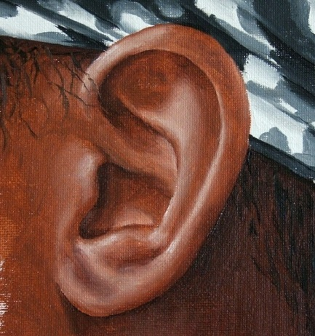


Human cognition
Input+Output:
Visual channel
Auditory channel
Haptic channel
90%
7%
3-1.5%
Alexandro Chen
Freepik
onlineartlessons.com
Medicina.ua
Movement

Slide 5



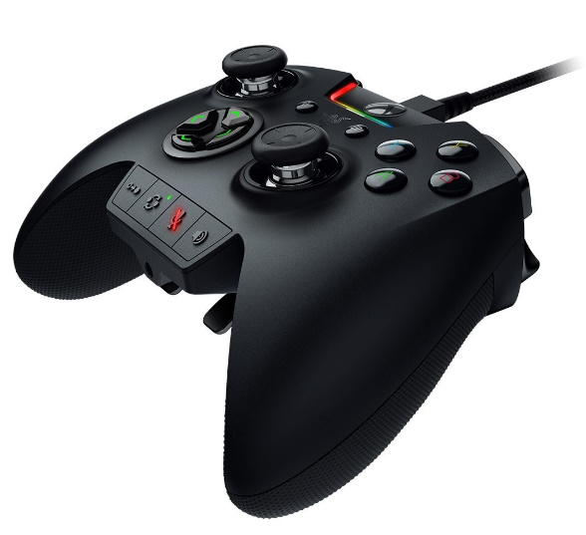
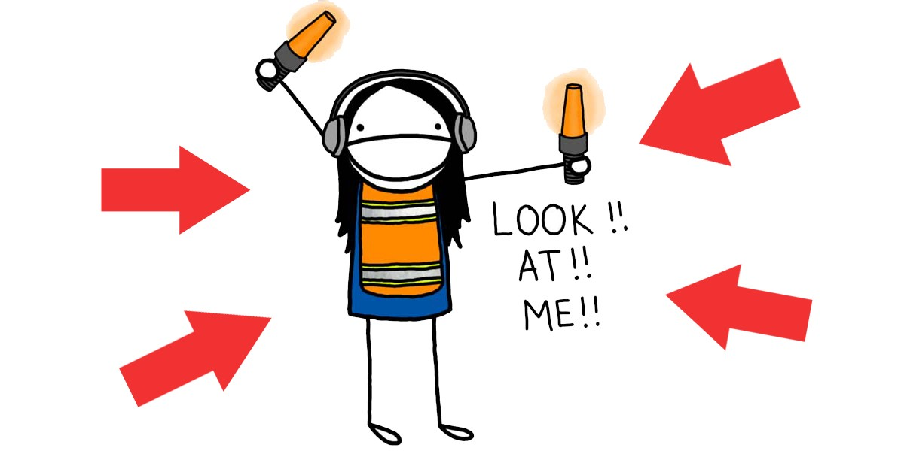
Better cognition
freeiconspng.com
community.sprint.com
cmuse.org
techpowerup.com
Krysta Harrison
medium.com

Slide 6
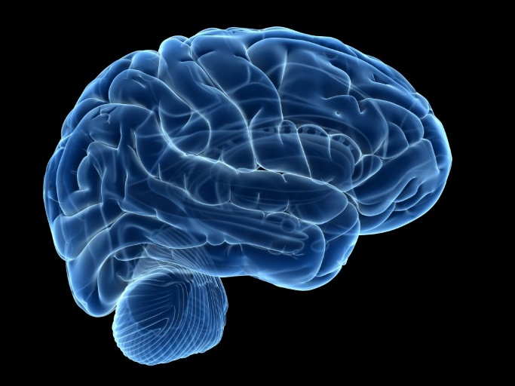
Human memory
See
Write
Listen
Memory:
Sensory
Short-term
Long-term
For best memorization
Repeat

Slide 7

Processing
Decision
Main parts of processing:
Reasoning
Problem solving
Skill acquisition
Tiredness
Errors
Emotions
Scheme of interaction
mrwolf.ru
output
user
system
input

Slide 8


Scheme of interaction
system
user
output
input
icons8.com
purepng.com

Slide 9

Goals of HCI
1. Understand the factors that determines how people use technology
2. Develop tools and technique to enable building suitable system
Create usable and safe system
3. Achieve efficient, effective and safe interaction
deathbattle.wikia.com
4. Put people first!

Slide 10

Cognition
perception
attention
pattern
matching
memory
language processing
pathwayspodcast.com
decision making
problem solving

Slide 11

Cognitive demands
RULES
CONCEPTS
RETAIN
stanfieldit.com

Slide 12



Limitations
HARD
EASY
smitak.weebly.com
smitak.weebly.com

Slide 13
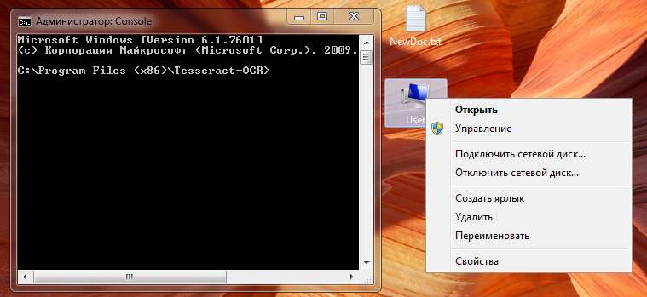

WIMP interface
Icon – small image used to represent some object
Pointer– graphical image that shows movements of the pointing device.
Window - area of the screen that behave as an independent terminal.
Menu– choice of operations

Slide 14

Future prediction
sfehrlich.com

Slide 15
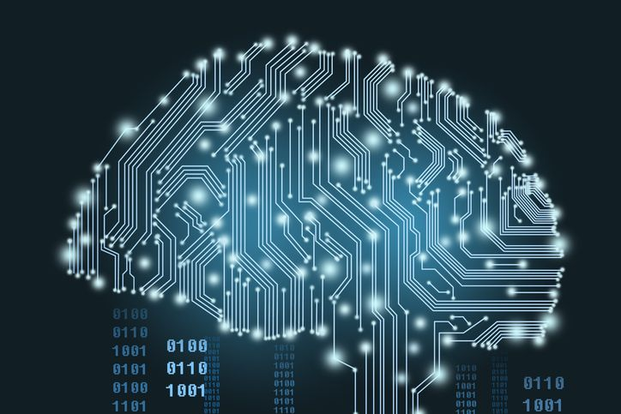
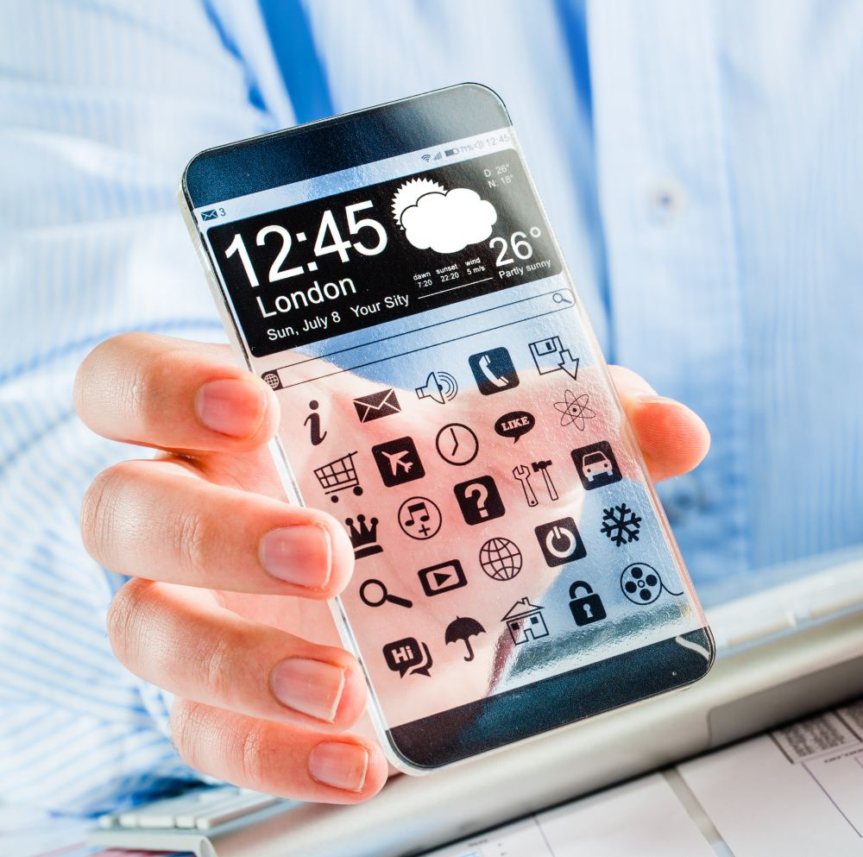

Future of ICT
AI
Phones
chiefexecutive.net
uswitch.com
VR
junkreality.com

