Slide 1

Computer programs
Computer program (software) - is a collection of data or computer instructions that tell the computer how to work.
Application –
designed to help people accomplish real-world tasks
System –
designed for
computer centric tasks
Software
industries.ul.com

Slide 2



Types of application software
Graphic
Video/Music
Professional sphere
Mapping and location-based
…
sbs.com.au
wiki.opnfv.org
kanbantool.com

Slide 3
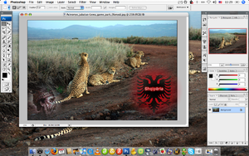
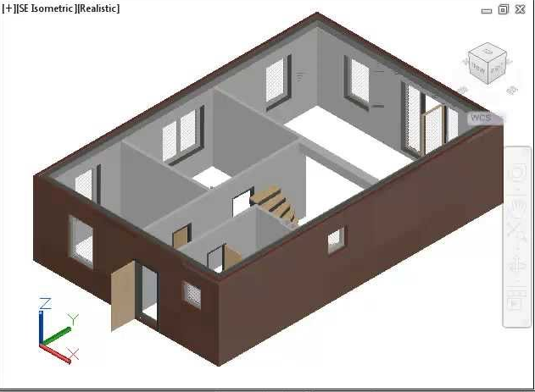
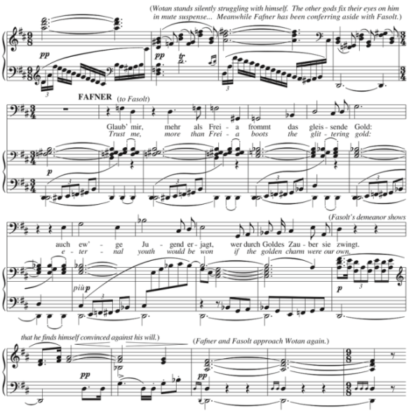
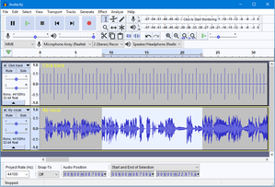
Application software
en.wikipedia.org
youtube.com
Graphic
3d CAD
en.wikipedia.org
en.wikipedia.org
Music

Slide 4
System software
operating systems
program languages
device drivers
utilities

Slide 5

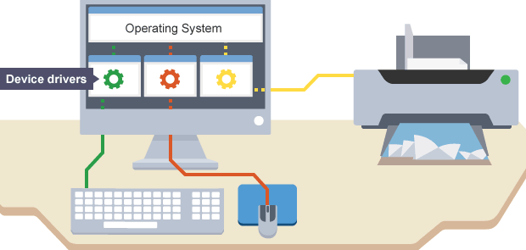


System software
Utilities - help you monitor and configure settings for your computer system equipment, operating system or application software.
Device driver - helps a
peripheral device to establish communication with a
computer.
Programming languages -
can be used by user to
create own programs.
en.wikipedia.org
blog.drivethelife.com
Robert W. Oliver II blog.sourcerer.io
habr.com

Slide 6
Operational system (OS)
OS - master controller for all activities that take place within a computer system.
Application program
Operating system
Device drivers
Hardware
Work order
CPU
RAM
Storage space
Peripheral devices
Resources of OS

Slide 7

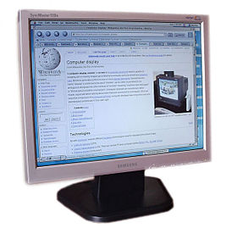
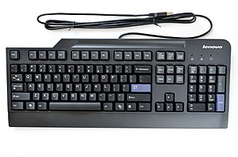
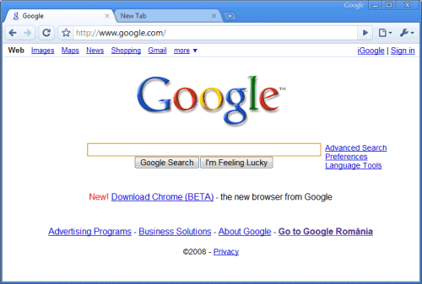
Process management in OS
Ankur Chowdhury
blog.trilyo.com
Process 1
Output
Process 2
Input
CPU
Process N
Web page
en.wikipedia.org
simple.wikipedia.org
portable-software.wikia.com

Slide 8
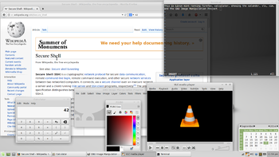
Work faster
Multitasking provides process and memory management services that allow two or more tasks, or programs to run simultaneously;
Multithreading allows multiple parts, or threads, to run simultaneously within a
single program;
Multiprocessing capability supports a division of labor among all the processing
units.
en.wikipedia.org
Program
thread N
thread 1
Time
Program
CPU 1
CPU 3
CPU 2

Slide 9
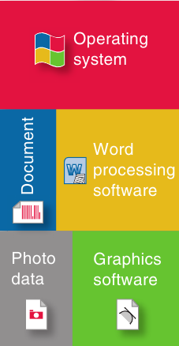
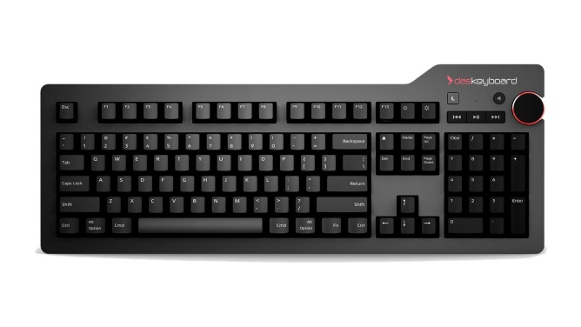
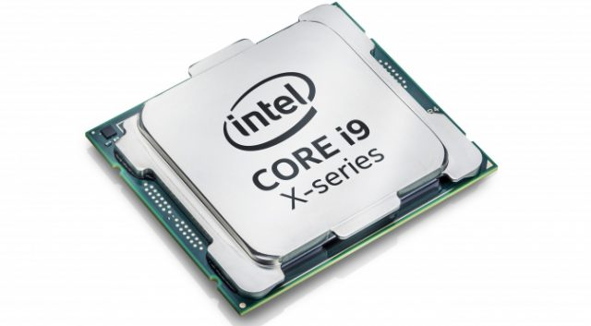
Allocation of programs in RAM
RAM
Buffers can collect and hold data while the computer is busy with other tasks.
keyboard
controller
geekboards.ru
System software
keyboard
buffer
cengage.co.uk
Joel Hruska
extremetech.com

Slide 10
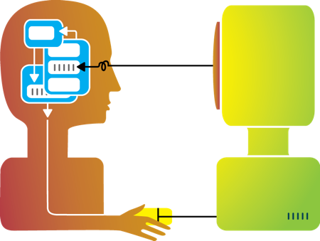
Functions of OS
customize work environment
launch programs
User interface
OS
en.wikipedia.org
configure computer equipment
manage files

Slide 11
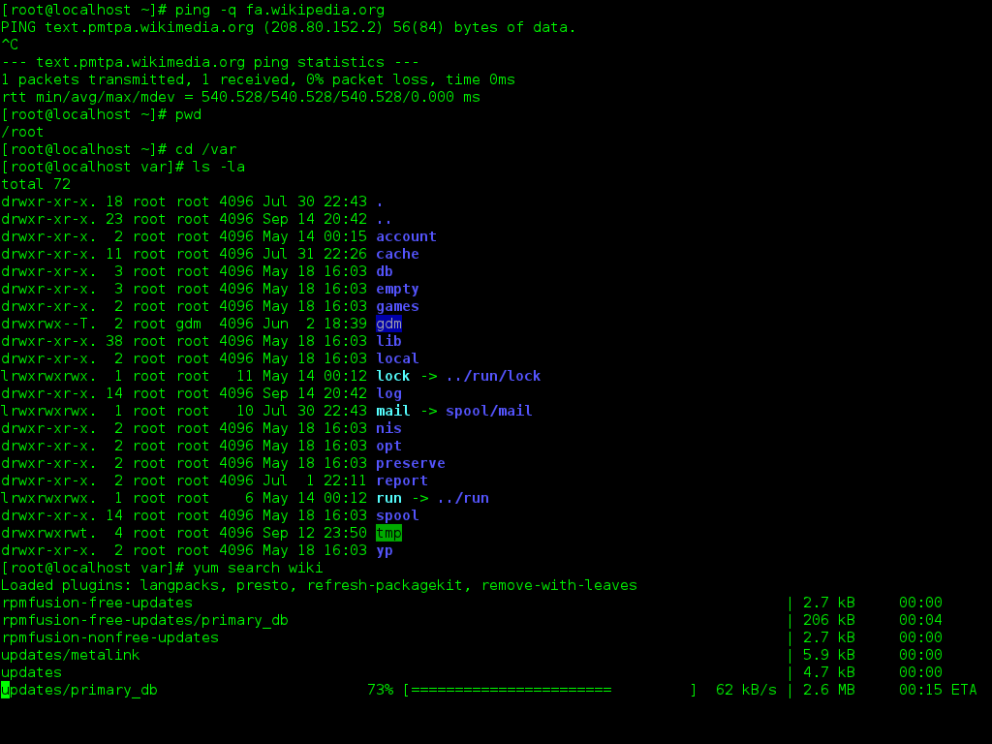
Command-line interface
In CLI it is hard to remember all the commands but easier to communicate with computer without mediator programs.
en.wikipedia.org

Slide 12
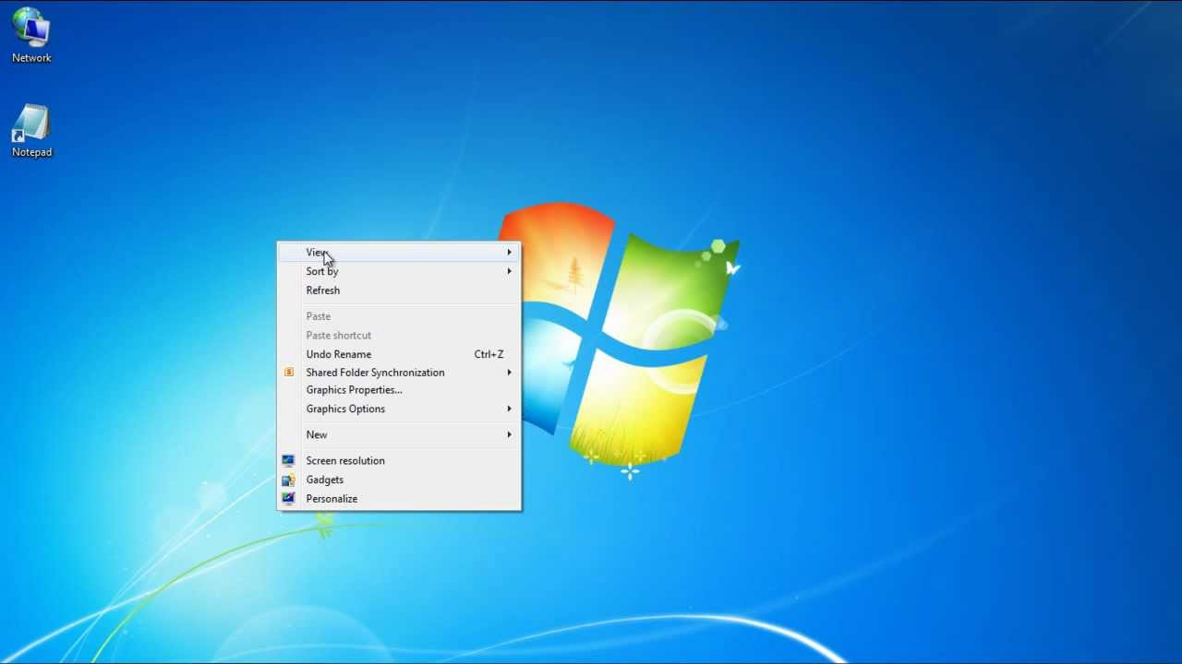
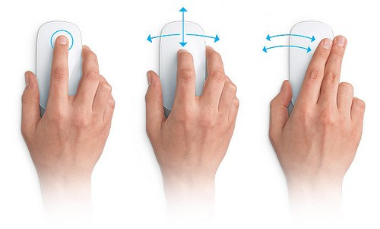
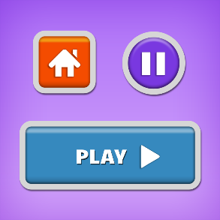
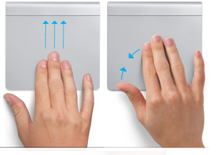
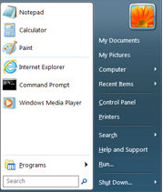
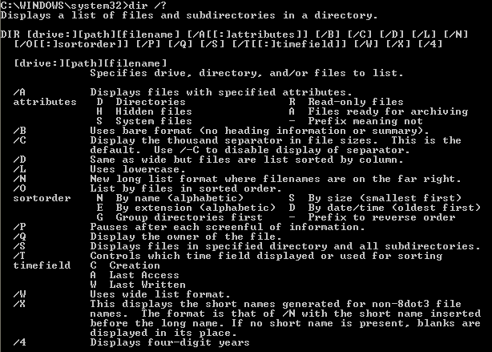

Graphical user interface
Icon
GUI
Menu
ileriseviye.wordpress.com
opengameart.org
youtube.com
Button
smart-service.ua
themastercleanse.org
Lincoln Spector
pcworld.com
online-tech-tips.com

Slide 13
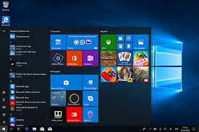
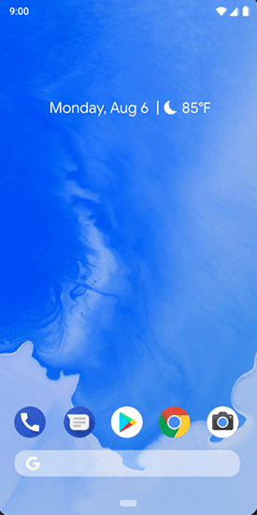
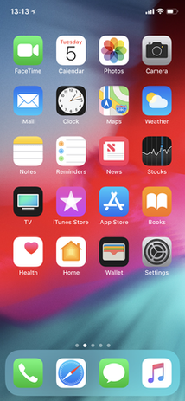
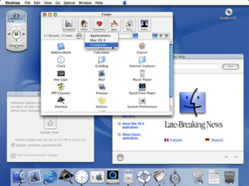
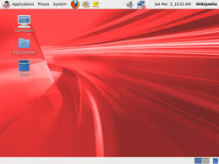
Types of OS
Desktop
Mobile
Android
IOS
Windows
en.wikipedia.org
en.wikipedia.org
en.wikipedia.org
MacOS
en.wikipedia.org
en.wikipedia.org
Linux

Slide 14
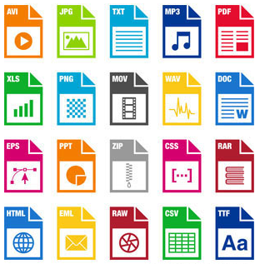
Computer files
Primary folder
File name
C:\Games\CS1.6\CS.exe
Drive letter
Secondary folder
File extension
File format is an organization and layout of data that is stored in a file.
computerhope.com

