Slide 1

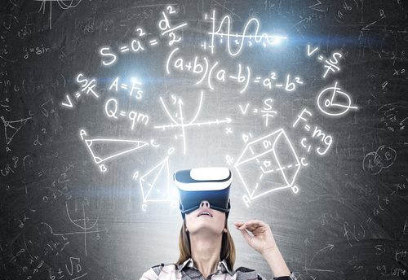

Education
Adaptive learning
VR learning
insightssuccess.com
Online courses
intelligentcio.com
epicflow.com

Slide 2
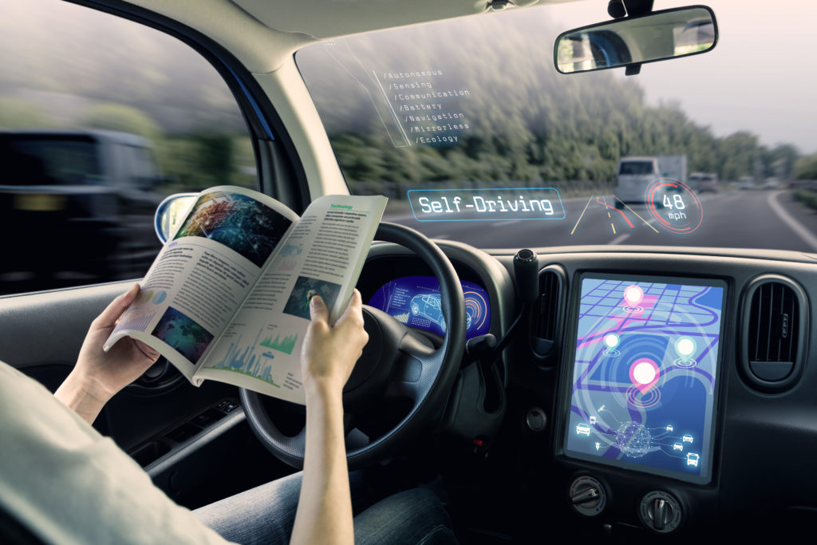
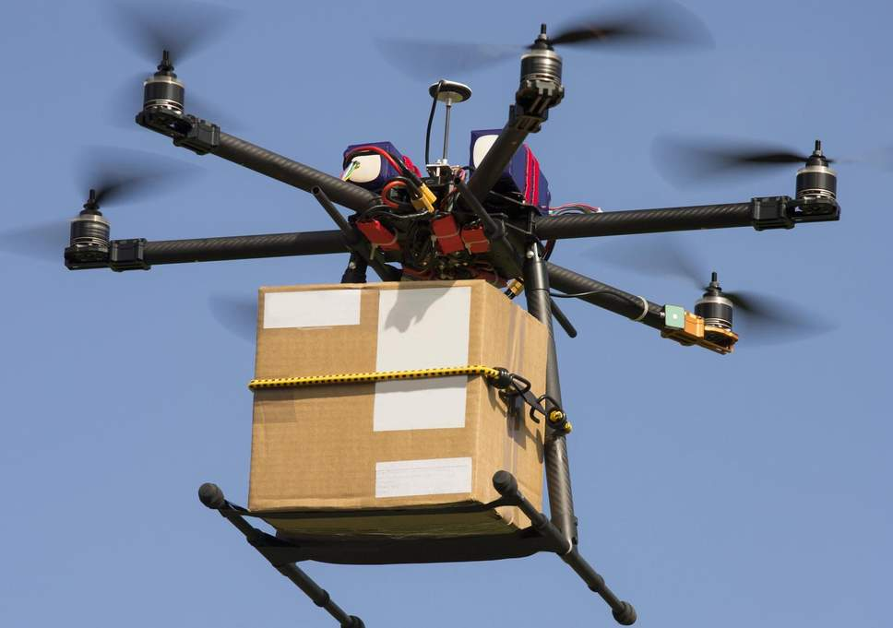
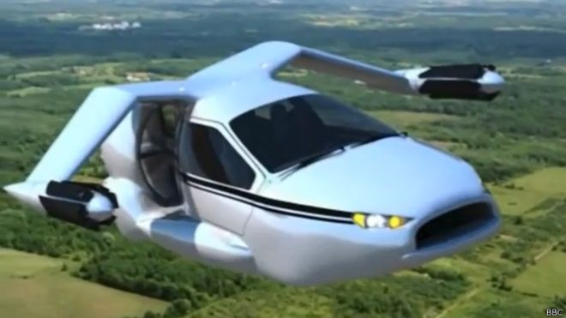
Transportation
Self-driving cars
Drones
pbs.org
independent.co.uk
Flying cars
bbc.com

Slide 3
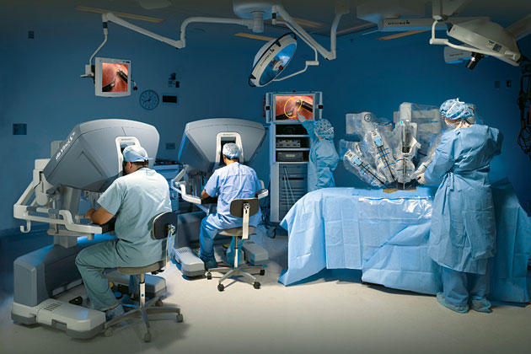
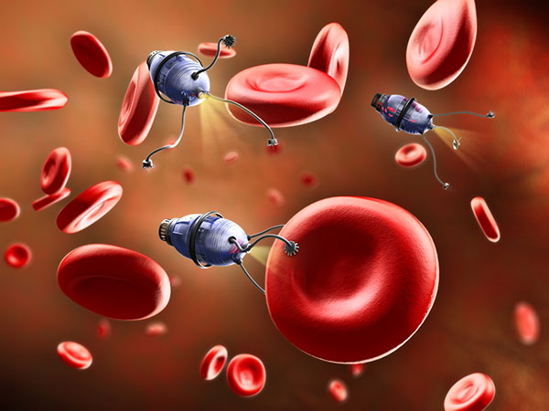
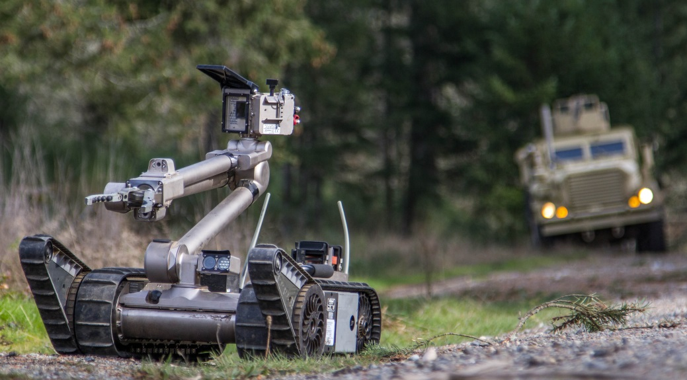
Medicine
Telemanipulators
Nanorobotics
medicalfacts.nl
robotnor.no
Robot-detector
cbrneportal.com

Slide 4
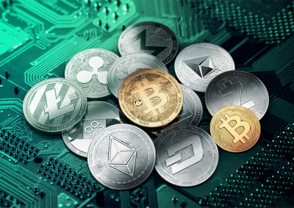

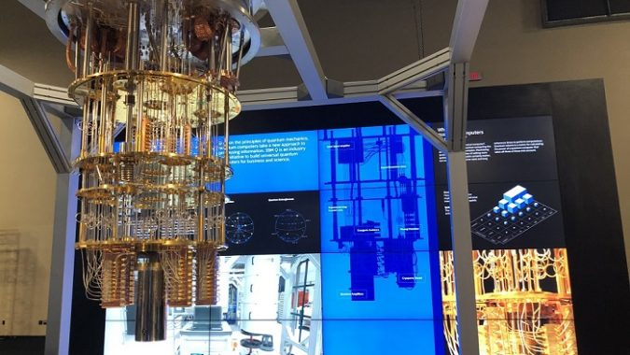
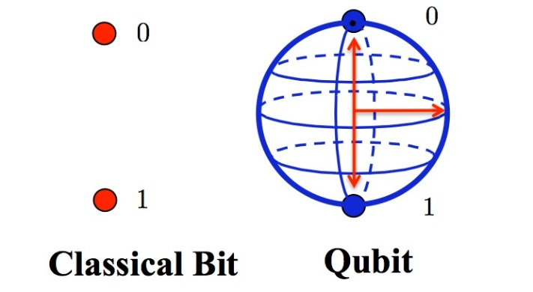
IT
Cryptocurrency
DNA computer
venturebeat.com
theconversation.com
Quantum computer
hpcwire.com
ibtimes.co.uk

