Slide 1
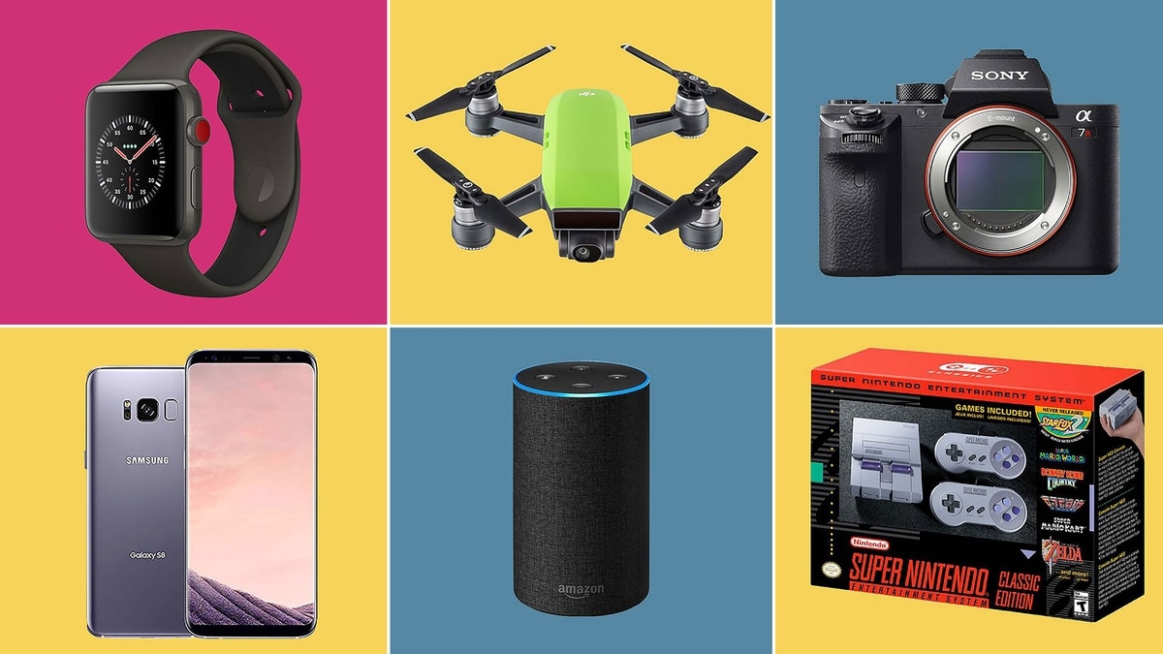

Smart technologies
We
pngimg.com
gadgets
infobae.com

Slide 2
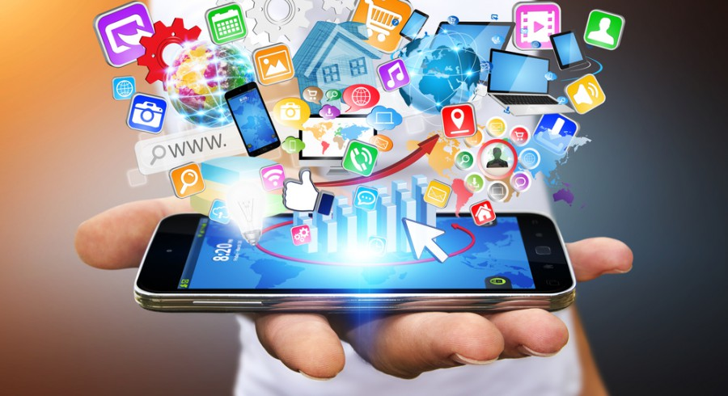

Help humans
help.blackboard.com
betanews.com
Help with our everyday activities.

Slide 3
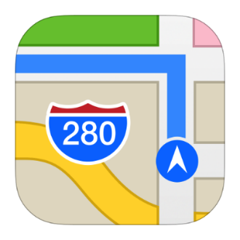

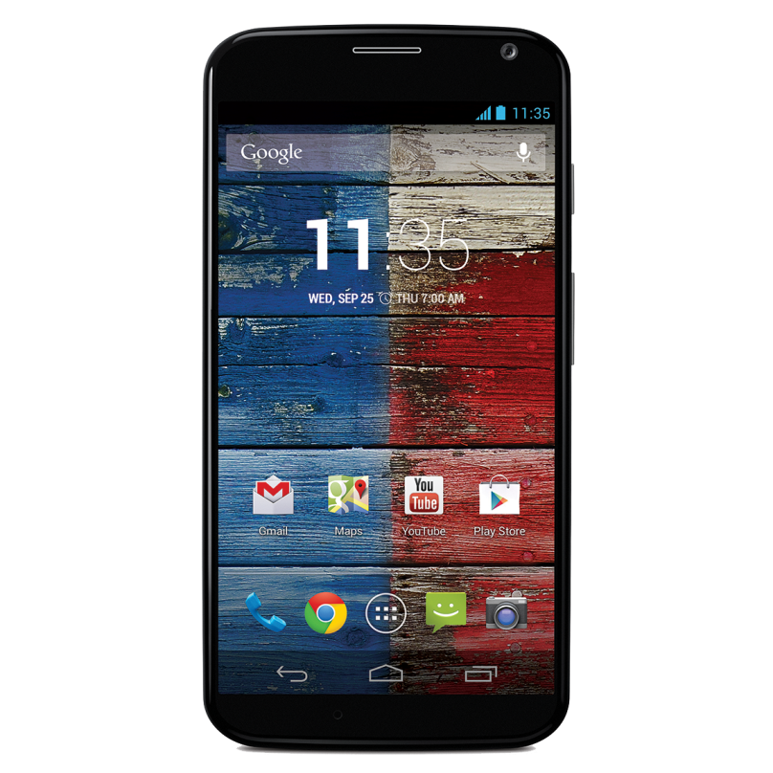


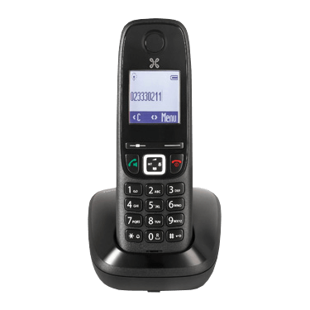




Smartphone
imgpng.ru
iphonefaq.org
iconfinder.com
pngonly.com
chittagongit.com
vexels.com
warosu.org
proximus.be
iconos8.es
vmacwrites.wordpress.com

Slide 4
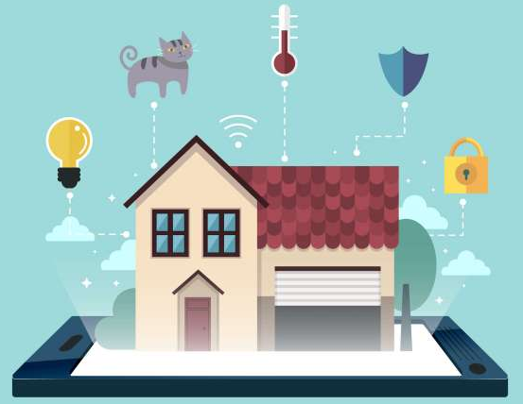

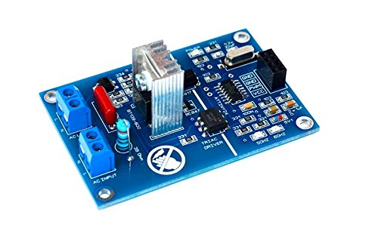

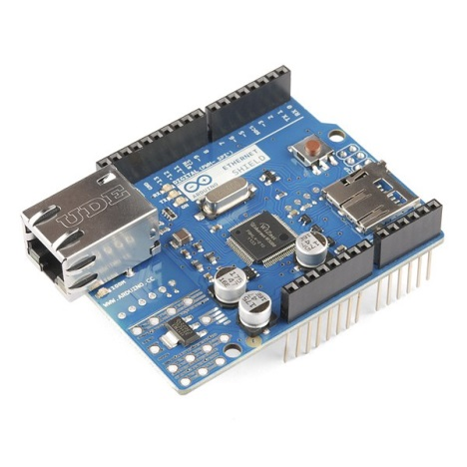
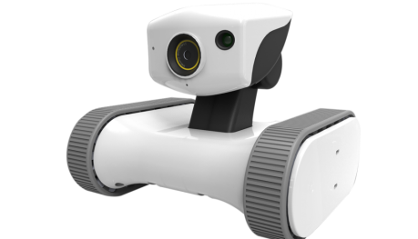
Smart house
Smart house is an intelligent automation system which controls lighting, climate, entertainment systems and appliances.
Entertainment
Medical care
Arduinomodules
Climate control
flaticon.es
Security
amazon.com
imgpng.ru
Infrastructure
Network
Smart robots
iArduino.ru
techomebuilder.com
eurosatellite.it

Slide 5
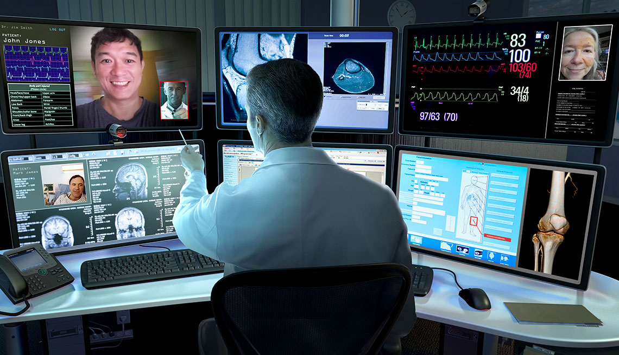
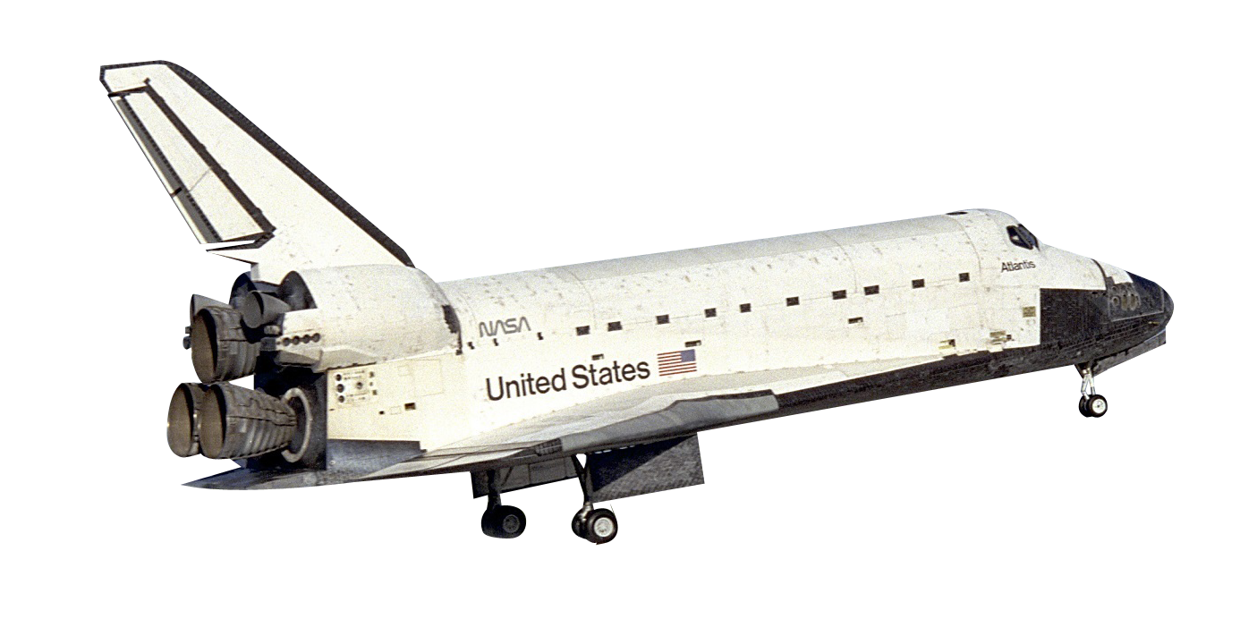

Telemedicine
Telemedicine is the use of telecommunication and information technology to provide clinical health care from a distance.
It can be divided into:
real-time – web broadcast, phone call;
asynchronous – e-mail, prescriptions.
aarp.org
aarp.org
pngpix.com
Patient
commons.wikimedia.org
Doctor
saving time
convenience
better monitoring
earlier treatment

Slide 6
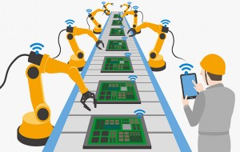
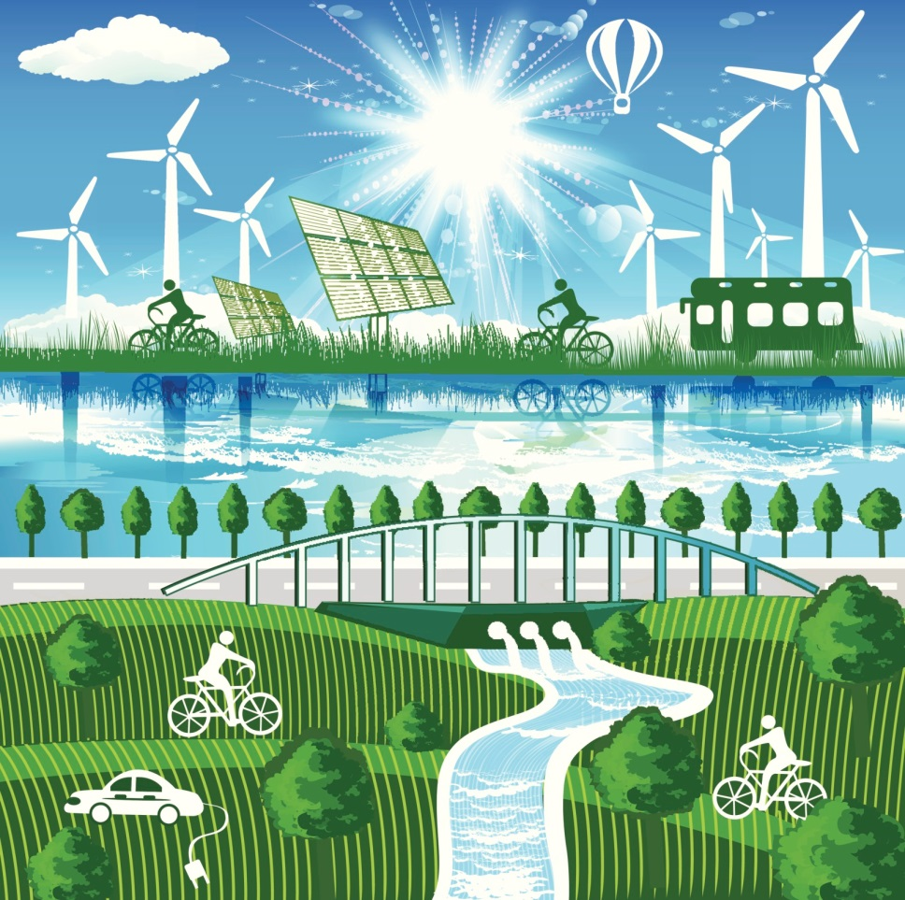
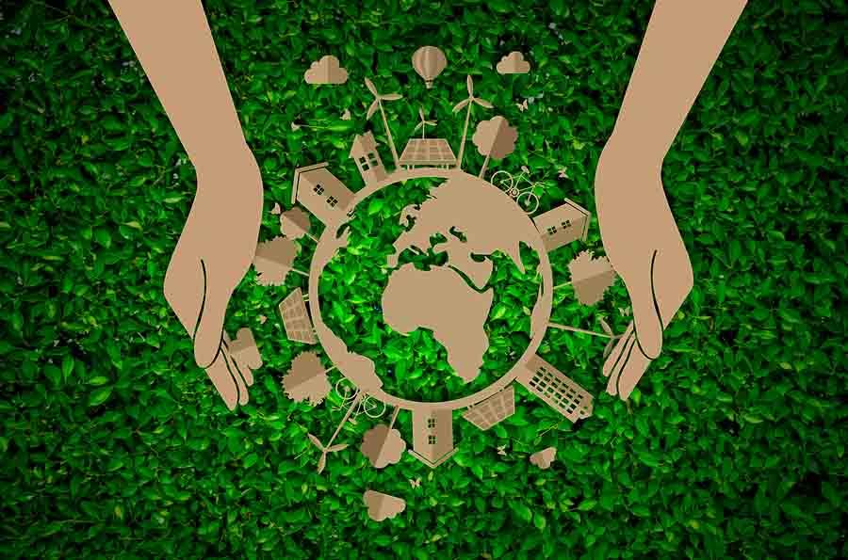
Green technologies
Green tech - process and product technologies with low or no waste and increase of resource- and energy-efficiency.
Production
bhs-business.com
Consumption
ec.europa.eu
lifepersona.com

Slide 7
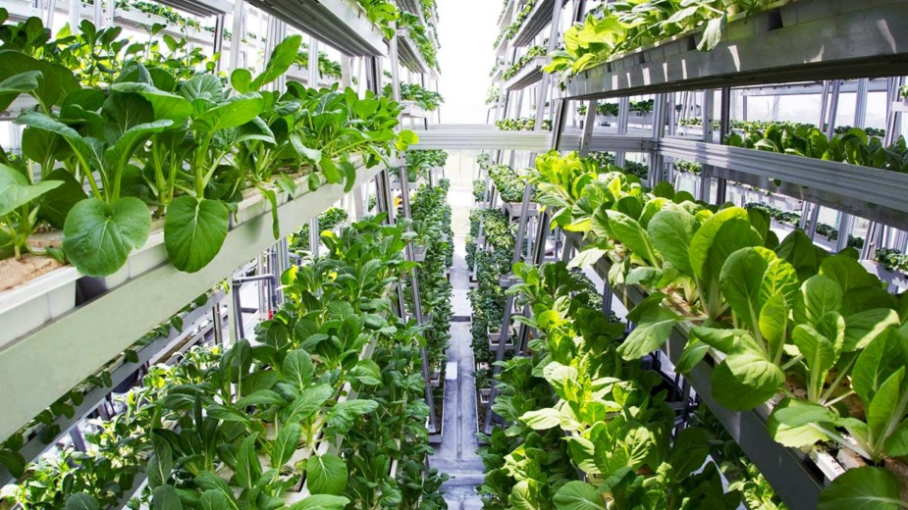
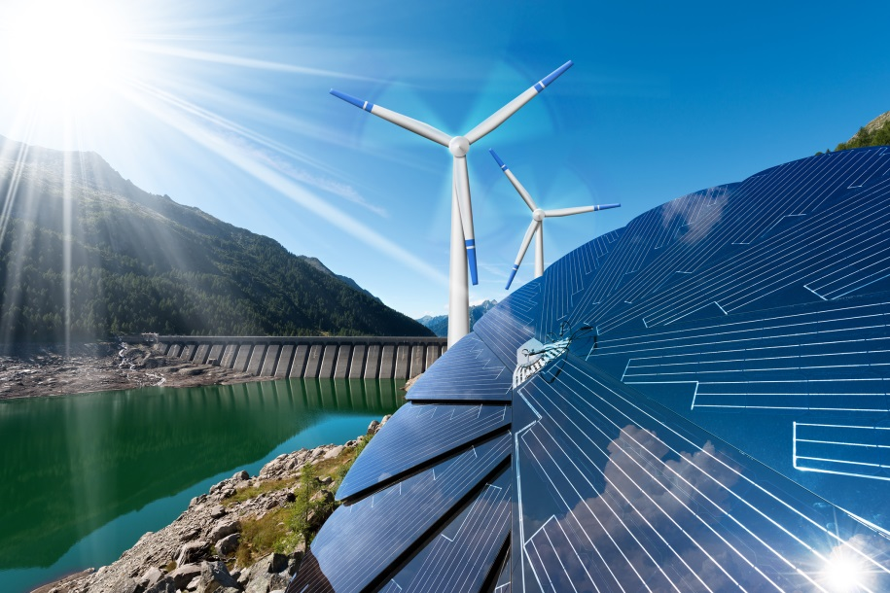

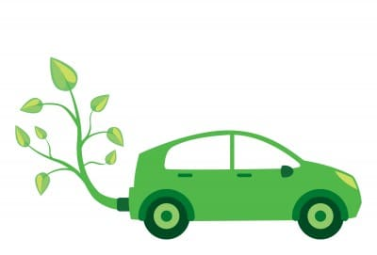

Green technologies
Agriculture
Green energy
Organic
fcpad.org
impactalpha.com
Water and waste management
chinadialogue.net
Fuel cell
Water
Wind
Geothermal
Solar
Green cars
csrd.bc.ca
cartrade.com

