Slide 1


Modern society
realtybiznews.com
medicalxpress.com

Slide 2

Aim of cloud computing
Main aim is to provide IT as a service to the users.
Pluses:
ﬂexibility;
availability;
reliability;
scalability.
defensesystems.com

Slide 3

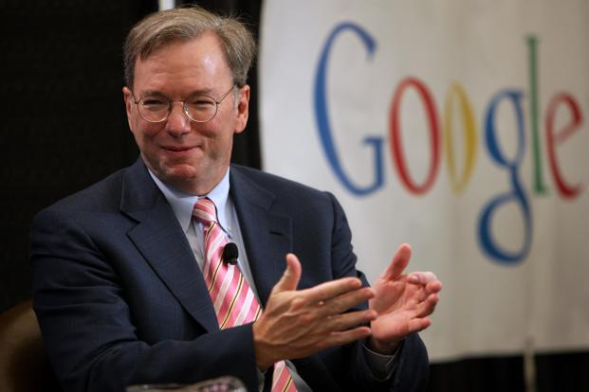

History
livemint.com
Grid computing
quora.com
Cloud computing
xpertics.com.mx

Slide 4

Types of clouds
composed of multiple internal or external clouds.
top25cloudcomputig.review
maintained within an organization and used solely for their internal purpose.
when organization rents cloud services from cloud providers on-demand basis.

Slide 5
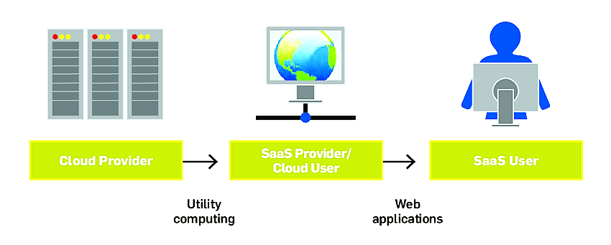
Stakeholders and virtualization
Types of stakeholders
researchgate.net
Cloud provider
Cloud user
SaaS user
Utility computing
Web applications
Application
OS
Virtualization - software translating the hardware instructions generated by conventional software to the understandable format for the physical hardware.
Virtualizing software
Physical hardware

Slide 6
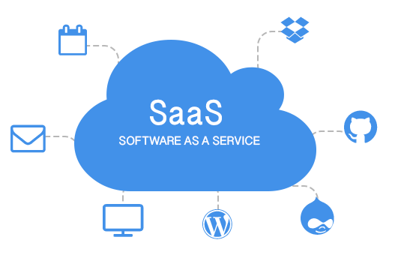
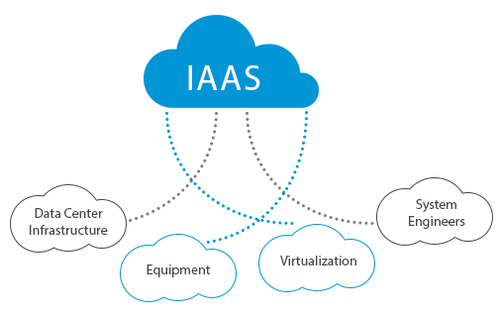
XaaS
1
2
birger.technology
iramari.com
3
computechcorp.com

Slide 7
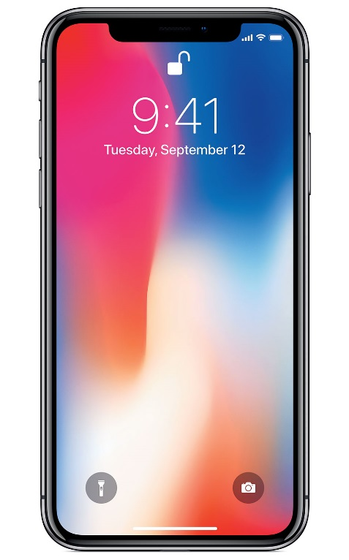


Mobile technology
t-mobile.com
ru.aliexpress.com
cebsworldwide.com

Slide 8
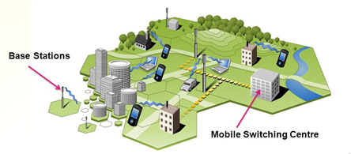
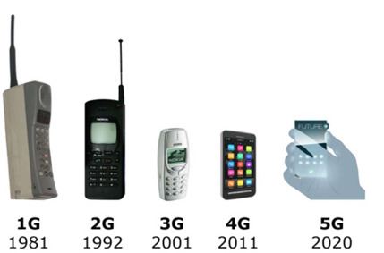




Mobile phones
Cellular networks
slideplayer.com
slideplayer.com
Cell
shop.bt.tn
aalphus.by
dryicons.com
pngmart.com
c.mi.com
Generations
Standards
NMT GSM UMTS\ LTE CDMA

Slide 9


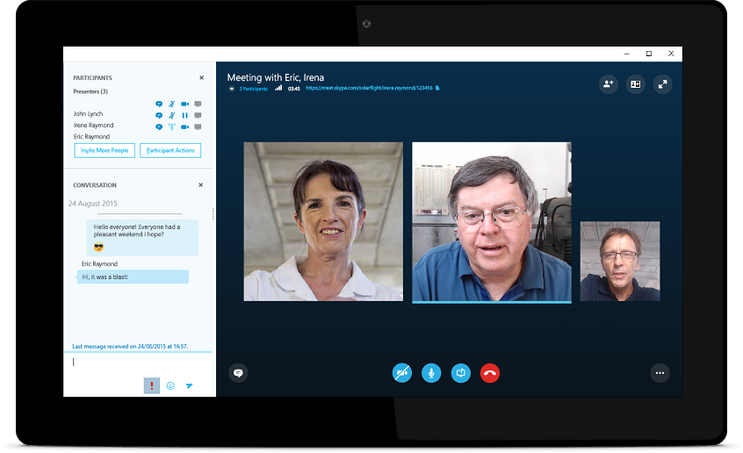
Modern families
flowmagazine.com
skype.com
onlinevideoconverter.com

