Slide 1



Al Farabi Kazakh National University
Faculty of Medicine and Health Care
2019-2020

Slide 2
Faculty of Medicine and Health Care
BACHLEOR PROGRAM
MASTER’S PROGRAM
DOCTORAL PROGRAM
INTERNSHIP
Physical education and sport
Public Health
General Medicine
Dentistry
Pharmacy
Physical education and sport
Public Health
Medicine
МВА
Management in Health Care
Health law
Physical education and sport
Public Health
Medicine
General Doctor
Dentistry
183
32
21
840

Slide 3
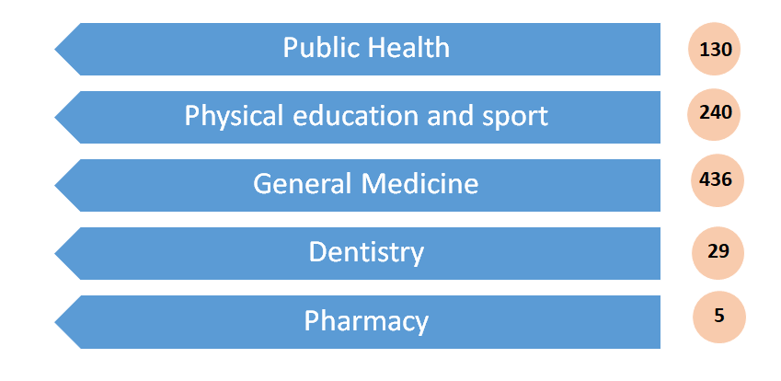
Undergraduate students contingent

Slide 4
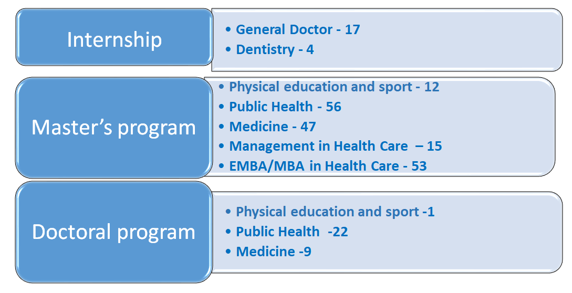
The contingent of students

