Slide 1
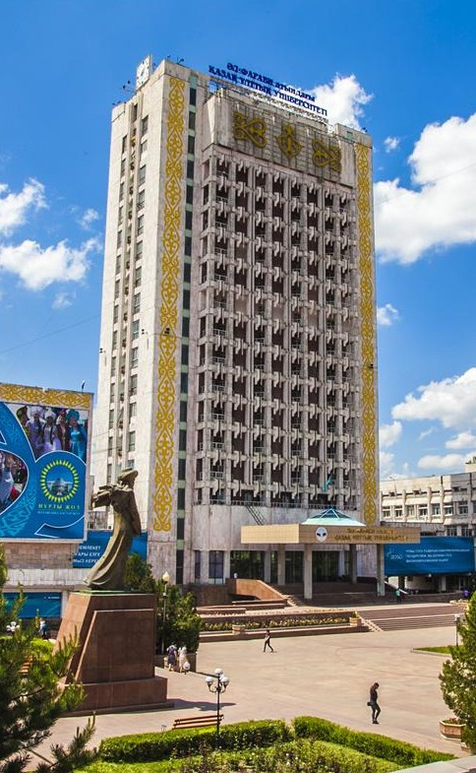
Higher School of Economics and Business

Slide 2

Departments
Department of Economics
Department of Management
Department of Finance and Accounting
Department of Business Technologies

Slide 3
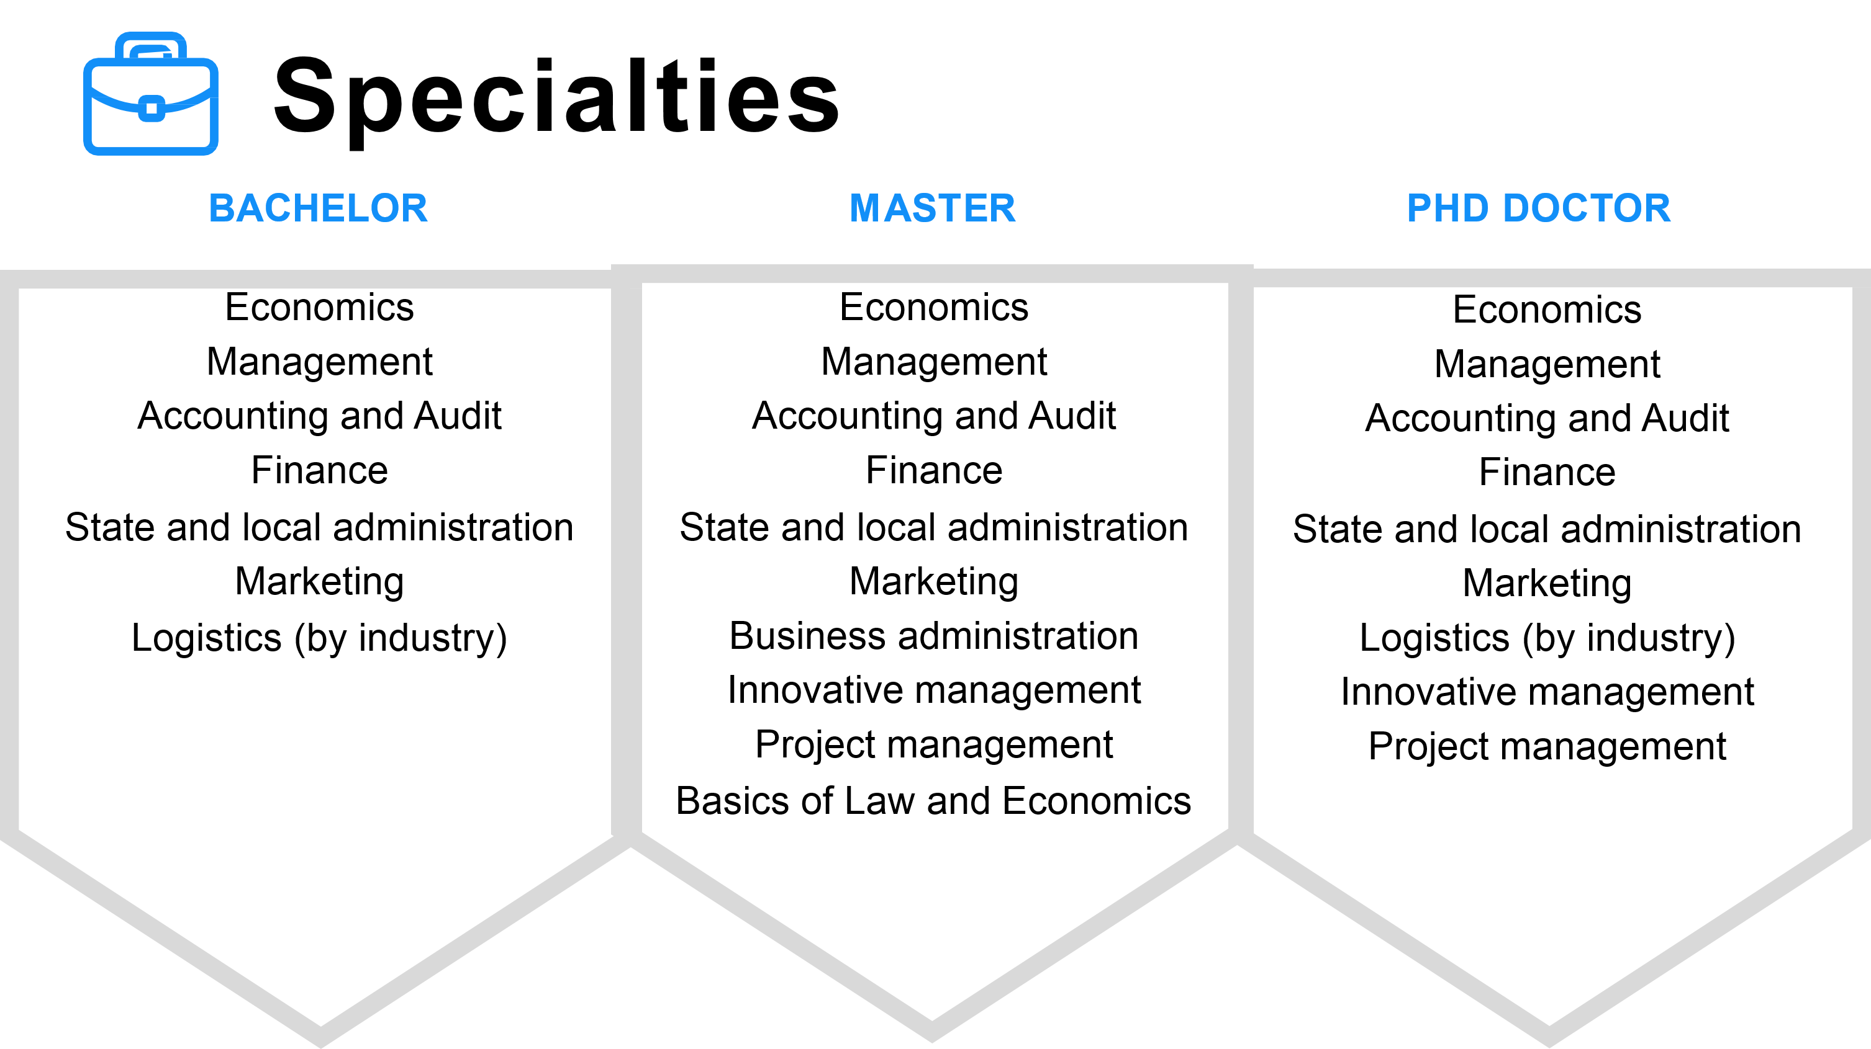

Slide 4

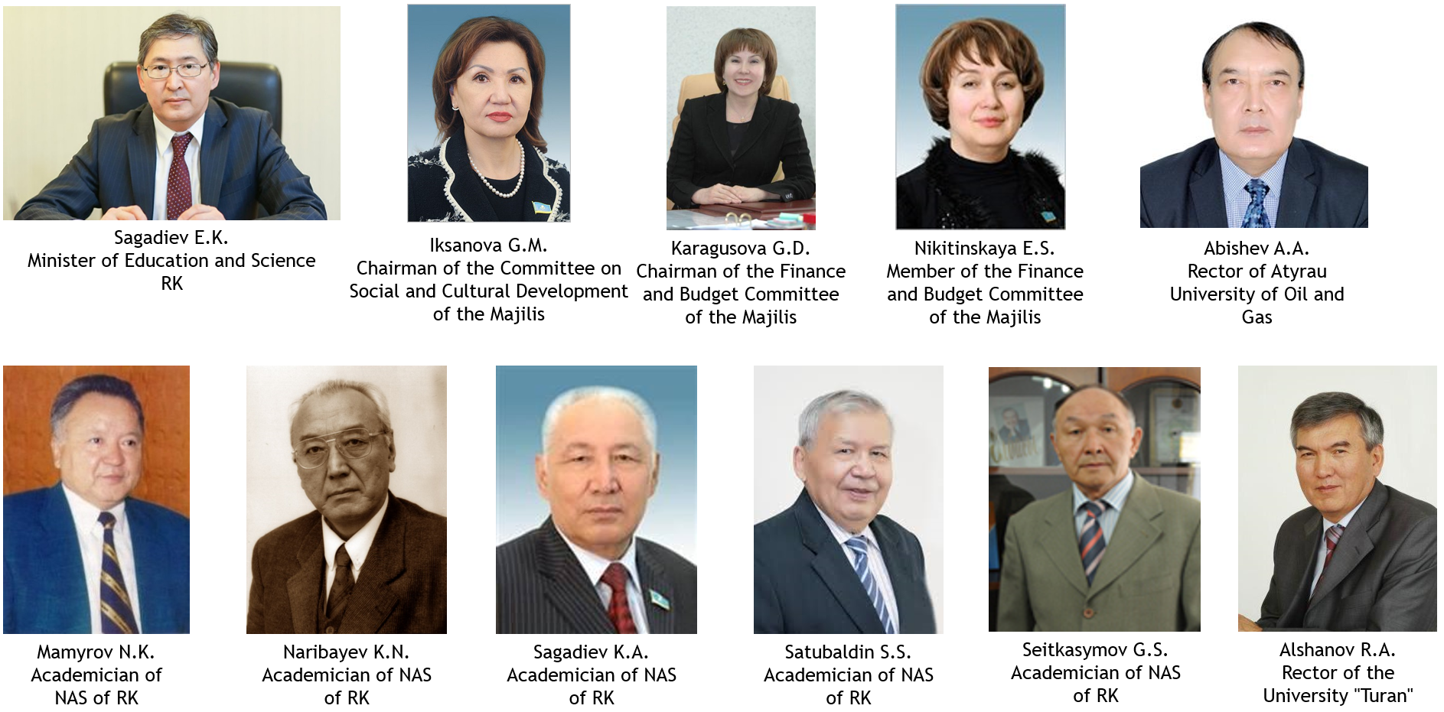
Our graduates

Slide 5
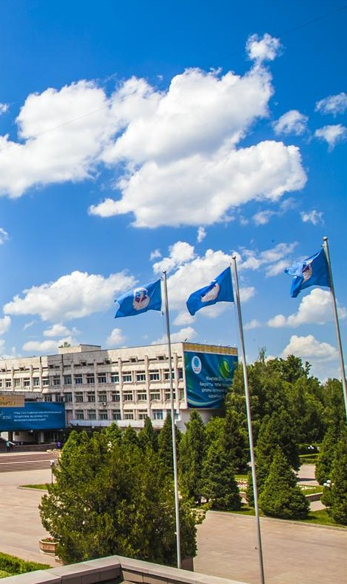
Scientific centers at the departments
Economic Research Center
Entrepreneurship and Innovation Center
Center of Management and Business Education
Center of Innovative Competencies in Accounting, Audit and Analysis
Stock Market Technologies Center
Islamic Finance Center

Slide 6

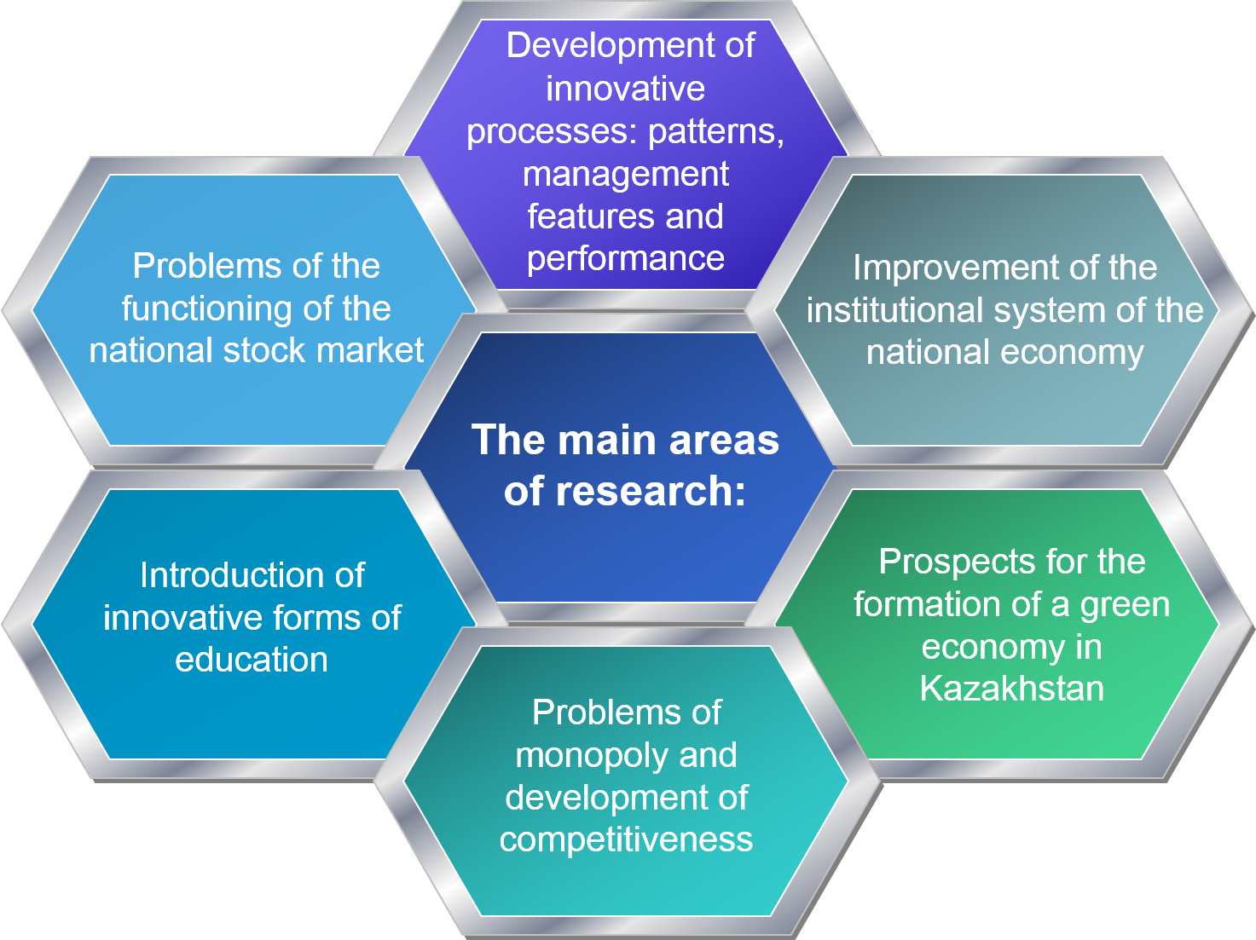
Center of Economic Research functions at the Higher School of Economics and Business

Slide 7

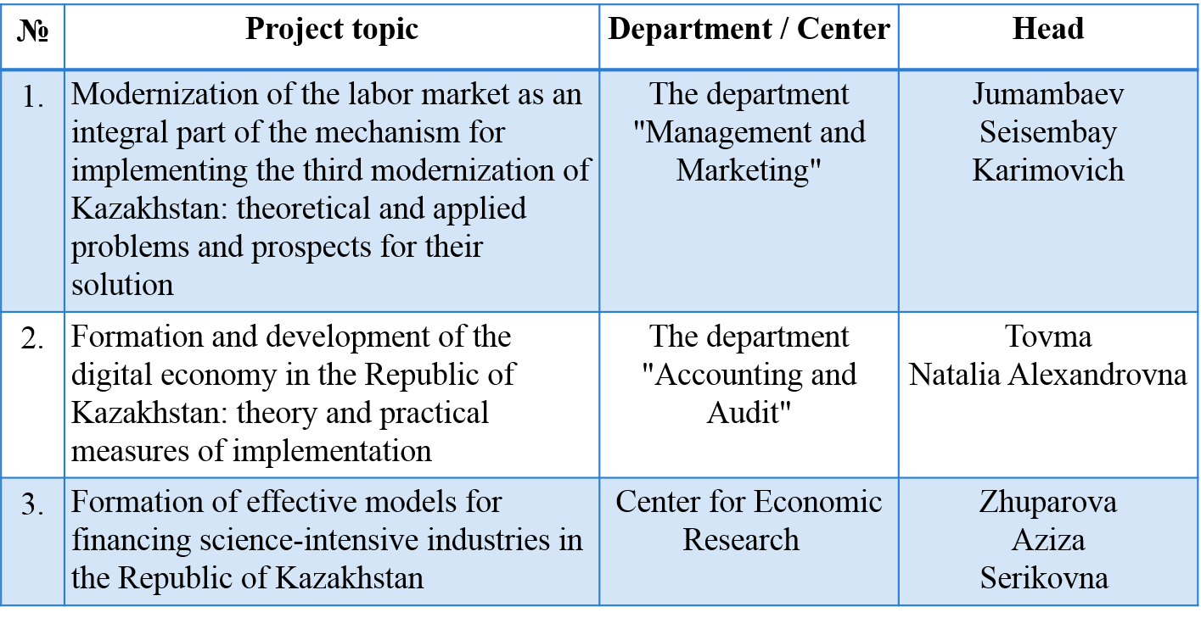
Projects within the framework of grant funding for scientific research for 2018-2020 in the priority area of “Scientific Foundations "Mangіlіk El "

Slide 8
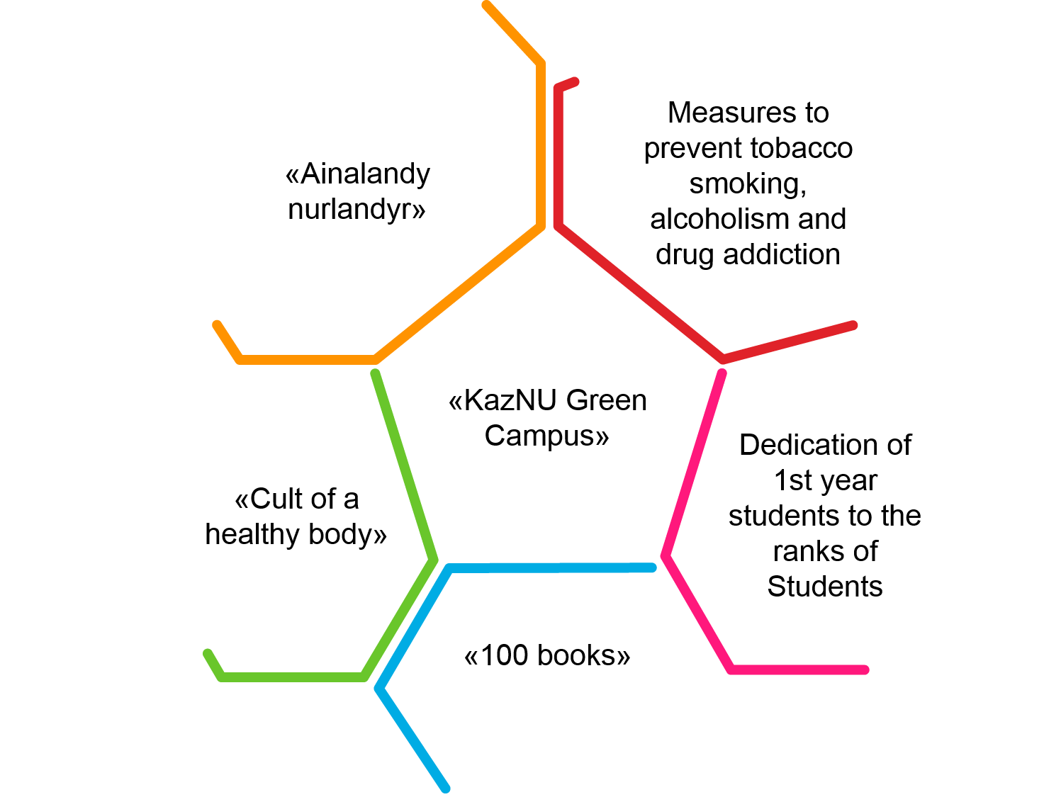
Social educational activity. Events

Slide 9

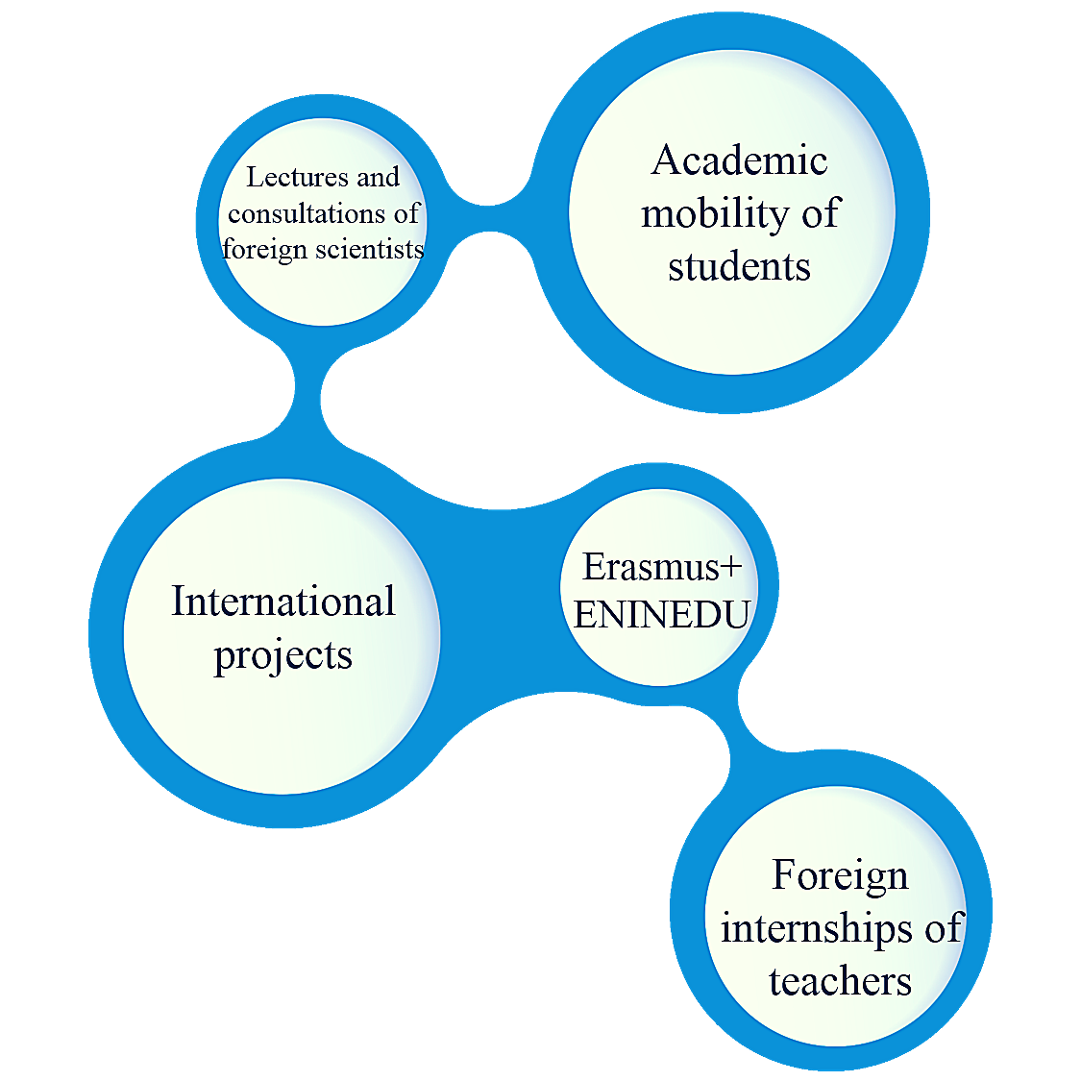

International activity

Slide 10












Foreign partners

Slide 11










Foreign partners

