Slide 1
Chair of pre-university training

Slide 2
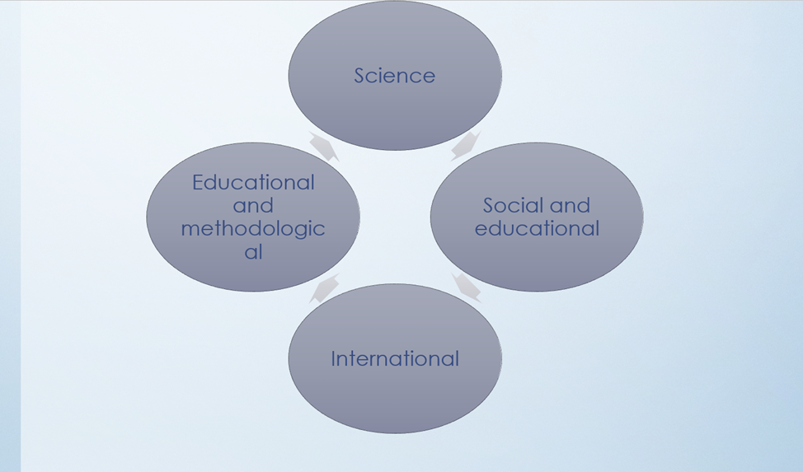

Slide 3
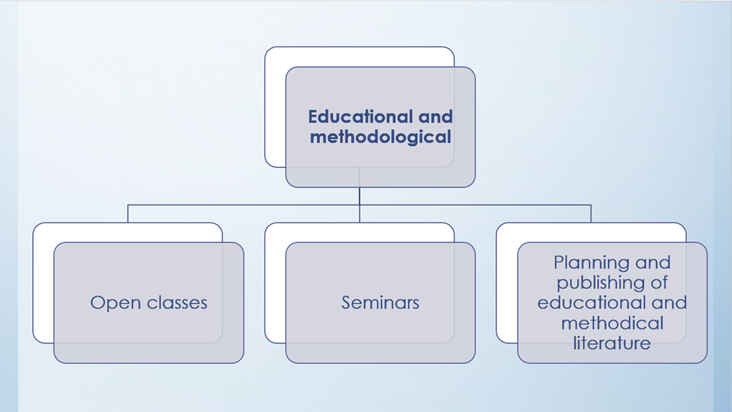

Slide 4


Slide 5
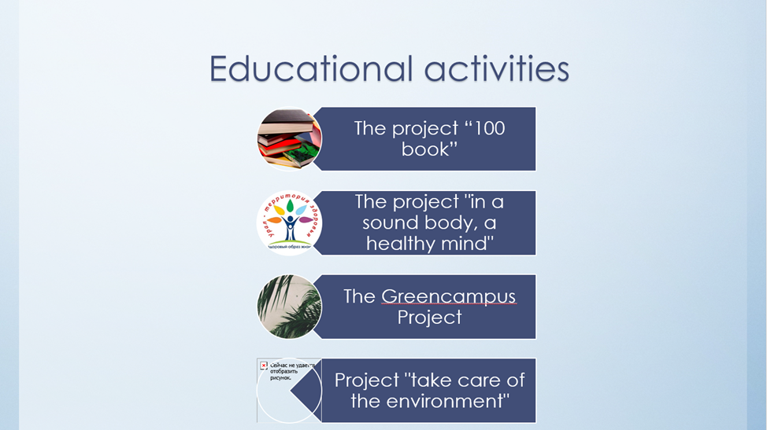

Slide 6
Scientific works: publication of articles and monographs
Organization and participation of international conferences
The project "Zhas talant"
Scientific and innovative activity
Leadership and participation in scientific projects
Research work of students
Organization and participation in scientific seminars

Slide 7
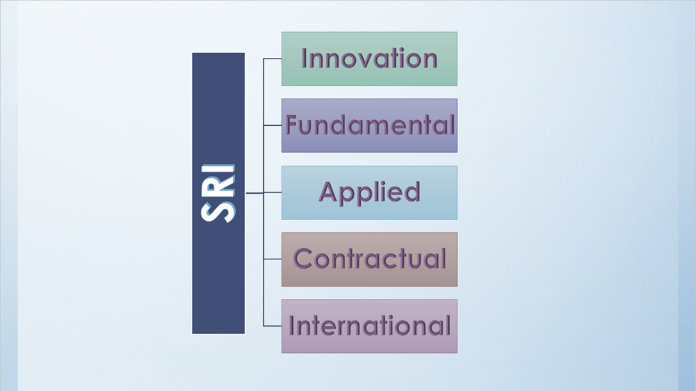

Slide 8
The work of curators-advisors within the department and faculty
Social work
Participation in competitions and Olympiads
Social and educational work
Cultural events
Educational work within the educational process
Organization of seminars, conferences and round tables and participation in them

Slide 9
Students of the department actively participate in annual international, republican conferences and competitions held by the Faculty of Pre-university Education. They are also members of various clubs and circles
Contests
conferences
University Amateur Art Competition "Student Spring"
International Scientific Conference of students and Young scientists in the framework of "Farabi Alemi"

