Slide 1
Molecular diagnostics. L6

Slide 2
sport, genetics & MEDICINE

Slide 3
In elite sporting codes, the identification and promotion of future athletes into specialized talent pathways is heavily reliant upon objective physical, technical, and tactical characteristics, in addition to subjective coach assessments. Currently, there are several methods of determining individual player achievement within a sport: team selection, career success, coach perception, and match performance within a season. Despite the availability of a plethora of assessments, the dependence on subjective forms of identification remain commonplace in most sporting codes.
Results of such tests as s the vertical jump, 20-metre sprint, and endurance time trials reveal indications of physical capabilities that may enhance or hinder an athlete’s ability to perform within a given sport or position within a sport. The results from these tests give information on the skill level of an athlete, and therefore an indication of the individual work required to elevate their abilities to an elite level.
New technology and training methods are continually being tested and developed to enhance performance and elevate athletes to an elite level status.

Slide 4
Our genetic material defines every aspect of our life, right from the definition of our physical features to our “gifts”, our disadvantages and our susceptibility to disease. Although more than 99% of human DNA is identical among all people, it is the remaining 1% that makes us each unique.
These tiny differences are called mutations and define our differences with other people.
Mutations in our genetic material define every aspect of our life. They make us unique, give us special abilities and advantages, but also create barriers and cause increased susceptibility to diseases compared to general population.

Slide 5
Genetic passport (or DNA passport) is a personal medical document containing data on the molecular and cellular analysis of the human genome.
Each of us has a unique hereditary code. Knowing it enables us to develop a personalized scheme of nutrition, lifestyle, and treatment of diseases.
Most of the DNA remains unchanged during life, consequently, it is enough to pass the analysis just once - these data can be used any time for the specific purpose intended. Family planning, dealing with health concerns, improving the quality of living and the life expectancy of people suffering from genetic diseases, selecting an individual anti-aging program - this can be done much easier if the patient has the DNA analysis results.
GENETIC PASSPORT
Medics are sure that a biometric passport will contribute to the development of healthcare throughout the world since the availability of a single database will improve the work of the medical care specialists.

Slide 6
There are approximately 7,000 rare diseases that affect 4 to 8% of the population.
A comprehensive genetic test allows to solve some problems that reduce the quality of modern people’s life.
The results of such a survey allow getting to know about the likelihood of hereditary diseases transmitted from generation to generation, ethnic affiliation, physical and intellectual abilities.
The undisputable advantage of DNA analysis is the possibility of latent diseases early diagnosis.
If any of your relatives were diagnosed with oncology, hypertension, diabetes, cardiovascular disorders, then there is a high likelihood that the inheritors will be in the risk group.

Slide 7
Genetic analysis is absolutely safe and has no contraindications. The blood, saliva, hair or nails can be the material for investigation.
Modern technologies allow to conduct genetic analysis for children even from the first days of life, it is recommended to have the test after 14 years, in order to obtain precise results
A newborn’s genetic passport is a set of DNA tests that helps to identify genetically occurring diseases, as well as genetic benefits. In order to compile a comprehensive genetic passport for the child umbilical cord blood testing is performed.
*Cord blood can be used immediately to treat disease (blood, bone marrow, immunodeficiency), or easily stored for future public or private use.
It is also an important resource for stem cell research. Since the first cord blood transplant in 1988, over 40,000 have been performed.

Slide 9
The Athletic Performance DNA Test detects mutations in genes which affect your physical condition, endurance capacity, your speed and strength, susceptibility to injuries. Moreover, it detects mutations in genes that control nutrient (food) metabolism and affect your performance, your physical condition and the risk of suffering from certain conditions during training and exercise.
What can you learn from your results?
● If you have the “appropriate” genes for optimal performance in respect of endurance capacity, strength and/or speed so that you can choose a suitable sport in which to compete (either on a professional or amateur level).
● Your genetic advantages and barriers, in order to “direct” your training program and diet plan to achieve optimal performance with minimum waste.
● How your genes affect the biological functions that are necessary for the sport that you are already involved in.
● If you are at an increased health risks (e.g., hypertension, cardiovascular problems) during exercise and training.
● How susceptible you are to sport-related injuries (tendons, bones, inflammation) and how you can protect yourself from them.
*The Athlete Biological Passport is a quite the new paradigm in testing based on the personalized monitoring of biomarkers of doping.
It may be used by the sponsors, colleges, sports clubs and cooperations who are looking specific genetic type of athlets to invest on or needs of their teams and projects and have special contracts & supports.

Slide 10
The common inheritance of approximately 20 000 genes defines each of us as human.
However, substantial variation exists between individual human genomes, including ‘replication’ of gene sequences (copy number variation, tandem repeats), or changes in individual base pairs (mutations if <1% frequency and single nucleotide polymorphisms if >1% frequency).
Such variation is common; indeed, approximately 10 million SNPs alone are thought to exist.
All variation in human traits (or phenotypes) results from the interaction between an individual’s unique genotype and environmental stimuli. Heritability is defined as the proportion of phenotypic variation in a population attributable to genetic variation (rather than variation in environment) among individuals. This holds true not just for disease, but for health and for sporting phenotypes.
A vast array of human phenotypes (e.g., muscle strength, skeletal structure, tendon elasticity, and heart and lung size) influences sports performance, each itself the result of a complex interaction between a myriad of anatomical, biochemical and physiological systems.
In theory, the chances of an individual having a perfect sporting genotype are much lower than 1 in 20 million.

Slide 11
We know that muscle performance is heavily influenced by basal muscle mass and its dynamic response to training. Muscle fibre type determination is complex. Whilst initial composition is likely to be strongly influenced by genetic factors, training has significant effects on fibre shifts.
Genetic factors account for approximately 50–80% of inter-individual variation in lean body mass, with impacts detected on both ‘training-naive’ muscle mass and its growth response. Similar genetic influences are seen on muscle function: heritability of grip and pull and push strength ranges from 44% to 83%.
This influence appears greater in males, especially for static strength and power compared with muscular endurance and varies with age. In addition to mass, the efficiency of muscle activity and contraction is likely to be influenced by genetic factors.
Several cytokines such as interleukin-6 and -15, cilliary neurotrophic factor and insulin like growth factor (IGF) have myoanabolic effects.
Genotype-associated differences in endocrine function, necessary for normal skeletal muscle growth and function, may also be of significance, with complex interactions existing between thyroxine, growth hormone and the downstream regulators of the anabolic pathways (such as IGF-1 and IGF-2). Sports Med 2011; 41 (10): 845-859; 0112-1642/11/0010-0845/$49.95/0

Slide 12
“Bad” genetics is not an excuse!

Slide 13
https://www.youtube.com/watch?v=SD-yAFfLCXg&t=398s

Slide 14
Neurodegenerative diseases (NDs), such as Alzheimer’s disease (AD), Parkinson’s disease (PD), Huntington’s disease (HD), and amyotrophic lateral sclerosis (ALS), are disorders characterized by progressive degeneration of the nervous system.
Currently, there is no disease-modifying treatments for most NDs.
Meanwhile, numerous studies conducted on human and animal models over the past decades have showed that exercises had beneficial effects on NDs. Inter-tissue communication by myokine, a peptide produced and secreted by skeletal muscles during exercise, is thought to be an important underlying mechanism for the advantages.
Myokines could exert beneficial effects on NDs through a variety of regulatory mechanisms, including cell survival, neurogenesis, neuroinflammation, oxidative stress, and protein modification.
Studies on exercise-induced myokines are expected to provide a novel strategy for treating NDs, for which there are no adequate treatments nowadays.
Lee, B.; Shin, M.; Park, Y.; Won, S.-Y.; Cho, K.S. Physical Exercise-Induced Myokines in Neurodegenerative Diseases. Int. J. Mol. Sci. 2021, 22, 5795. https://doi.org/10.3390/ijms22115795

Slide 15
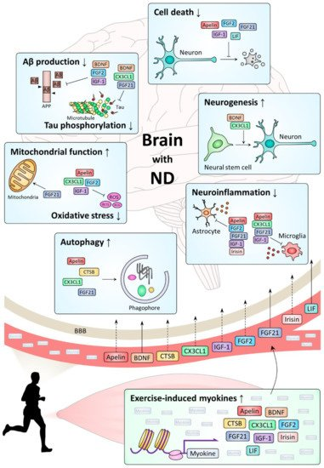
Mechanism of action of representative exercise-induced myokines in the brain with neurodegenerative diseases.
While there is experimental evidence that some myokines penetrate the blood–brain barrier
Solid arrows from blood vessels through the BBB to the brain), others do not so far (dashed arrows from the blood vessels through the BBB to the brain).

Slide 16
Montgomery, H. E. et al. Association of angiotensin-converting enzyme gene I/D polymorphism with change in left ventricular mass in response to physical training. Circulation 96, 741–747 (1997).
The first gene identified as an indicator of sporting performance (paper shown above)
This gene, ACE, has now been extensively studied and been shown to be predictive of endurance and power-oriented performance. Numerous other genes have also been studied and fourteen genetic polymorphisms have been included in the DNA Sport test. They have been identified as those with high scientific credibility and those which can make a difference to the training and lifestyle intervention of an athlete, based on knowledge of his/her genes.
The ACE DD genotype has been associated with greater lean body mass, muscle volume, and percentage of Type II fast twitch muscle fibres. Various studies have shown that the D allele is overrepresented in power and strength athletes. D accounted 1.48 % of sprint time variance. The D allele or DD genotype has shown to be over-represented in short and middle-distance swimmers.
Following a 12-week high speed training program in older woman, Pereira et al. (2013) showed that D allele carriers had greater improvements in maximum strength and power.
Individuals with the ACE DD genotype should be aware of an increased risk left ventricular hypertrophy as a result of exercise training.

Slide 17
On the other hand, a significant relationship can also be predicted between the ACE genotype, which affects metabolic efficiency, and performance in hypoxic environments (high altitude).
A significant increase in the I allele frequency was observed in professional British male climbers who climbed higher than 7000 meters without using additional oxygen, compared to control groups.
Another gene commonly prominent in athletic performance development is the alpha-actinin-3 (ACTN3) sprint gene. It is stated that alpha-actinins release high power and high-speed strength by activating fast-twitch fibers in activities (100, 200, 400m, shot put, javelin, hammer, Olympic lifts, bodybuilding, powerlifting, team sports etc.) where speed and explosive power are dominant.
Weekly micro cycle associated with ACE & ACTN3 genes, exertion parameters, and muscle fiber types used (presumptive approach). https://doi.org/10.46733/PESH20920065c

Slide 18
Bradykinin is an endothelium-dependent vasodilator and acts via the Bradykinin B2 Receptor (BDKRB2). ACE is able to degrade the vasodilator bradykinin by forming a complex with BDKRB2, thought to play a role in the cross-talk between the renin-angiotensin and the kallikrein-kinin systems. The absence (-9) of a 9 base pair repeat in exon 1 of BDKRB2 is associated with higher gene transcriptional activity and mRNA expression of BDKRB2 (T allele).
Levels of bradykinin may affect skeletal muscle glucose uptake and blood flow during exercise. The BDKRB2 -9 (T) allele has been positively associated with endurance exercise performance, likely due to enhanced skeletal muscle mechanical and metabolic efficiency (the amount of energy used per unit of power output) with this allele.
In 2004, Williams et al. showed that the BDKRB2 -9 (T) allele is associated with greater muscle contraction efficiency in healthy individuals as well as Olympic track athletes. Saunders et al. (2006), showed that the BDKRB2 -9-9 (TT) genotype occurred at a significantly higher frequency in an ironman triathlete group compared to controls.
Vascular Endothelial Growth Factor (VEGF) is an endothelial cell proliferator involved in blood vessel growth. The -634 C>G polymorphism in the promotor region of the VEGF gene has been linked to altered expression of the VEGF protein. This gene variant has been associated with aerobic capacity and endurance athlete status

Slide 20
Athletic ability can be an inherited trait

Slide 21
In addition, specific homozygous genotypes in the peroxisome proliferator-activated receptor gamma co-activator 1-alpha (PPARGC1A) gene and the beta-adrenergic receptors 1/2/3 (ADRB 1/2/3) have been linked with higher maximal oxygen uptake (VO2max), better endurance performance and more favourable body mass index in long-distance runners, long-distance swimmers road cyclists, cross-country skiers, triathletes, sprinters, sprint swimmers, weight and power lifters, track and field jumpers and throwers, boxers, and kayakers. Despite the intriguing nature of these studies, there has been no strong candidate genes associated with performance in skill execution within sport. Polymorphisms within the brain-derived neurotropic factor (BDNF), dopamine D2 receptor (DRD2), and catechol-O-methyltransferase (COMT) genes have all been associated with motor control and/or learning.
https://doi.org/10.3390/sports6030088

Slide 22
Almost 200 polymorphisms are known to exist in the vitamin D receptor (VDR) gene.
VDR genotype is associated with differences in strength in premenopausal women.
VDR expression decreases with age and VDR genotype is associated with fat free mass and strength in elderly men and women. Polymorphisms of the peroxisome proliferator-activated receptor a(PPARa) gene and R577x polymorphism of the ACTN3 gene are both associated with specific fibre compositions.
Alterations in cardiac size have been associated with both increased performance and excess cardiovascular mortality. PPARa is a ligand-activated transcription factor that regulates genes involved in fatty acid uptake and oxidation, lipid metabolism and inflammation.
Psychology plays an important role in training, competition, tolerance of pain and motivation.
However, the role of genetic variation in determining psychological state and responses remains poorly understood; only recently have specific genes been implicated in motivational behavior and maintenance of exercise. Thyroid hormone receptors exist within the brain and influence both neurogenesis and behavior.

Slide 23
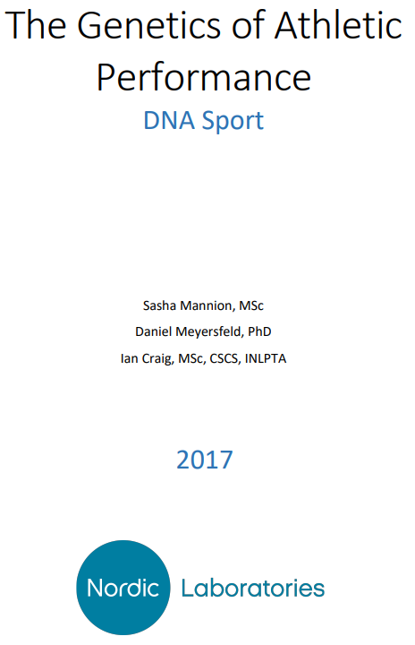
Multiple variables influence sports or exercise performance; more recently, circadian rhythms and chronotype have been noted as considerable factors.
Chronotype refers to morning preference, evening preference or neither and affects several physiological variables. Interesting study on athletes and sleep http://dx.doi.org/10.1136/bjsports-2020-102025
An individual’s chronotype may affect the time of day they are most likely to be at peak performance.
Caffeine is a central nervous system and metabolic stimulant that is used to reduce physical fatigue. In athletics, moderate doses of caffeine have been known to improve both sprint and endurance performance. Cytochrome P450 1A2 (CYP1A2) is one of the main enzymes that catalyze the oxidation of caffeine in humans.
Womack et al. (2012) investigated the ergogenic effects of caffeine and the CYP1A2 polymorphism in trained cyclists.
Individuals with the AA genotype experienced a greater ergogenic effect and enhanced performance benefit with caffeine ingestion, in comparison to C allele carriers.
Pataky et al. (2016) further demonstrated that cyclists with the CYP1A2 A allele benefited from caffeine ingestion with or without a caffeine mouth rinse 1 hour prior to exercise.

Slide 24
The identification of risk factors and the assessment of athlete’s predisposition to suffer an injury and the way in which it will occur is hard to predict due to the multifactorial origin of the lesions. In recent years, the importance of the genetic component of each individual as a possible cause of injury predisposition is being evaluated.
A relationship between the polymorphisms studied in the IGF-II (insulin-like growth factor II) and CCL2 (chemokine ligand 2) genes was observed with the severity of the muscle injury. IGF-II plays an important role in the growth of soft tissue tissues and participates in the activation of satellite cells, increasing their expression in response to post-injury degeneration and regeneration processes. CCL2 is a cytokine produced by macrophages and by satellite cells that participates in muscle repair and adaptation processes. Players with GC genotype for the IGF-II gene had muscle injuries. Likewise, CC/GC genotype players for the CCL2 gene had fewer severe injuries than those with GG genotype.
The absence of elastin or poorly constituted protein distorts the presentation and stability of other components of the extracellular matrix and the interactions, making the ELN (elastin) very important for elastogenesis and functioning of living in elastic fibers.
In this case, players with AA genotype are more prone to severe injuries and take much longer to recover from them than those with AG/GG genotypes. When injured and during repair and regeneration the contractile function is lost, and cellular differentiation takes place towards the immature elastin phenotype capable of proliferating and depositing in the extracellular matrix.

Slide 28
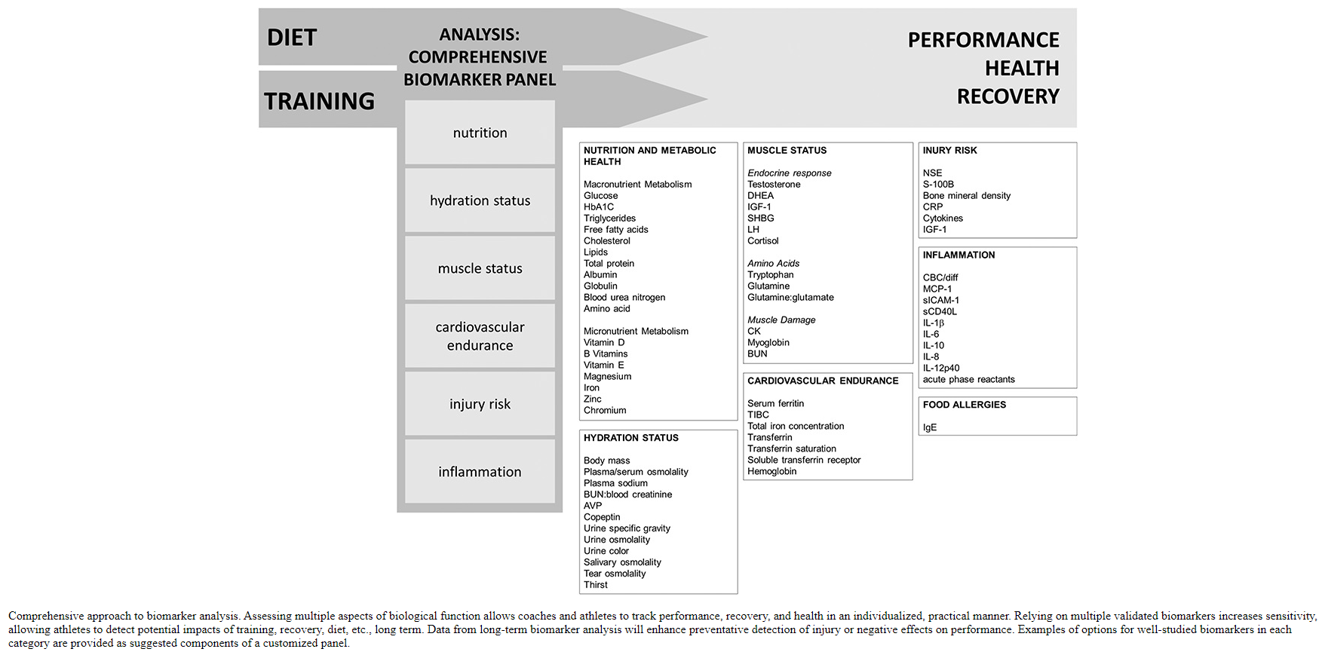

Slide 29
Suggested biomarker testing time points:
biomarker panel testing at diagnostic opportunities throughout off-season and during-season training.
competitive season during which both training and competition occur.
peak competition season during which championship matches might occur.
Suggested time points for biomarker testing include before and after each major shift in training. Frequent (2–3 tests) testing during rested, healthy periods in the off-season will provide baseline values for many biomarkers and will be important for providing individualized biomarker data. Testing is also recommended before and after at least 1 acute exercise bout or performance test in the middle of a training season to acquire data around optimal performance. Testing before and after an acute bout of exercise will also allow athletes to analyze variables that might be more meaningful as responsive to an acute bout rather than as a single value at rest. It is also recommended that flexibility be built in to test biomarkers around a major championship competition or acute injury event. Testing not just before and after such an event, but also at additional time points after the competition or injury will allow the athlete to assess a recovery response. Data from biomarkers should be analyzed with physiological and physical data to contextualize results. This approach will optimize sensitivity, precision, and accuracy.
DOI: 10.1519/JSC.0000000000002122

Slide 30
https://rm.coe.int/presentation-covid-and-physical-activity-2021/1680a2dce9

Slide 31
List of references
https://fineartamerica.com/featured/human-genome-research-peter-menzelscience-photo-library.html
https://wellcomecollection.org/series/WdJB3CcAAIE-RlQp
https://www.researchgate.net/profile/Abhishek_Singh138/publication/277780501/figure/fig1/AS:294320428077059@1447182866191/A-general-approach-to-show-the-use-of-human-umbilical-cord-blood-stem-cell.png
https://www.closerlookatstemcells.org/cord-blood-just-the-facts/
https://www.electronicsweekly.com/news/dna-sequencing-can-give-everyone-genetic-passport-2017-01/
https://ivfrigastemcells.lv/en/useful-information/genetic-passport/
Look at right now:
https://gen87.kz/technology/kletochnaya-terapiya/genetic-passport.html
https://www.youtube.com/watch?v=6MvnQPP6I20
Further reading:
https://www.rivm.nl/bibliotheek/rapporten/2015-0177.pdf

