Slide 1
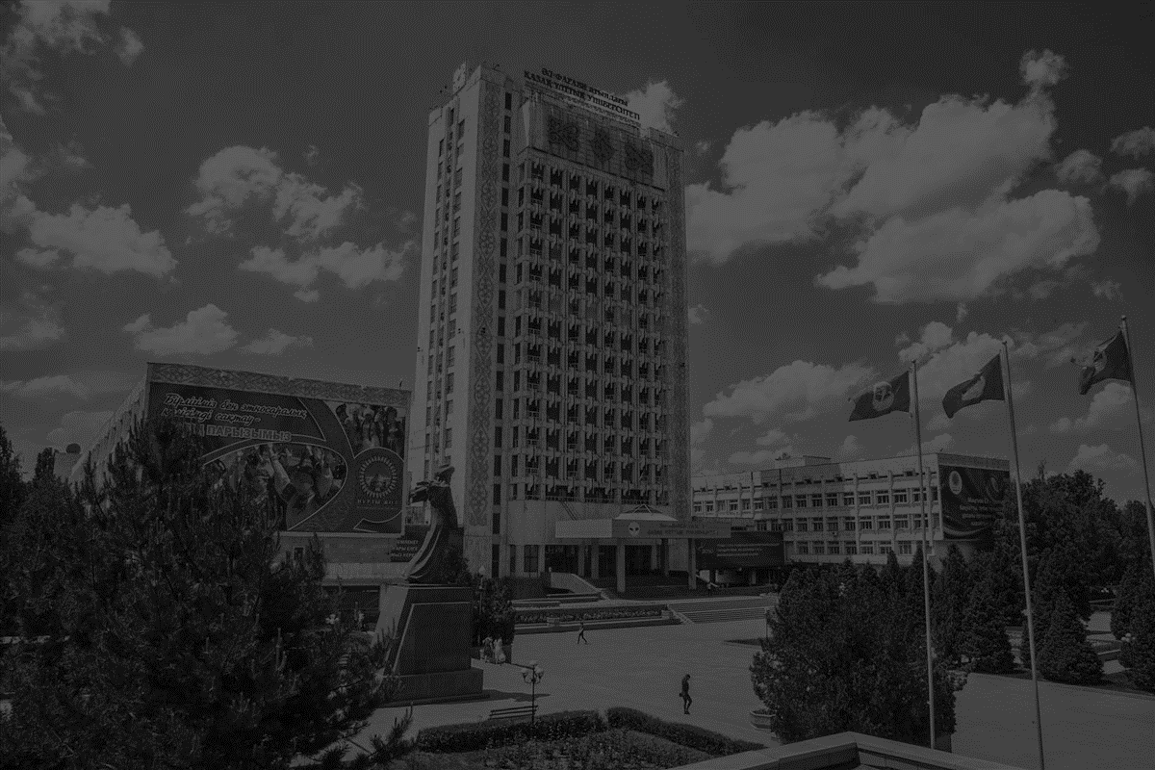


management department
© 2020

Slide 2
ABOUT US
Today effective management of the state and company is the main task of the modern country, and for these purposes a separate department “Management” was created in 2019 to train competitive specialists at High school of Economics and business
Workforce of
6 professors, 4 PhD students and 10 docents
25
years of experience
30+ professors and
teachers
1000+
graduates
100+
projects
Vision
Mission
Values
Training high qualified specialists in the field of public administration and management for a successful professional services in public administration, business also education and science.
Preparing graduates to:
operational and strategic planning;
Information technology;
HR management;
Sales management and market research;
Practical skills
Be Passionate
Be Innovative
Be Fair
Be Creative

Slide 3

Milestones & achievements
Founded departments «Management and business» and «Marketing and commerce»
Two departments were merged and transformed into a department «Management and Marketing»
Department “Management” became a separate department
1995
2006 - 2015
2011
2017
2019
Teachers of the department awarded the title «The Best teacher of the University"
MES RK
Passed quality expertise and accreditation at accrediting agency FIBAA

Slide 4













International relations

Slide 5
Thank you!
Any questions?
You can find us at
T +7 (727) 221-12-48
W www.kaznu.kz
E kafedra09@gmail.com
A Kazakhstan, Almaty, Al Farabi avenue, 71, GUK-3

