Slide 1
Lec#7
Organization of maintenance and operation of information systems

Slide 2
Maintenance of information systems (IS) consists of two large and diverse tasks.
The first task is to operate the information system.
The second task is to make changes to the information system

Slide 3
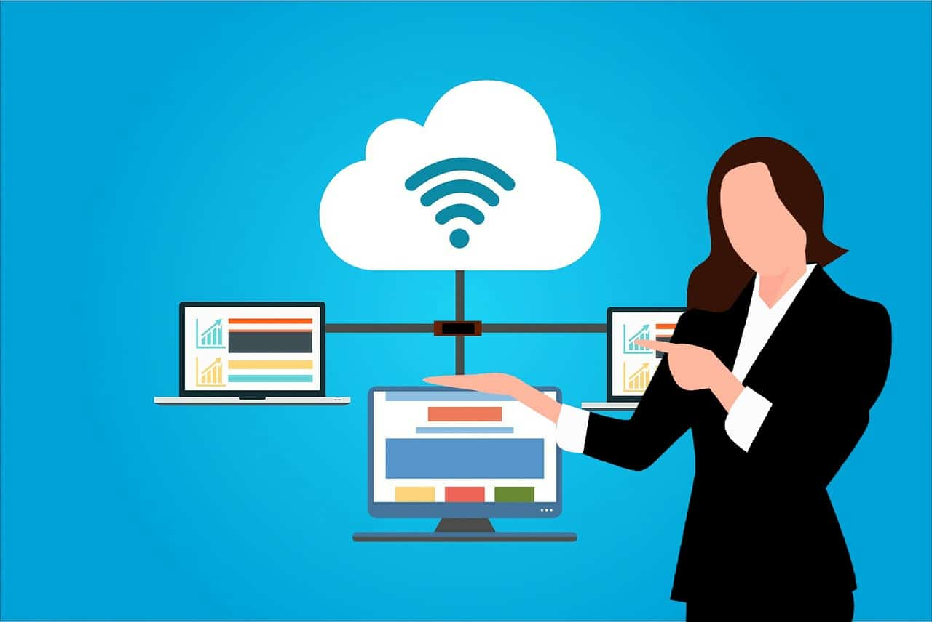
Maintenance of the functioning of information systems is a type of professional activity, thanks to which the stable operation of the software is ensured. It includes the organization of operation (software installation, configuration), as well as pre-configuration and changes (updating and revision if necessary).

Slide 4
Resource management involves the following actions:
assessment of the effectiveness of the functioning of the software;
installation and configuration of hardware and software;
correction at the software level of the found errors.

Slide 5
Benefits of providing services for the operation of information systems
prevention of occurrences of violations in applications, software update and remote management of them;
receiving requests from the client;
system health support;
diagnostics and troubleshooting;
quick response to emergencies and their solution.

Slide 6
The basic information system maintenance program includes:
Collecting information about the system;
Service specialists consultations;
Installation and configuration of hardware and software;
Correction of identified problems at the software level.

Slide 7
The extended information system maintenance program includes:
Continuous monitoring of the state of the information system;
Analysis and development of systemic and technical solutions for the optimization and development of the supported information system;
Solution of integration problems;
Installation and configuration of hardware and software;
Prevention of software malfunctions;
Correction of identified problems at the software level;
Reducing the risks of implementing the proposed solutions by checking them in the laboratory of the technical support center;

Slide 8
Operation of the Information System
Operation of the Information System
Operation includes work on the implementation of software components into operation, including configuration by Databases and user workplaces, provision of operational documentation, training of personnel, etc., and direct operation, including localization of problems and elimination of their causes, modification
Software within the established regulations, preparation of proposals for the improvement, development and modernization of the system.

Slide 9
Operation of the information system
- Includes:
1.System and applied maintenance of IS.
2. Technical support of hardware IC.
3.System support of information security means.
4. Organization of the educational process of IP users.
5. Execution of works on remote maintenance of ISs.
6. Purchase of components.
7. Modernization of IS in terms of modernization of existing functions.
8. Service maintenance.

Slide 10
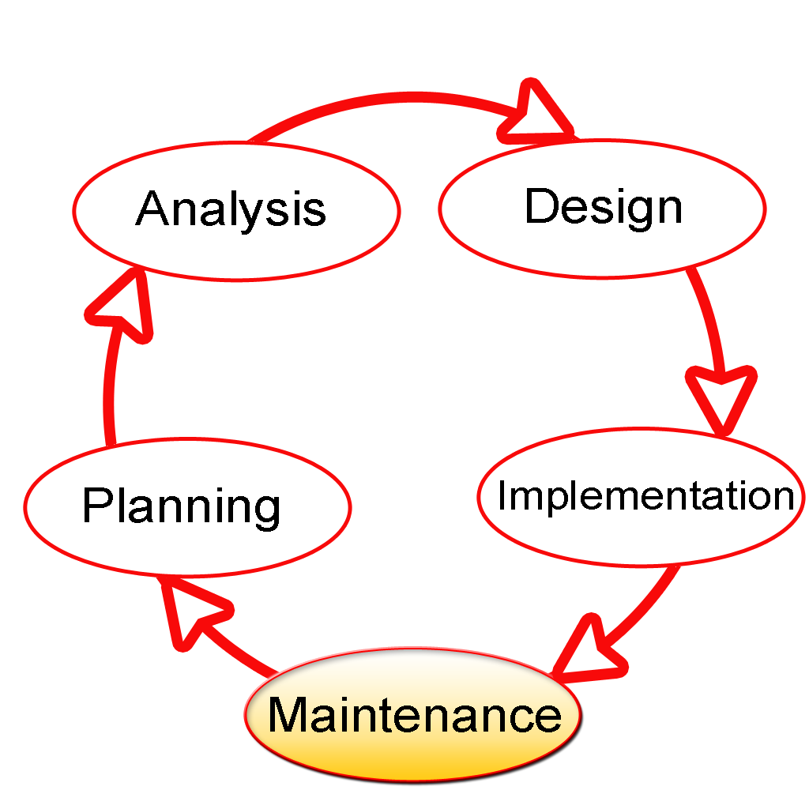
The life cycle of an Information System is a model for its creation and use. The model reflects various states of the information system, starting from the moment the need for this system arises and ending with the moment of its complete withdrawal from use by all users.

Slide 11
The four classes of information systems within the framework of the organization's information system:
key
auxiliary
strategic
potential

