Slide 1
Lec#6
The architecture of computer systems, common for example SOA, CORBA. Business-oriented systems on the example of ERP, CRM.

Slide 2
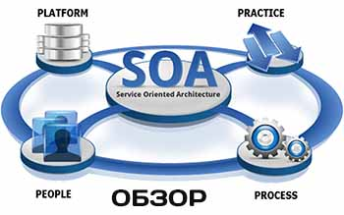
What is SOA, or service-oriented architecture?
SOA, or service-oriented architecture, defines a way to make software components reusable and interoperable via service interfaces. Services use common interface standards and an architectural pattern so they can be rapidly incorporated into new applications.

Slide 3
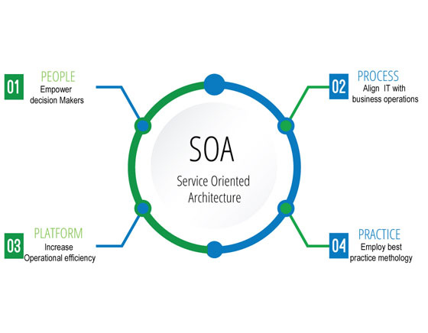
SOA
Code
Data

Slide 4
SOA represents an important stage in the evolution of application development and integration over the last few decades.

Slide 5
Benefits of SOA
Greater business agility; faster time to market
Ability to leverage legacy functionality in new markets
Improved collaboration between business and IT:

Slide 6
CORBA
The Common Object Request Broker Architecture (CORBA) is a standard developed by the Object Management Group (OMG) to provide interoperability among distributed objects. CORBA is the world's leading middleware solution enabling the exchange of information, independent of hardware platforms, programming languages, and operating systems.

Slide 7
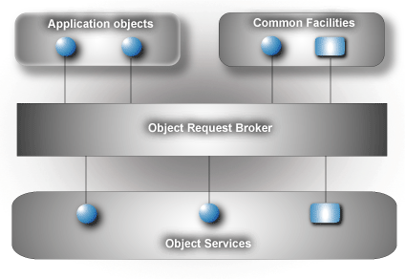

Slide 8
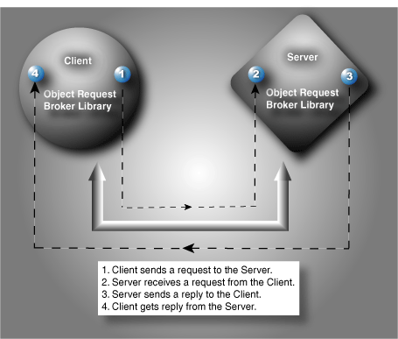

Slide 9
ERP system
Enterprise resource planning (ERP) refers to a type of software that organizations use to manage day-to-day business activities such as accounting, procurement, project management, risk management and compliance, and supply chain operations.
A complete ERP suite also includes enterprise performance management, software that helps plan, budget, predict, and report on an organization’s financial results.

Slide 10
ERP fundamentals
ERP systems are designed around a single, defined data structure (schema) that typically has a common database. This helps ensure that the information used across the enterprise is normalized and based on common definitions and user experiences. These core constructs are then interconnected with business processes driven by workflows across business departments (e.g. finance, human resources, engineering, marketing, operations), connecting systems and the people who use them. Simply put, ERP is the vehicle for integrating people, processes, and technologies across a modern enterprise.

Slide 11
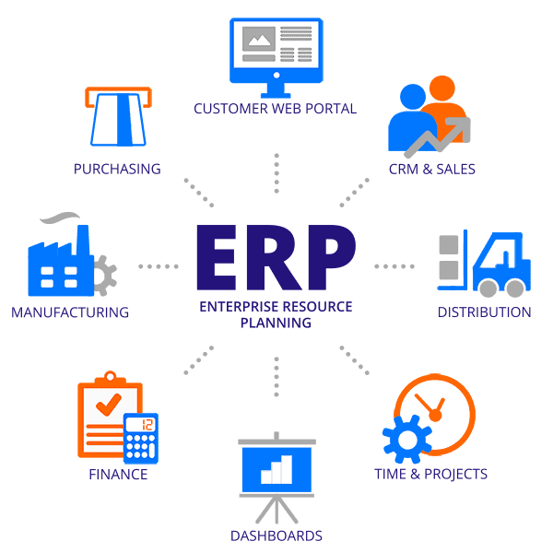

Slide 12
The business value of ERP
Improved business insight
Lower operational costs
Enhanced collaboration
Improved efficiency
Consistent infrastructure
Higher user-adoption rates
Reduced risk
Lower management and operational costs

Slide 13
CRM
Customer relationship management (CRM) is a technology for managing all your company’s relationships and interactions with customers and potential customers. The goal is simple: Improve business relationships to grow your business. A CRM system helps companies stay connected to customers, streamline processes, and improve profitability.

Slide 14
CRM software has been around since the mid-1990s, but has come into its own over the last decade. CRM platforms are powerful systems that connect all the data from your sales leads and customers all in one place. A CRM records and analyzes all calls, emails and meetings, helping improve customer service, drive sales, and increase revenue.

Slide 15
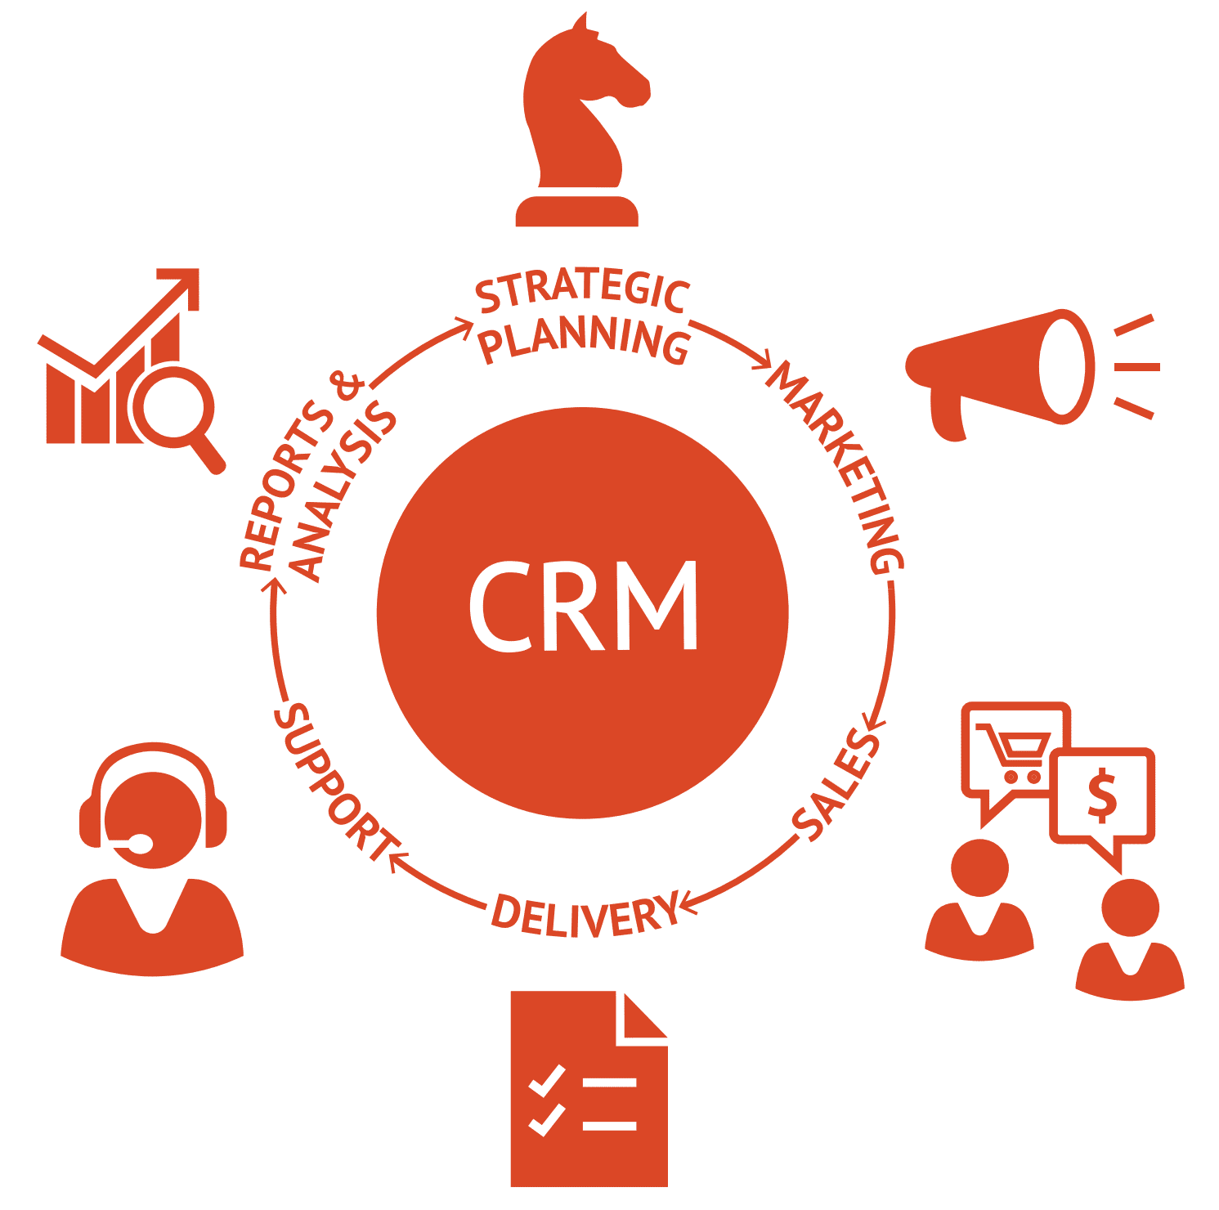

Slide 16
Benefits of CRM Software
The benefits of a CRM system are available to salespeople, marketing teams, customer support specialists, and anyone who comes in contact with customers at large companies as well as small businesses.

