Slide 1
Lec#3
IT infrastructure of the enterprise. Modern approaches to improving the IT infrastructure of an enterprise. Enterprise architecture development process

Slide 2
Plan:
Enterprise technology
Understanding the Enterprise IT Infrastructure
Key Components of Enterprise IT Infrastructure
Future Trends of Enterprise IT Infrastructure
Defining the DevOps Model

Slide 3
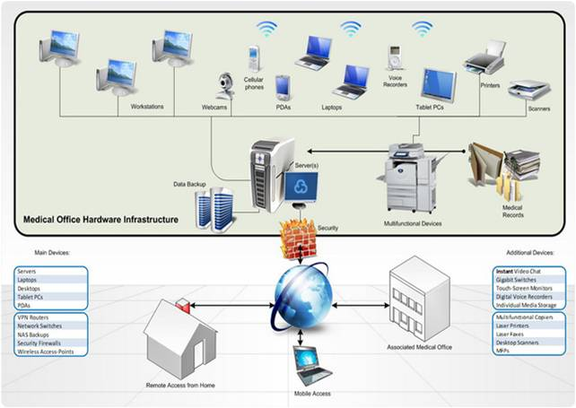
Enterprise technology and infrastructure refers to the concept of Information Technology (IT) where resources and data are shared across an enterprise.

Slide 4
Within this concept involves technical efforts such as infrastructure engineering for building, managing, and evolving shared IT or infrastructure operations for administering and monitoring the performance of the IT service being provided to the enterprise; IT services management; and information services management.

Slide 5
Understanding the Enterprise IT Infrastructure
Enterprise IT infrastructure refers to the composite hardware, software, network resources and services required for the existence, operation and management of an enterprise IT environment. It allows an organization to deliver IT solutions and services to its employees, partners and/or customers and is usually internal to an organization and deployed within owned facilities.

Slide 6
Key Components of Enterprise IT Infrastructure
IT infrastructure is composed of seven major components:
Computer hardware platforms
Operating system platforms
Enterprise and other software applications
Data management and storage
Networking and telecommunications platforms
Internet platforms
Consulting and system integration services

Slide 7
Future Trends of Enterprise IT Infrastructure
1.‘As-a-service’ consumption for everything from software to hardware.
2. Cybersecurity remains a major concern
3. Mainstream comfort with ‘white box’ hardware
4. DevOps for software and hardware
5. Artificial intelligence and machine-learning-optimized stacks

Slide 8
Defining the DevOps Model
DevOps is a combination of cultural principles, approaches and tools that improves the ability of companies to create applications and services at high speed.

Slide 9
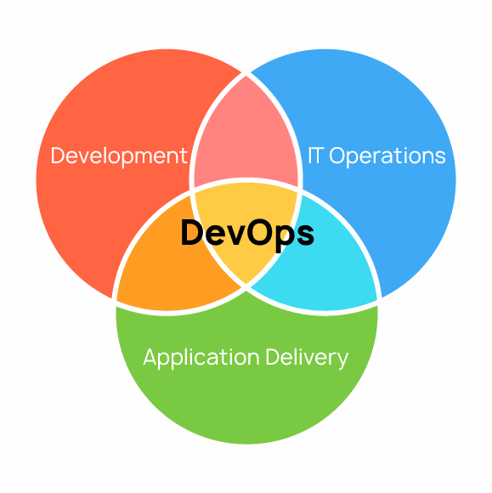
How DevOps works
With these tools, technicians can do things on their own that would normally require the help of other teams, such as deploying code or provisioning infrastructure, and further speed up the overall workflow.

Slide 10
Toolchains of DevOps
Coding – code development and review, source code management tools, code merging.
Building – continuous integration tools, build status.
Testing – continuous testing tools that provide quick and timely feedback on business risks.
Packaging – artifact repository, application pre-deployment staging.
Releasing – change management, release approvals, release automation.
Configuring – infrastructure configuration and management, infrastructure as code tools.
Monitoring – applications performance monitoring, end-user experience.

