Slide 1
Identification of SNP markers for grain quality traits in a barley collection (Hordeum vulgare L.) harvested in Kazakhstan
Genievskaya Yuliya, Almerekova Shyryn, Abugalieva Saule, Turuspekov Yerlan
Laboratory of Molecular Genetics
Institute of Plant Biology and Biotechnology

Slide 2
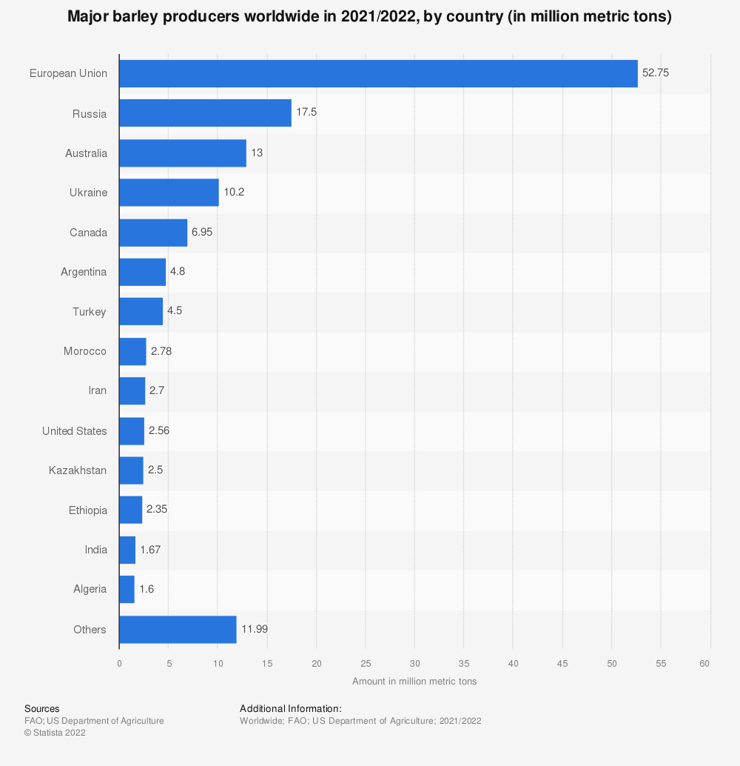
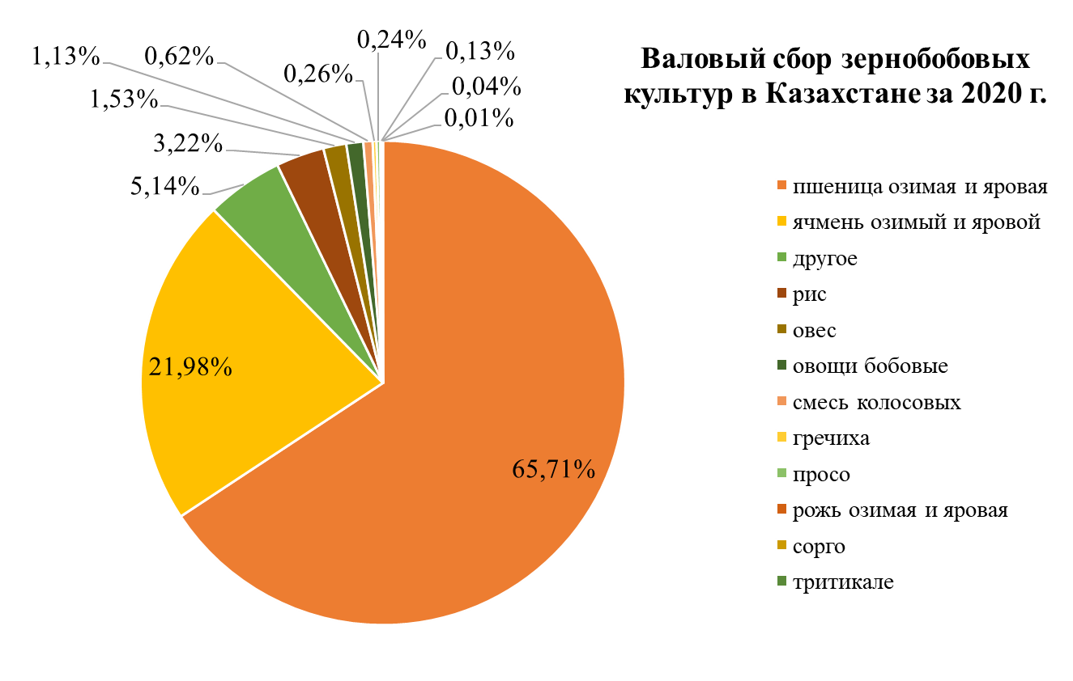
Major barley producers worldwide in 2021/2022, by country
(in million metric tons)
In Kazakhstan, barley is the second most important cereal after wheat;
Currently, Kazakhstan provides 0.8 million metric tons of barley to the international market;
The country is among the largest exporters of barley in the world.
European Union
52.75
Russia
17.5
Australia
13
Ukraine
10.2
Canada
6.95
Argentina
4.8
Türkiye
4.5
Morocco
2.78
Production of cereals and
legumes in Kazakhstan in 2021
Iran
2.7
2.56
USA
Spring and winter wheat
Kazakhstan
Spring and winter barley
2.5
Others
Ethiopia
2.35
Rice
India
Oat
1.67
Legume vegetables
Algeria
1.6
Mix of cereals
Others
Buckwheat
11.99
Millet
Spring and winter rye
Sorghum
Triticale

Slide 3
Basic steps of the study
Genome-wide association study (GWAS). Identification of significant associations between SNP markers alleles and phenotypic variations.
Selection of markers significantly associated with the traits of interest.
Transformation of SNP markers into KASP assays. Design of KASP primers.
Validation of KASP assays using previously non-genotyped material.
Phenotyping of barley collection for two years to assess grain quality traits in three regions of Kazakhstan.

Slide 4
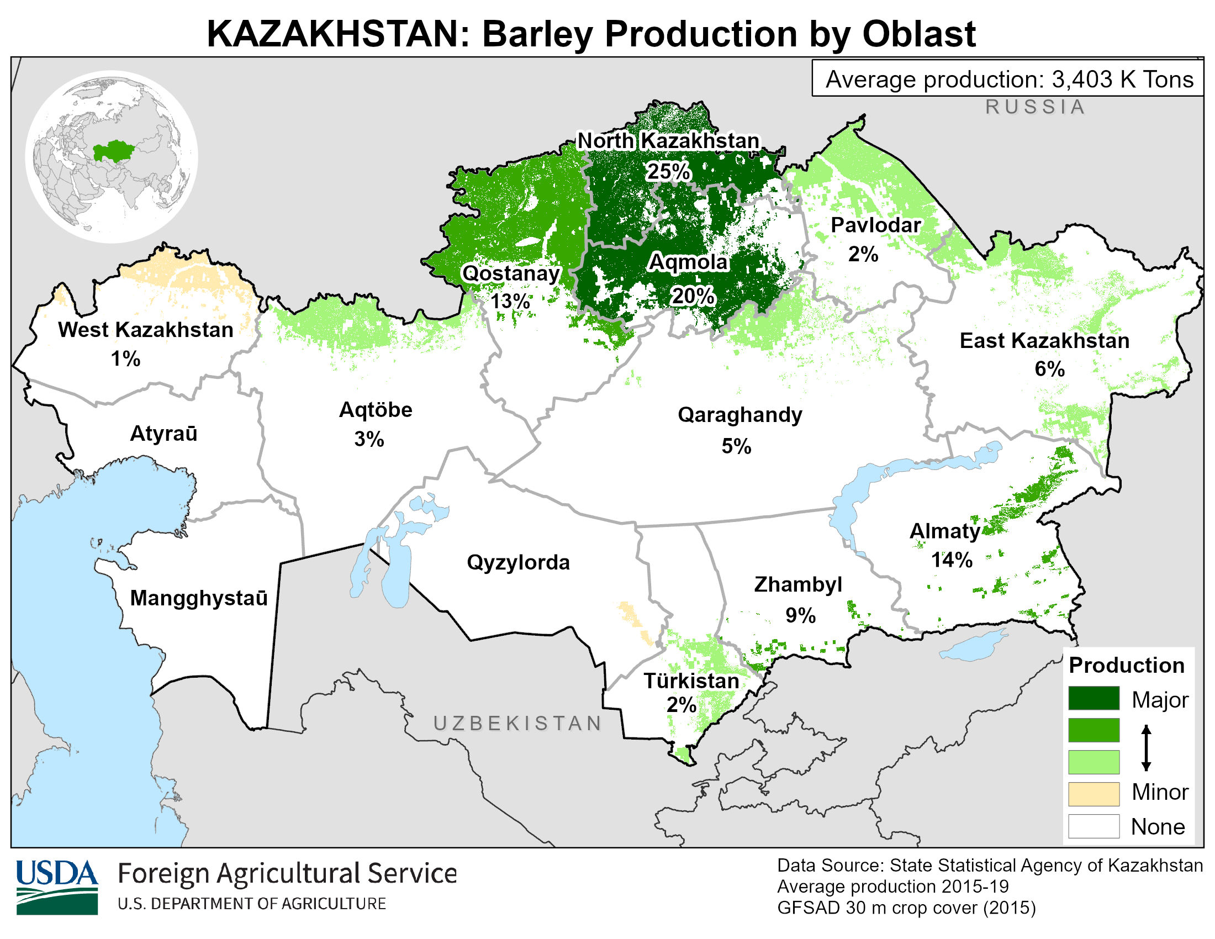
Materials and methods
Spring barley collection, including 557 2-R and 6-R accessions from the USA and 104 2-R accessions from Kazakhstan (661 accessions in total) grown in tree regions of Kazakhstan – Kostanay (north), Karaganda (center), and Kyzylorda (south) regions in 2010 and 2011 (Fig. 1).
Studied grain quality traits: content of raw protein (GPC, %), starch (GSC, %), grain test weight (TWL, g/L), and extractivity (GEX, %).
The GPC, GSC, and EX were measured using the NIRS DS2500 Grain Analyzer (FOSS, Hillerød, Denmark), with the calibration supplied by the manufacturer. TWL was determined according to the guide provided by the Canadian Grain Commission (www.grainscanada.gc.ca).
The collection was genotyped using barley iSelect 9K SNP array resulted in 2,344 polymorphic markers.
GAPIT for R software package were used for GWAS analyses (MLM model).
The collection of 34 promising spring barley lines was used for KASP genotyping and validation.
Karabalyk Agricultural Experimental
Station (KB)
Karaganda Agricultural Experimental
Station (KA)
I. Zhakhaev Kazakh Research Institute of Rice Growing (KO)
Figure 1 – Barley-producing regions of Kazakhstan and experimental fields used in the study.

Slide 5
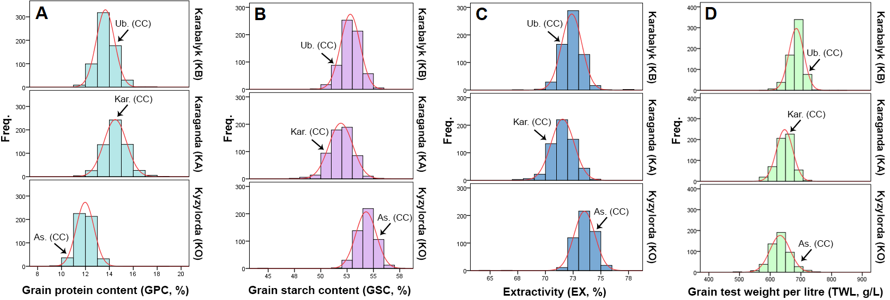
Step 1. Phenotyping of barley collection
Figure 2. Average values over two years of grain quality traits of the collection harvested in three regions. (A) Grain protein content (GPC,%). (B) Grain starch content (GSC,%). (C) Extractivity (EX,%). (D) Grain test weight per liter (TWL, g/L). Freq.—frequency; CC—check cultivar; Ub.—Ubagan—check cultivar of KB; Kar.—Karagandinsky 5—check cultivar of KA; As.—Assem—check cultivar of KO

Slide 6
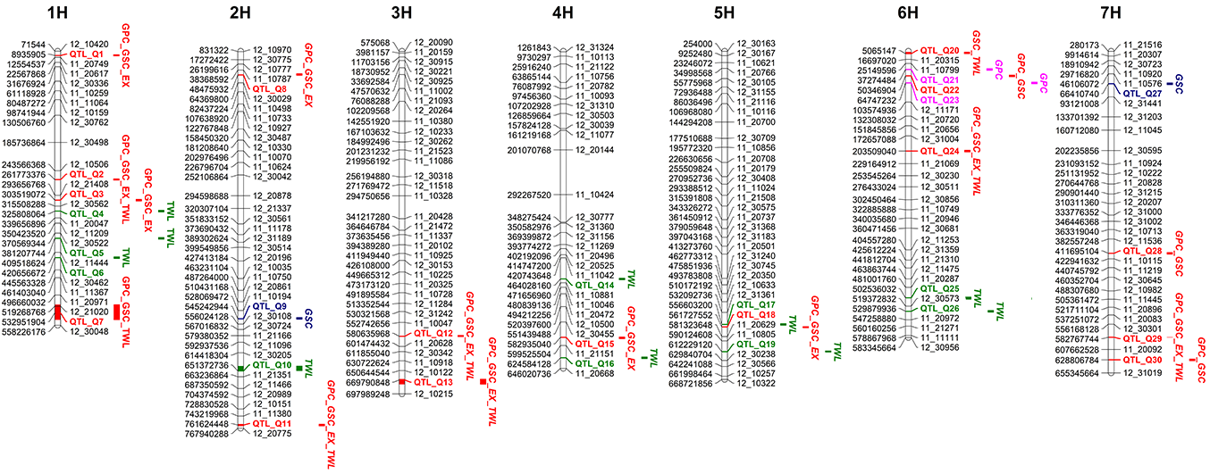
Step 2. Genome-wide association study (GWAS)
As a result of the GWAS analysis, 76 associations between grain quality traits and SNP markers were detected on all seven chromosomes (p-values < 0.001).
The linked MTAs (LD (r2) > 0.1) were grouped together, resulting in 30 QTLs in total (Fig. 3).
Figure 3. The positions of QTLs associated with barley grain quality traits on the genetic map. The names of SNPs and QTLs are shown on the right, and the positions of the loci are shown on the left of the linkage maps as base pairs (bp). The QTLs identified in this study are highlighted in blue for grain starch content, pink for grain protein content, green for grain test weight, and red for multi-trait QTLs. GPC—grain protein content; GSC—grain starch content; EX—extractivity; TWL—grain test weight.

Slide 7
Step 3. Selection of markers significantly associated with the traits of interest
For 25 out of 30 QTLs, possible candidate genes and/or QTLs from literature were found. SNP markers with high significance were chosen for further validation (Table 1).
Table 1. List of the most significant marker–trait associations (p < 2.6× 10⁻⁵ and FDR-adjusted p < 0.05) for grain quality traits. Novel QTLs are indicated in bold.
# of MTA | QTL | KASP assay | Trait | SNP | Chr. | Pos. (bp) | p-Value | FDR Adjusted p-Value | R² | Allele | Effect
1 | QTL_Q2 | ipbb_hv_116 | GPC | 11_11336 | 1H | 261,773,377 | 6.37×10⁻⁶ | 0.0039 | 0.023 | A | 0.495
2 |  |  | GSC |  |  |  | 1.03×10⁻⁴ | 0.0396 | 0.019 | G | 0.565
3 | QTL_Q8 | - | GSC | 11_10178 | 2H | 48,475,931 | 7.64×10⁻⁵ | 0.0367 | 0.020 | G | 0.455
4 | QTL_Q12 | ipbb_hv_6 | GPC | 11_21505 | 3H | 580,635,994 | 2.14×10⁻⁶ | 0.0021 | 0.026 | A | 0.590
5 |  |  | TWL |  |  |  | 1.15×10⁻⁷ | 0.0002 | 0.035 | A | 20.275
6 |  |  | GSC |  |  |  | 6.01×10⁻⁵ | 0.0367 | 0.021 | G | 0.647
7 | QTL_Q13 | ipbb_hv_119 | GPC | 11_10935 | 3H | 678,512,385 | 1.25×10⁻⁴ | 0.0482 | 0.017 | C | 0.391
8 |  |  | TWL |  |  |  | 2.75×10⁻⁷ | 0.0003 | 0.033 | C | 16.244
9 | QTL_Q20 | - | TWL | 11_20886 | 6H | 53,62,408 | 4.96×10⁻⁵ | 0.0190 | 0.020 | A | 8.744
10 | QTL_Q24 | ipbb_hv_7 | EX | 12_31509 | 6H | 203,509,034 | 7.21×10⁻⁶ | 0.0138 | 0.027 | A | 0.656
11 |  |  | GPC |  |  |  | 9.10×10⁻⁸ | 0.0002 | 0.033 | G | 0.664
12 |  |  | TWL |  |  |  | 3.53×10⁻⁶ | 0.0017 | 0.027 | G | 17.627
13 |  |  | GSC |  |  |  | 2.40×10⁻⁶ | 0.0046 | 0.029 | A | 0.759
14 | QTL_Q29 | ipbb_hv_128 | GPC | 11_21103 | 7H | 582,767,743 | 8.17×10⁻⁶ | 0.0039 | 0.023 | A | 0.494
15 |  |  | TWL |  |  |  | 1.85×10⁻⁶ | 0.0012 | 0.028 | A | 16.331
16 |  |  | GSC |  |  |  | 5.26×10⁻⁵ | 0.0367 | 0.021 | G | 0.591
Chr., chromosome; Pos., physical position on the chromosome; FDR, false discovery rate; R2, phenotypic variation explained by the MTA; GPC, grain protein content (%); GSC, grain starch content (%); EX, extractivity (%); TWL, grain test weight per liter (%).

Slide 8
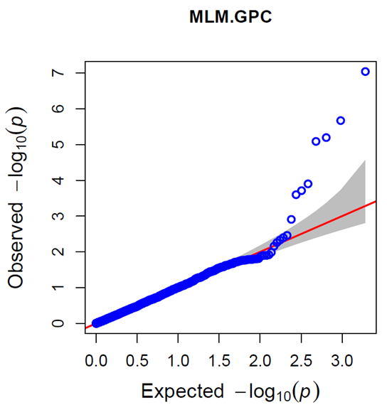
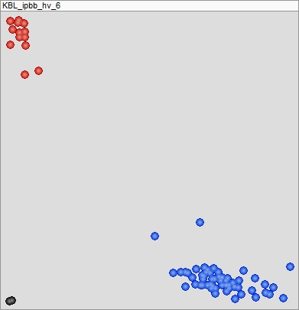
Step 4. Transformation of SNP markers into KASP assays
A
B
C
Genotype AA
11_21505
11_21505
Genotype GG
Figure 4. Flowchart of the development of KASP assay. (A) Quantile-quantile (QQ) plot of significantly associated SNPs from GWAS. (B) Manhattan plot of significantly associated SNPs. (C) KASP plot with the results of new material genotyping.
Table 2. The list of KASP assays for SNP markers associated grain quality traits.
SNP | KASP | Chr. | Allele 1 | Allele 2 | Allele 1 primer (forward) | Allele 2 primer (forward) | Common primer (reverse)
11_21505 | ipbb_hv_6 | 3H | A | G | GAAGGTTGGACTGGCCCTGCGGA | GAAGGTTGGACTGGCCCTGCGGG | TCAGGCCATCCTTATCGGCCCATT
12_31509 | ipbb_hv_7 | 6H | C | T | TTTGGTTGGGAGTTTTGCTTC | TTTGGTTGGGAGTTTTGCTTT | CAGCACCCTTTAGTACTCTCCCTCC
11_11336 | ipbb_hv_116 | 1H | A | G | TCAGCTACGTAGTGTTACAATACA | TCAGCTACGTAGTGTTACAATACG | GGGAAATGCAAGAGAACAGTGT
11_10935 | ipbb_hv_119 | 3H | A | C | TCCCAGATGGCCTGCACA | TCCCAGATGGCCTGCACC | ACGATGACGCCTCTCTTCAC
11_21103 | ipbb_hv_128 | 7H | T | C | GTGGTTGCTGGTGGTGGT | GTGGTTGCTGGTGGTGGC | ACTCCGTCAAGAAGAGGCTC

Slide 9
Table 3. Effect of genotypes on grain quality traits in the 34 tested barley breeding lines
2020
ipbb_hv_6 (chromosome 3H) | p-value | Genotype | N | Mean | SD | Effect
Grain protein content (GPC,%) | 3.47×10⁻⁴ | A:A | 6 | 11.45 | 0.23 | −1.15%
 |  | G:G | 28 | 12.60 | 1.44 | +1.15%
Grain starch content (GSC,%) | 1.23×10⁻⁵ | A:A | 6 | 61.27 | 0.45 | +1.71%
 |  | G:G | 28 | 59.56 | 1.19 | −1.71%
Extractivity (EX,%) | 2.88×10⁻⁴ | A:A | 6 | 78.32 | 0.42 | +1.10%
 |  | G:G | 28 | 77.22 | 0.84 | −1.10%
ipbb_hv_128 (chromosome 7H) | p-value | Genotype | N | Mean | SD | Effect
Grain protein content (GPC,%) | 0.005 | T:T | 5 | 11.64 | 0.25 | −0.89%
 |  | C:C | 29 | 12.53 | 1.45 | +0.89%
Grain starch content (GSC,%) | 0.016 | T:T | 5 | 60.95 | 0.76 | +1.26%
 |  | C:C | 29 | 59.69 | 1.27 | −1.26%
2021
ipbb_hv_6 (chromosome 3H) | p-value | Genotype | N | Mean | SD | Effect
Grain protein content (GPC,%) | 9.16×10⁻⁵ | A:A | 6 | 12.60 | 0.83 | −2.60%
 |  | G:G | 28 | 15.20 | 1.10 | +2.60%
Grain starch content (GSC,%) | 5.89×10⁻⁵ | A:A | 6 | 62.13 | 0.53 | +2.05%
 |  | G:G | 28 | 60.08 | 0.78 | −2.05%
Extractivity (EX,%) | 1.14×10⁻⁵ | A:A | 6 | 78.65 | 0.30 | +0.93%
 |  | A:A | 28 | 77.72 | 0.69 | −0.93%
MEAN
ipbb_hv_6 (chromosome 3H) | p-value | Genotype | N | Mean | SD | Effect
Grain protein content (GPC,%) | 4.69×10⁻⁶ | A:A | 6 | 12.03 | 19.80 | −1.87%
 |  | G:G | 28 | 13.90 | 31.69 | +1.87%
Grain starch content (GSC,%) | 5.38×10⁻⁸ | A:A | 6 | 61.70 | 0.36 | +1.87%
 |  | G:G | 28 | 59.83 | 0.81 | −1.87%
Extractivity (EX,%) | 4.85×10⁻⁵ | A:A | 6 | 78.48 | 0.33 | +0.99%
 |  | G:G | 28 | 77.49 | 0.68 | −0.99%
ipbb_hv_128 (chromosome 7H) | p-value | Genotype | N | Mean | SD | Effect
Grain starch content (GSC,%) | 0.037 | T:T | 5 | 61.24 | 0.96 | +1.27%
 |  | C:C | 29 | 59.97 | 0.94 | −1.27%
Step 5. Validation of KASP assays
Figure 5. KASP plots of five SNPs associated with grain quality traits. (A) ipbb_hv_6. (B) ipbb_hv_7. (C) ipbb_hv_116. (D) ipbb_hv_119. (E) ipbb_hv_128. Red and blue dots denote genotypes and black dots are negative control (H2O)

Slide 10
Conclusions
Generally, studied barley collection had demonstrated high levels of variation in grain protein and starch content, as well as highly variable extractivity and test weight in all three regions of Kazakhstan. Phenotypic data provided sufficient variability for the GWAS.
Seventy-six MTAs were identified in the GWAS on all 7 barley chromosomes for all studied grain quality traits. They were unified in 30 significant QTLs, considering the pleiotropic effect and genetic linkage of several markers. Five of pleiotropic QTLs with the highest significance (p < 2.6×10⁻⁵ and FDR-adjusted p < 0.05) were selected for KASP assays development.
Validation of 7 KASP assays, which were associated with grain protein content, starch content and grain test weight in the GWAS, confirmed associations of two assays – ipbb_hv_6 (chromosome 3H) and ipbb_hv_128 (chromosome 7H) .
KASP assays associated with key barley grain quality traits may be used for rapid and relatively cheap identification of promising germplasm. While other QTLs detected in different regions of Kazakhstan have a potential usage for local barley breeding programs.
This study was supported by the grant AP08052804 “Development and validation of KASP arrays efficiency for key productivity and grain quality traits in two-rowed spring barley” from the Ministry of Education and Science of the Republic of Kazakhstan.
Results were reported in the “Agronomy” journal (Genievskaya Y., Almerekova S., Abugalieva S., Chudinov V., Blake T., Abugalieva A., Turuspekov Y. Identification of SNP markers associated with grain quality traits in a barley collection (Hordeum vulgare L.) harvested in Kazakhstan. Agronomy. 2022. V. 12. P. 2431).

Slide 11
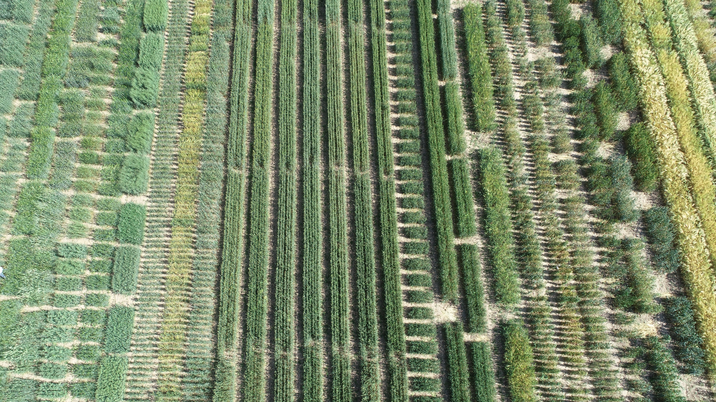
Thank you for your attention!

