Slide 1

In honor of Dr. Zarema Biyasheva, January 26, 2023
It is remarkable to continue working later in life to stay socially
engaged, mentally sharp and pursue life passions.
May you always stay happy and healthy!
Happy Birthday!

Slide 2
Soybean genetics and genomics on seed value traits and disease resistance.
By Ruslan Biyashev
January 26, 2023

Slide 3
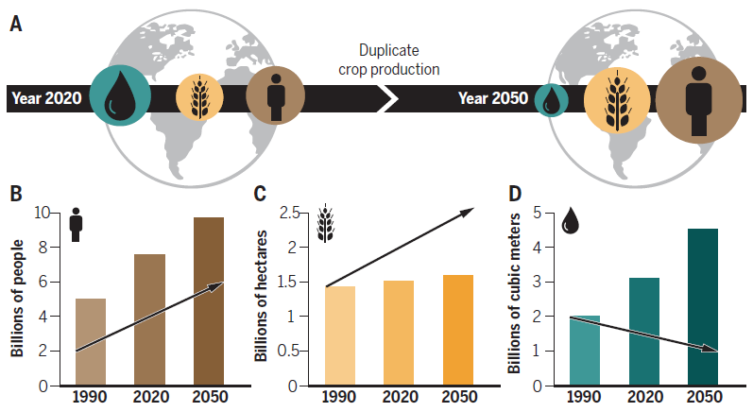
Past, present, and future of global climate, agriculture, and food security
(A) Most scenarios predict that water scarcity will increase in the coming years. With the world’s population continuously growing, crop production must also increase to fulfill civilization’s basic needs. For this purpose, plants must become more water efficient. (B) Estimated world population for the 1990–2050 time period. The arrow indicates the estimated number of people living in water-scarce areas. (C) Global arable land for agriculture for the 1990–2050 time period. The arrow indicates the predicted demand for arable land to ensure food security, given the current rates of crop production per hectare. (D) Global freshwater demand for agriculture for the 1990–2050 time period. The arrow indicates the predicted decline in freshwater availability for agriculture, given the current trends for climate change and precipitation.
Gupta et al., 2020

Slide 4
Impact of diseases on soybean production
The remarkable growth in the number of major diseases and their area has been observed in the past 50 years.
The impact of diseases on soybean can be measured by average annual economic loss due to diseases in the USA nearly $4.6 billion.
There has been considerable focus on the seedling diseases caused by oomycete pathogens, such as Phytophthora sojae and numerous Pythium species.

Slide 5
Soybean is an important legume crop
Soybean fulfills the substantial demand for food and feed globally.
It is high in seed protein and oil content.
About 70% of soybean economic value is for its meal, of which 97% is consumed as livestock and poultry feed.
Globally, soybean is grown in an area of 126.6 million hectares with an annual average production of 336.6 million tons.
The leading producers of soybean are Brazil, the USA, China, Argentina and India.

Slide 6
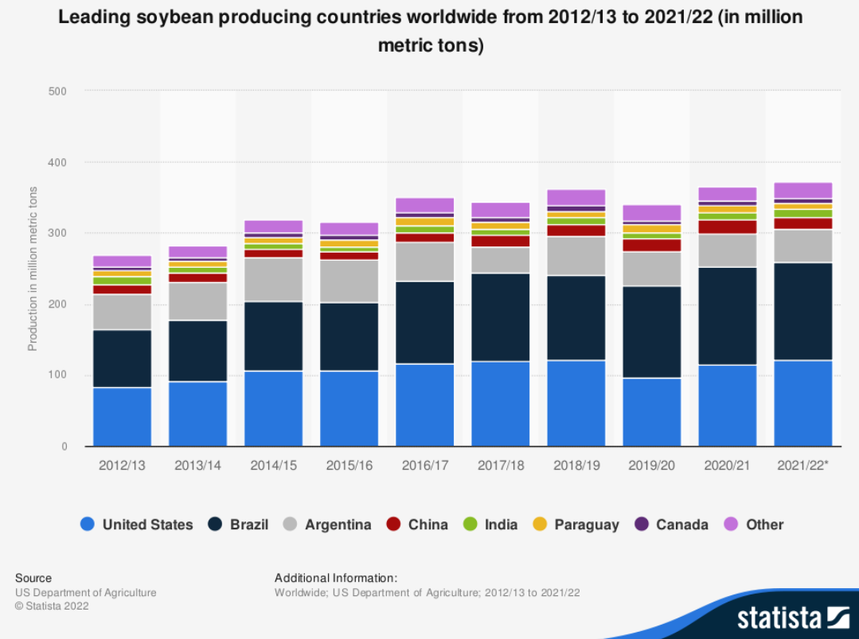

Slide 7
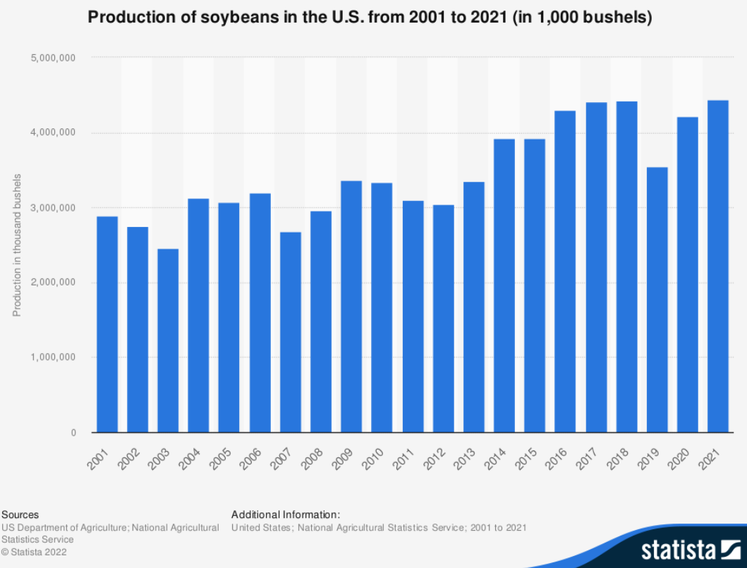
1 bushel of soy=27.22 kg

Slide 8
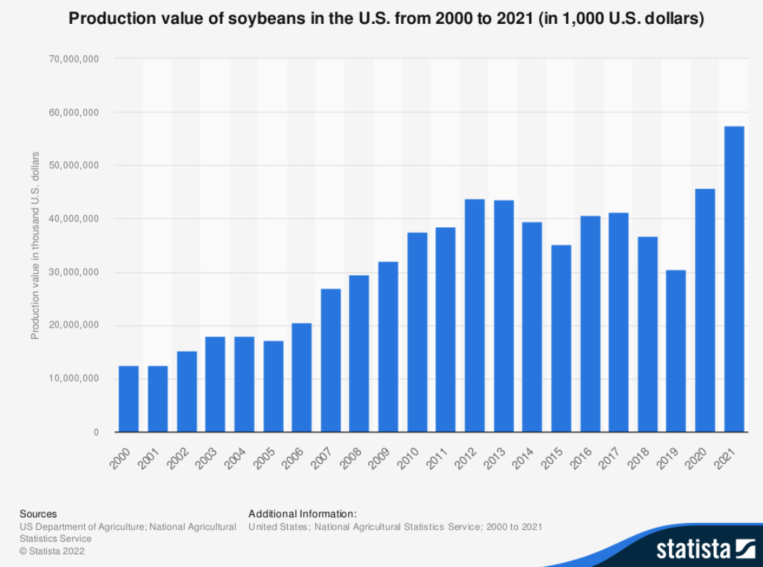

Slide 9
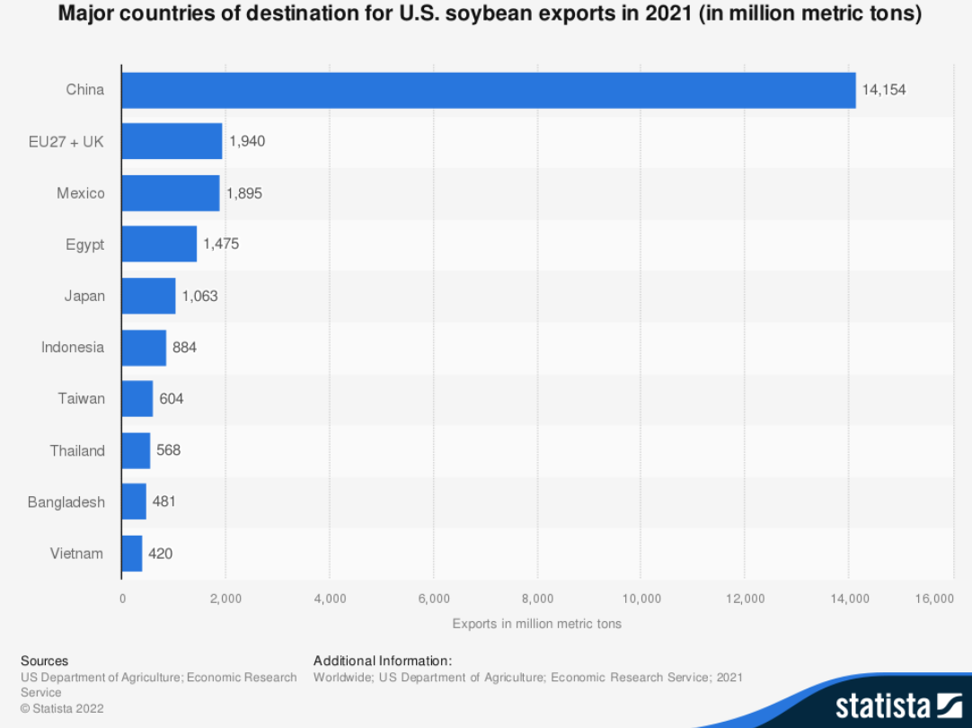

Slide 10
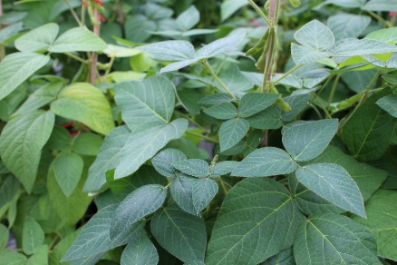
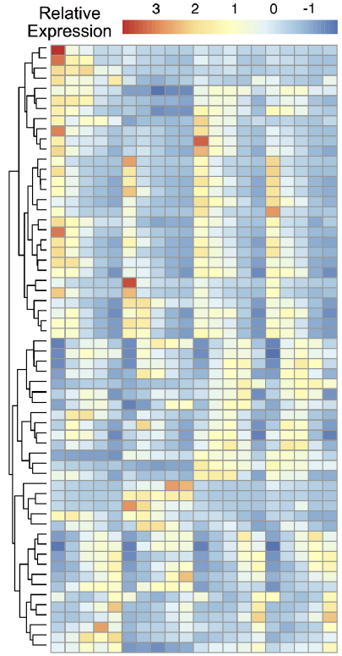
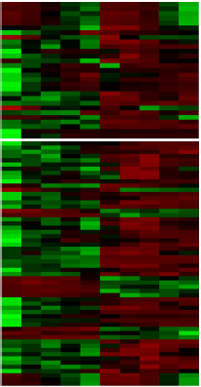
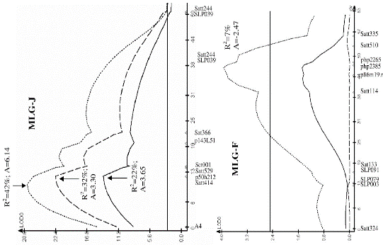
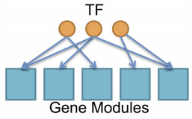
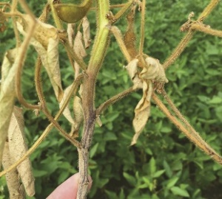
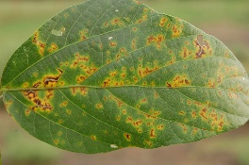
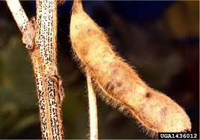
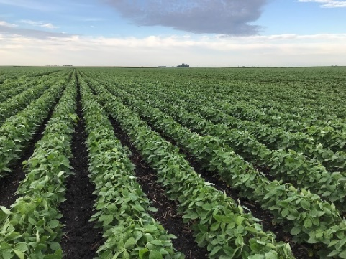
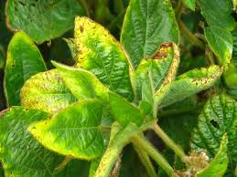
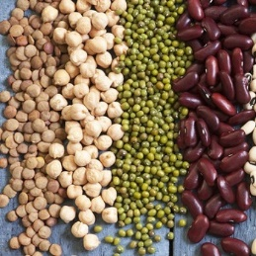
Source of
resistance
GWAS
Mapping
populations
RILs, NILs
Markers
DNA/RNA
sequencing
and analyses
Markers
QTL
detection
Genotyping
by sequencing
Markers
Markers
Resistant gene
network analysis
Markers
eQTL
Introgress
into elite
germplasm
Functional analysis
of candidate genes
Perfect markers-targets for CRISPR/CAS9

Slide 11
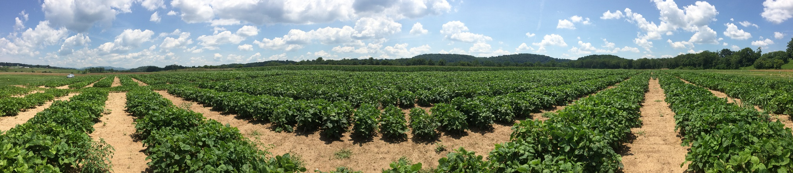
Experimental procedure
Soybean populations
Field observation
Collect marker data
Harvest seed
Construct linkage map
Combine genetic, sequence and trait data – QTL analysis and gene discovery
Analyze composition traits
genomics
bioinformatics
phenomics
agronomics

Slide 12
Most typical mapping populations:
Parent A Parent B
Genotype AA x BB
MapMaker symbol [A] [B]
F1 [AB]
H Haploids
Cross to parent B
Self ≥5X
Doubling with
colchicine
Self
BC1F1 F2 RILs DHs
[AB] [BB] [AA] [AB] [BB] [AA] [BB] [AA] [BB]
H B A H B A B A B

Slide 13
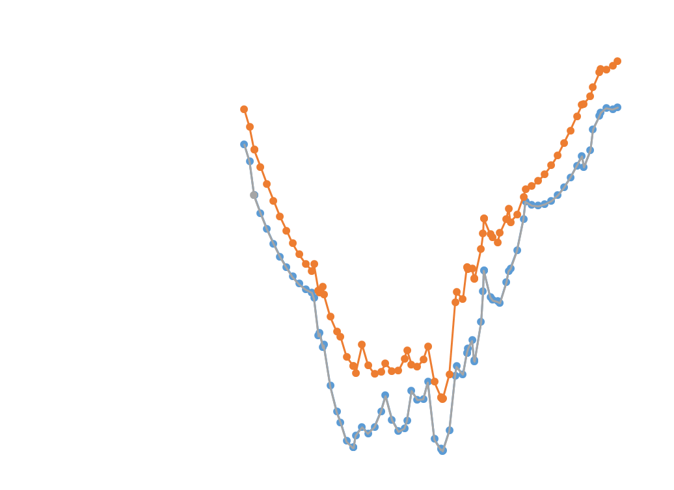
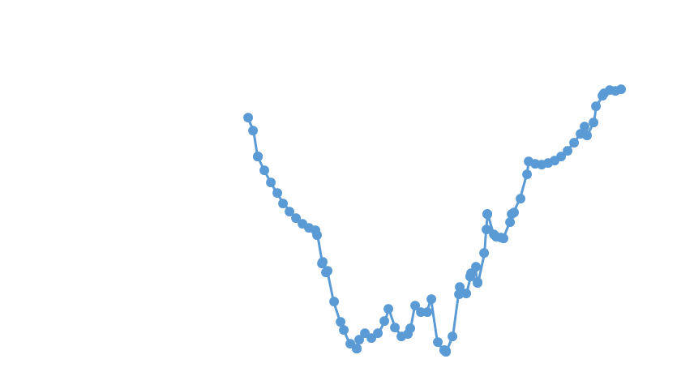
Identification of QDR Loci for three
Pythium Species in Soybean
8284689 | 8288765 | Glyma.08g107700 | LEUCINE-RICH REPEAT RECEPTOR-LIKE PROTEIN KINASE
8968563 | 8975029 | Glyma.08g116600 | LEUCINE-RICH REPEAT RECEPTOR-LIKE PROTEIN KINASE
9019800 | 9023179 | Glyma.08g117000 | LEUCINE-RICH REPEAT RECEPTOR-LIKE PROTEIN KINASE
9192002 | 9196512 | Glyma.08g119200 | LRR and NB-ARC domains-containing disease resistance protein
9269694 | 9276831 | Glyma.08g120300 | LEUCINE-RICH REPEAT RECEPTOR-LIKE PROTEIN KINASE

Slide 14
Protein-Oil QTL
Regional map of chr. 2
Protein-Oil QTL
Regional map of chr. 15
251.5
GBS02_45347921K
GBS02_45366600K
20.1
GBS15_2513726
252.0
Gm02_46855228_G_A
20.5
GBS15_2737468
253.7
Gm02_47125519_G_A
20.9
GBS15_2772035
Gm15_2729636_A_C
253.9
GBS02_45826999
21.1
GBS15_2659397
GBS15_2776883
254.2
GBS02_45854718K
21.3
GBS15_2606582
254.8
GBS02_45826864K
Gm02_47064977_G_A
21.4
Gm15_2781077_T_C
255.9
Gm02_47314350_T_C
26.5
GBS15_3114687
256.2
GBS02_46068736
26.6
Gm15_3160423_T_G
GBS15_3115107
256.4
Gm02_47394316_A_G
GBS02_46134474K
26.7
GBS15_3115087
GBS02_46081454K
29.0
Gm15_3334810_G_T
257.7
Sat_183
32.4
Gm15_3468596_G_T
258.7
GBS02_46121284K
34.7
GBS15_3658418
259.2
Gm02_47515175_G_A
35.4
GBS15_3606728
GBS15_3657980
259.7
GBS02_46303869
BARCBARCSOYSSR_02_1623
36.0
Gm15_3573558_A_G
260.1
GBS02_46356322
36.1
GBS15_3736202
260.7
GBS02_46303834
36.2
Gm15_3621773_C_T
GBS15_3658223
261.1
GBS02_46380557K
36.4
Gm15_3845971_T_C
261.8
Gm02_47790307_C_T
36.9
GBS15_3943287
GBS15_3919636
262.9
BARCSOYSSR_02_1627
37.3
GBS15_3886506
265.4
BARCSOYSSR_02_1645
37.5
GBS15_3889235
269.3
Gm02_48248895_A_C
Gm02_48185680_G_A
37.8
Gm15g49200_CC
Max LOD region for
seed protein and oil
content on chr. 15
GBS02_46929767K
39.6
GBS15_4120851
270.2
Satt274
Max LOD region for
seed protein and oil
content on chr. 2
Gm15_3967324_A_G
GBS15_4143366
272.1
GBS02_47122206K
Gm02_48382122_G_A
39.9
GBS15_4030717
GBS15_4145893
Satt459
40.0
GBS15_4151097
275.6
BARCSOYSSR_02_1672
BARCSOYSSR_02_1674
40.2
GBS15_4029740
278.2
Gm02_48583877_A_C
40.5
GBS15_4125045
278.4
BARCSOYSSR_02_1680
40.7
GBS15_4125279
279.9
Gm02_48702118_T_G
41.2
GBS15_4125304
280.1
GBS02_47440443K
41.5
Gm15_4114622_T_C
280.6
BARCSOYSSR_02_1684
41.6
GBS15_4125184K
281.1
GBS02_47432297K
42.4
Satt384
283.1
BARCSOYSSR_02_1685
43.5
BARCSOYSSR_15_0200
293.0
GBS02_48182062
45.0
GBS15_3975982K
293.1
GBS02_48472387
45.1
GBS15_4056831
293.5
GBS02_48129094
49.2
Gm15_4522374_C_A
293.9
Gm02_49388210_T_G
50.7
GBS15_4617109K
295.2
Staga002
51.8
GBS15_4505831K
GBS15_4489762K
297.9
Gm02_49727178_A_C
298.5
GBS02_48418381
298.6
GBS02_48252114
GBS02_48282552
298.7
GBS02_48282500
61.0
GBS15_5930469
298.8
GBS02_48167149
61.5
GBS15_5864418
299.0
GBS02_48251972
61.7
Gm15_5924951_A_G
299.2
GBS02_48252607
61.8
GBS15_6166100
299.3
GBS02_48347005
62.4
GBS15_5897866
299.4
GBS02_48321862
62.9
GBS15_5897826
299.5
Gm02_49540930_T_C
(Sat_289)
299.7
GBS02_48230552
299.8
GBS02_48406180
300.1
GBS02_48105672
300.2
GBS02_48114832
Figure 1.
Figure 2.

Slide 15
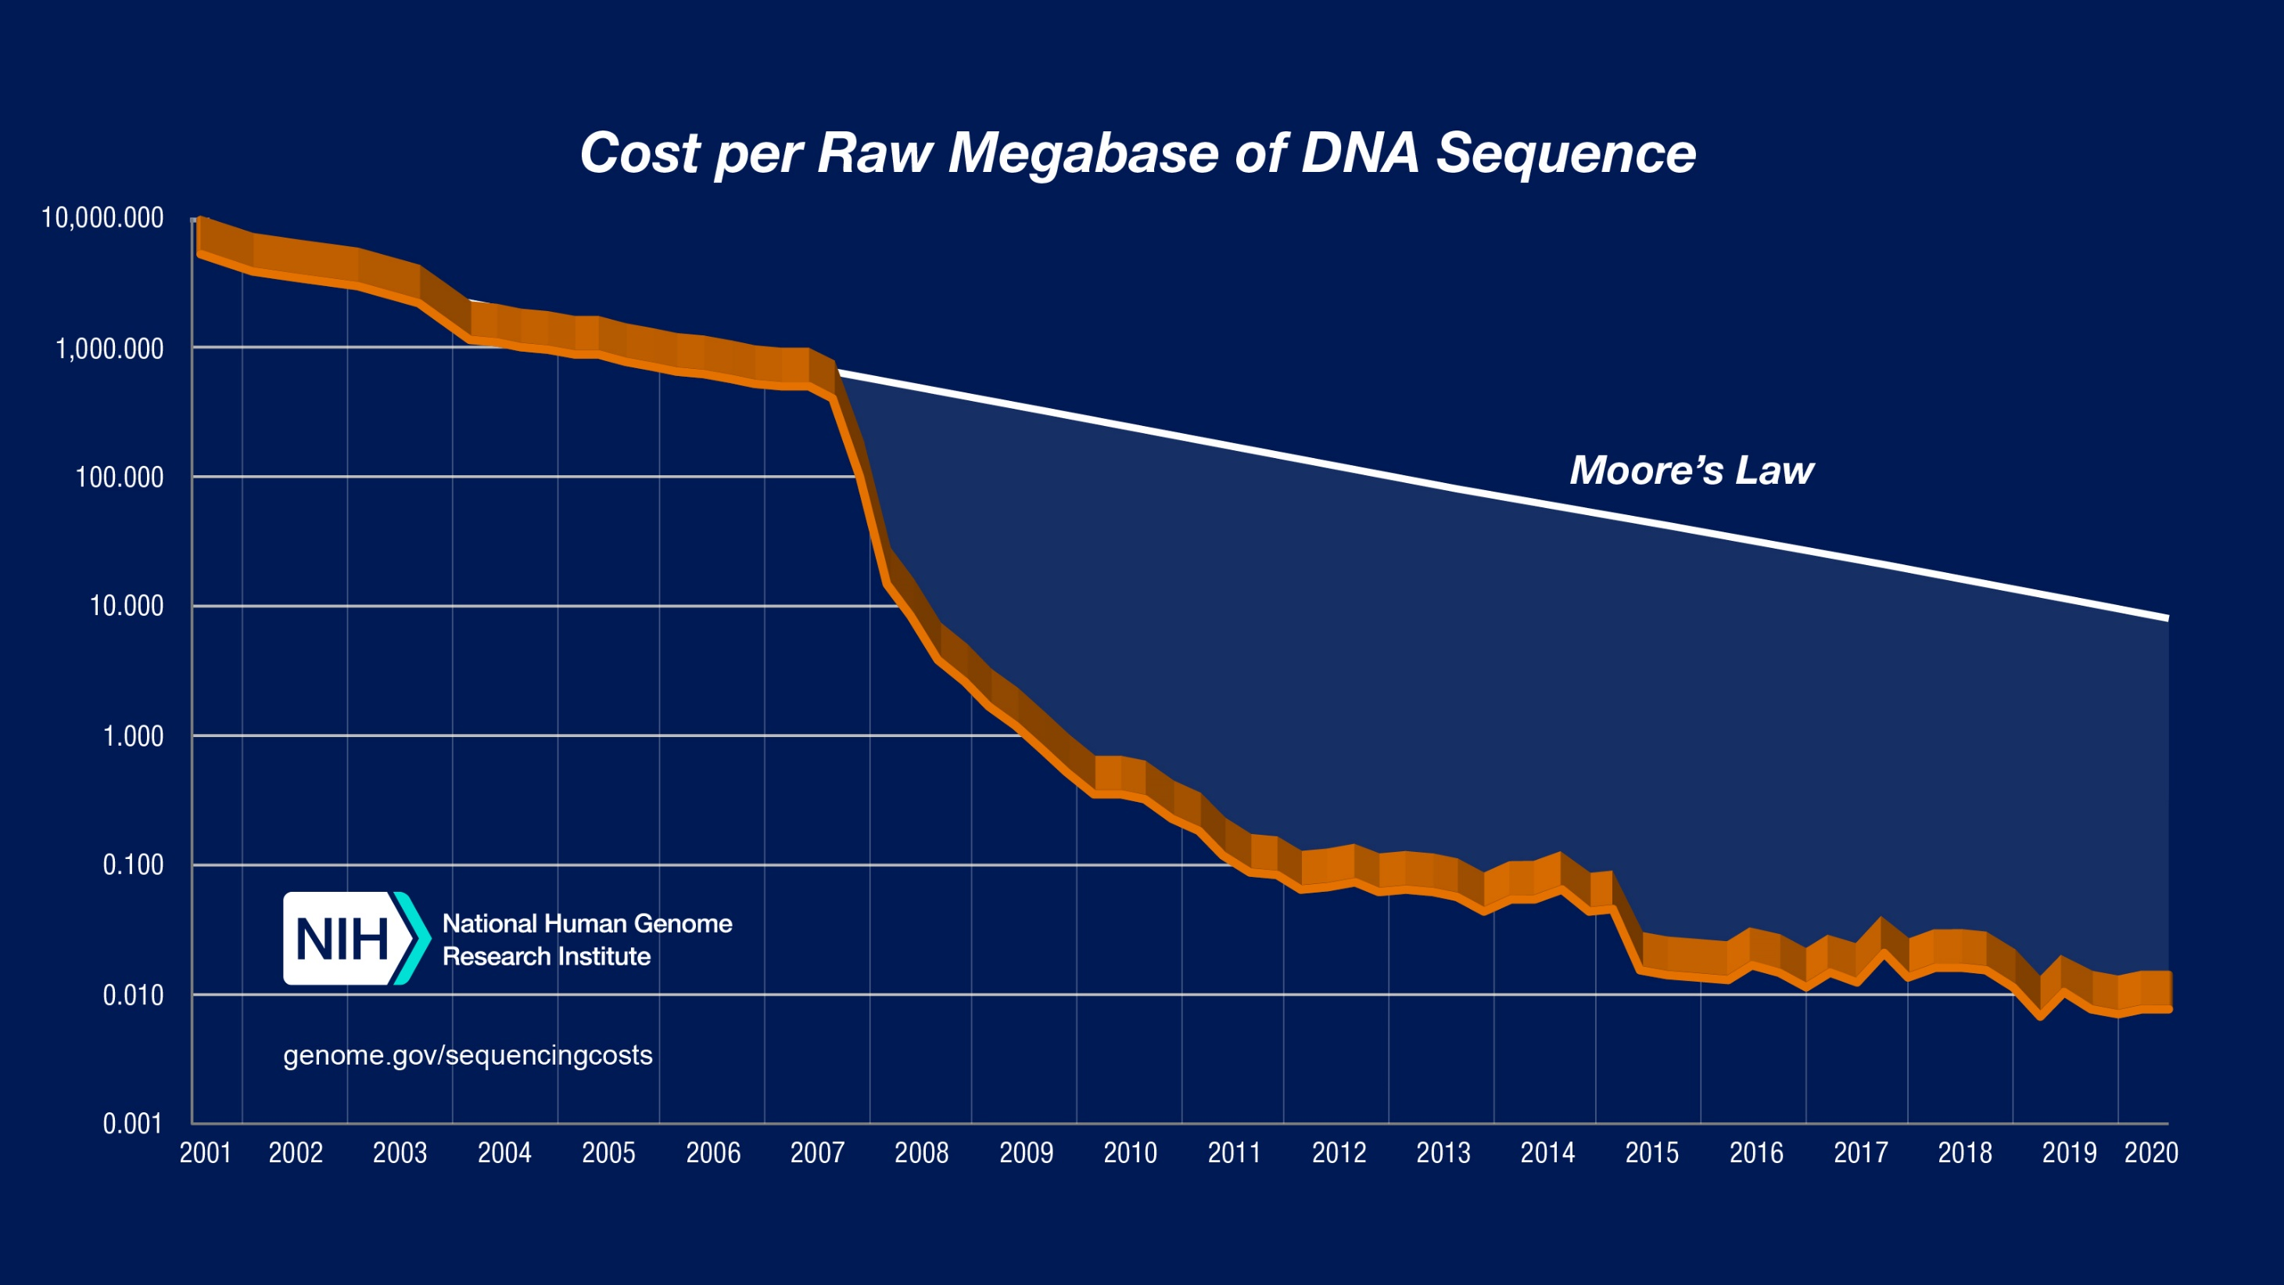
Sequencing cost per megabase – August 2020

Slide 16
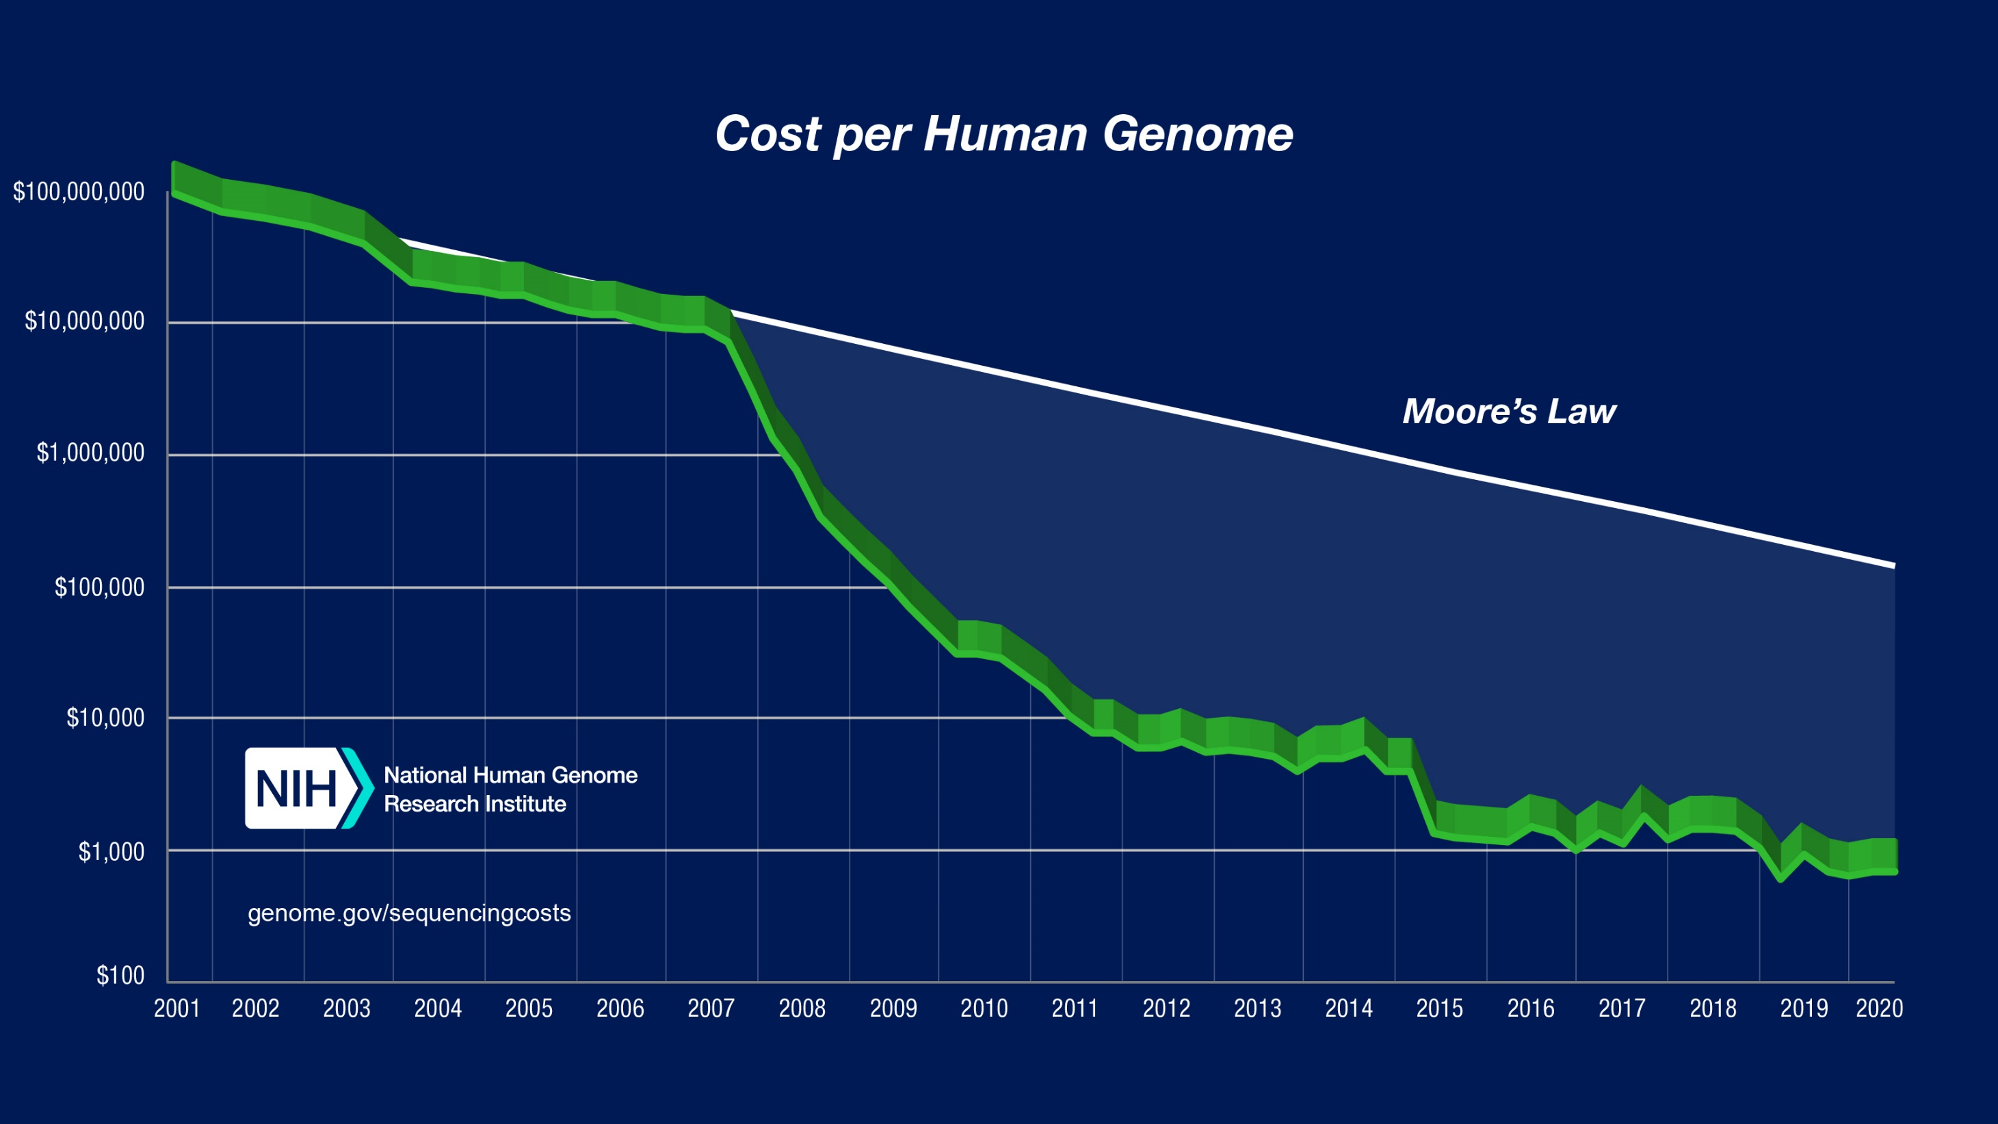
Cost per genome data – August 2020

