Slide 1
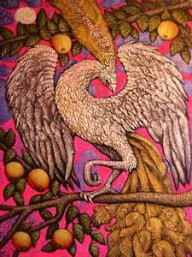
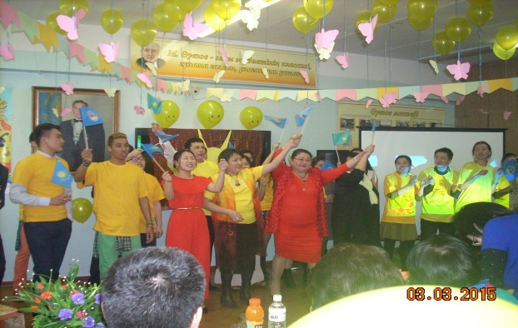
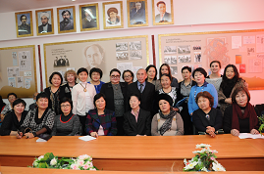
М
DEPARTMENT OF RUSSIAN PHILOLOGY, RUSSIAN AND WORLD LITERATURE

Slide 2
HISTORY OF THE CHAIR
Department of Russian Philology, Russian and World Literature organized in 2011 by the merger of the three departments of the Faculty of Philology: Russian language, Russian and world literature, Russian philology.

Slide 3
STAFF OF THE DEPARTMENT
Кафедра русской филологии,
русской и мировой литературы –
творчески нацеленный,
работоспособный и сплоченный
коллектив единомышленников
под руководством
члена-корреспондента НАН РК,
доктора филологических наук, профессора
Баян Умирбековны Джолдасбековой, занимающей ответственный пост
председателя Союза женщин
КазНУ им. аль-Фараби.

Slide 4
STAFF OF THE DEPARTMENT

Slide 5
AWARDS DEPARTMENT
In the
«Best Department of the University»
in 2014
the Department of Russian Philology, Russian and World Literature
won
third place

Slide 6
ACHIEVEMENTS OF THE CHAIR
Teachers of the department have numerous thanks to the leadership of the University, were awarded medals and honorary signs
The department has
6 winners
Republican contest the MES
"The best teacher of the university"

Slide 7
" «Best University Teacher» 2014
Corresponding Member of the National Academy of Sciences of Kazakhstan,
Doctor of Philology, Professor
Dzholdasbekova
Bayan
Umirbekovna

Slide 8
AREAS OF TRAINING
SPECIALITY
OF THE DEPARTMENT
PHILOLOGY:
RUSSIAN PHILOLOGY
RUSSIAN LANGUAGE AND LITERATURE

Slide 9
THE THREE-STAGE PREPARATION
3
DOCTOR
PhD
2
MASTER
1
UNDER-
GRADUATE

Slide 10
RESEARCH PROJECTS DEPARTMENT
The Role of the Humanitarian Discourse
of Leader of Nation in the Creation of
National Idea of Kazakhstan in the
Period of Independence
A paradigm of intellectual and
innovative potential of the personality
in literature of Kazakhstan of the
period of Independence
Development of Innovative socio-
Humanitarian Cluster of Discursive
Strategies and Instruments of Impact
in the Field of Social Practices
Add Your
Title
Development of Innovative socio-
Humanitarian Cluster of Discursive
Strategies and Instruments of Impact
in the Field of Social Practices
Modern literature of Kazakhstan as
a form of national self
Prose and Poetry 1970-2000
Kazakhstans literature in the context
of Central Asia
Hypertext Space of Olzhas
Suleimenovs Creativity in the
Context of Russian- Turkic Interrelation
Prose and Poetry 1970-2000
Kazakhstan's literature in the context
of Central Asia

Slide 11
Multidisciplinary Research and Innovation Center "GLOSS"
TRAINING
RUSSIAN LANGUAGE TRAINING
CONTEST
SECTION
REVIEWING
CONFERENCES
LINGUISTIC EXPERTISE

Slide 12
INTERNATIONAL COOPERATION
The department cooperates with leading universities and research institutes in the countries near and far abroad:
Moscow State University (Moscow, Russia)
St. Petersburg State University (Saint Petersburg, Russia)
Peoples Friendship University of Russia (Moscow, Russia)
Pushkin House RAS (Moscow, Russia)
University of Prague (Prague, Czech Republic)
University of Helsinki (Helsinki, Finland)
University of Granada (Granada, Spain)
Shanghai University (Shanghai, China)

Slide 13
COOPERATION academics and students
ДЕНЬ
РУССКОЙ
КУЛЬТУРЫ
МИР
НАУКИ
БАГИЗБАЕВСКИЕ
ЧТЕНИЯ
ФЕСТИВАЛЬ
РУССКОЙ
КУЛЬТУРЫ

Slide 14
БАГИЗБАЕВСКИЕ ЧТЕНИЯ
Ежегодно в 20-х числах апреля проводятся Багизбаевские чтения. Международная научная конференция проводится с 2009 г. и охватывает участников из России, стран СНГ и дальнего зарубежья.

Slide 15
ДЕНЬ РУССКОЙ КУЛЬТУРЫ
Стало хорошей традицией завершать работу Багизбаевских чтений грандиозным праздником - Днем русской культуры.

Slide 16
CIRCLES AND CLUBS
CLUB
SOCIETY
CIRCLE
RUSSIAN
CLUB
LINGGUISTIC CIRCLE OF Makhmudov H.Kh.
LITERARY SOCIETY
«АҚҚАЙЫН»

Slide 17
RUSSIAN CLUB
The aim of the Russian Club instill interest in the study of languages ​​in the framework of the scale of the Republican project "Trinity of languages": Kazakh, Russian and English.

Slide 18
LITERARY SOCIETY «АҚҚАЙЫН»
The main purpose of the literary society "Akkayyn" - education for the versatile creative person, spiritually and artistically gifted, capable of aesthetically and ethically evaluate any artistic phenomenon.

Slide 19
LINGGUISTIC CIRCLE of Makhmudov H.Kh.
The main objectives of a student's linguistic circle is the organization and carrying out the actions connected with profound studying of single topical issues of Russian philology, acquaintance with life and scientific works of foreign and domestic linguists, promoting of linguistic knowledge.

Slide 20
OUR SPECIALISTS ARE HAPPY EVERYWHERE!
PEDA-
GOGY
MANAGE-
MENT
SCIENCE
PHILOLOGY
AND
REFERENCES
MEDIA
TRADE
AND PR
EDITORIAL
THE
ACTIVITIES

