Slide 1
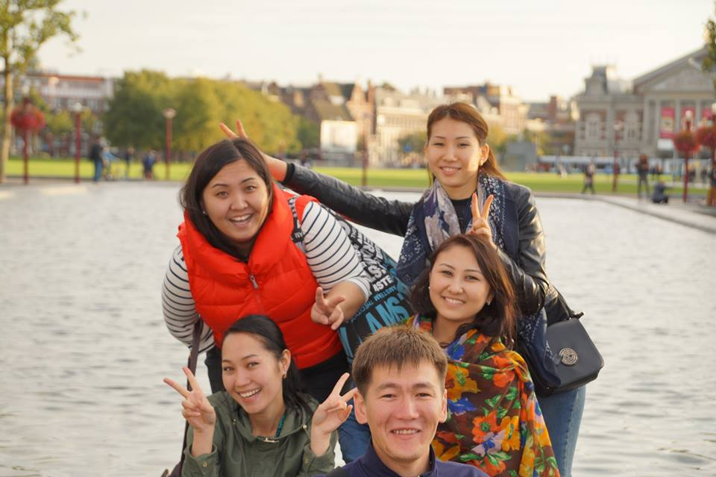
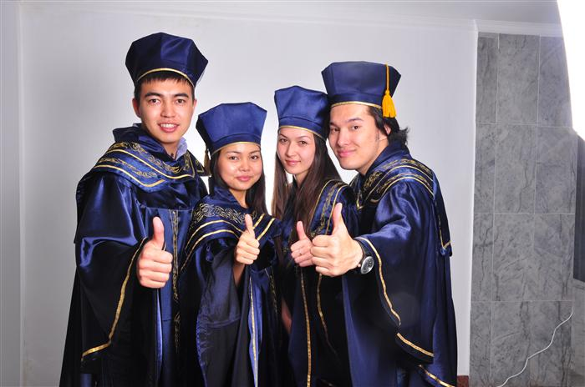
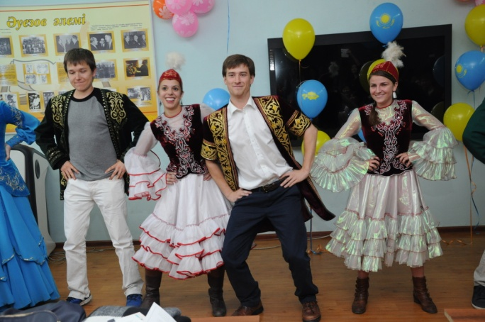
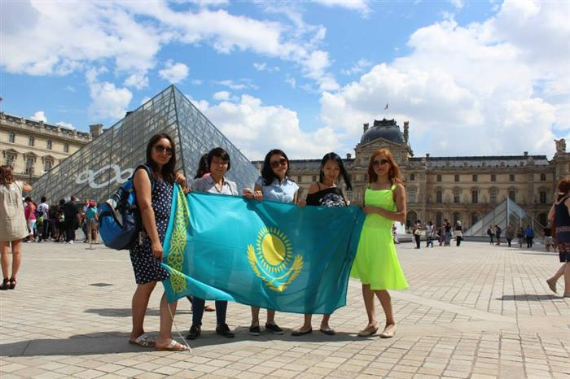

Slide 2
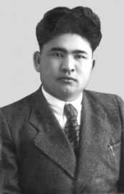
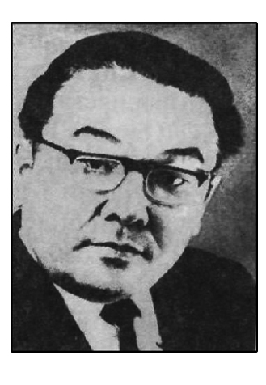
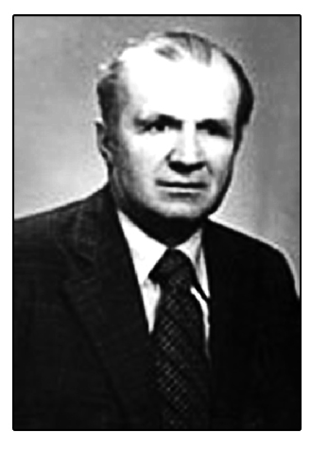
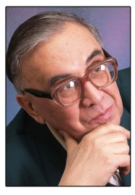
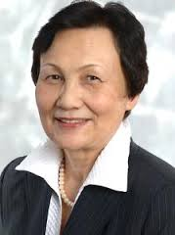
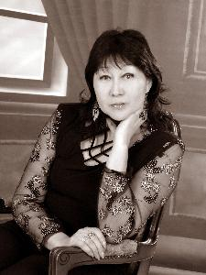
Head of the Department in different years
1950-1961 Zh.А. Aralbayev
1961-1977 K.A. Akhanov
1977-1979 V.M. Nikitevich
1979-1995 A.S. Amanzholov
1995-2009 E.D. Suleymenova
2009 G.B. Madiyeva

Slide 3
The department of general linguistics and foreign philology carries out preparation of the following specialties:
Code of specialty | Specialities | Duration of study | Qualifications
Bachelor degree
5B021000 | Foreign philology | 4 y | Bachelor of humanitarian sciences
5B011900 | Foreign language: two foreign languages (English) | 4 y | Bachelor of humanitarian sciences
Master degree
6M021300 | Linguistics | 2 y | Master of humanitarian sciences
6M021000 | Foreign philology | 2 y | Master of humanitarian sciences
Doctoral degree
6D021300 | Linguistics | 3 y | Doctor of philosophical sciences (PhD)
6D021000 | Foreign philology | 3 y | Doctor of philosophical sciences (PhD)
Second Higher Education
5B021000 | Foreign philology | 2 y | Bachelor of humanitarian sciences

Slide 4
В процессе обучения студент приобретает знания в области:
Linguistics;
Sociolinguistics;
Psycholinguistics;
Contrastive linguistics;
Computer linguistics;
Corpus linguistics;
Language and Gender
Introduction to Turkic
philology
Introduction to Linguistics
Introduction to Special Philology
Foreign philology;
Legal Linguistics;
Intercultural
communication;
Linguistic conflict studies
Latin language

Slide 5
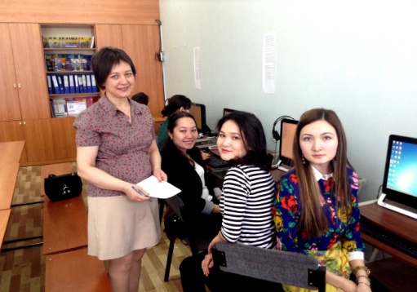
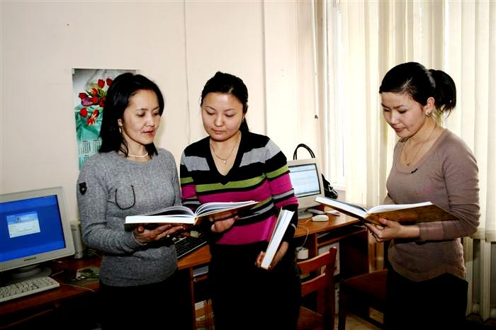
Research centers and laboratories of the Department
1
2
3
Laboratory of "The Kazakh language: socio-psycholinguistic research“ Head: d.ph.s., prof. Suleimenov ED
"The British Centre: Language and Culture" Research Center. Head: Karagoishieva D.A.
"Computer linguistics" Research Center. Head: Umatova Zh.M.

Slide 6
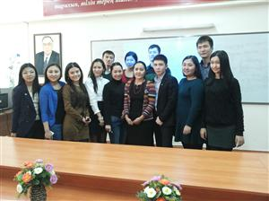
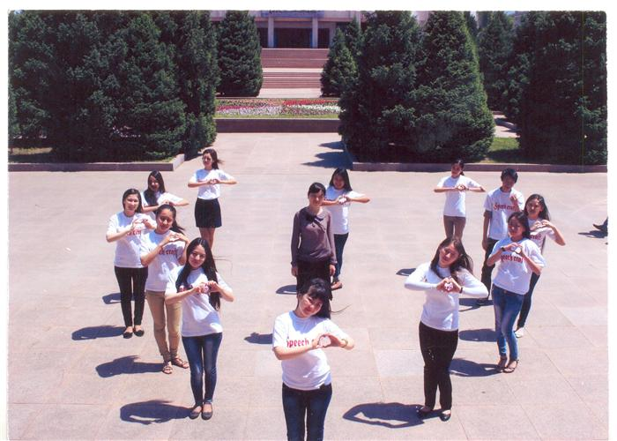
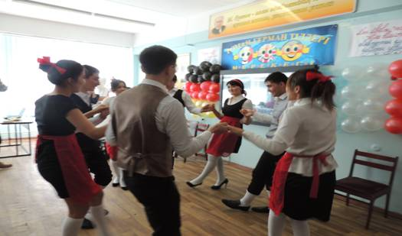
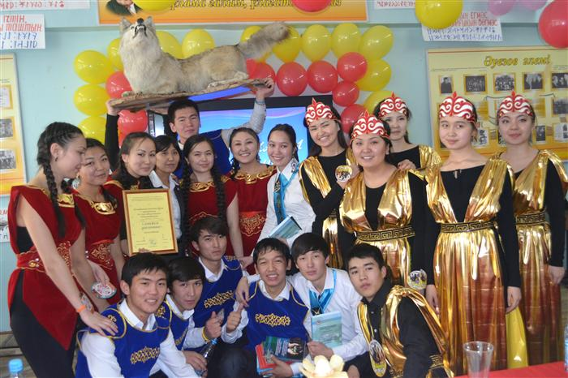
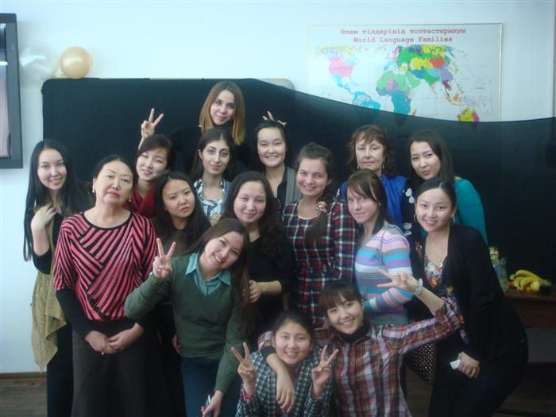
Клубы и кружки кафедры
“Young linguistics”
“Zheruiyk”
“Speechcraft”
“Roman-german languages”
“Turkic world”
“English Drama”

Slide 7
The department is actively cooperating with foreign universities and universities of the CIS:
Moscow State Linguistic University (Russia)
Moscow State University named after M.V. Lomonosov
Institute of Linguistics of the Russian Academy of Sciences (Russia);
University Justus Liebig Giessen (Germany);
Association "Siberian Association linguists experts" (Russia);
Nizhny Novgorod State Linguistic University named after N.A. Dobrolyubov (Russia);
University. Constantine the Philosopher in Nitra (Slovakia);
University of Economics and Business in Vienna (Austria);
University Otto-von-Guericke (Germany);
University of Amsterdam (Netherlands);
The University of Chicago (USA);
Indiana University (USA);
University of Cadiz (Spain);
Utrecht University (Netherlands);
University of Lisbon (Portugal)
et al.

Slide 8
Companies and organizations in which students in the department of general linguistics and foreign philology pass an industrial practice :
Institute of Linguistics
Named after A.Baitursynov
MES RK
Secondary educational
institutions, gymnasium
and Colleges
Turkic center
Department
Center of
"Computer
linguistics "
British centre: language
and culture
Teaching and experimental
Laboratory "The Kazakh language:
socio- and psycholinguistic
research »

Slide 9
Olympiads and competitions, conferences
Students of the department actively participate in the annual international, national level contests and conferences at the Faculty of Philology, Literary Studies and World Languages in Al-Farabi Kazakh National University, also they are members of various clubs and societies.
Competitions:
Conferences:
University competition "The best linguist";
Competition of scientific works of young researchers;
The Republican contest for composing in French;
City competition for the recitation of the French language.
International scientific conference of students and young scientists "World of Science";
International scientific-practical conference "Language and Intercultural communication ";
International Scientific Conference "Ahanov reading";
International conference of students and young scientists held in foreign countries.

