Slide 1
Department of Kazakh linguistics

Slide 2
activities of the Department
1 Research activities
Department of Kazakh linguistics
. Educational-methodical activity
International activities
Social Educational Activity

Slide 3
Areas of training
Undergraduate
magistracy
Doctoral
5B020500 -
Philology: Kazakh Philology
5B011700 -
Kazakh language and literature
Education - 4 years
6M020500 -
Philology (scientific pedal gineering direction)
Education - 2 years
6D020500 -
Philology (postgraduate education -doktorantur)
Education - 3 years

Slide 4
academic Mobility
The Country
USA
CIS
chair
China
Turkia
Europe

Slide 5
research projects
priorities functional
grammar
Kazakh language in the world
space: Theory and Practice
Chairs
Official language:
trends and
Prospects for Development

Slide 6
Educational-methodical activity
Textbook
Uchebnikt
The collection of tests
Educational and methodical
posobiet

Slide 7
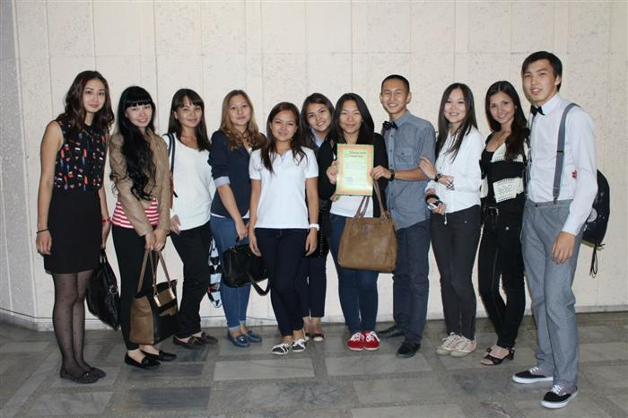
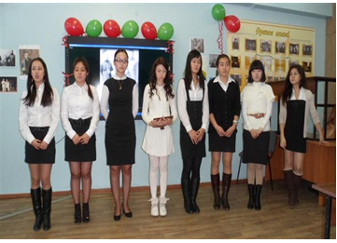
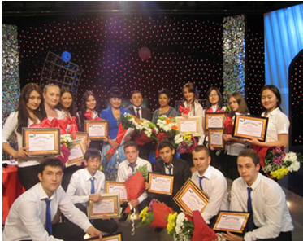
Social Educational Activity
Club "Ak sөyle" Club "soz marzhny"
Circle "Linguistic Association« Circle "Center for Linguistic prediction»

