Slide 1



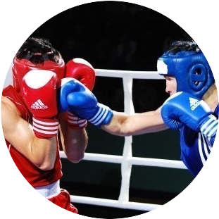
Chair of Physical Training and Sport
FASTER, HIGHER, STRONGER

Slide 2
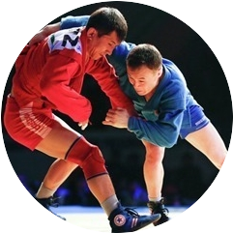
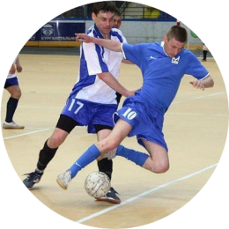
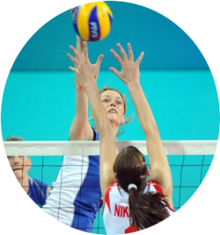
SERVICES & ACTIVITIES
Chair of Physical Training and Sport
Educational work
Educational-methodical activity
Research work
Educational аctivities
Preparation of athletes

Slide 3
Areas of training
«Chair of Physical Training and Sport»
DIRECTIONS
TRAINING
PEDAGOGICAL
Specialty 5ВМ010800 – «Physical Culture and Sports»
BACHELOR
Scientific and pedagogical
Specialty 6М010800 – «Physical Culture and Sports»
MASTER

Slide 4
Direction of educational programs
Cipher specialty | Specialty | Training period | Qualification
Bachelor of science
5В010800 | «Kultura physical and sport» | 4 years full-time | «Bachelor of Education kultura physical and sport »
5В010800 | «Kultura physical and sport» | 3 years full-time on base secondary vocational education | «Bachelor of Education kultura physical and sport »
5В010800 | «Kultura physical and sport» | 2 years full-time with higher education | «Bachelor of Education kultura physical and sport »
Magistracy
6М010800 | «Kultura physical and sport» | 2 years - full-time | Graduate Schools of Education Sciences by specialty «Kultura physical and sport»

Slide 5
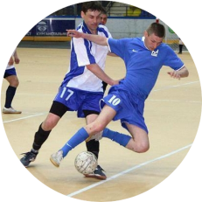
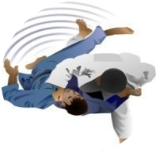
Contingent
Chair of Physical Training and Sport
Professor
3
Honored coaches the Republic of Kazakhstan
9
International masters Class of sports end masters of sports
33
Contingent Chair of Physical Training and Sport
8
Docents
1
PhD doctor
4
Candidate of pedagogical sciences
2
Doctor of Pedagogy

Slide 6
Professional development
Chair of Physical Training and Sport
 | Number of students by year
 | 2011-2012 | 2012-2013 | 2013-2014 | 2014-2015
1. National center for professional development «Orleu» | - | - | 11 | -
2. RAS (Russia, Pushchino) 3. Ben -Guriona University (Israel) | 1 | 1 | - | -
4. The Asian Badminton Confederation, Kazakhstan | 1 | - | - | -
5. International Federation of shaping (Russia, St. Petersburg ) | 1 | 1 | - | -
6. Institute for Advanced Studies Kazakh National University Al-Farabi | 1 | - | - | 3
7. Institute for Advanced Studies National Scientific and Practical Center Physical Education MES RK | 19 | 9 | - | 49

Slide 7
Publishing Faculty staff
SCIENTIFIC AND METHODICAL CONFERENCE, PUBLICATIONS, JOURNAL | 2011-2012 | 2012-2013 | 2013-2014 | 2014-2015
International Conferences near Abroad | 5 | 15 | 10 | 12
Editions far abroad | - | 2 | - | 1
International Conferences, Kazakhstan | 4 | 15 | 8 | 2
The Conference of the Kazakh National University Al-Farabi | 9 | 11 | 8 | 46
Scientific Publications Kazakhstan recommended KKSON | 5 | 20 | 10 | 36

Slide 8
NUMBER SPORTS EVENTS
2011-2012
2012-2013
2013-2014
2014-2015
1st semester
59
105
117
113
11889
14616
16210
participants
participants
9059
participants
participants

Slide 9
Sporting achievements
On specialty «Physical Culture and Sports» trained with students-athletes among them:
13 International masters Class of sports
39 Masters of Sports
54 Candidate Master of Sports
All of them are members of national teams the Republic of Kazakhstan and have high achievements in sports.

Slide 10
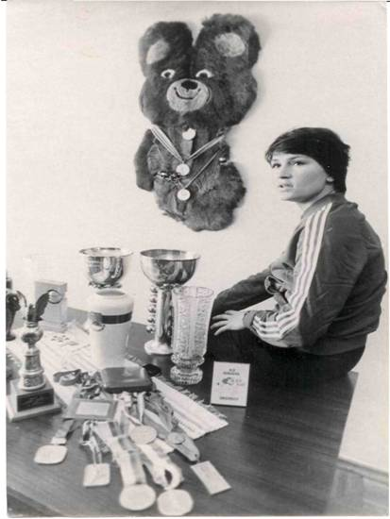
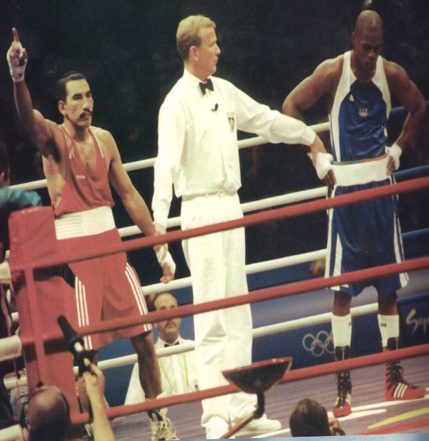
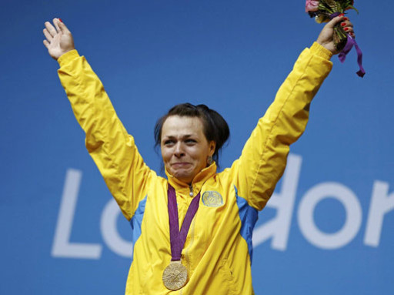
Sporting achievements
Kazakh National University Al-Farabi
Olympic champions:
Nadezhda Olhova – basketball – 1976, 1980
Yermakhan Ibraimov –
boxing - 2000
Svetlana Podobedova – weightlifting - 2012

Slide 11
Sporting achievements
Kazakh National University Al-Farabi
Olympic medalists:
Champions and winners of the World Universiade - 10 people
Champions and winners of the World and Europe - 15 people
Yermakhan Ibraimov – boxing – 1996 – bronze
T. Gorlitz – basketball – 1988 – silver
A. Zhitkeev – judo – 2008 – silver
O. Turchak - athletics – 1988 - bronze
E. Korol'kov – cycling – 1984 – silver

Slide 12
Sports at the University of
OLYMPIC FIGURATIONS
RACQUETBALL, BASKETBALL, BOXING, VOLLEYBALL, WRESTLING, JUDO, ATHLETICS, TABLE TENNIS, SWIMMING, BEACH VOLLEYBALL, ARCHERY, TAEKWONDO, TENNIS, FENCING, FOOTBALL
FIGURATION
NOT INCLUDED IN THE OLYMPIC PROGRAM
MOUNTAINEERING, DARTS, KARATE-DO, KICKBOXING, MINI FOOTBALL, BEACH FOOTBALL, SAMBO, MOUNTAIN CLIMBING, RUGBY, CHESS
NATIONAL FIGURATION
KAZAK KURES, BELT WRESTLING, TOGYZKUMALAK

Slide 13
UNIVERSIADES
REPUBLIC OF KAZAKHSTAN
 | Number of medals won the team KazNU figuration sports |  |  | Participated in sports | Team place
 | bronze | silver | gold
V summers 2009 | 3 | 10 | 14 | 42 | I
VI summers 2011 | 4 | 7 | 15 | 36 | I
VII summers 2013 | 3 | 7 | 15 | 36 | I

Slide 14
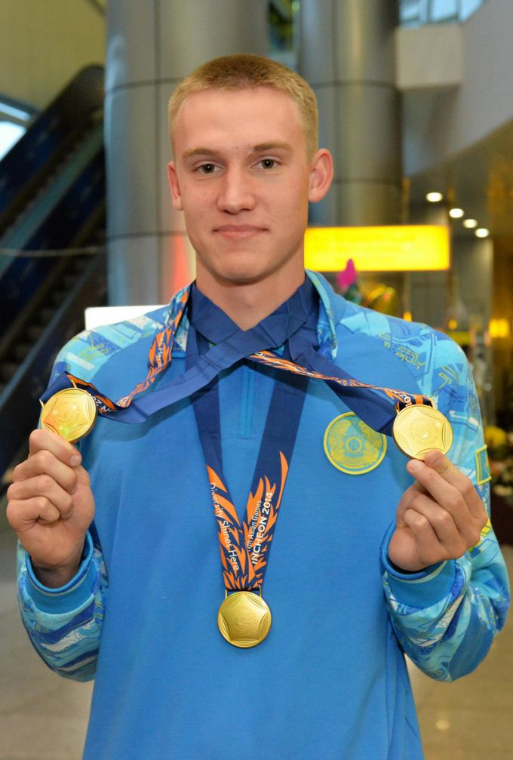
BEST STUDENTS OF THE DEPARTMENT
BALANDIN DMITRY 2 year student faculty of biology and biotechnology Athletic title – Master sport international grade Republic Kazakhstan on swimming Member team commands RK on swimming The best achievement in season 2013/2014 triple champion Asian games in Incheon to distances 200,100 and 50 meters breaststroke.

Slide 15
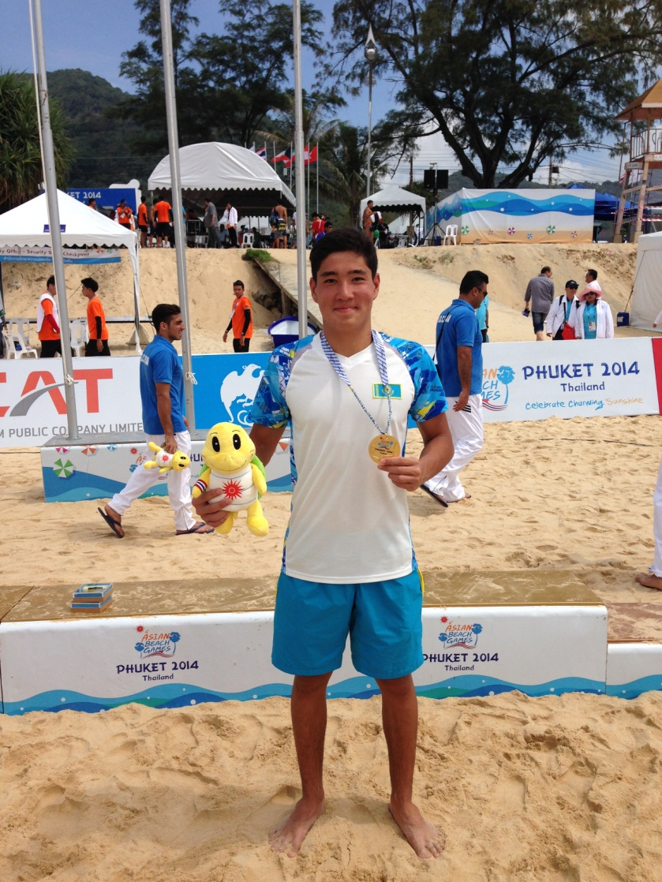
BEST STUDENTS OF THE DEPARTMENT
AUBACIROV MIRAS ERMECOVICH
faculty: «Biology and biotechnology»speciality: «Physical culture and sport»course: I kind sport: WATER HOLLOW
The best student 2014-2015 year
1. Asian Beach Games – 1 place
Phuket (Tailand) from with 14-23 november 2014 year
2. To Asian championchip club – 5 place
Teheran (Iran) from with 15-20 december 2014 year
3. International tournament «NODAR GVAKHARIAS CUP» – 2 place
Tbilisi (Georgia) from with 23-25 january 2015 year

Slide 16
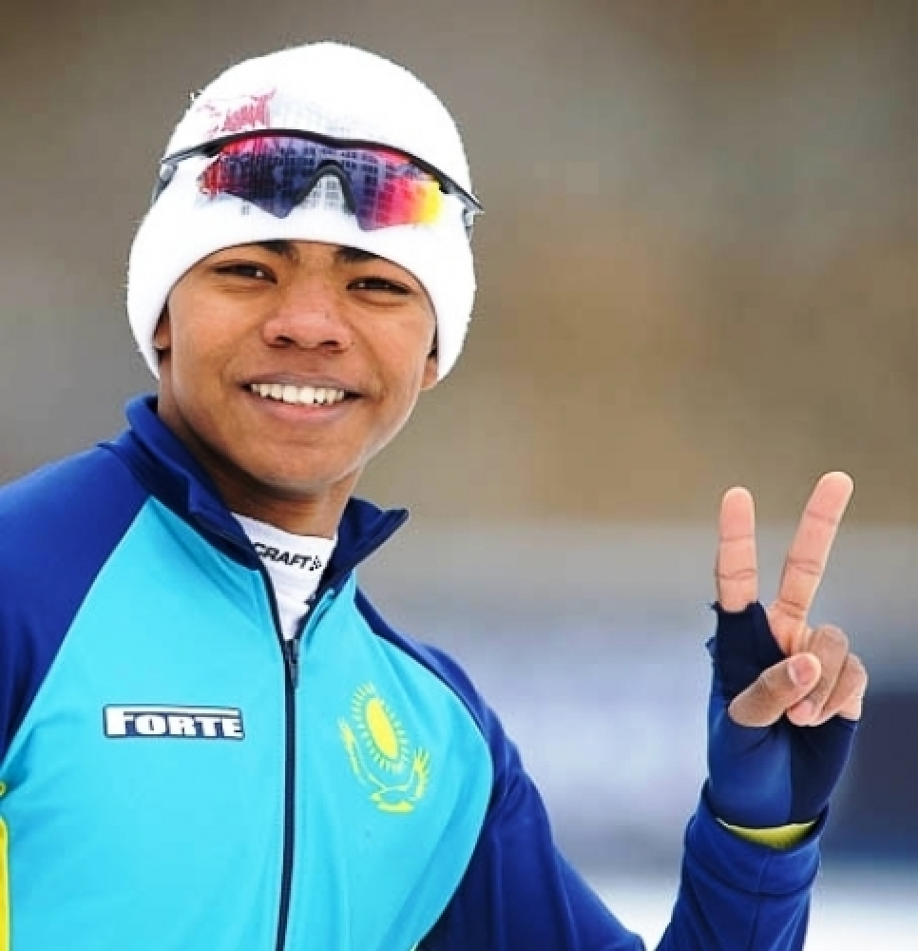
BEST STUDENTS OF THE DEPARTMENT
DARSIL ESSAMAMBO
Third year student.faculty of biology and biotechnology
Master of sports of the Republic of Kazakhstan of the international class in speed skating. The member of a National team of the Republic of Kazakhstan on speed skating.
The best achievement in 2013/2014 seasons - the first place in the junior World Cup. Numerous participant of the championships and World Cups. Champion of the Republic of Kazakhstan among juniors

