Slide 1
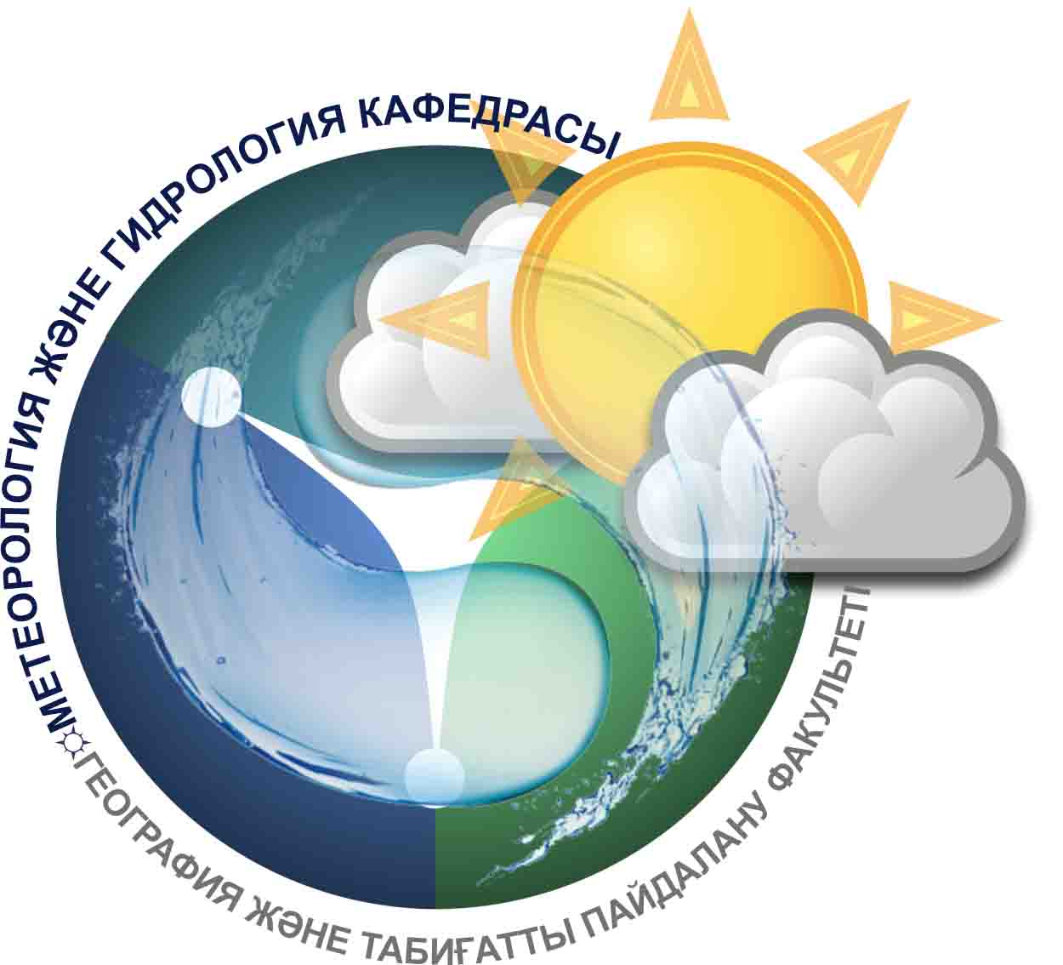
Department of
Meteorology and Hydrology

Slide 2
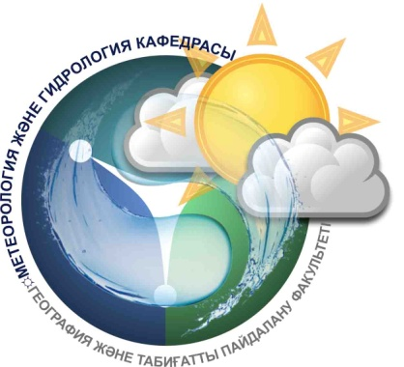
Department Activities
Department mission
Educational-methodical
Scientific-Researching
Social-educational
International cooperation

Slide 3
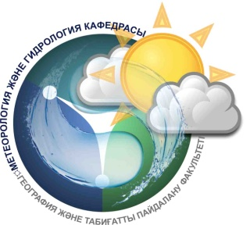
Department mission
Preparation of competitive specialists with a modern elite higher education, focused on solving the problems of intensive development of the important directions of economy and science. The department aims to continuously update and optimize the credit system, improve the quality of training of the graduates and the needs of the labor market

Slide 4
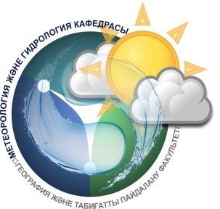
Educational-methodical activities
Specialities
PhD
Doctorate
Bachelor
Magistracy
5В061000-Hydrology
5В061200-Meteorology
6М061000-Hydrology
6М061200-Meteorology
6D061000-Hydrology
6D061200-Meteorology

Slide 5
Professorial teaching staff
7 doctors of sciences
16 candidates of sciences
1 PhD doctor

Slide 6

Research projects of the department
1
2
3
4
5
"Development of methods, models and geo-information technologies of control, analysis and forecasting of the dynamics of desertification processes on the territory of the Republic of Kazakhstan"
"Assessment of water-erosion danger mountain and foothill areas of South-East Kazakhstan, taking into account the impact of natural and anthropogenic factors"
"The development of geographical bases of water security of the Republic of Kazakhstan in conditions of climatic and anthropogenic changes in river water"
"Determination of the spring runoff of plain rivers of Kazakhstan"
"Scientific basis for optimizing the use of natural resources and sustainable development in a changing climate"

Slide 7
Main directions of scientific activity in hydrology
Hydrology of mountainous
areas of Kazakhstan
Hydrological problems inland basins
Transboundary rivers problems
of the Republic of Kazakhstan
Hydrology
Water security
the Republic of Kazakhstan
Assessment and forecast of water resources
the Republic of Kazakhstan
Hydroecological problems
the Republic of Kazakhstan

Slide 8
Main directions of scientific activity in hydrology meteorology
Spatial and temporal patterns of climate change in the potential pollution of the atmosphere in different seasons
Features of atmospheric circulation and distribution of the average monthly temperature and precipitation in southern Kazakhstan
Climatic features
precipitation in Kazakhstan
Meteorology
Possibilities of use
solar and wind energy
in Kazakhstan
Study of peculiarities of formation
fog, thunderstorms, hail
different regions of Kazakhstan
Agro-climatic variability resources
of Kazakhstan in conditions
global warming

Slide 9
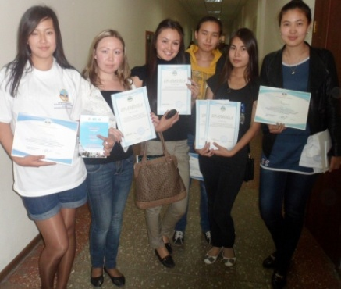
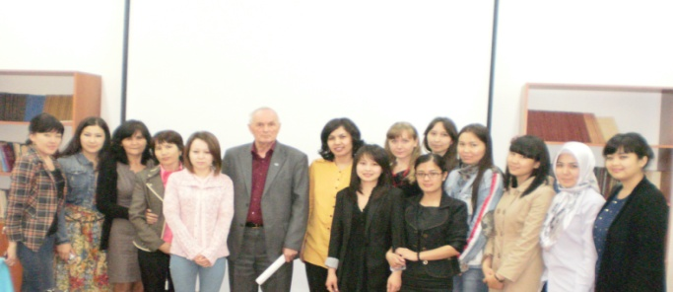
Scientific student's club
Improving the knowledge of the basic and special disciplines, allowing students to obtain advanced college degree to work in various areas in the field of meteorology and hydrology
Club
Hydrology
Club Meteorology

Slide 10
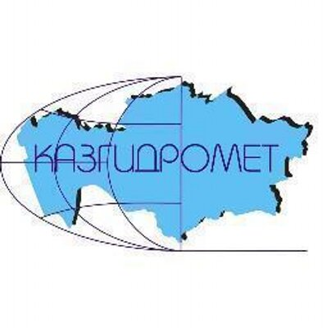
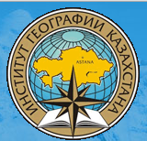
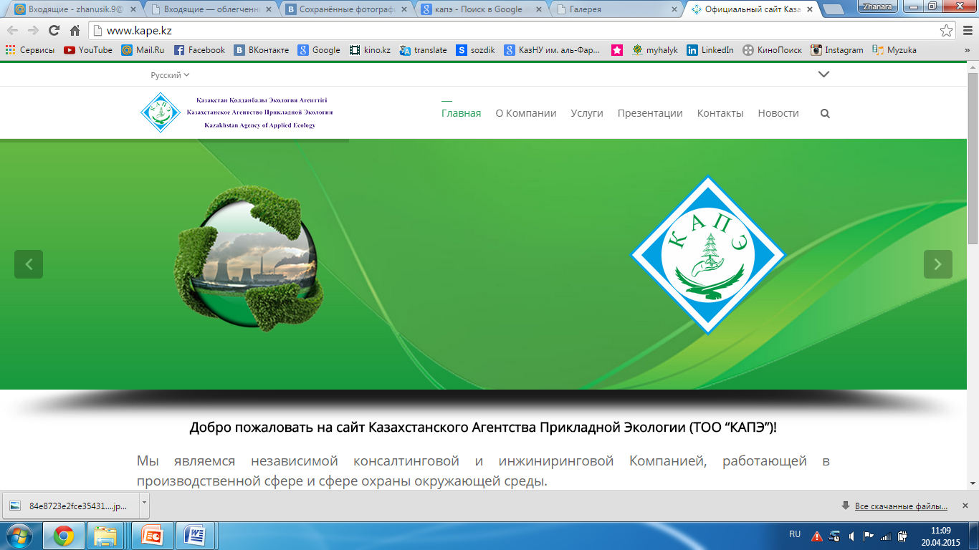
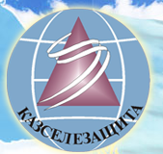
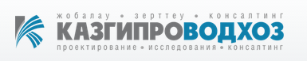
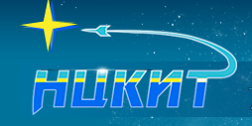
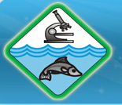
Partnerships with academic and industrial organizations
RSE "Kazhydromet"
"Institute of Geography" MES
"The Kazakh Agency of Applied Ecology"
SI "KazSeleZashshita MES RK"
Institute "Kazgiprovodkhoz"
"National Center for Space Research and Technology“
"Kazakh Research Institute of Fisheries"

Slide 11







International Partners
RSHU
(Russia)
MSU
(Russia)
The university of
Nottingham
(United Kingdom)
University
of Cyprus
(Cyprus)
Technical
University of
Valencia
(Spain)
Middlesex
university
(United Kingdom)
University
of Leipzig
(Germany)

