Slide 1
Department of Chemistry and Technology of Organic Substances, Natural Compounds and Polymers

Slide 2
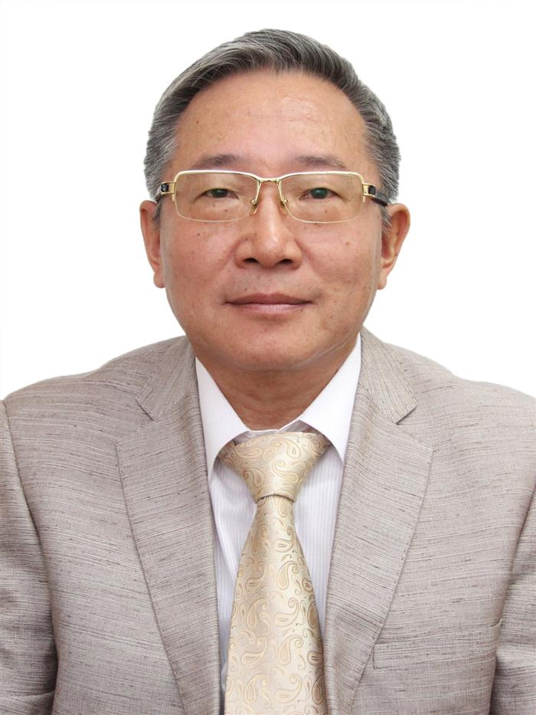
Head of the Department, Doctor of Chemical Sciences, Professor G.A. Moon

Slide 3
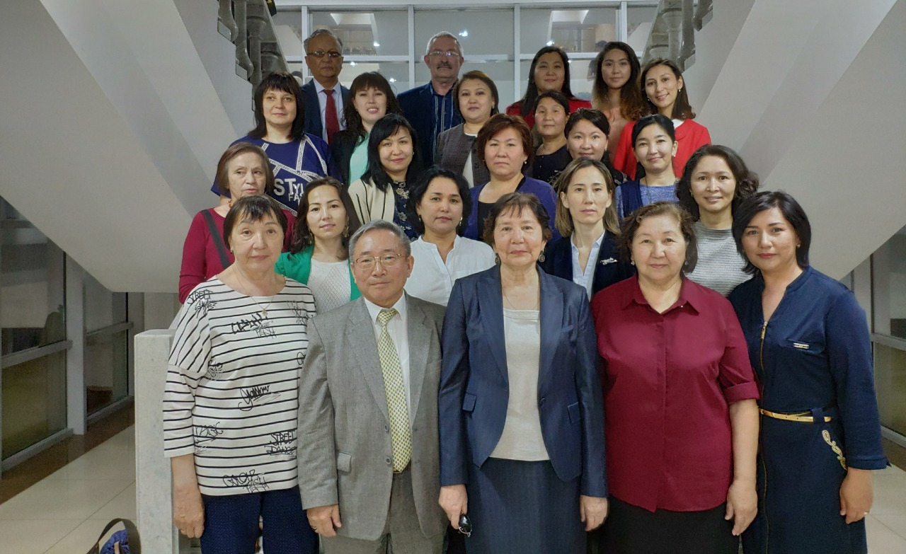
There are 4 academics, 7 professors, 2 acting professors, 2 international professors, 11 assistant professors, 5 acting assistant professor, 20 senior lecturers, 2 candidates of chemical sciences, 2 PhD-doctors and training support staff in the amount of 16 people at the Department.

Slide 4
Scientific directions and prospects of the department

Slide 5
Scientific directions
Organic synthesis
Chemistry of natural compounds
Immobilization of biologically active substances
Chemistry of macromolecular compounds

Slide 6
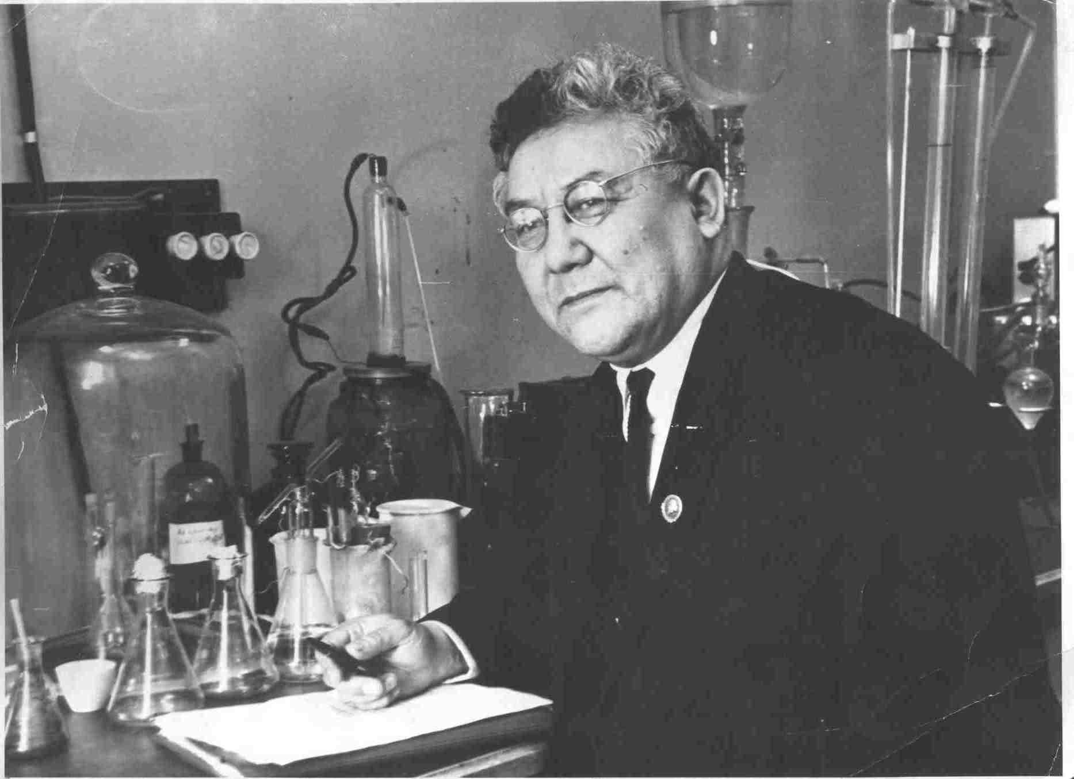
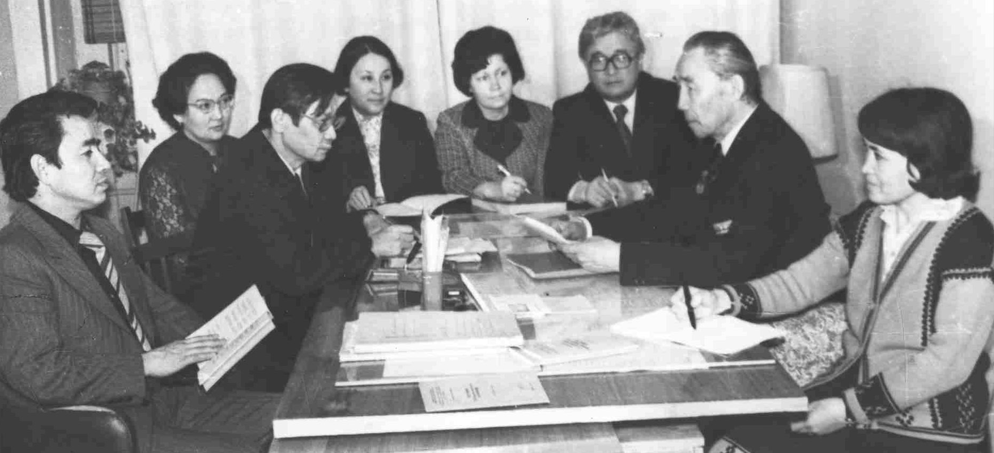
Organic synthesis
Academician of the Academy of Sciences of the USSR Ivan Nikolaevich Nazarov, Corresponding Member of the AS of the USSR, Azerbaev Irdan Nigmetovich, Corresponding Member Academy of Sciences of the Republic of Kazakhstan, Honored Scientist of the Republic of Kazakhstan, Professor Akhmetzhan Sharifkanovich Sharifkanov stood at the origins of the direction on the synthesis of new organic substances and materials.. His students: professors Akhmedova Sh.S., Kalugin S.N., associate professors Turmukhanova M.Zh., Mamutova A.A., Nurlibaev A.K., continue research in this direction.
Academician of the Academy of Sciences of the USSR Ivan Nikolaevich Nazarov
Corresponding member Academy of Sciences of the Kazakh SSR, Doctor of Chemical Sciences, Professor A.Sh. Sharifkanov holds a meeting of the department (1980)

Slide 7
Leading experts in this area
Turmukhanova Mirgul Zhuragatovna, Doctor of Chemical Sciences, Associate Professor
Kalugin Sergey Nikolaevich, Doctor of Chemical Sciences, Professor
Mamutova Alua Asabaevna, Candidate of Chemical Sciences, Associate Professor
Dyusebaeva Moldyr Akimzhanovna, Candidate of Chemical Sciences, Associate Professor
Elibaeva Nazym Saidildaevna, PhD Senior Lecturer
Zhilkibaev Oral Tankievich, Doctor of Chemical Sciences, Professor

Slide 8
Chemistry of natural compounds
The chemistry of natural compounds was headed by Honored Scientist of the Republic of Kazakhstan, Doctor of Chemical Sciences, Professor Tair Kukashevich Chumbalov. His students are professors: Taraskina K.V., Kil A., Mukhamedyarova M.M., Nurgalieva G.M., Omurkamzinova V.B. G.E. ZHUSUPOVA, G.Sh. Burasheva, and D.Kh.N. R. A. MUZYCHKINA, V. V. Polyakov, S. B. Rakhmadieva
Professor Zhusupova G.E. with students
Professor Burasheva G.Sh.
Creation and introduction of medicinal substances and preparations from plants into medicine. Development of technology for obtaining pharmaceuticals. Isolation and establishment of the structure of complex organic substances of natural origin.

Slide 9
Leading experts in this area
Burasheva Gaukhar Shakhmanovna, Doctor of Chemical Sciences, Professor
Zhusupova Galiya Eintaevna, Doctor of Chemical Sciences, Professor
Dmitry Korulkin, Doctor of Chemical Sciences, Professor
Zhenis Zhanar, PhD, professor
Kipchakbaeva Aliya Kuanyshovna, PhD Senior Lecturer
Seitimova Gulnaz Absattarovna, PhD., Acting associate professor
Umbetova Almagul Kendebaevna, Ph.D. Senior Lecturer
Litvinenko Yulia Alekseevna, Candidate of Chemical Sciences, Senior Lecturer
Ikhsanov Erbol Saginovich, PhD, senior lecturer
Shevchenko Anastasia Sergeevna, PhD, Senior Lecturer

Slide 10
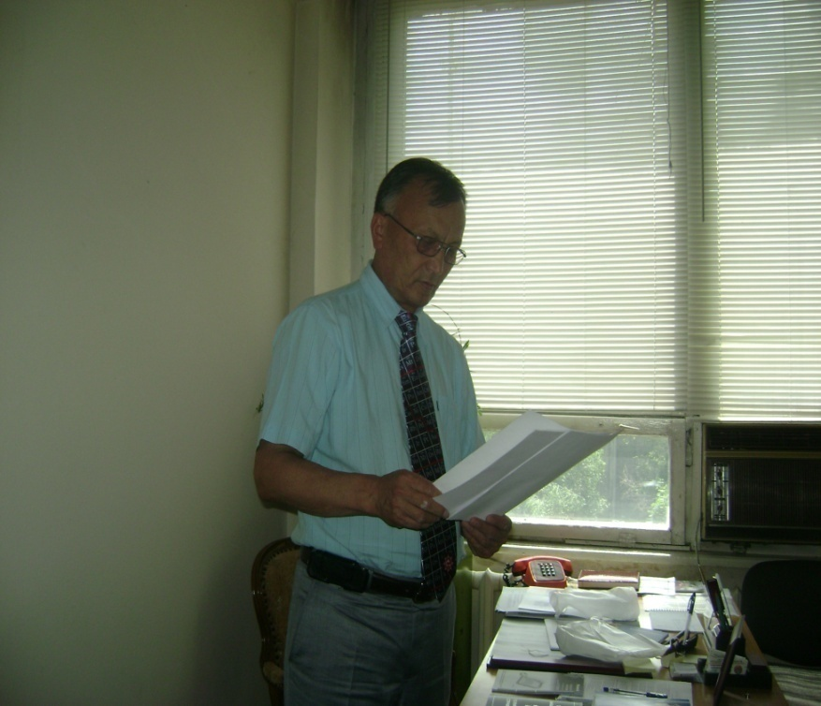
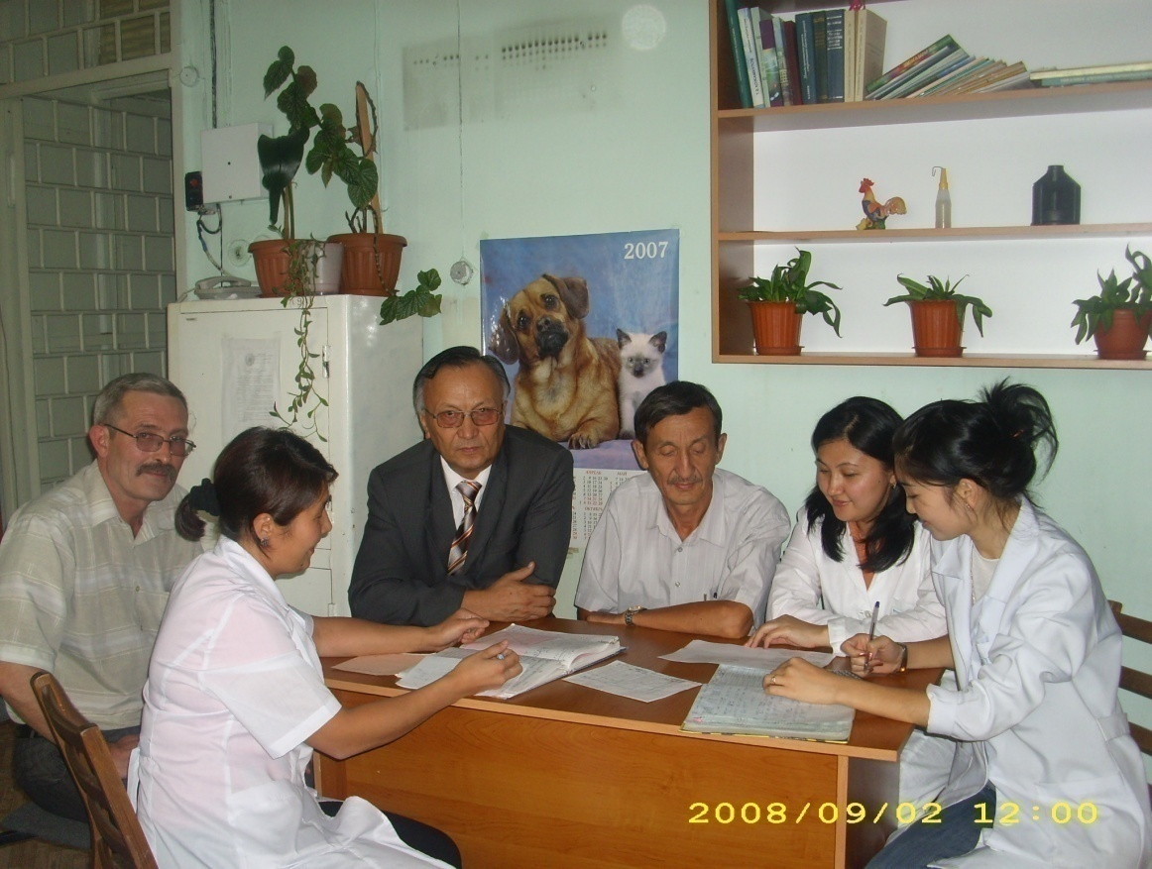
Immobilization of biologically active compounds on
polymer matrices
New composite dosage forms of effective drugs are being developed that have significant advantages over traditional dosage forms.
Specialists of the direction discussing scientific results
Head of the direction, Doctor of Chemical Sciences Professor
Abilov Zh.A.

Slide 11
Leading experts in this area
Abilov Zharylkasyn Abduakhitovich, Head of the Department, Doctor of Chemical Sciences, Professor
Zhumagalieva Shynar Nurlanovna, Doctor of Chemical Sciences, Professor
Kudaibergenova Bates Malikovna, PhD, Senior Lecturer
Iminova Rizvangul Sinyasulkyzy, Ph.D., Lecturer
Kairalapova Gulfayruz Zhumabaevna, Ph.D., Lecturer

Slide 12
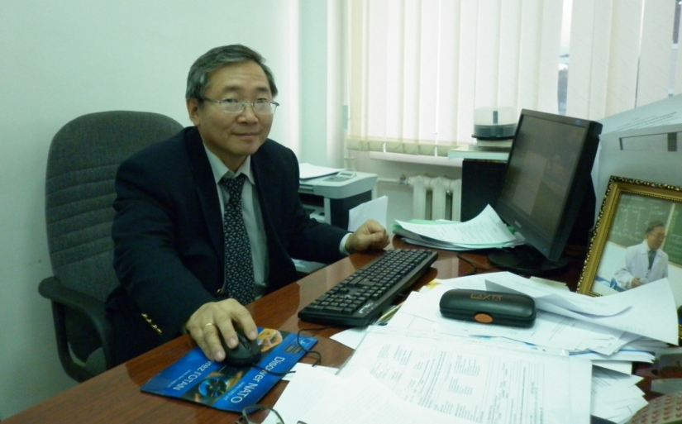
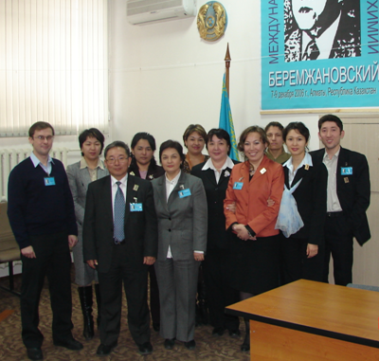
Macromolecular compounds
Head of the Department, Professor G.A. Moon
Scientific directions:
Kinetics and mechanism of radical polymerization
Radiation chemistry of polymers
Biomedical polymers
Synthesis and characterization of stimulus-sensitive polymers
Intermacromolecular reactions and composite materials based on polycomplexes
Chemistry and physics of polymer hydrogels
Nanostructured polymer composite materials
Track membranes
Participation in international
scientific conference

Slide 13
Leading experts in this area
Moon Grigory Alekseevich, Doctor of Chemical Sciences, Professor
Abdykalykova Raushana Asagatovna, Candidate of Chemical Sciences, Associate Professor
Urkimbaeva Perizat Ibragimovna, Candidate of Chemical Sciences, Associate Professor
Mangazbayeva Rauash Amantayevna, Ph.D., associate professor
Rakhmetullaeva Raikhan Kulymbetovna, Ph.D., associate professor
Irmukhametova Galiya Serikbaevna, Candidate of Chemical Sciences, Associate Professor
Agibaeva Laura Erlanovna, Deputy Head of Department for scientific and innovative work and international relations, senior lecturer
Nurpeisova Zhansaya Abirovna, PhD, Senior Lecturer
Kaldybekov Daulet Bolatovich, PhD, Senior Lecturer
Nurgazieva Elmira Kudaibergenovna, PhD, Senior Lecturer
Kenesova Zarina Anvarovna, PhD, acting associate professor

Slide 14
Партнерство с зарубежными научными организациями
Research Institute of Chemistry, University of Karachi (Pakistan)
Tsinjian Technical Institute of Physics and Chemistry
University of Postdam
(Germany)
Moscow State University M.V. Lomonosov
Rostock University
(Germany)
Partners
Crimean State Medical University
University of Reading(England)
University of Memphis(USA)
University of Mississippi (USA)
Sainz University (Malaysia, Panang)

Slide 15
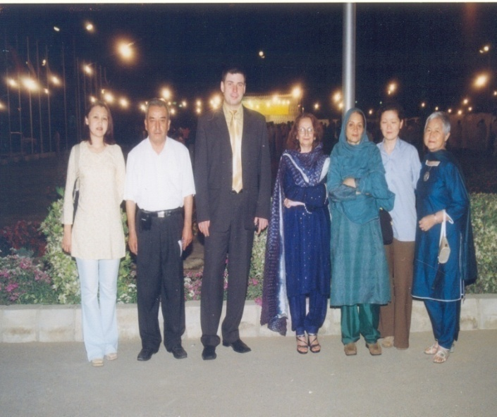
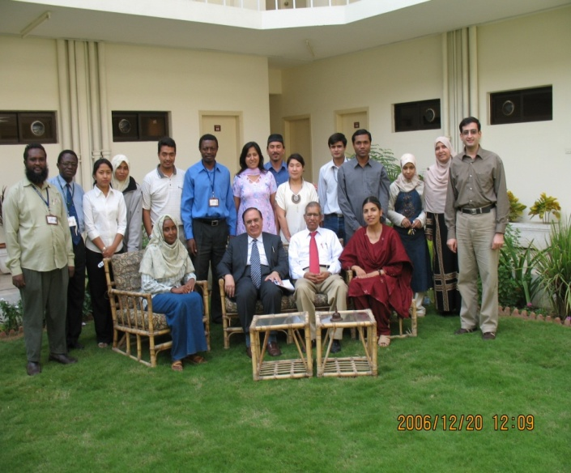
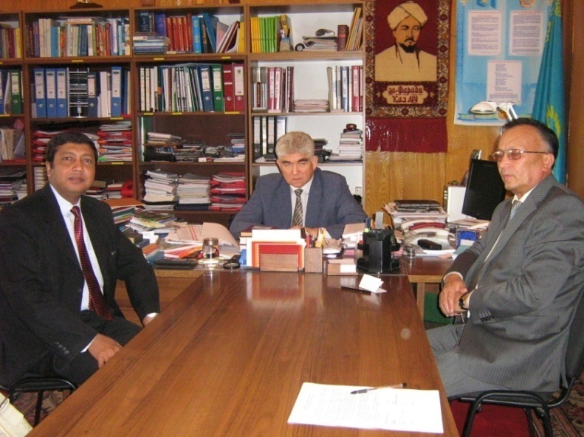
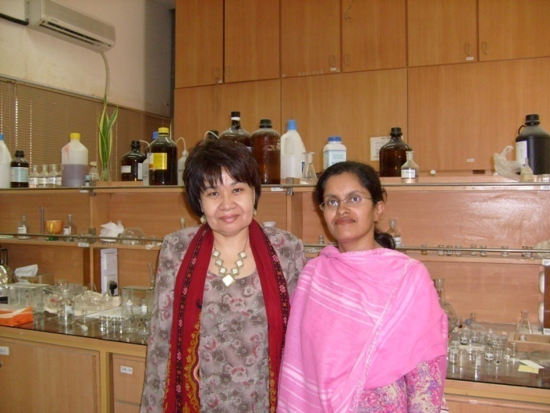
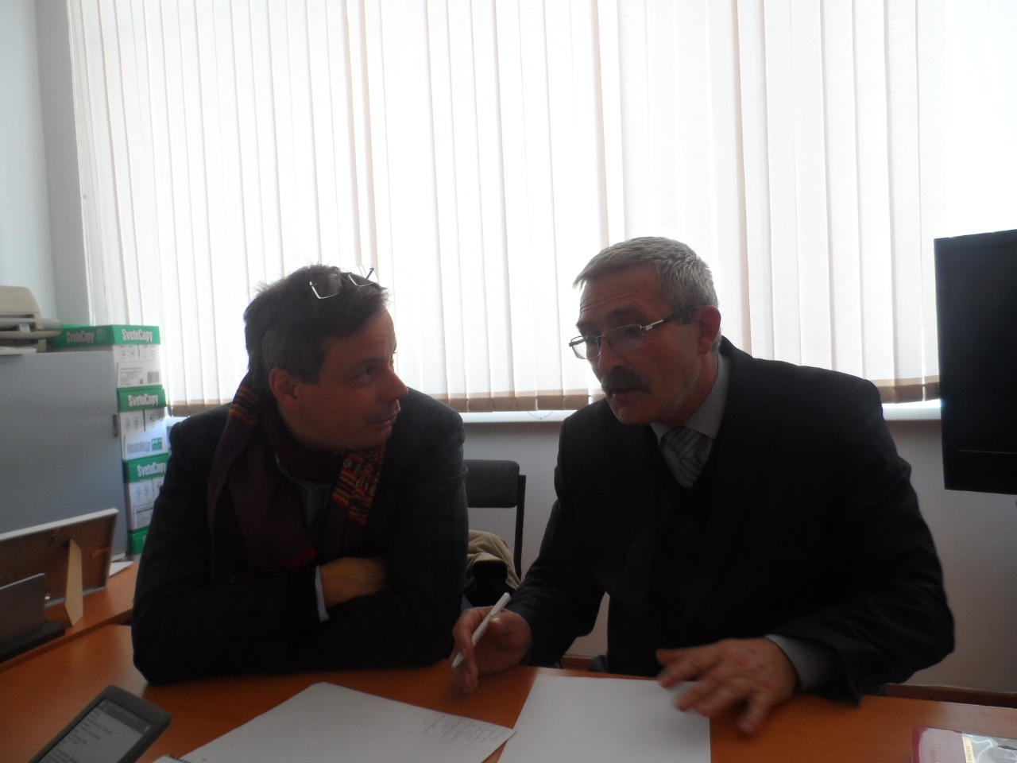
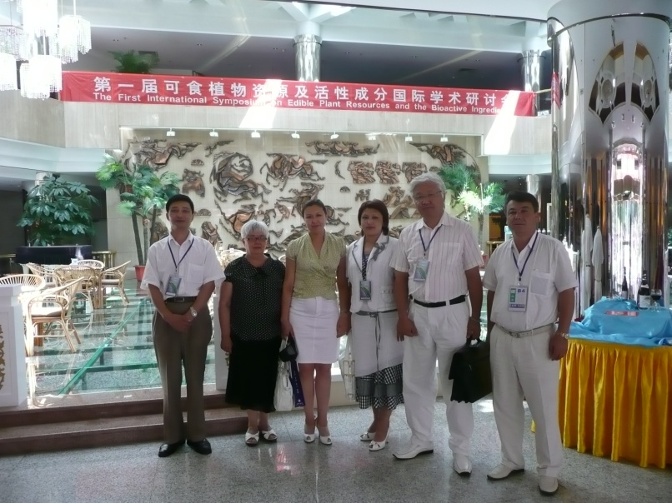
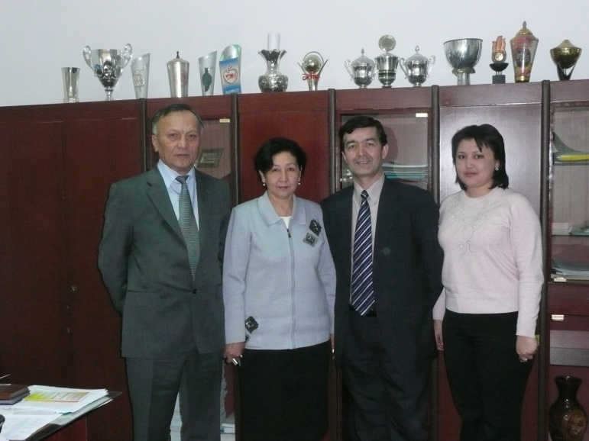
The visit of Professor M.I. Chaudhary
Karachi, Pakistan
Visit of Professor Peter Langer (Germany)
Visit of Professor Azhi Akbar
г. Урумчи, Китай

Slide 16
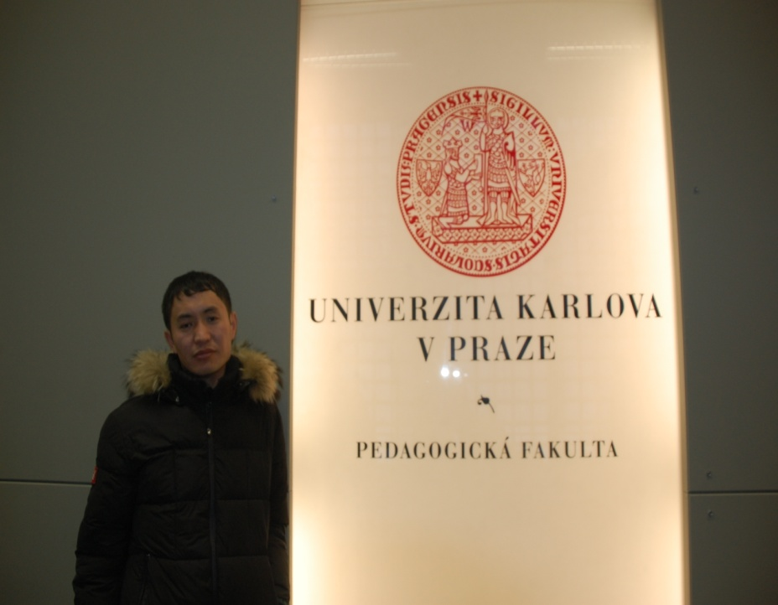
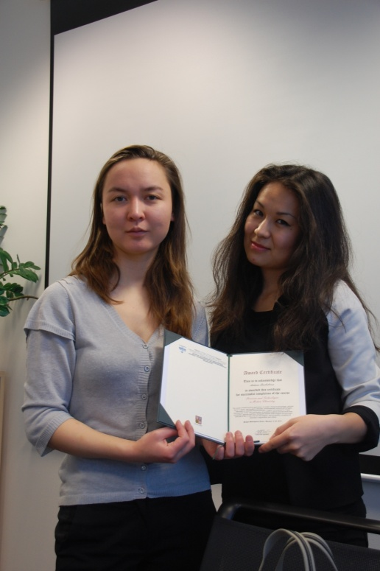
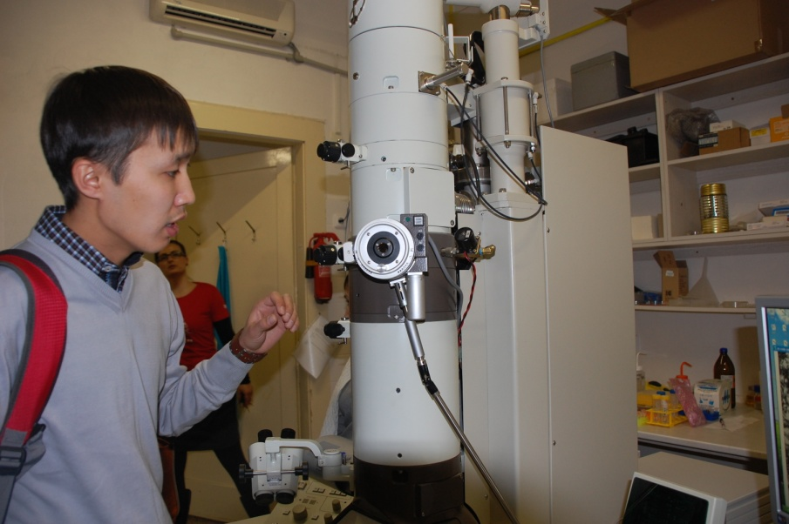
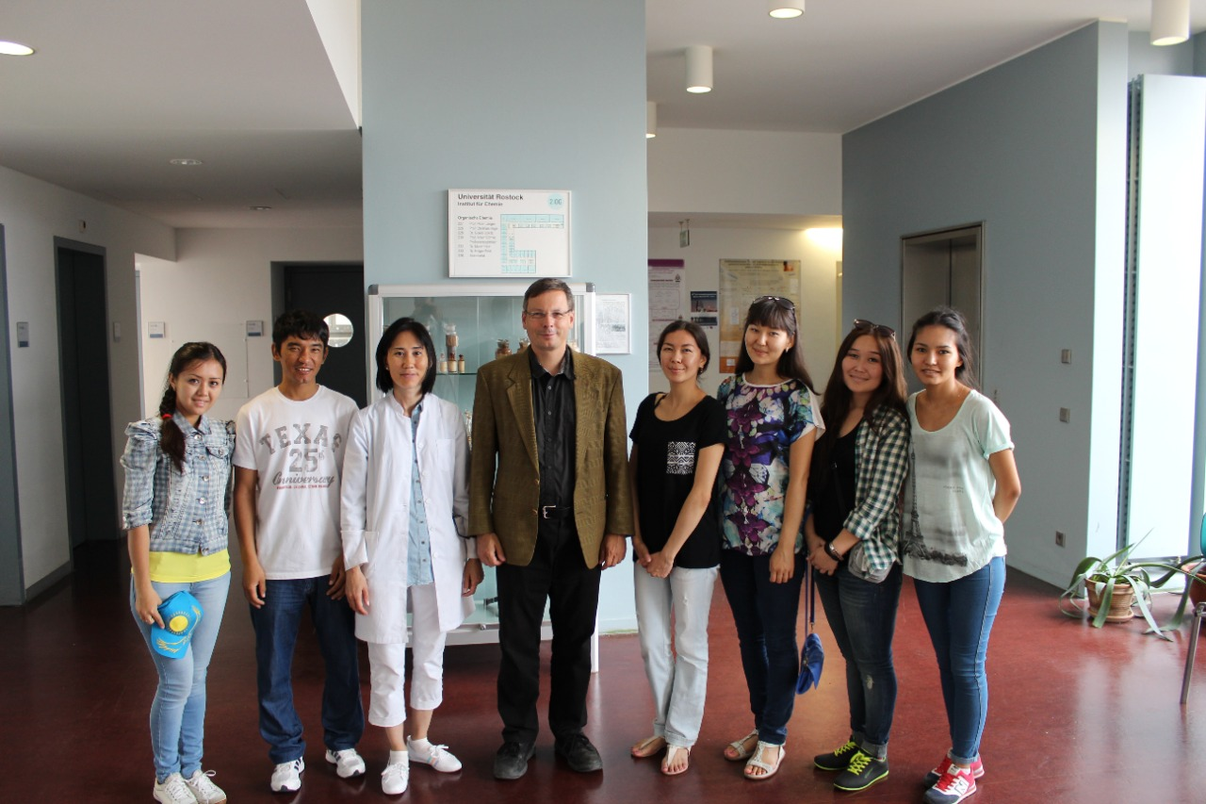
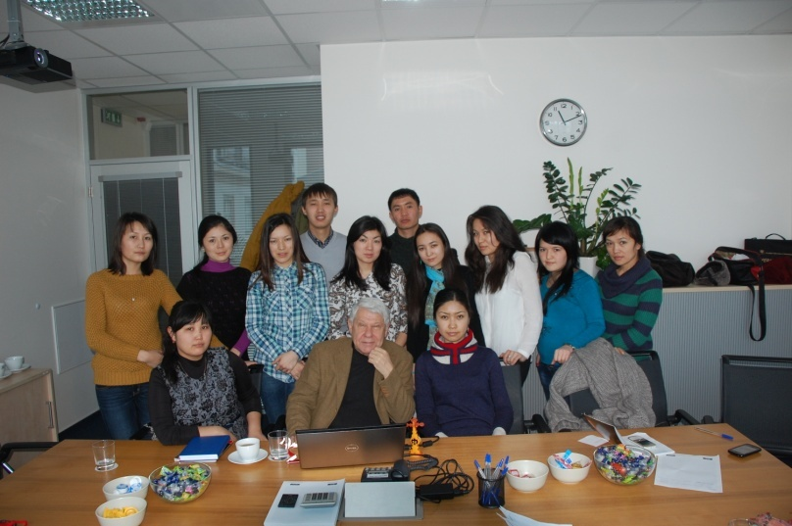
Scientific internship for doctoral students and undergraduates of the department, University of Rostock (Germany), 2016

Slide 17
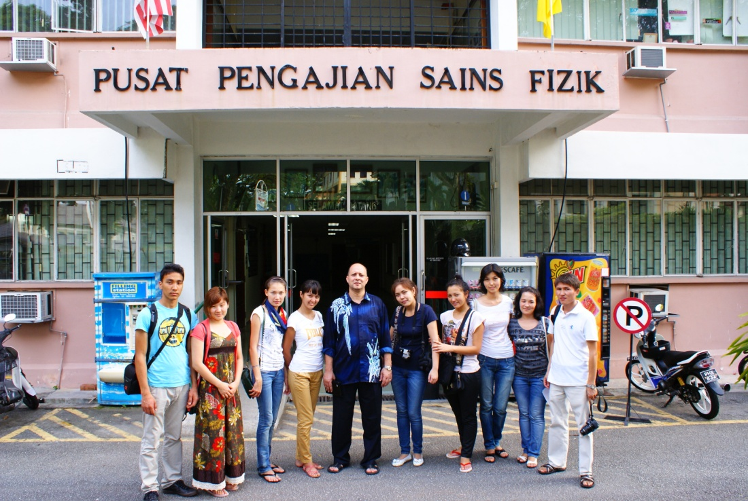
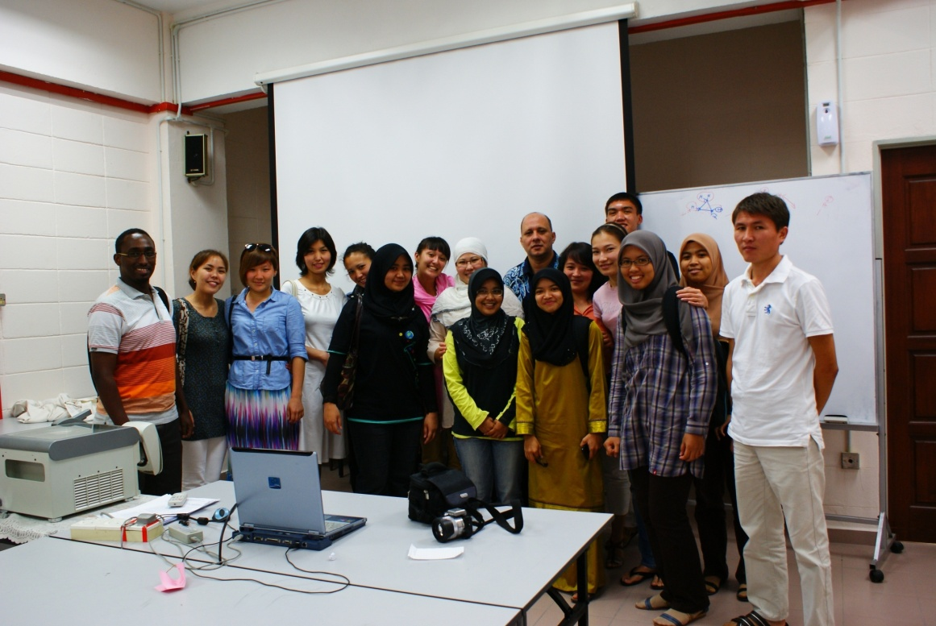
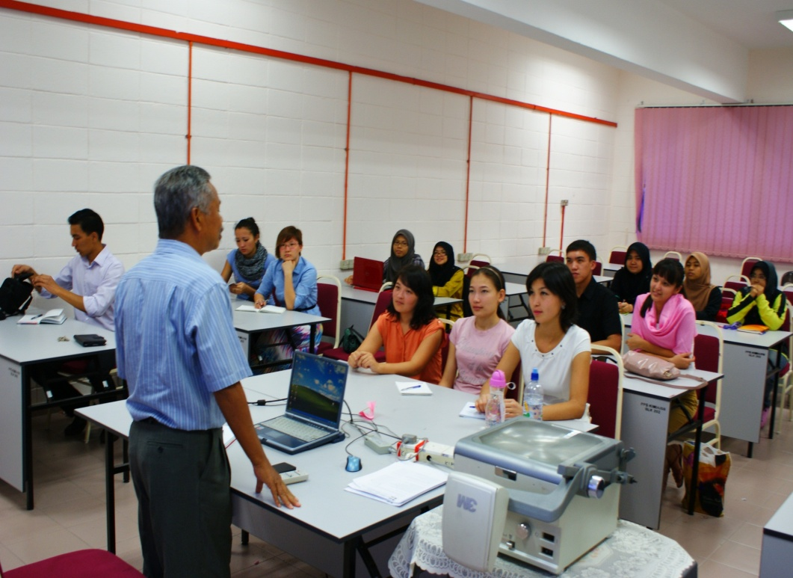
Scientific internship of 1st year undergraduates under the program "Academic mobility", Science University of Mallasia, 2012

Slide 18
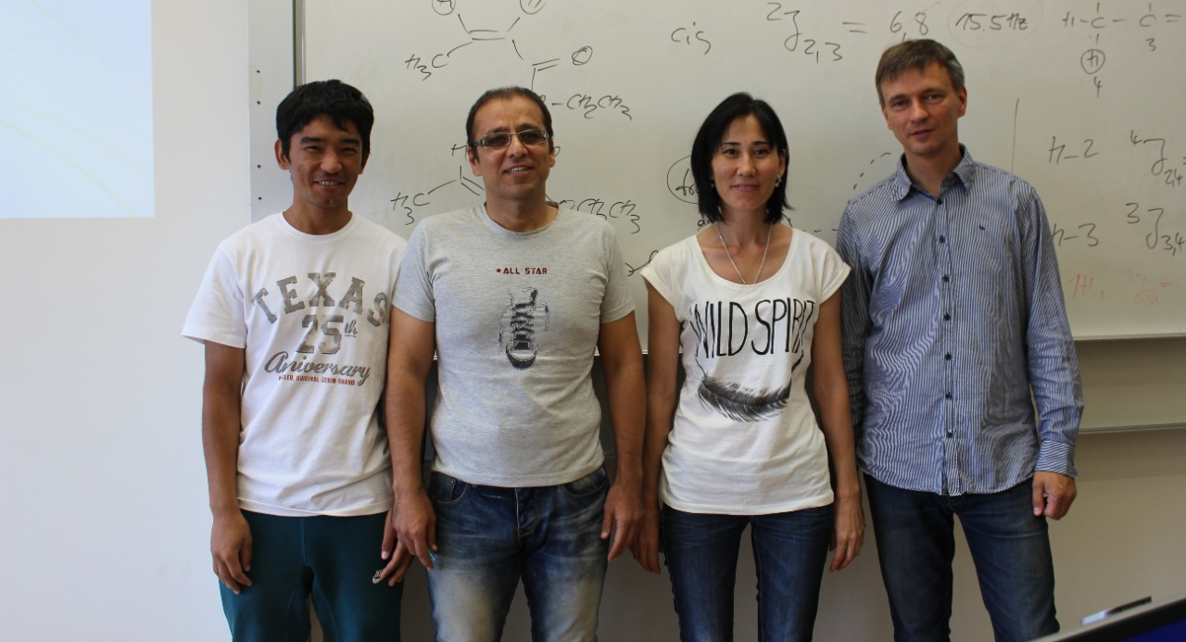
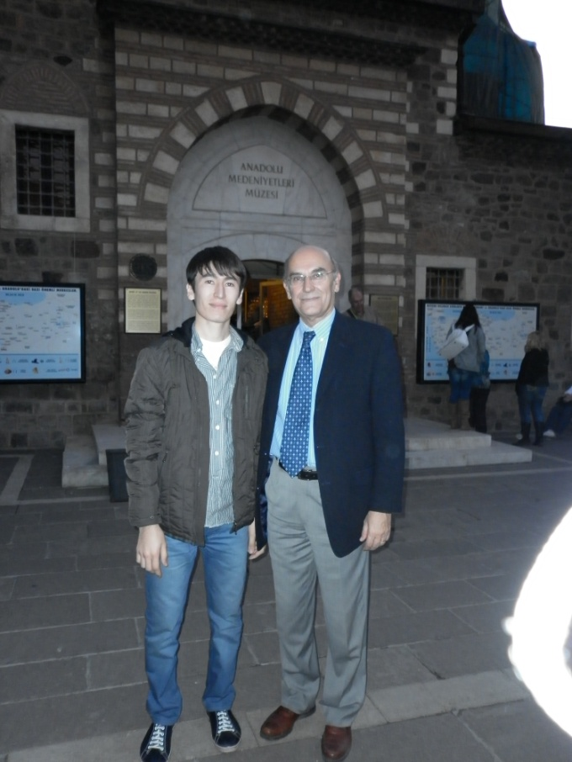
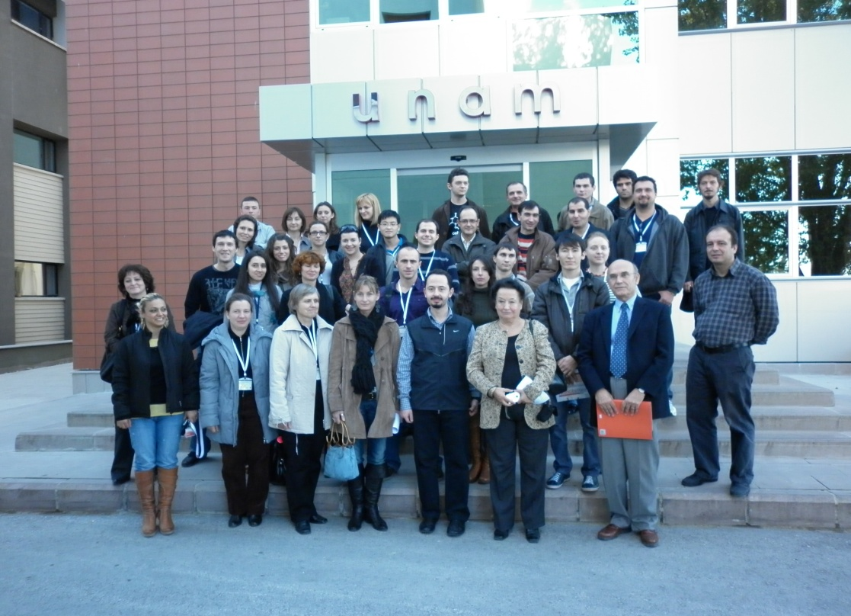
Participation of PhD doctoral student Kaldybekov Daulet in international scientific conferences (currently located in Turkey)
Turkey
Hajattepe University, Ankara

Slide 19
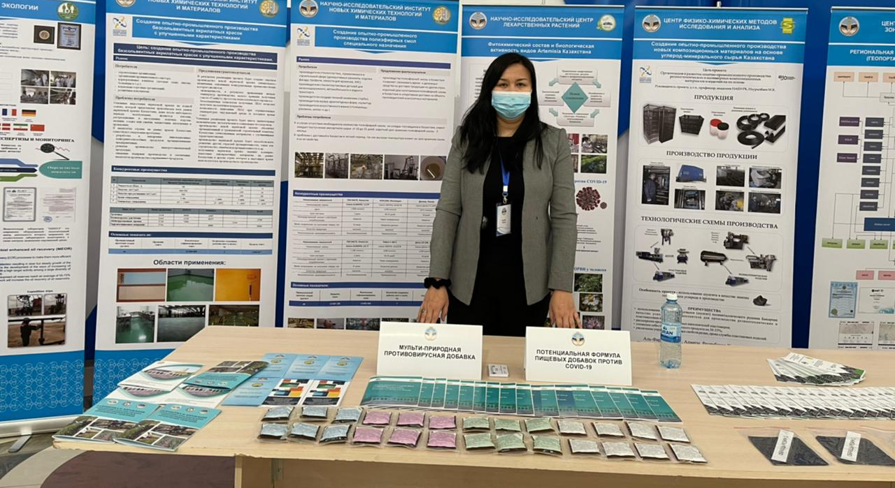
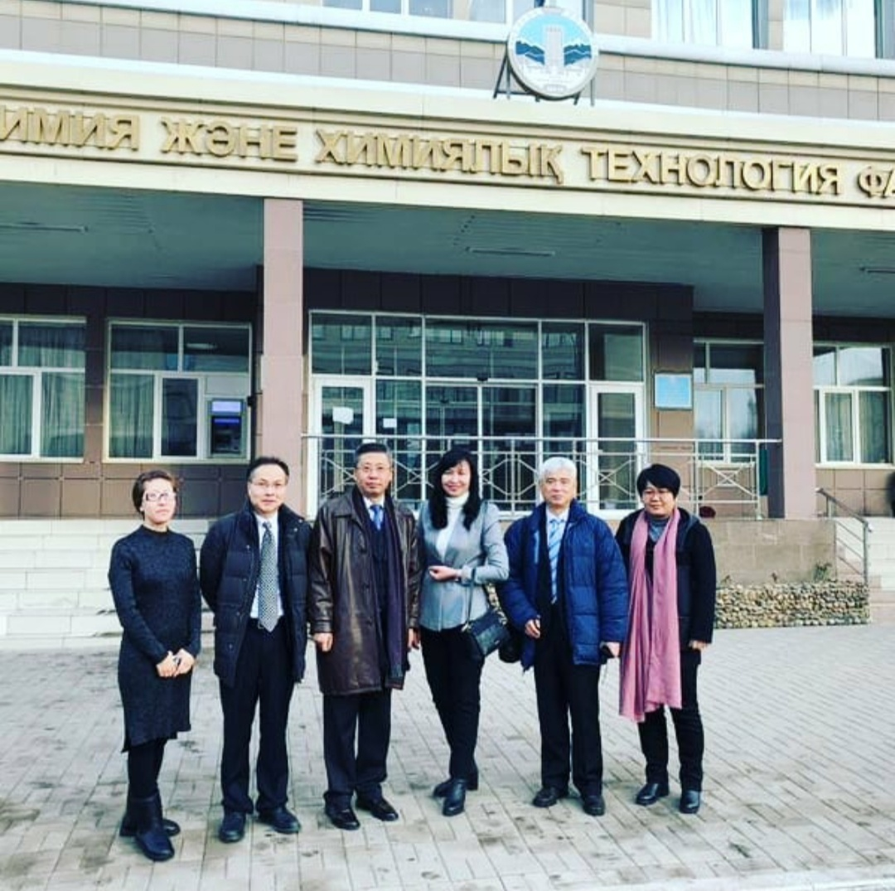
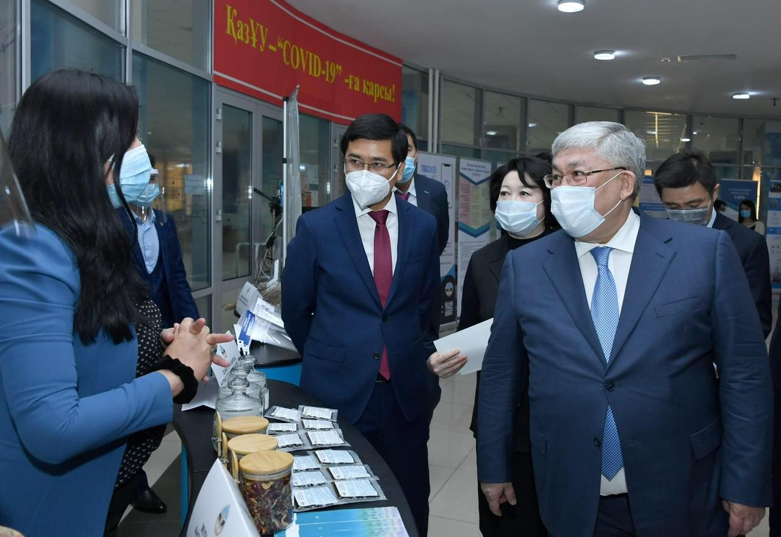
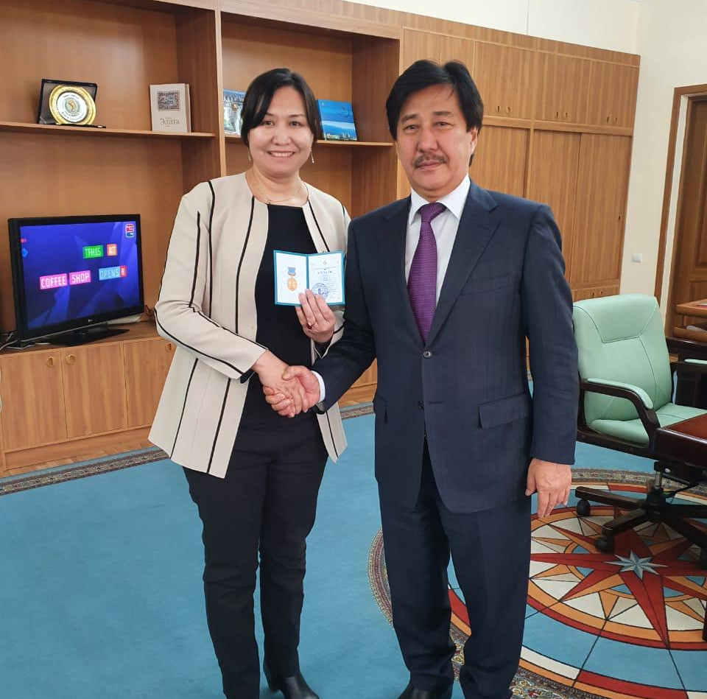
Зарубежная стажировка докторантов в Шанхайском институте лекарственных препаратов, Китайская Академия наук, 2018-2019
Acquaintance at the conference with "Potential Nutraceutical Formula Against COVID-19" and "Natural Blend of Multibacterial Antivirals."
Professor Ye Yang's visit to the Shanghai Institute of Medicines
Professor of the department Zhenis Zhanar at the presentation of the medal of the Kazakh National University. Al-Farabi "For Valiant Labor"

Slide 20
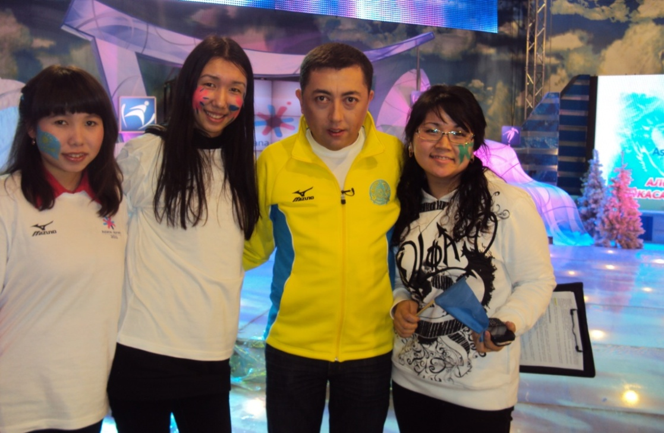
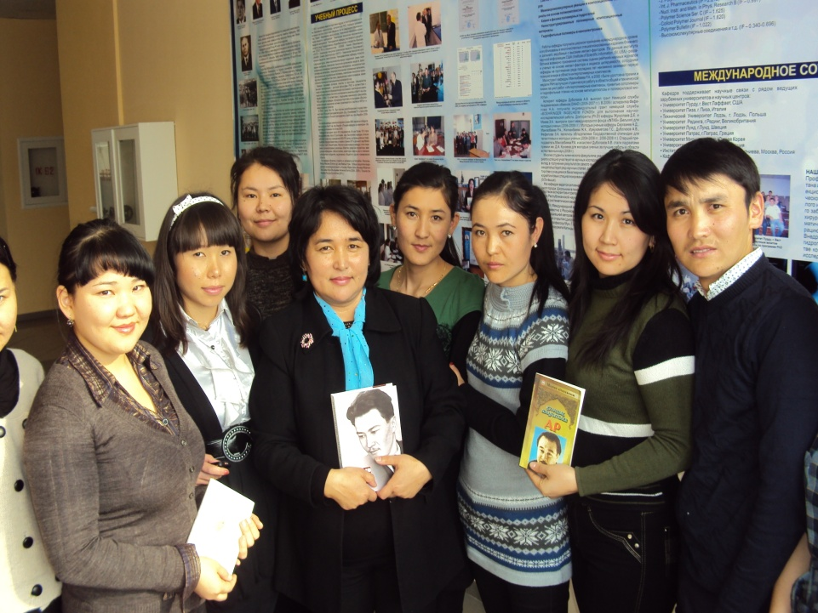
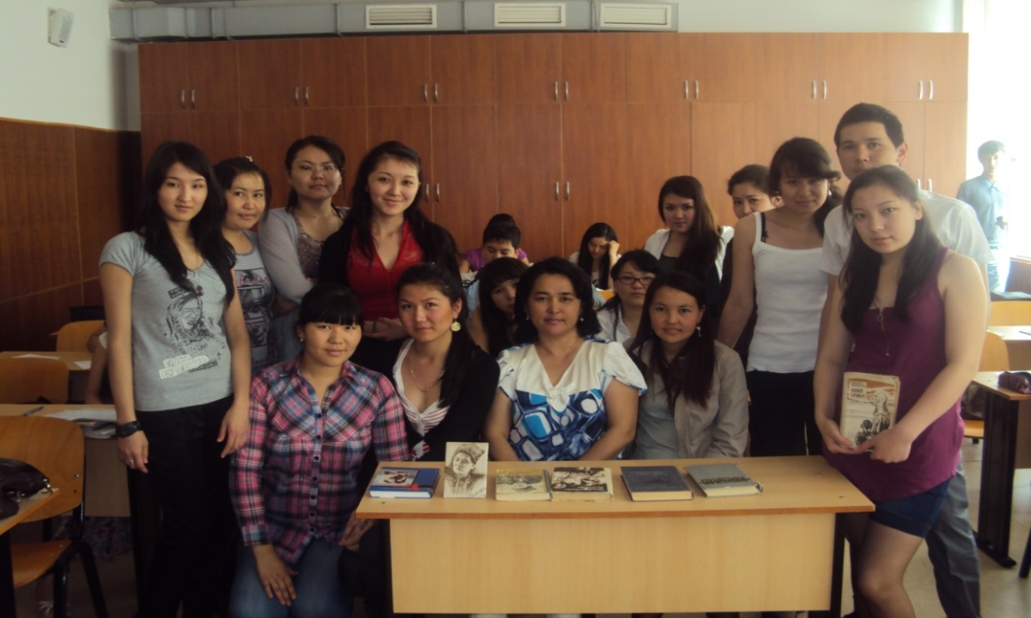
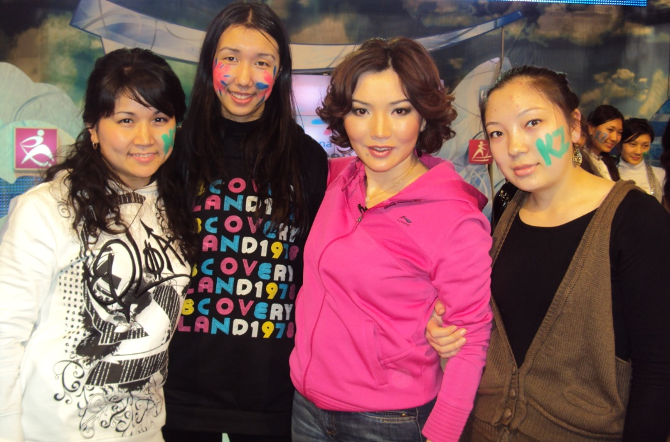
Participation of teachers and students
in cultural events

Slide 21
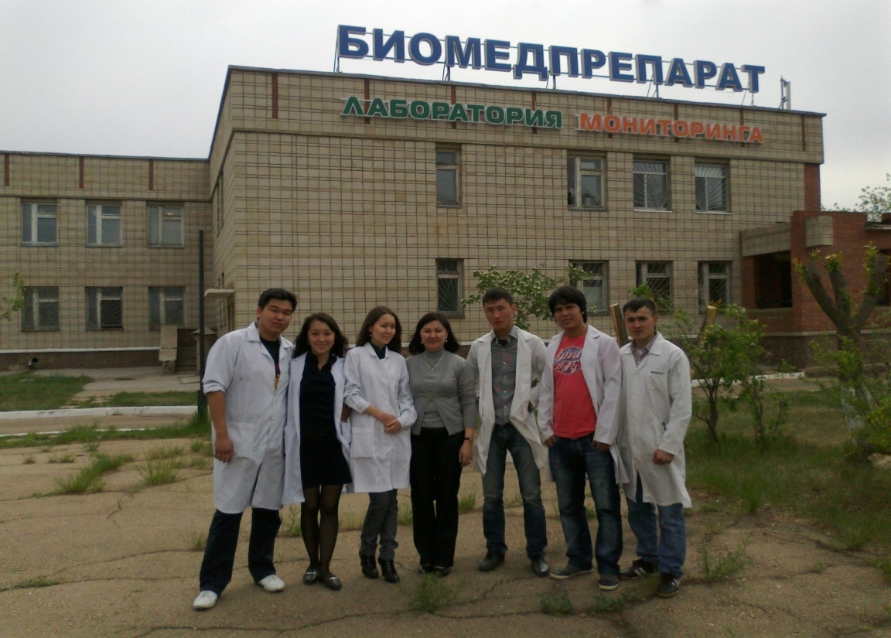
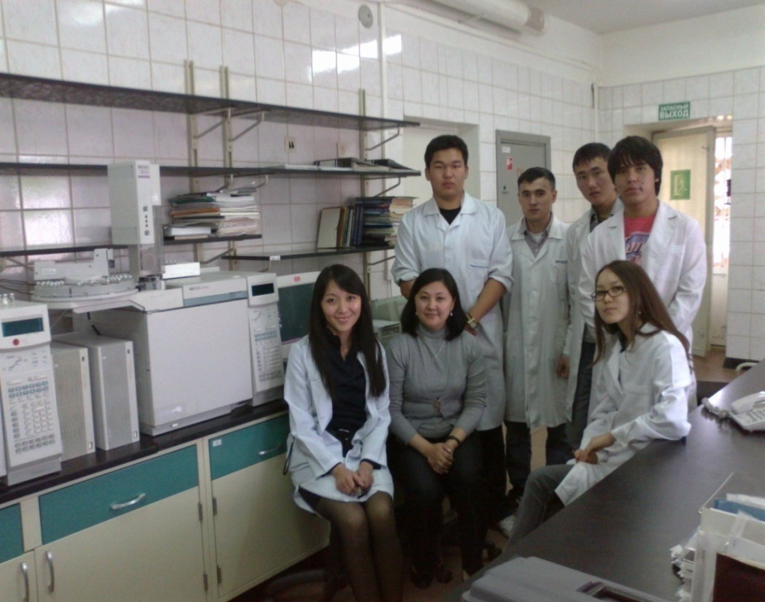
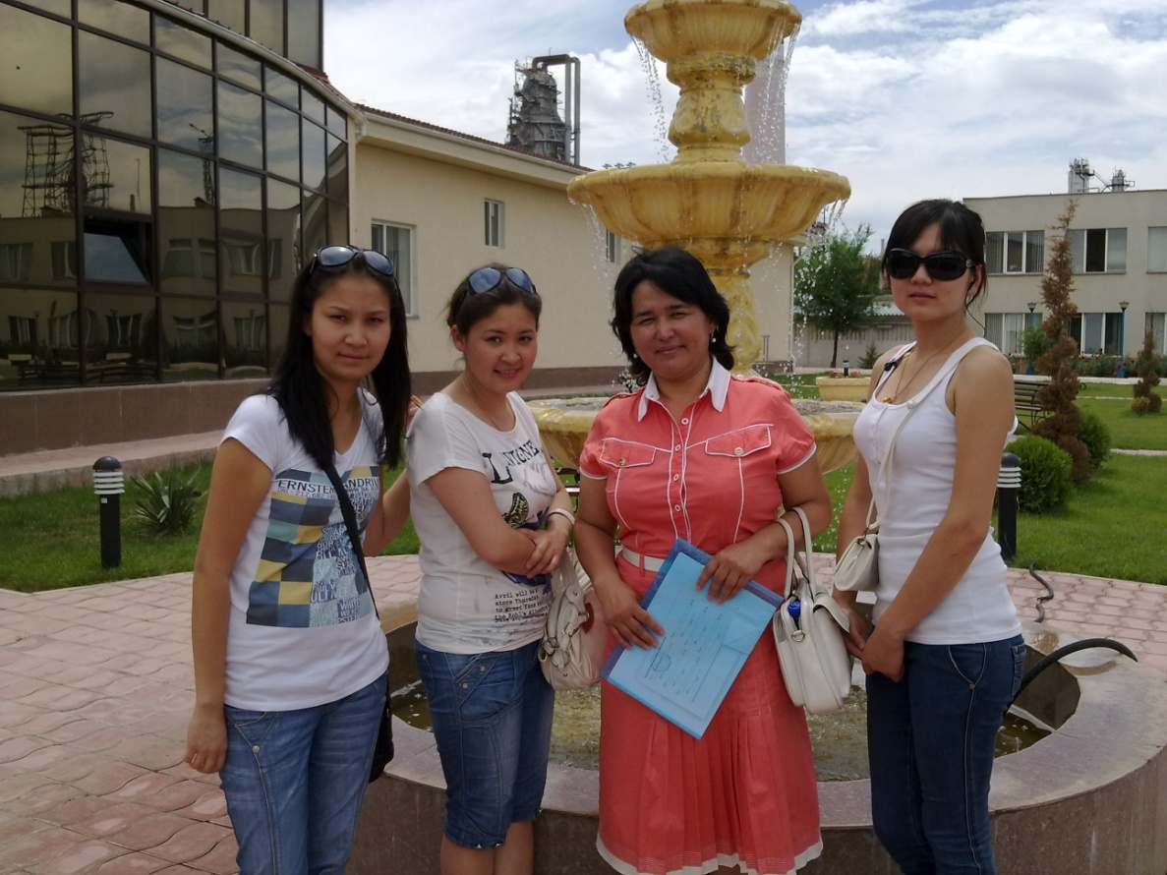
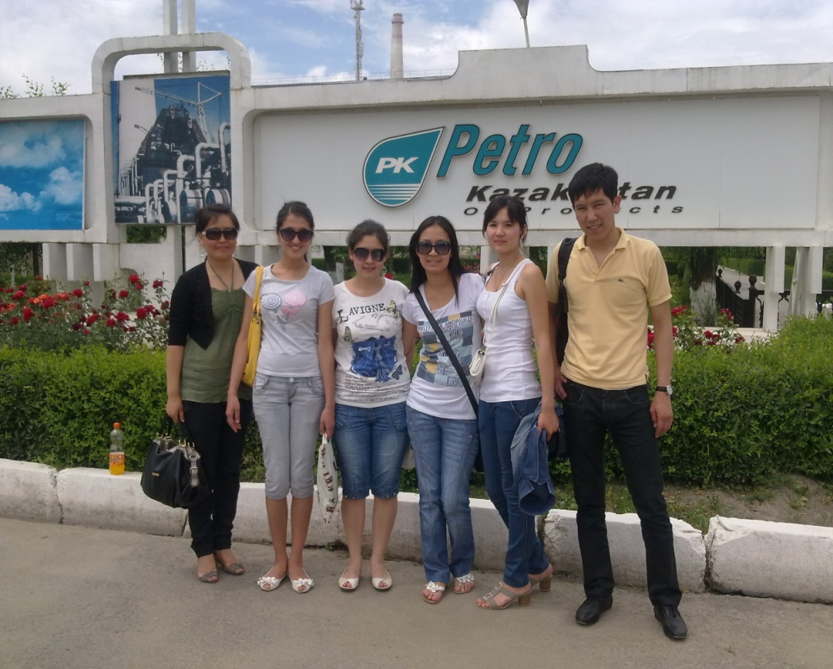
Industrial practice of students of the department,
3 course

Slide 22
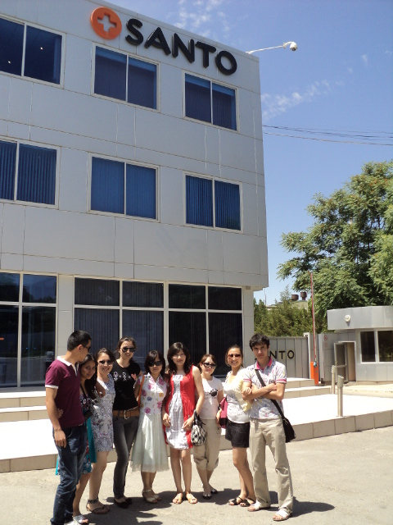
Industrial practice of students
of the department, 3 course

Slide 23
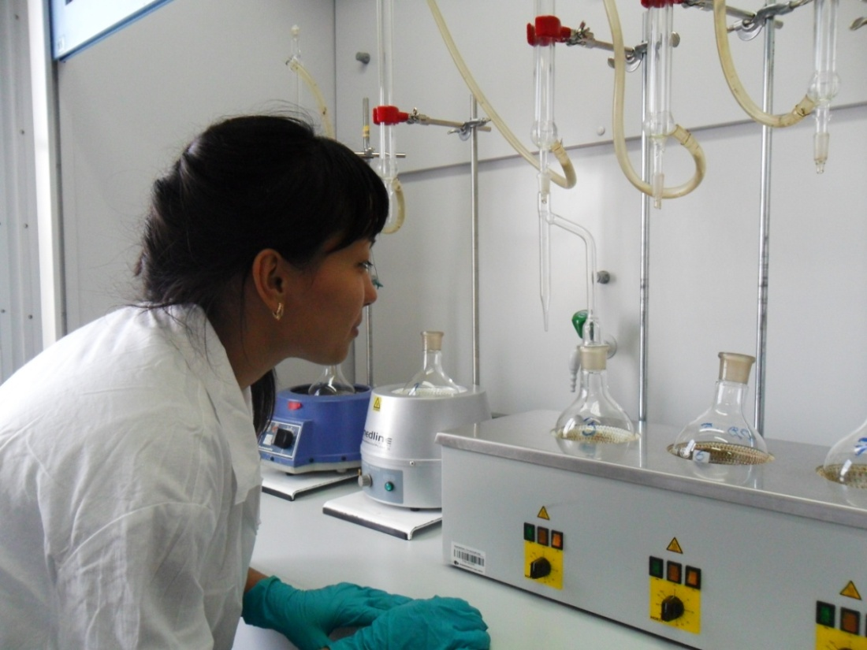
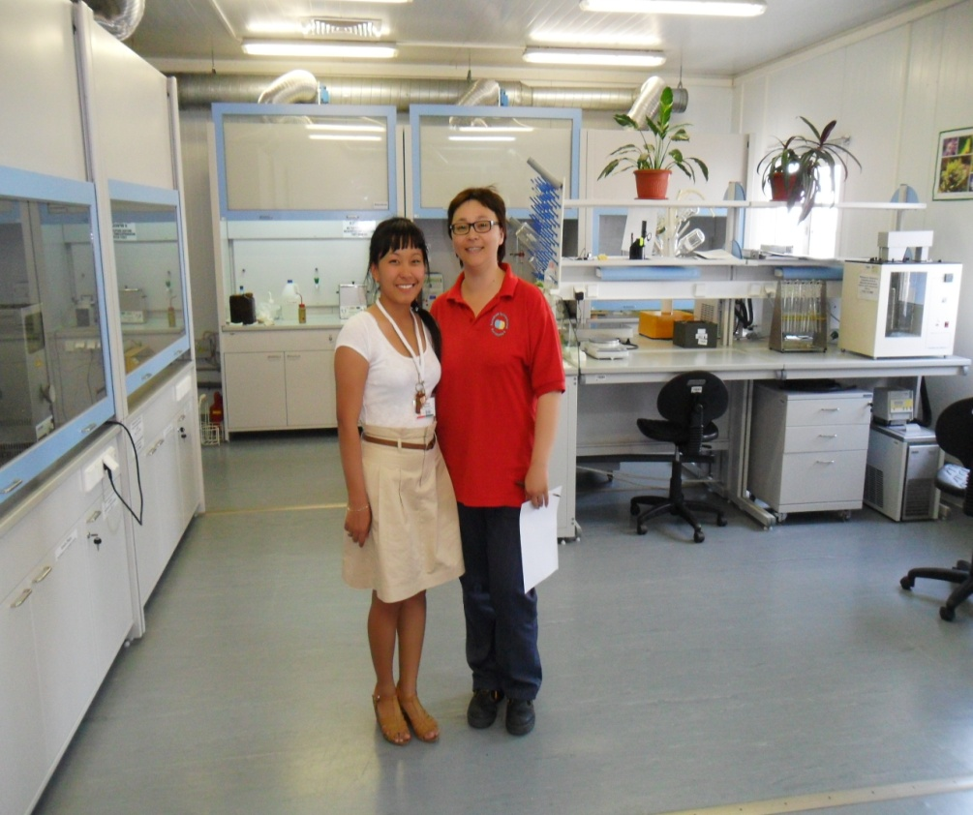
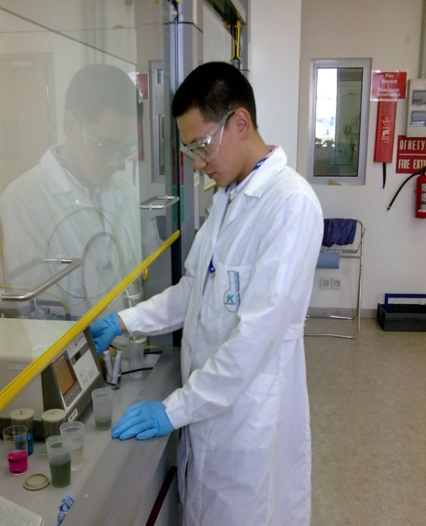
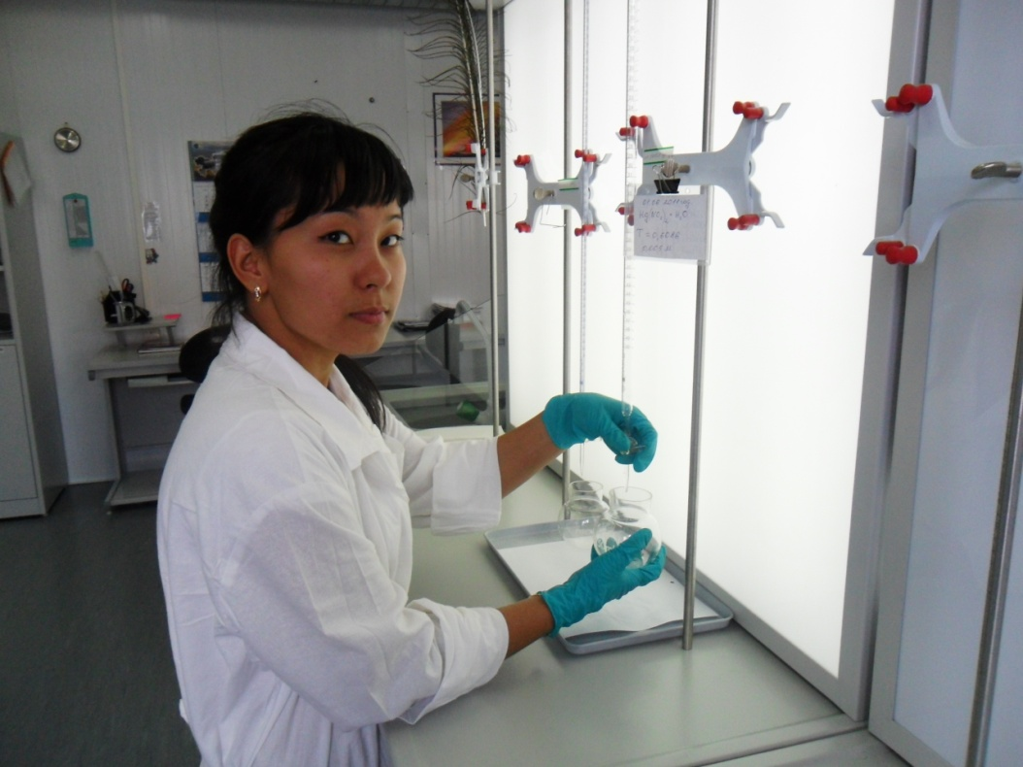
Industrial practice of students of the department,
3 course

Slide 24
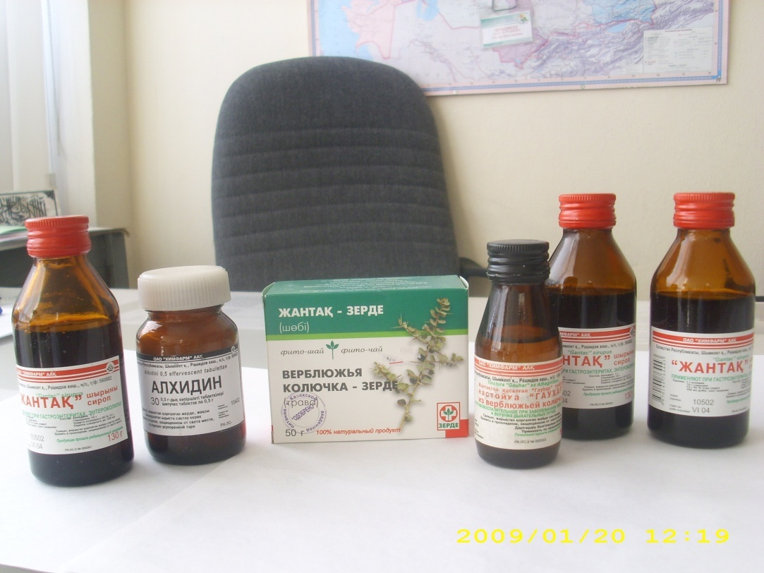
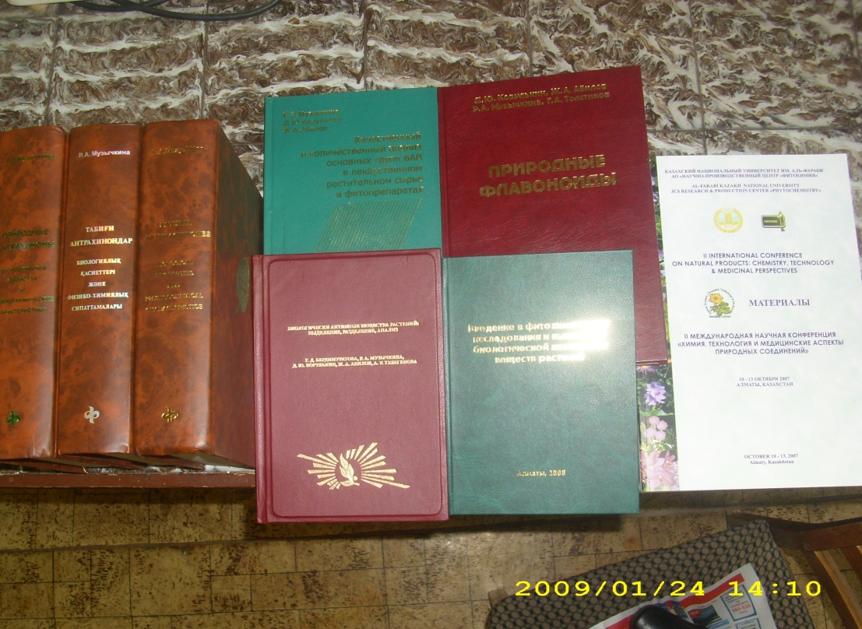
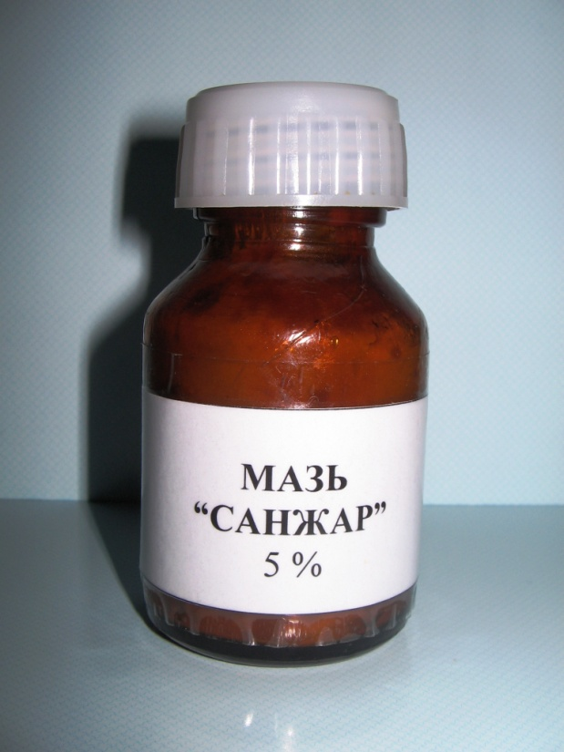
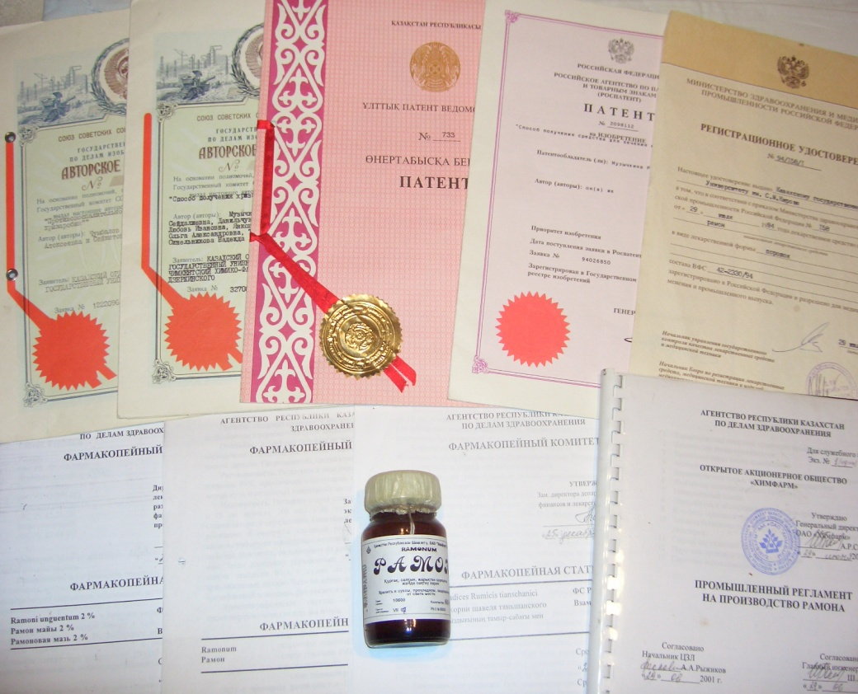
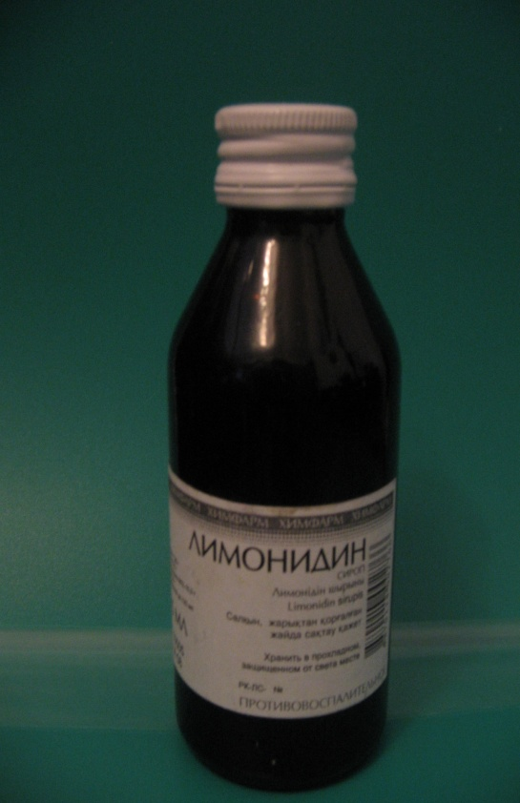
Products of the Department

Slide 25
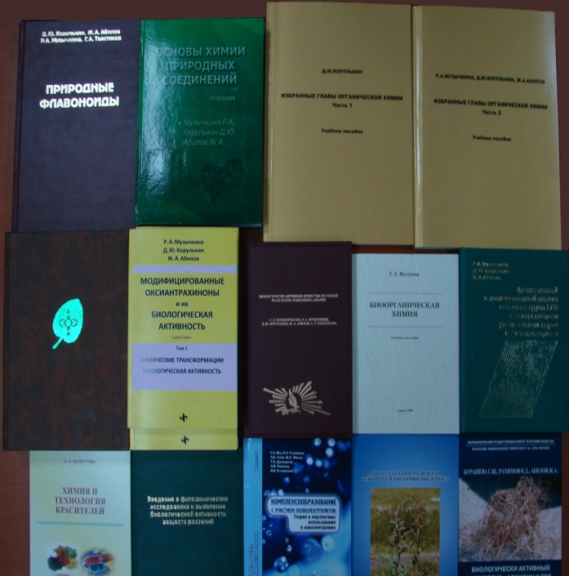
Scientific and educational works
Based on the results of scientific research with employees it
more than 500 articles,
8 monographs,
12 teaching aids
1 tutorial.
were published
Scientific research results are protected
52 patents and copyright certificates of Kazakhstan,
20 pharmacopoeial articles of the Republic of Kazakhstan,
10 experimental industrial regulations.

Slide 26
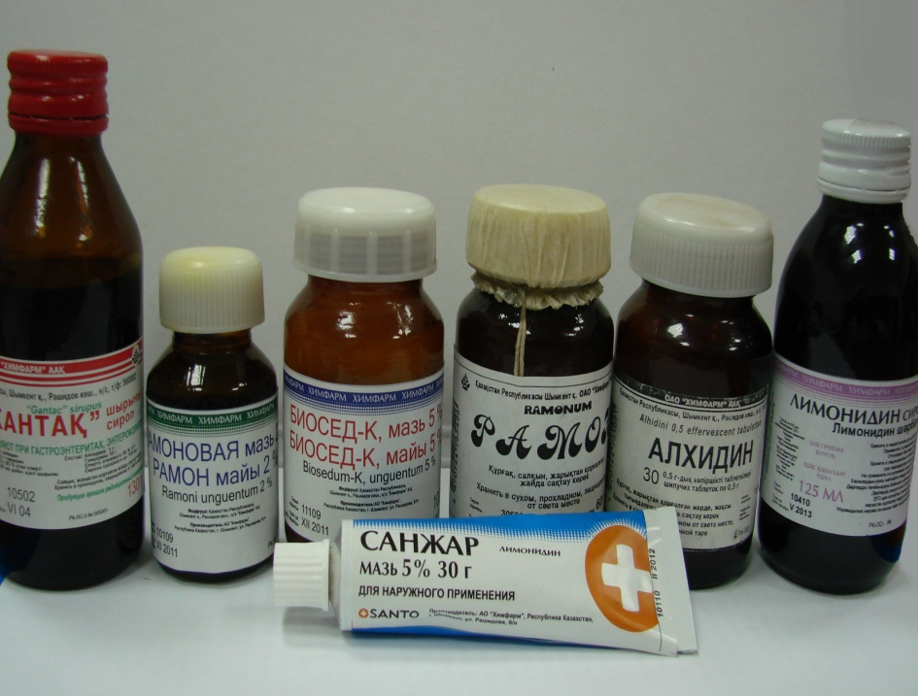
Implementation of the Department
"Alkhidin" - anti-inflammatory, antineoplastic, wound healing agent
"Limonidin" - anti-inflammatory, antiviral, hepatoprotective agent
"Sanzhar" - anti-inflammatory, wound healing, antiviral and immunomodulatory agent
"Biosed-K" - anti-inflammatory, antiviral agent
–

Slide 27
Polymer dosage forms of biologically active substances
The theory of polymerization processes is developed.
About 100 new polymers have been synthesized.
A large amount of fundamental information has been obtained on the reaction mechanism, structure and properties of new polymers.
The principles of functioning of a wide range of polymeric materials have been established.
Dressings for the treatment of wounds and burns, a contact gel for ultrasound diagnostics, an implantation material for internal endoprosthetics "Glycogel", etc. have been introduced into medical practice.
The obtained polymers are used in biotechnology, membrane technology, electronics, etc.
New effective dosage forms (ointments, gels, films) of prolonged action have been developed based on polymers of organic and inorganic origin and preparations obtained at the department: anesthetic action "Rikhlokain" and anti-inflammatory action - "Alchidin"

Slide 28
Where our graduates work
Department graduates
LUKOIL Overseas Service Ltd.
«Аroma»
«KazMunayGas»
"Karachaganak Petroleum Operating"
PHILIP MORRIS KAZAKHSTAN
«Аlina»
«Аrgus-Pharm»
Соса-соla Аlmaty
"RAKHAT" confectionery factory
«Tengiz Chevroil»

Slide 29
Where our graduates work
Zakir Aigerim
specialist of the 1st category
JSC "National Center for Expertise and Certification" Department of Standardization, Metrology and Certification
Zhunuspaev Daulet
Erkenovich
Manager of the Technical Support Department of United Chemical Company LLP (subsidiary of Samruk-Kazyna National Welfare Fund JSC).
Altynai Sarsembay Specialist of the Testing Laboratory of JV Global Pharm LLP

Slide 30
Where our graduates work
Kabyl Kairat - Head of Quality Control Department
JSC "Nobel" Almaty Pharmaceutical Factory
Karamyrzaeva Orazai
Senior Controller of the Quality Control Department
Akmaral Bodaova Quality Control Chemist

Slide 31
Where our graduates work
Nukenov Yerzhan
laboratory chemist,
AtyrauTengiz field, project Sewage treatment plant, technology Holland, designer company "Witteven bos"
Maratuly Armat
Forensic expert in the Department of Internal Affairs of the WKO

Slide 32
Welcome
to the Department of Chemistry and Technology of Organic Substances, Natural Compounds and Polymers !!!

