Slide 1
D E P A R T M E N T O F " F I N A N C E "
Al-Farabi Kazakh National University

Slide 2
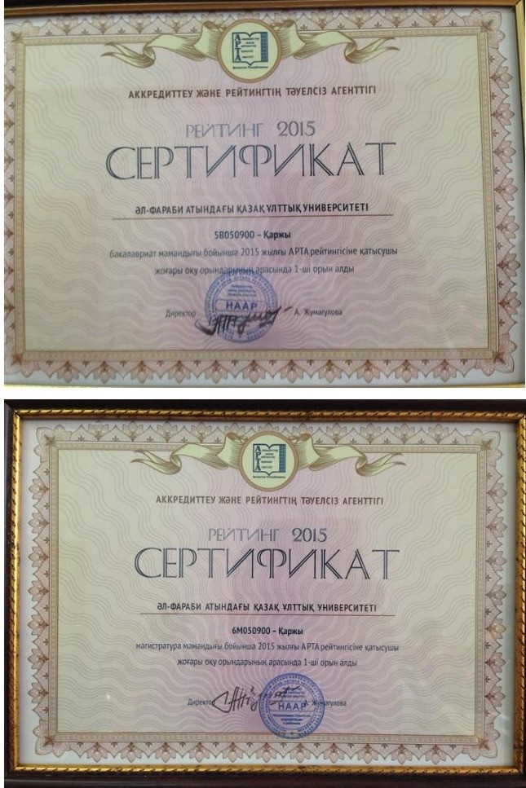
Department of Finance Purpose: preparation of competitive specialists in the field of economics and business
Specialty:
Bachelor's program (5B050900 – Finance): with the award of an academic degree
"Bachelor". The term of study is 4 years. Magistracy (6M050900 – Finance): with the award of an academic degree
"Master". The term of study is 2 years.
Magistracy (6M050900 – Finance): with the award of an academic degree
"Master". The term of study is 1 year.
Doctoral studies (6D050900 – Finance)
with the award of the degree of Doctor of Philosophy (PhD). The term of study is 3 years.

Slide 3

The department trains highly educated specialists for such organizations as:
The National Bank of Kazakhstan
Commercial Banks
Ministry of Finance of the Republic of Kazakhstan
Treasury Department
State Revenue Department
Stock Exchange
Leasing companies, etc.

Slide 4

Joint educational programs
Master's Courses
"6M050900 – Finance" together with the Russian University of Friendship of Peoples
"6M050900 – Finance " together with Institute of Economics of the Committee of Science of the Ministry of Education and Science of the Republic of Kazakhstan
Doctoral studies
"6D050900 – Finance " together with the Institute of Economics of the Committee of Science of the Ministry of Education and Science of the Republic of Kazakhstan

Slide 5


The Scientific and Student Society of Financiers
The research work of students at the university is an integral part of the educational process, as the most effective means of raising the level of professional and special training of well done professionals.
Since September 2011, under the chair "Finance" was organized and is currently actively working "Scientific Student Society of Financiers" (NSOF).
Activities of NSOs:
Creation of conditions for comprehensive and fullest development and realization of creative and scientific potential of students;
Orientation of students to engage in research activities in bachelor's, master's and postgraduate courses; Vocational guidance of students on scientific activity, the provision of practice, which will be useful in the future;
Encourage students to learn the skills of scientific and organizational activities.

Slide 6
In the process of learning, the student acquires knowledge in the following basic disciplines
Money, credit, banks;
finance;
taxes and taxation;
banking;
insurance business
Exchange business;
corporate finance;
stocks and bods market.
Training is conducted on credit technology in Kazakh, Russian and English. More than half of the specialty disciplines are elective (elective courses); the student can choose the disciplines of interest.

Slide 7
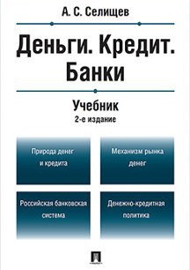









TEXTBOOKS AND TEACHING AIDS OF THE DEPARTMENT OF FINANCE

Slide 8







Companies and organizations in which the students of the department "Finance" pass practical training: government institutions, the National Bank of the Republic of Kazakhstan, ministries, the banking sector, financial organizations, commercial structures, audit companies, etc.

