Slide 1

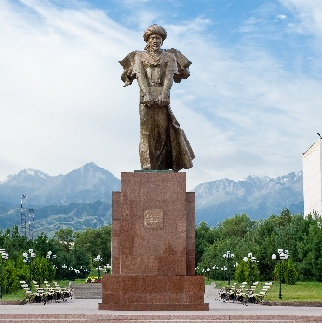
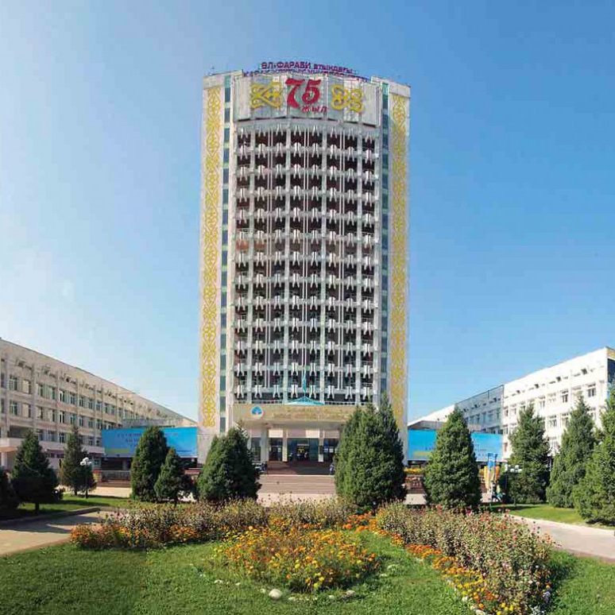
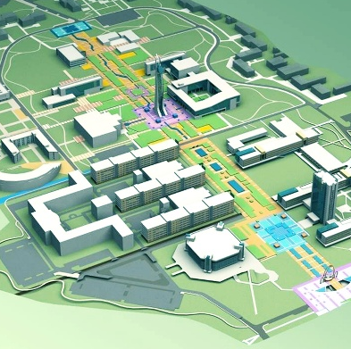
Statistic Overview of Academic Activity

Slide 2
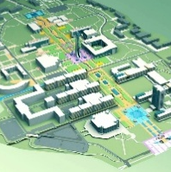

The core curriculum of al-Farabi KazNU
№ | The blocks (cycles) of subjects | Credits
 |  | State Stan-dard | Тop 100 Foreign Universities | Nazarbayev University | Core curriculum of KazNU by directions: Physical & Life / Social & Humanity
1 | Common subjects | 33 | 6 | 10 | 15
 | Compulsory part | 33 | 6 | 10 | 11
 | Optional part | - | - | - | 4
2 | Basic subjects | 64 | 33 | 34 | 81/72
 | Compulsory part | 20 | - | - | 69/66
 | Optional part | 44 |  |  | -
 | STEM | - | 33 | 34 | 12/6
3 | Specialized subjects | 32 | 93 | 82 | 30/35
 | Compulsory part | 5 | 71 | 62 | -
 | Optional part | 27 | 22 | 20 | 30/35
 | Interdisciplinary module | - | - | - | 4/8
 | Total theoretical education | 129 | 132 | 126 | 130

