Slide 1

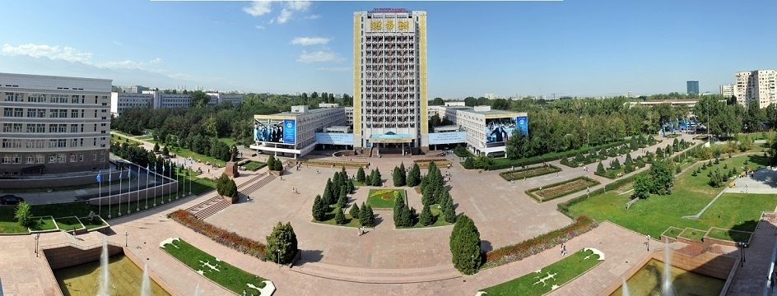
Al-Farabi Kazakh National University
Faculty of pre-university education
www.kaznu.kz

Slide 2
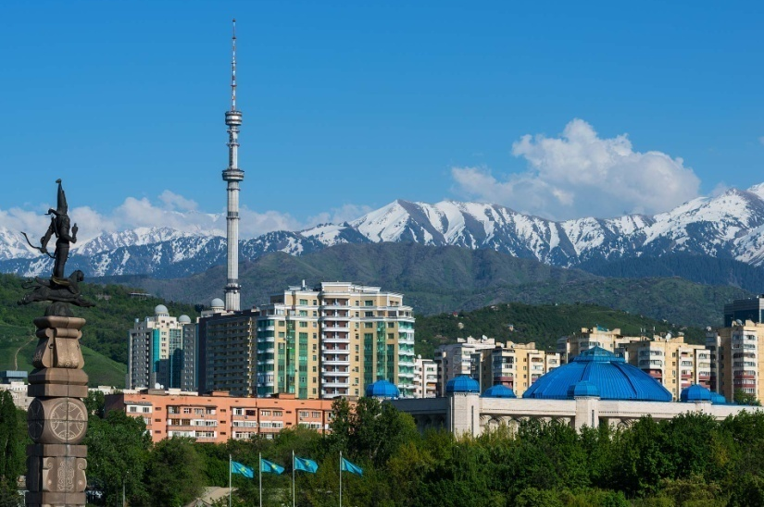
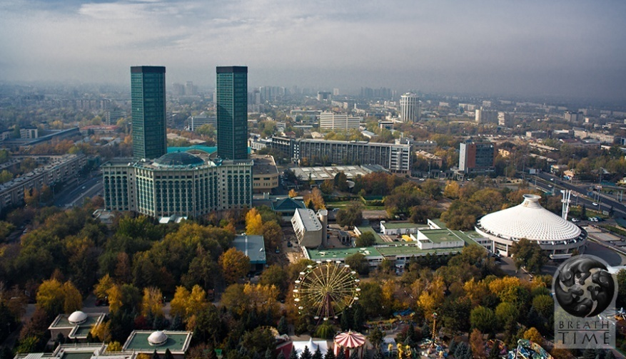
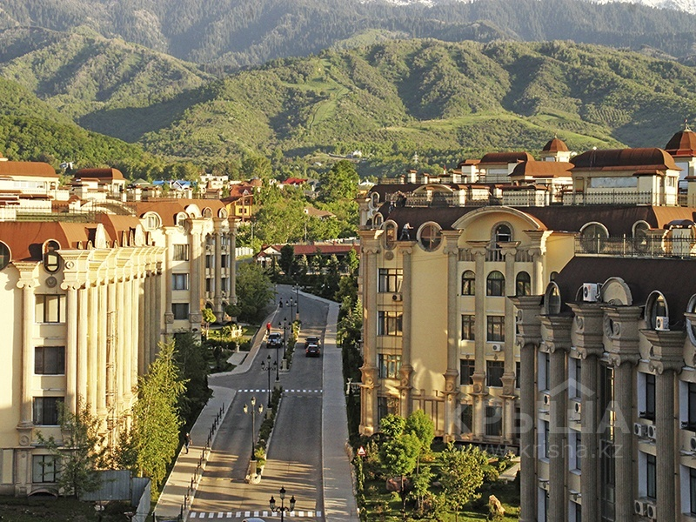
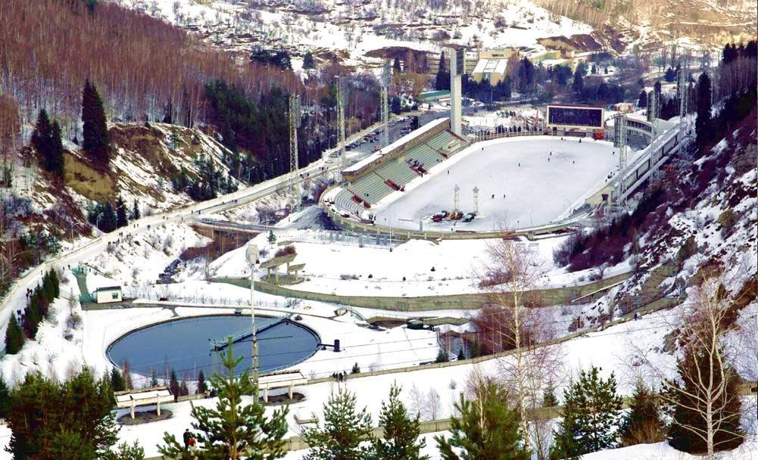
Al-Farabi Kazakh National University
is situated in almaty, kazakhstan

Slide 3
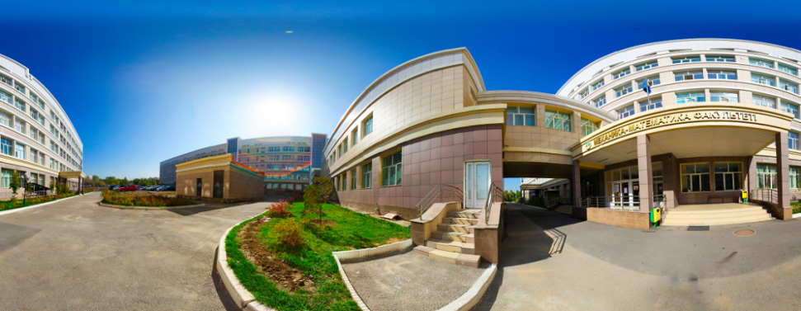
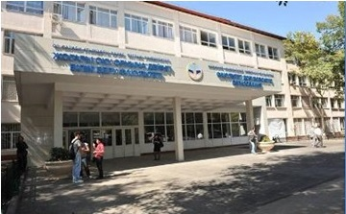
HISTORY OF FACULTY
Faculty of pre-university education was established in 2011 on the basis of the preparatory faculty for foreign citizens, which was founded in 1985. History of the Faculty is part of the eighty-year history of our beloved university. At present, the University continues to develop and improve their international relations, he confidently integrated into the European educational space.
Over the years the Department has trained more than 7,000 foreigners from more than 100 countries around the world: representatives of Kazakh Diaspora from near and far abroad, foreign students on international exchange student program, students of foreign companies, embassies, international organizations. Faculty cooperates with embassies and consulates in different countries: USA, Japan, the Islamic Republic of Afghanistan, South Korea, Mongolia, Spain, Turkey, the People's Republic of China, Iran and others.

Slide 4
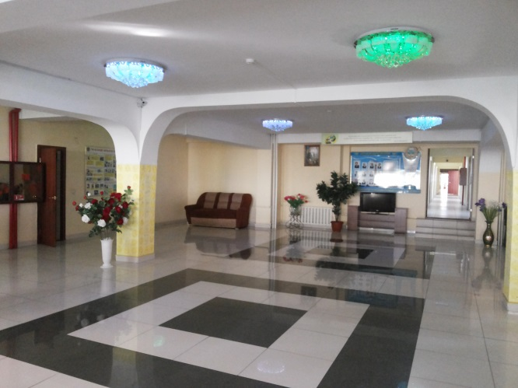
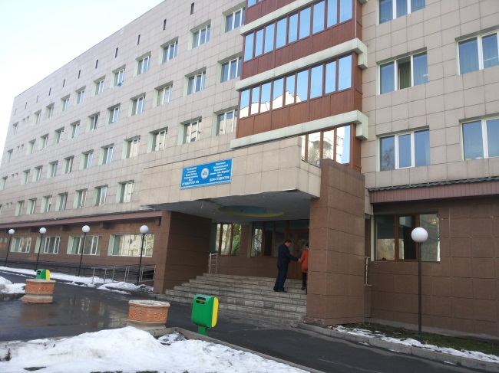
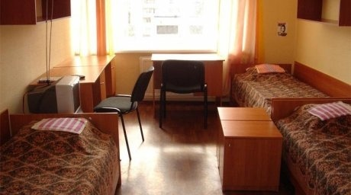
OUR CAMPUS

Slide 5
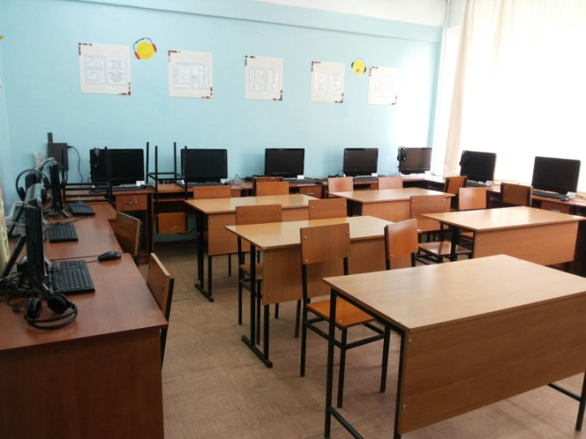
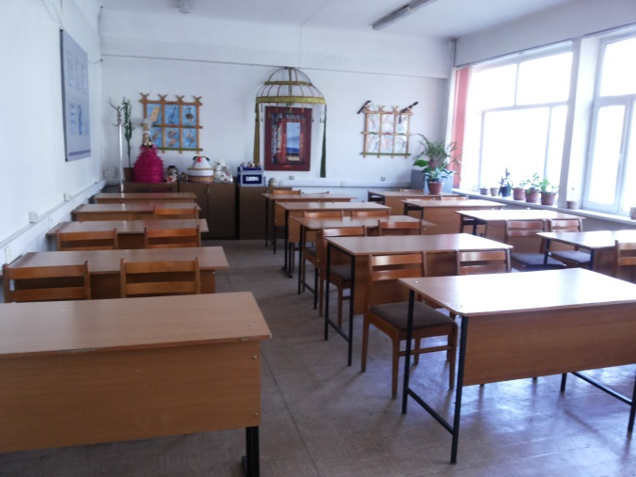
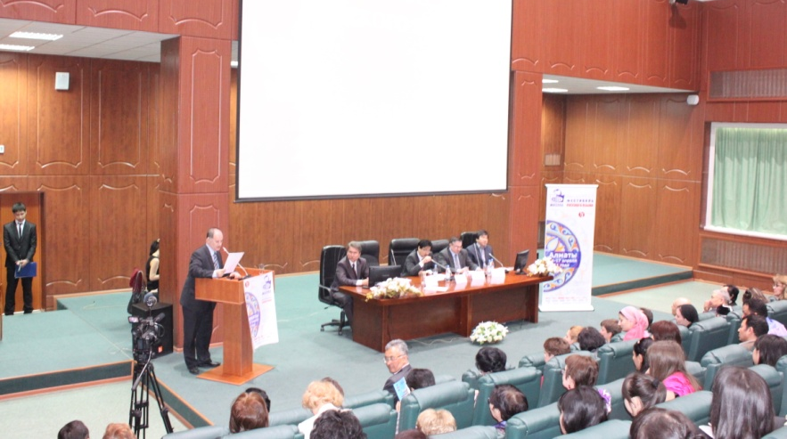
OUR SCIENTIFIC AND TECHNOLOGICAL DEVELOPMENT:
At our Faculty the following methods are developed and implemented in the learning process:
structuring of simple sentences,
algorithmized technology of presentation
of the grammatical material,
modular technology,
dynamic model of language acquisition,
multimedia learning,
interactive methods,
the use of video format and
the Internet,
heuristic learning,
portfolio technology, etc.

Slide 6
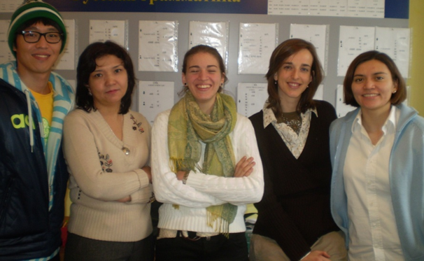
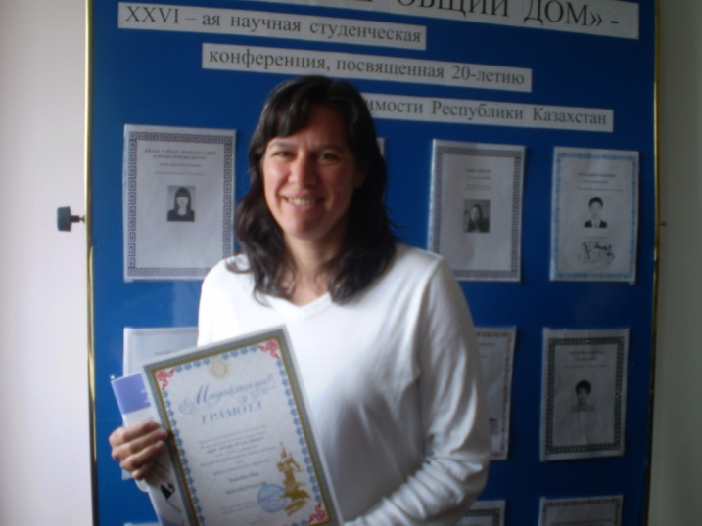
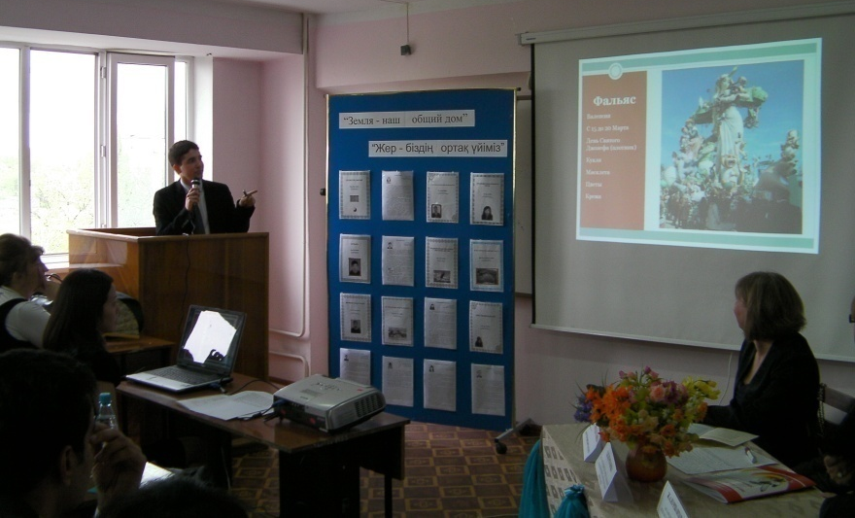
Faculty structure:
Chair of Pre-University Training
Department of training language and general education
College
Profession-oriented school

Slide 7
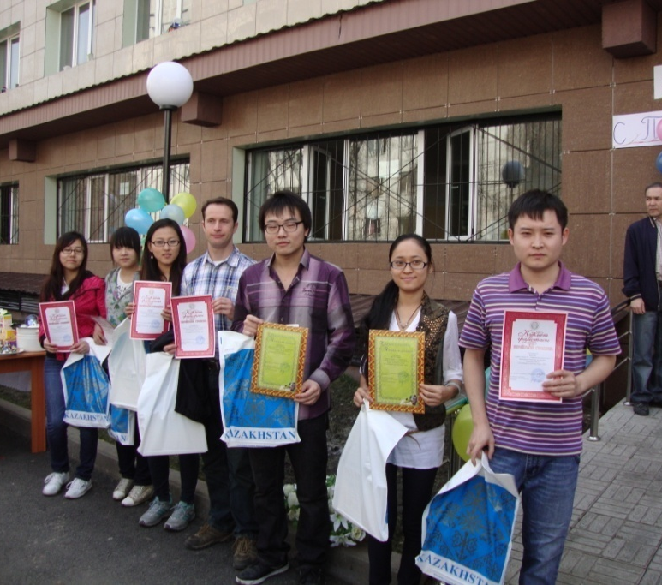
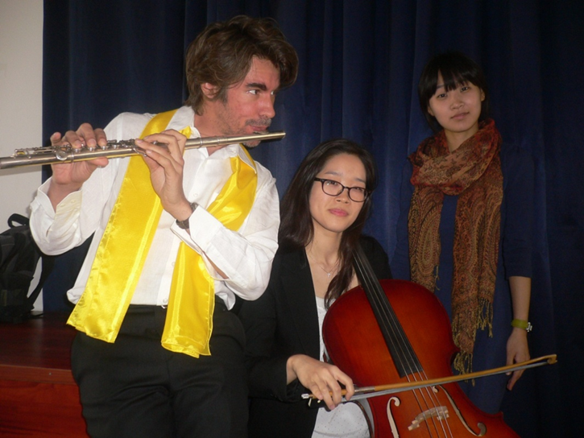
STUDENT LIFE
You can participate in the scientific life of the department. Every year we hold an International Student Scientific Conference. Your works will be published in the conference proceedings.

Slide 8
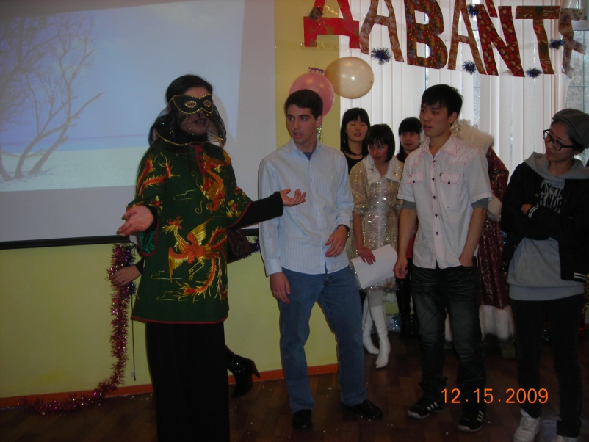
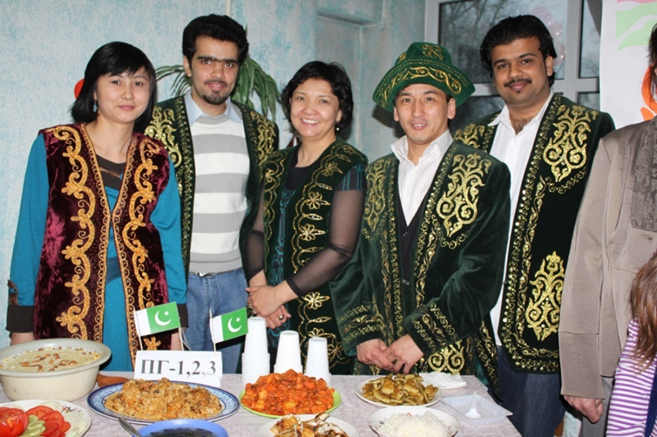
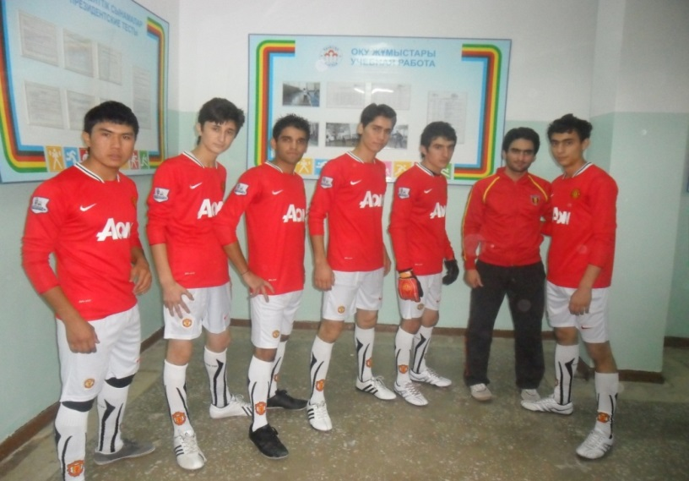
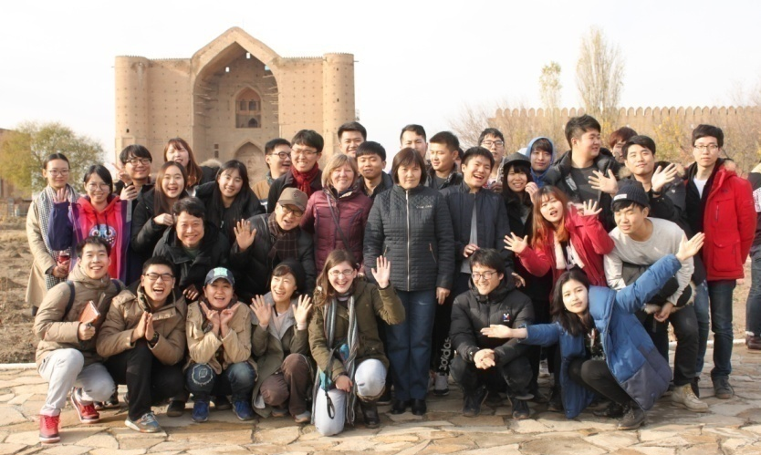
WE HAVE THE FOLLOWING CLUBS:
Sports club "Health"
Theatrical
Literary
Singing
Local lore

Slide 9
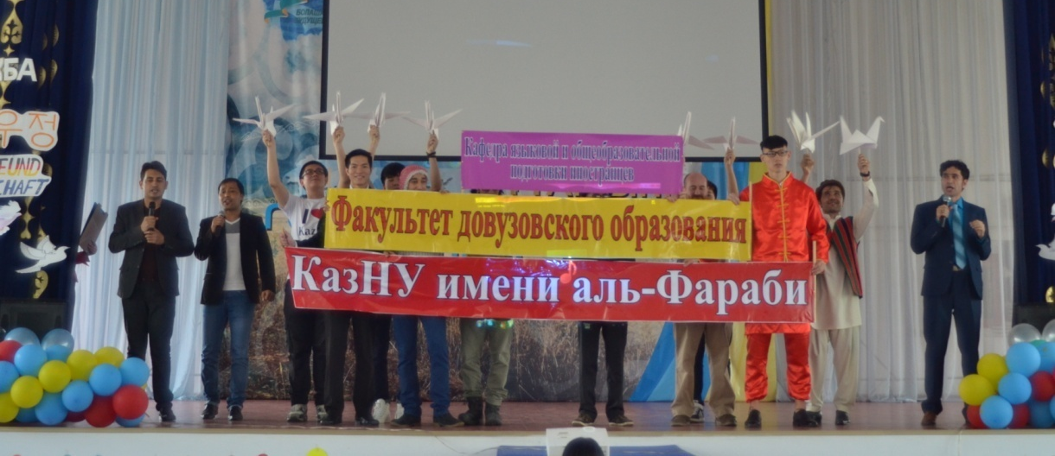
WHAT WE HAVE
Educational building
Dormitory
Student Hall
Stadium
Medical center
Dinner Hall
Internet Club
WELCOME TO KAZAKHSTAN!

Slide 10
Al-Farabi Kazakh national university
Faculty of Pre-university Education
Department of Language and general education of foreigners
Address: 39/47 Masanchi St. (street corner of Bogenbai batyr), 050038, Almaty, Kazakhstan.
Phone: 292-57-17 (ext. 21-99, 21-76)
e-mail: Gulnara.Ikhsangalieva@kaznu.kz
raimbekova@yandex.kz

