Slide 1
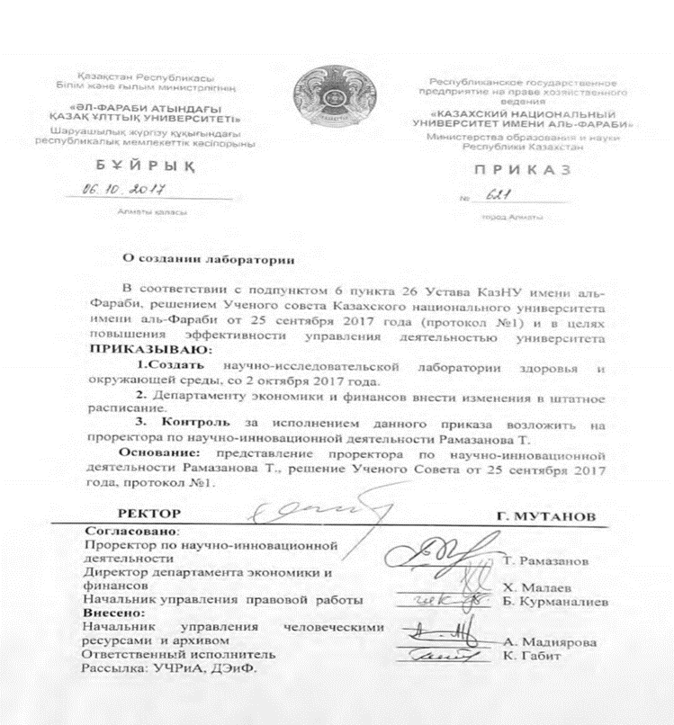
The order #621 of the Kazakh National University rector from the 6th of October 2017 “Establishment of the Health and the Environment Scientific Research Laboratory”

Slide 2
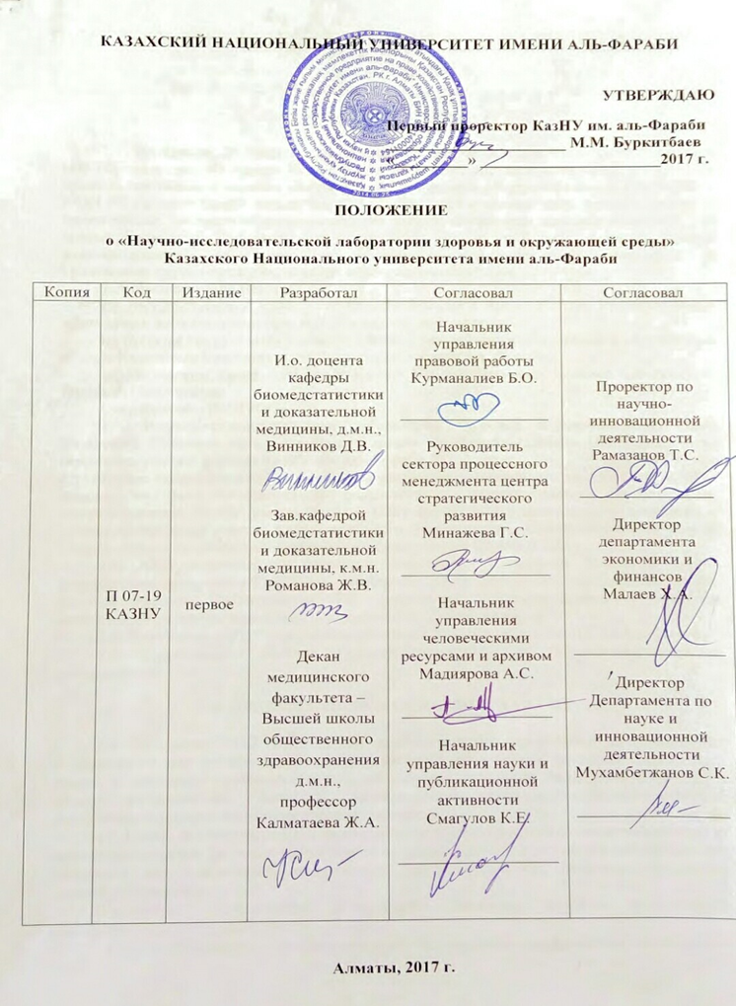
The objectives of the research laboratory:
The discovery of Laboratory is conditioned by the need to conduct population studies to determine the degree of harmful effects of environmental factors, including industrial factors on the health of the population of the Republic of Kazakhstan for the respiratory diseases prevention, cardiovascular morbidity and other pathological conditions.
The goal of the Laboratory is hygienic and clinical epidemiological assessment of the impact of environmental factors on the level and structure of the incidence of the population for the further planning of preventive programs for maintaining the health of the population.
The subject of the Laboratory is scientific research of a fundamental and applied nature.

Slide 3

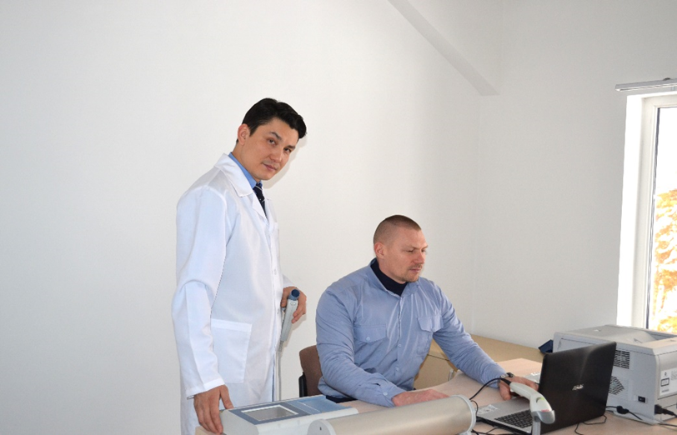
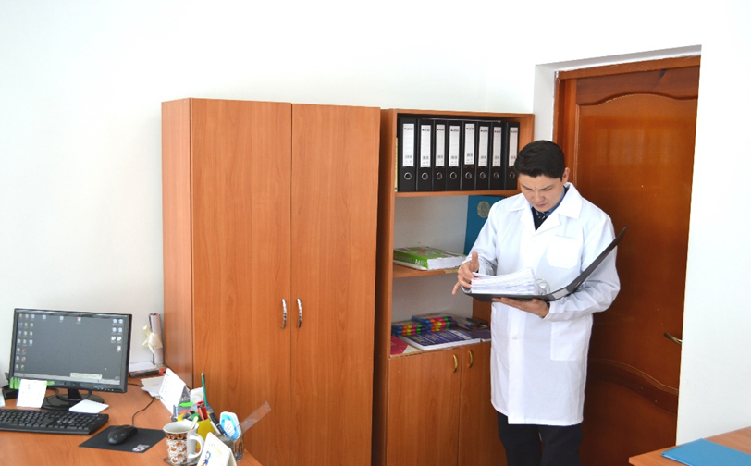
Conducting high-quality epidemiological studies of the impact of environmental factors on health and occupational factors, including primarily air pollutants.
Systematization of the currently available evidence base in the world scientific space on the impact of environmental factors and production factors through analysis and reviews with publication of the results.
Coordination of all scientific and research work of the Public Health School of the al-Farabi KazNU by forming an intellectual center for the planning and implementation of clinical epidemiological studies.
Active implementation of modern principles of biostatistical analysis into the educational process and faculty training corresponding to the challenges of modern times and the requirements for a significant strengthening of the country's scientific potential and KazNU al-Farabi in particular.
Raising the rating and reputation of al-Farabi KazNU as the leading research institution of the country by publishing the created intellectual product in the leading ranked journals.
Conducting international conferences, lectures, round tables and seminars on topical scientific problems of health and the environment.
Implementation of scientific projects (including jointly with foreign partners).
Coverage in the media of the results of ongoing research to improve the level of medical and hygienic knowledge of the population.

Slide 4
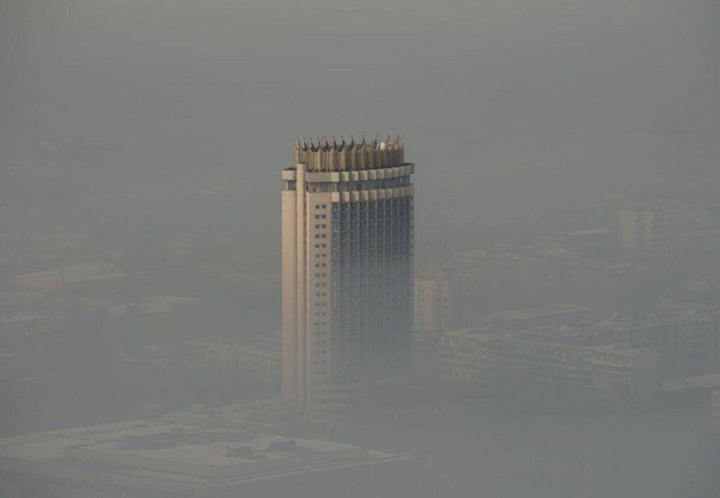
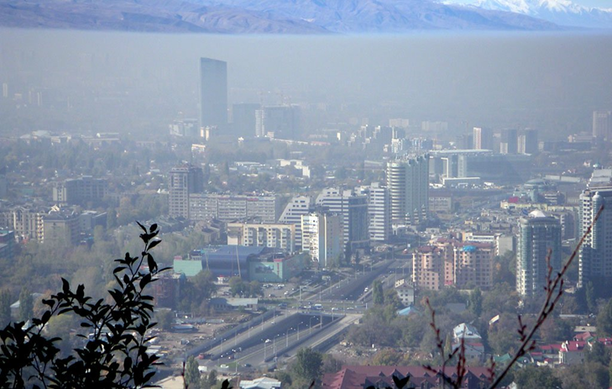
Respiratory System Diseases (RSD) - the first place in the structure of the appeal to the primary link, the greatest burden for the health system
The main cause of RSD is environmental factors, smoking and air pollution
Despite the individual laboratories monitoring the pollution in the country, up to the present moment in PUBMED there is not a single current clinical and epidemiological work (publication) on the effect of air pollution on cities of Kazakhstan on the RSD
This branch of Public Health (PH) is not developed at all
There is a unique opportunity to lead all work in this direction at the international level
There are unique, trained personnel in the SSHO for such work

Slide 5


The main subject of public health is the study of the risk of diseases of the population depending on the influencing factors of the environment
One of the main subjects of public health - the impact of environmental factors on human health - is taught theoretically
The creation of the laboratory will allow to purchase equipment and allocate personnel for purposeful work in this direction

Slide 6
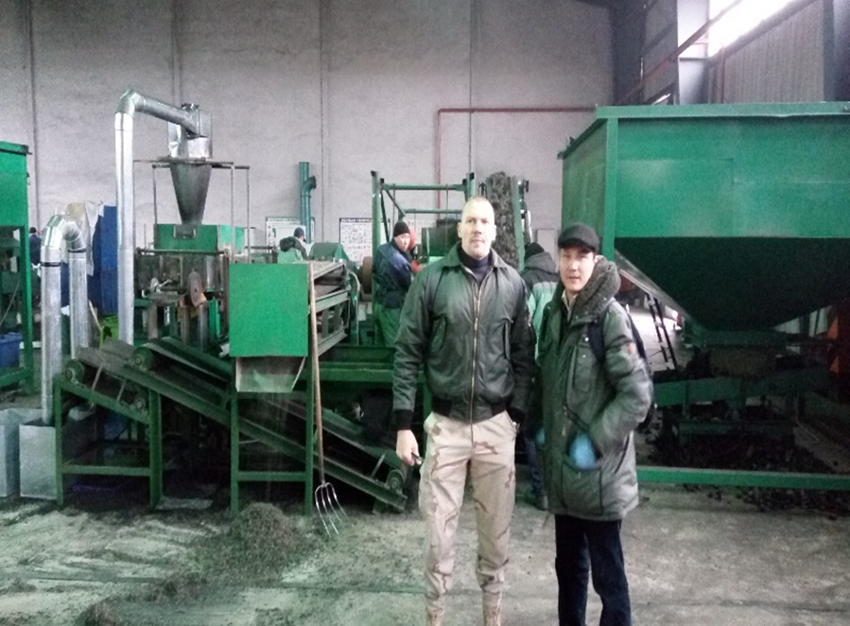
Head of the SRL - graduate of the University of California Berkeley, Master of Science in Environmental Science. Doctor of Medical Sciences, specialty "Internal Diseases". Author of 26 publications in the Web of Science, including journals Journal of Occupational and Environmental Medicine, Occupational Medicine, American Journal of Industrial Medicine, BMC Public Health, High Altitude Medicine and Biology, Wilderness and Environmental Medicine, etc. Only 10 months. 2017 there were 7 articles Web of Science, 7 more are on reviewing. Member of the European Respiratory Society, active member of the ERS / ATS working group (10 professors from the world's leading universities) on the burden of occupational respiratory disease.
Researcher - doctoral student of the biomedical statistics and evidence medicine department of the KazNU medical faculty.
The proposed topics of the laboratory work are planned for doctoral PhD students of the faculty. At the same time, there is a guarantee of timely protection with the publication of several articles. Themes - epidemiological studies of the association of air pollution with the emergence of COPD in workers of various industries, residents of Kazakhstan cities.

Slide 7
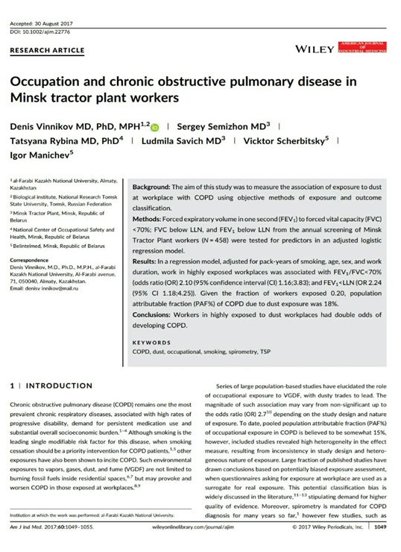
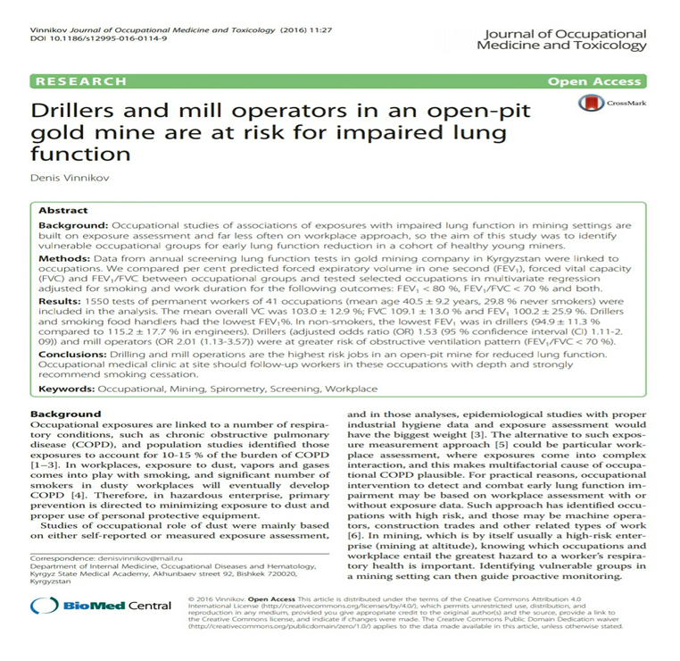
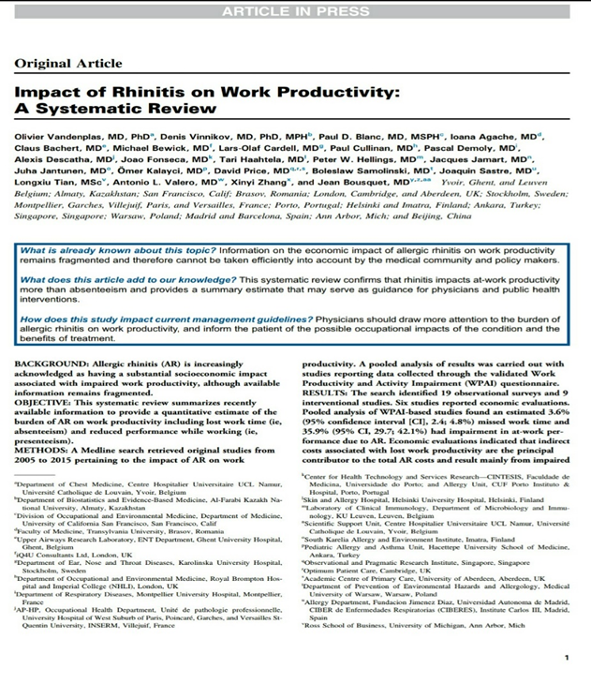
Publications in international indexed publications
The total number of citations for the last 5 years on articles published over the past 5 years on the Scopus database: 29
The total value of the h-index: 10

Slide 8
Participation of Laboratory in international conferences
27th Annual Congress of European Respiratory Society, September 9-13. Organizators – European Respiratory Society.
Grand Round Presentation: High-altitude pulmonary edema in a miner
Poster Presentation: Driving commercial vehicle as a risk factor for obstructive sleep apnea
Poster Discussion: Cytisine is an effective smoking cessation medication: more evidence now than ever before

Slide 9
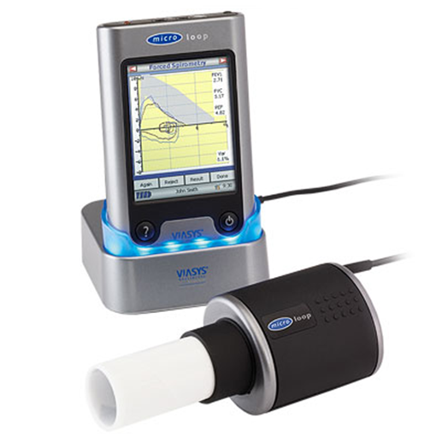

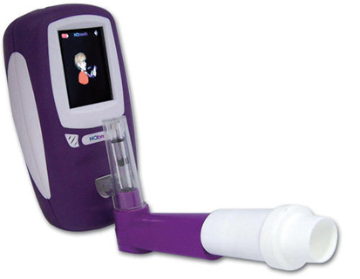
The laboratory applied for the purchase of measuring equipment: Equipment for measuring pollution levels (portable devices); Equipment for studying the function of external respiration

Slide 10
Expected results of the research laboratory:
The rapid growth of the involvement of faculty members in scientific activity with the publication of high-quality clinical epidemiological studies in the leading journals of the world
The use of the laboratory as not only a scientific, but also a training base for undergraduates and doctoral students on the subject "the impact of environmental factors on public health"
Possibility of preparation and successful protection of subsequent doctoral candidates
Significant expansion of the possibility of scientific cooperation with the world's leading universities and presentations at world congresses
A sharp increase in the publication activity in the world's leading journals on the profile of Public Health, occupational and environmental health

