Slide 1
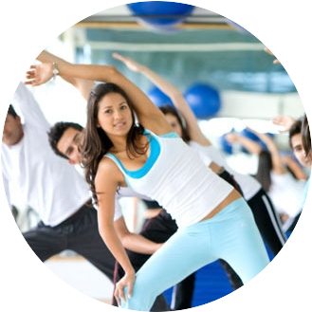
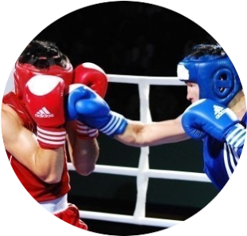
Activity of the "HEALTHY LIFESTYLE" Center of the al-Farabi Kazakh National University

Slide 2
«A healthy lifestyle and the principle of a person's shared responsibility for one's health is what should be the main thing in public health policy and the everyday life of the population». Nazarbayev N.A.
The situation in the world
40% of residents do sports at least once a week;
65% of residents exercise at least once a week; (Special eurobarometer 334, “sport and physical activity” , 2010)
1987 – Primary school curricula include daily physical education. (The Resolution of Senate)
90% of Finnish citizens regularly go in for sports (Report of the Chairman Kozhagapanova E.T. to the Majilis of the Parliament of the Republic of Kazakhstan, 2013)

Slide 3
Situation in Kazakhstan
The coverage of citizens engaged in physical culture and sports at the end of 2012 amounted to 21.6%.
In 2012, only 3% of students passed presidential tests.
During the passage of the medical board of military commissariats, 7 out of 10 conscripts are considered unfit for service in our army» (http://www.kazinform.kz/rus/article/2572771)
According to the medical examination, about 30% of students of KazNU have various deviations in the state of health. (Data of the student polyclinic, 2017)

Slide 4
Mission of the Center
Bringing students and university staff to a healthy lifestyle
The purpose of the Center
Popularization, development of mass sports and improvement of youth and adult generation

Slide 5
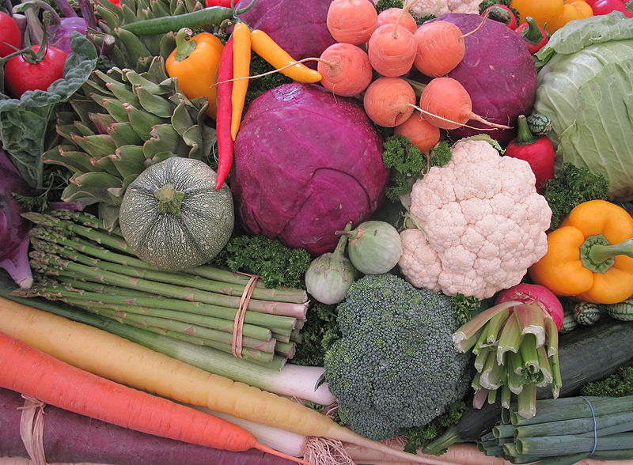
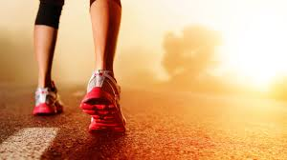
Structure of the Center
Physical Culture and sport
Wellness and prevention
Tourism and active recreation

Slide 6
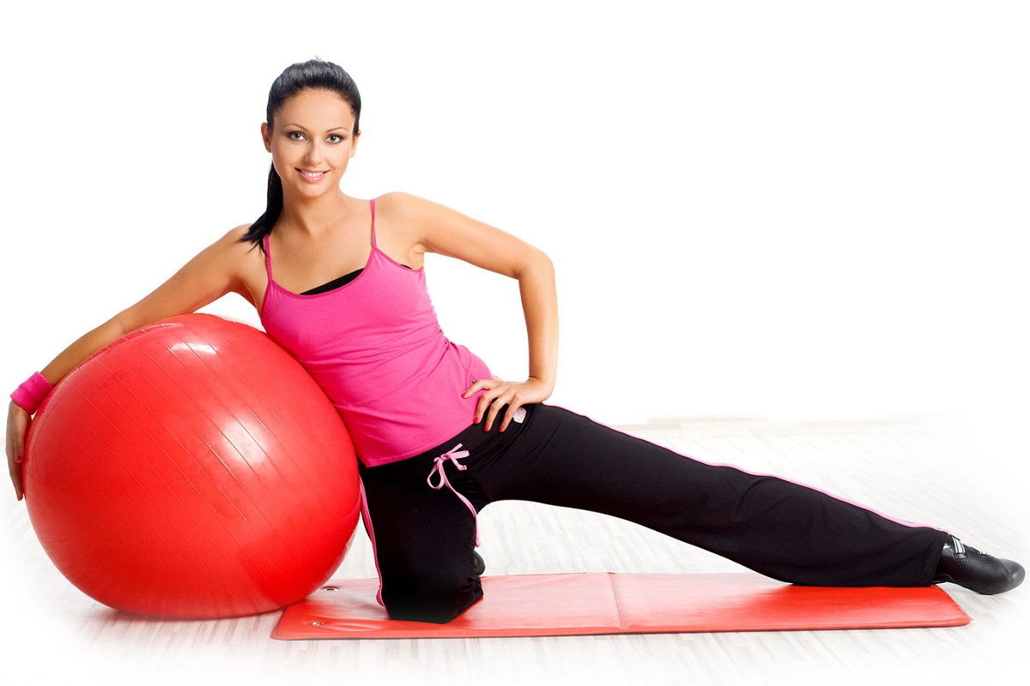
Physical Culture and sport
Sports-mass direction
15 kinds of sports(at the student's choice):
For students who have various abnormalities in the state of health, or who undergo rehabilitation after the illnesses:
Athletics
Basketball
Volleyball
Athletic gymnastics
Table tennis
Chess
Togyzkumalak
Badminton
Judo
Football
Box
Sambo
Kazakh wrestling
Aerobics
General physical preparation
Special medical groups
2. Groups of therapeutic physical culture

Slide 7
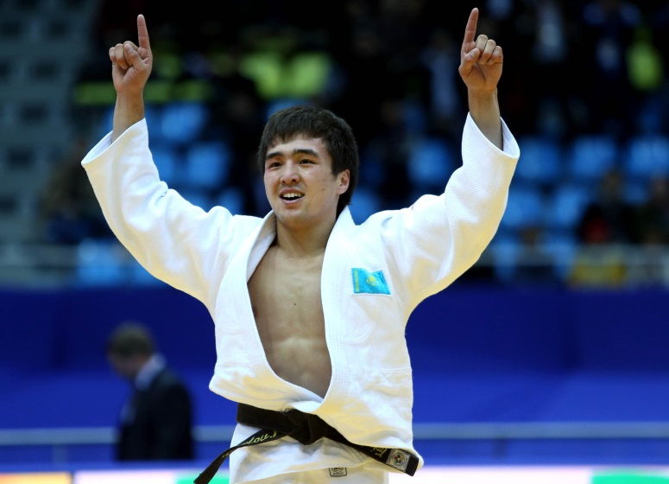
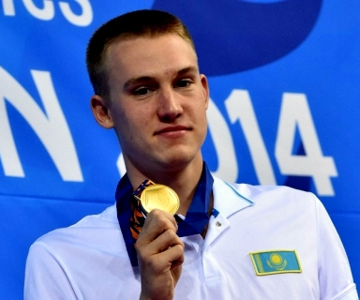
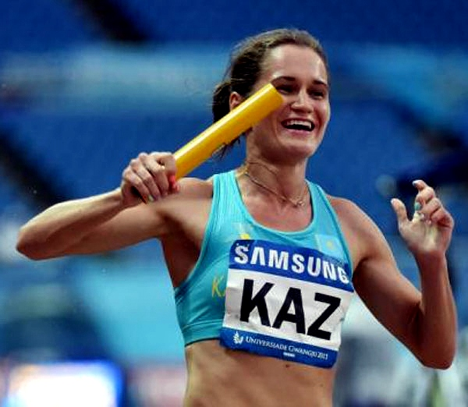
Physical Culture and sport
Professional Sports
Preparation of national teams of KazNU for 30 sports to:
City, Republic, International competitions
National Student League for game sports
Republican and World Universiade
Championships of Asia, of the World and the Olympic Games

Slide 8
Wellness and prevention
The medical control for determining the level of physical development and motor activity.
Introduction of modern (innovative) health saving technologies in curricula.
Preparation of individual health programs for people with disabilities in health.

Slide 9
Wellness and prevention
Organization and conducting of a series of lectures on healthy lifestyle involving narcologists, psychologists, psychiatrists and other interested specialists.
Organization and conducting of a series of lectures on the organization of rational and proper nutrition of students with the involvement of nutritionists

Slide 10
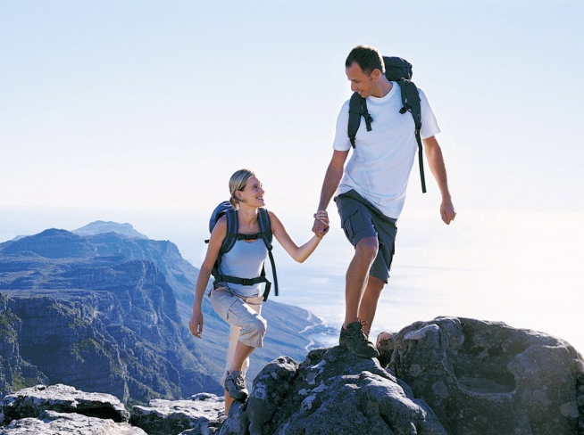
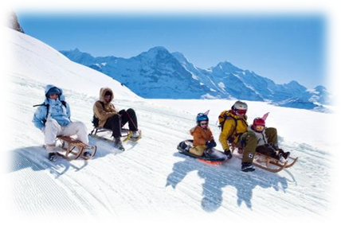
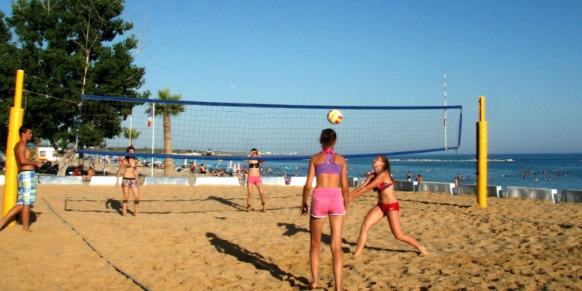
Tourism and active recreation
Organization of weekend tourism
Holding the "Holiday of Winter"»
Sports and recreational activities in «СОЛ КазНУ» on the Issyk-Kul lake.

Slide 11
Planned activities in the HLS Center
Complex inter-faculty competitions among students and teaching staff
Mass activities to involve students and teachers in the movement "Cult of a healthy body"
During a year
Activities organized in the "Students' Homes"
Activities on patriotic
education

Slide 12
Complex inter-faculty competitions among students and teaching staff
71st Inter-faculty sports contest among students
basketball m / f
volleyball m / f
mini football
chess
Togyzkumalak
table tennis
badminton
46th Sports Contest "Health" among teachers, doctoral students PhD
Darts
Togyzkumalak
Volleyball m / f
Table tennis
Mini football
Badminton
Chess

Slide 13
Mass activities to involve students and teachers in the movement "Cult of a healthy body"
Competitions for the "Rector's Cup"
Competition «Presidential Mile» among students
Autumn Championship of the KazNU on Orienteering
Competitions "Day of freshmen"
Cups of Deans of Faculties

Slide 14
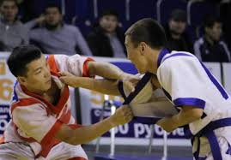
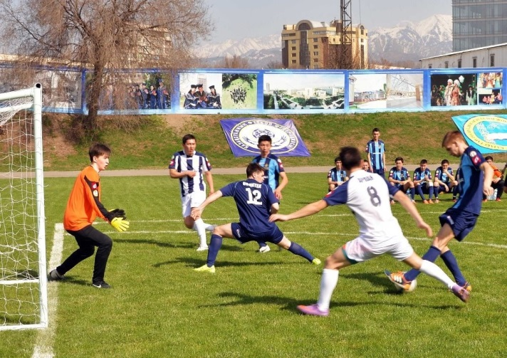
Activities organized in the "Students' Homes"
Morning exercise in Kazgugrad
National sports
Kinds of sport
Chess
Streetball or basketball
Beach volleyball
Beach football
Table tennis
Badminton
Volleyball
Darts
Togyzkumalak
Kazakh wrestling
Belt wrestling
Tug of war

Slide 15
Activities on patriotic education
Match meetings between the KazNU team and the Alumni team, dedicated to the University's birthday
Sports holidays dedicated to the significant dates of the Republic of Kazakhstan
Traditional cross-country athletics track dedicated to the "VICTORY DAY"
Republican and International tournaments dedicated to the memory of honored sportsmen of the Republic of Kazakhstan
Open championship of KazNU on Togyzkumalak, dedicated to the hero of the USSR Bauyrzhan Momyshuly

Slide 16
Upcoming tasks
1) Grant a choice to the student
STUDENT HAS A CHOICE:
Kinds of sport
Convenient time of employment
Participation in sporting events
Control of physical condition

Slide 17
Upcoming tasks
2) Strengthen agitation and propaganda work
Connect Mass Media
Create a website for the HLS Center
Regular information coverage on the university's website
Publishing of printed materials about sports and healthy life
Organization of lecture programs on healthy lifestyle with the involvement of specialists

Slide 18
Upcoming tasks
3) Provision of paid services
Additional sports activities for students on a preferential basis
Development of individual wellness programs
Providing services for traditional and non-traditional sports on request

Slide 19
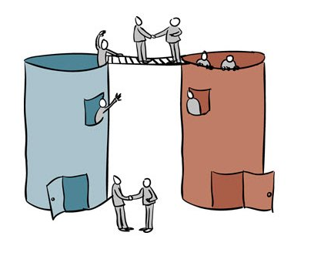
Upcoming tasks
4) Expansion of inter-faculty and inter-cadre relations in the field of sports and healthy living
Faculty of Geography and Nature Management | Sphere of tourism and active recreation
Faculty of Philosophy and Political Science | Organization of lectures on healthy lifestyle Sociological research
Department of Biophysics and Biomedicine | Organization of a series of lectures and research on rational and proper nutrition
Diagnostic Center of KazNU named after al-Farabi | The medical control for determining the level of physical development and motor activity

Slide 20
Expected results
Increase the number of people engaged in physical training and sports up to 30%.
Increase in the number of students taking part in passing the standards of Presidential tests.
Improvement of health indicators of students, involvement of teaching staff and staff in the process of health preservation and education by personal example.
Reducing the incidence of students and PPP.
To occupy leading positions in competitions of the Republican and International scale among high schools.

