Slide 1
Information Center for Political Research at the Department of Political Science and Political Technologies

Slide 2
Information Center for Political Studies Department of Political Science and Political Technologies Information Center for Policy Studies has been operating since 2010. The subject of the Center's activities is research / scientific and educational work, consulting and other types of services in the following main areas: - 1. Consulting services: (political consulting); - 2. Conducting political expertise on political events; - 3. Educational advisory services: (short-term courses of improvement of professional skill in political sciences). Head of the Center: Doctor of Philosophical Science, Professor Abdigaliyeva Gulzhan Kanaevna.

Slide 3
The objectives of the Information Center for Political Studies are: the development and dissemination of knowledge about the socio-economic and political processes of modern Kazakhstanian society, organizational and information coverage of the activities of political parties and socio-political associations, a comprehensive analysis of contemporary problems of political processes, the collection and analysis of information on political science .

Slide 4
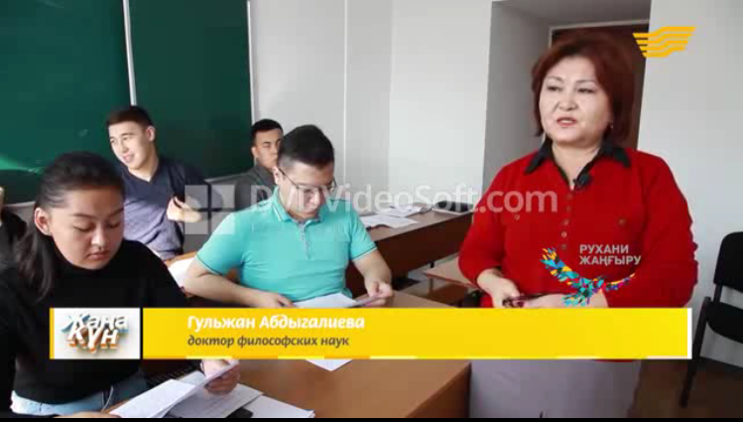
The Information Center for Political Research conducts activities on the main provisions of the article of the Head of State "A Look into the Future: Modernization of Public Consciousness"

Slide 5
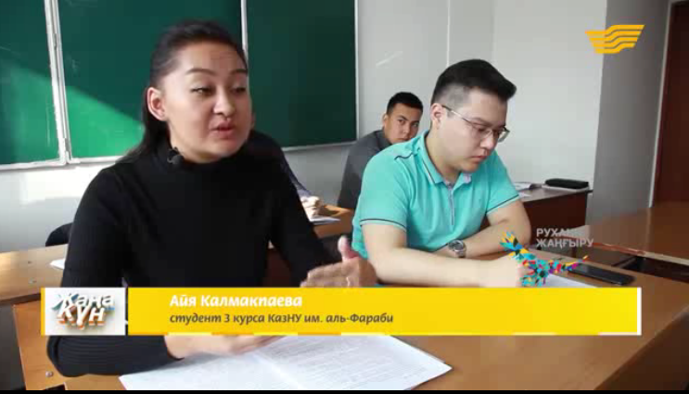

Slide 6
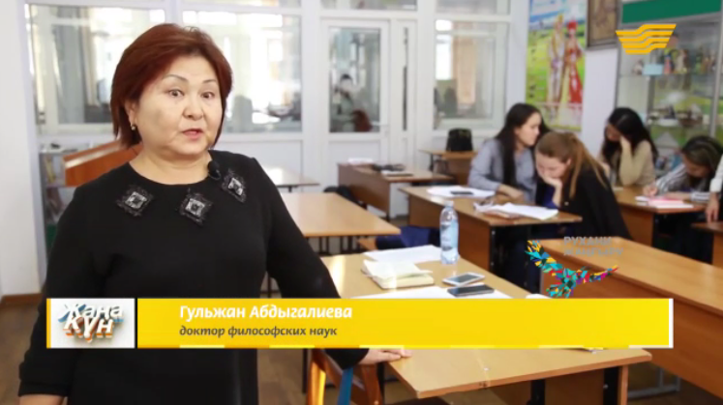

Slide 7
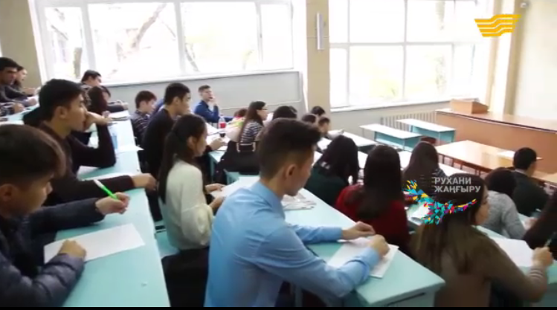
The Information Center for Political Studies together with students by political scientists conducted a total dictation for the new Latin alphabet.

Slide 8


Slide 9
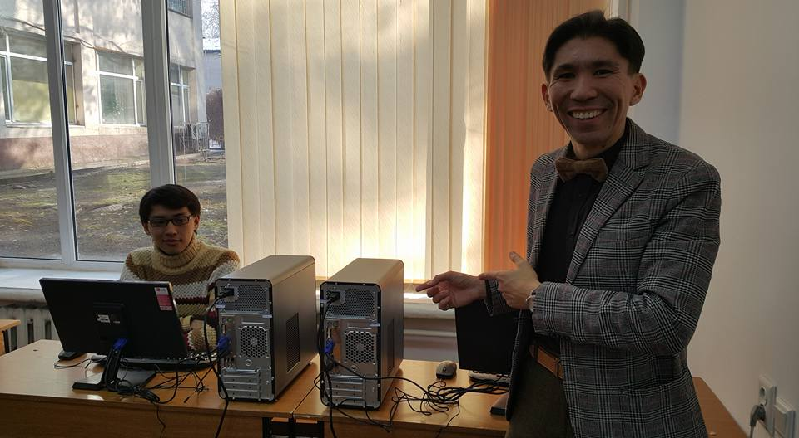
The Information Center for Policy Studies is equipped with all the necessary equipment for collecting and processing information.

Slide 10
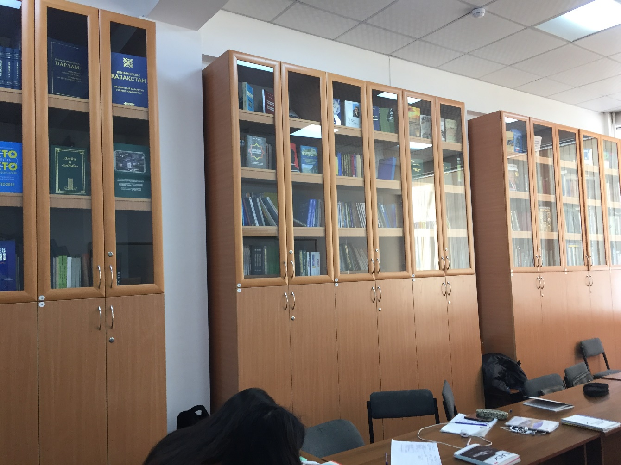
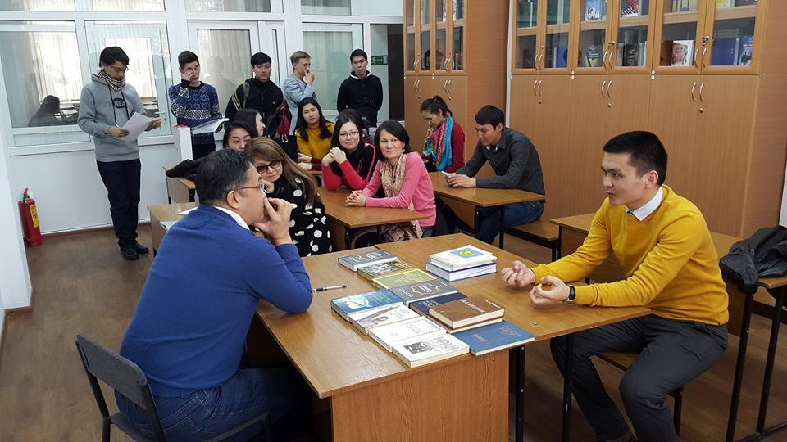

Slide 11
