Slide 1
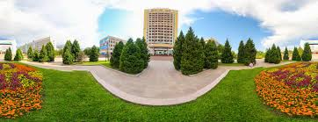
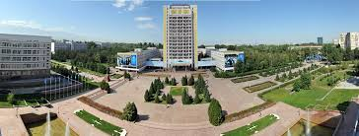
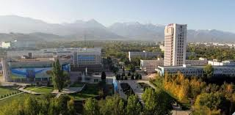
Al-FARABI KAZAKH NATIONAL UNIVERSITY

Slide 2
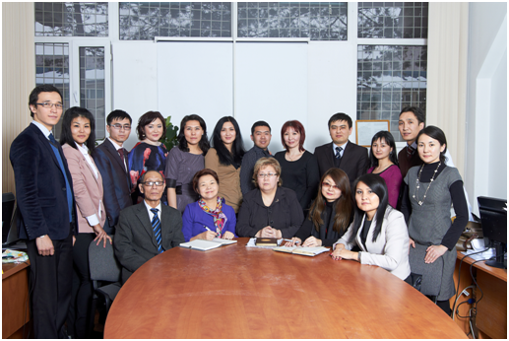
Department of Political Science and Political Technologies
The first time in Kazakhstan the Department of Political science was opened in al-Farabi Kazakh National University in 1992.

Slide 3
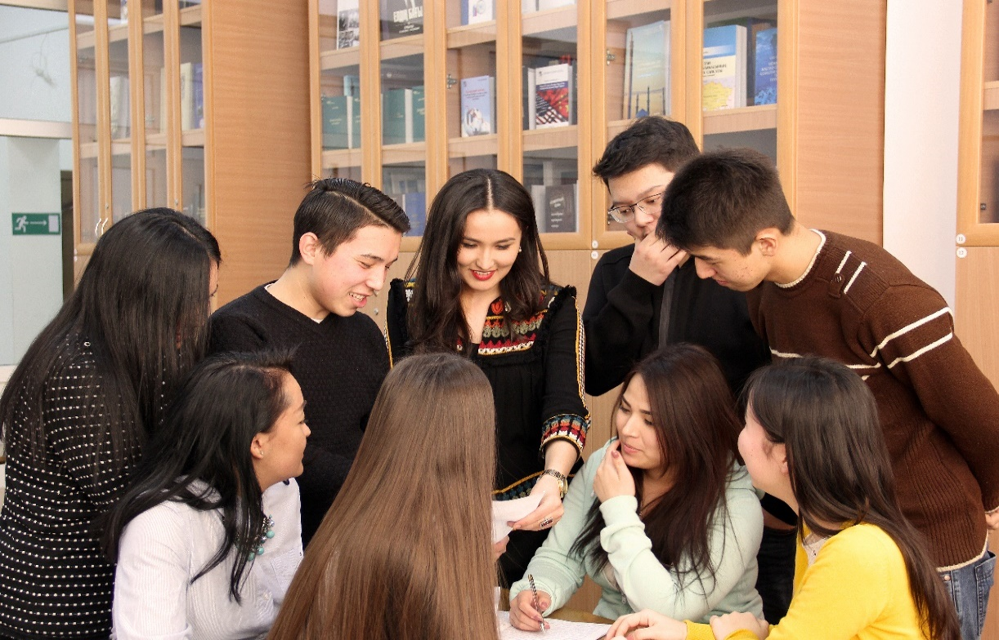
Department of Political Science and Political Technologies
Students are trained in the following areas: Bachelor's degree "5В050200-Political Science", the term of study – 4 years. Master's program "6M050200-Political Science", the term of study - 2 years. Doctoral studies "6D050200-Political Science", the term of study - 3 years.

Slide 4
Department of Political Science and Political Technologies
Staff of the Department of Political Science and Political Technologies:

Slide 5
Department of Political Science and Political Technologies
Scientific projects of the Department of Political Science and Political Technologies:
“Educational migration from Kazakhstan: trends, factors and socio-political consequences“
“Formation of the political culture of student’s youth.“
“Prospects for the development of the Eurasian Economic Union as a new regional association “.
“Social and political stability as the basis of a new stage in the development of Kazakhstan.“
“Modernization of the Spiritual and Moral Values of the Republic of Kazakhstan in the Context of Globalization“
“Intellectual capital of social and humanitarian sciences and its role in socio-cultural modernization of Kazakhstan society “

Slide 6
Department of Political Science and Political Technologies
Foreign professors who read courses during one semester or academic year on the basis of the Department of Political Science and Political Technologies:
Cynthia Kaplan - PhD, Professor, University of California, Santa Barbara:(UCSB).
Farhod Aminjonov - PhD, Associate professor at Wilfrid Laurier University, Waterloo, Canada.
Rafis Abazov - PhD, профессор Columbia University, USA.
Martin Brusis - PhD, Professor Ludwig-Maximilians-Universität München? Germany.
Vincent Fournier, PhD, Professor, Graduate School of Social Sciences (EHESS) Paris, France.
Joel Jensould is PhD, Professor , Oklahoma State University.
Pak Miong-Ho-PhD, Professor, Dongguk University, Seoul, Republic of Korea.
Sally Cummings-PhD, Professor, University of St Andrews, UK.
Beate Eschment - PhD, Professor of the Center for Eastern European Studies at the University of Bremen, Germany.
Enkyu Kim - PhD , Professor of Hanyang University, Republic of Korea.

Slide 7
Department of Political Science and Political Technologies
The Department of Political Science and Political Technologies conducts international cooperation with the leading universities of the world:
University of California, Santa Barbara (UCSB); Lomonosov Moscow State University; St. Petersburg State University; Dongguk University ( Seoul, Republic of Korea).

Slide 8
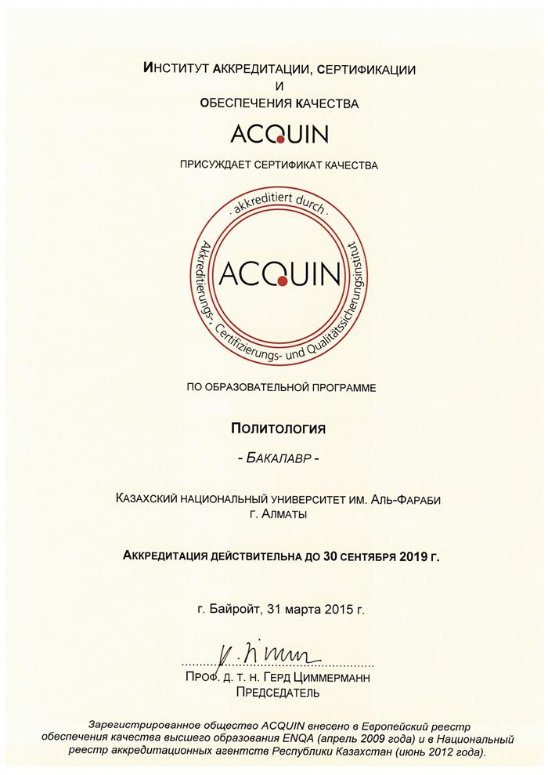
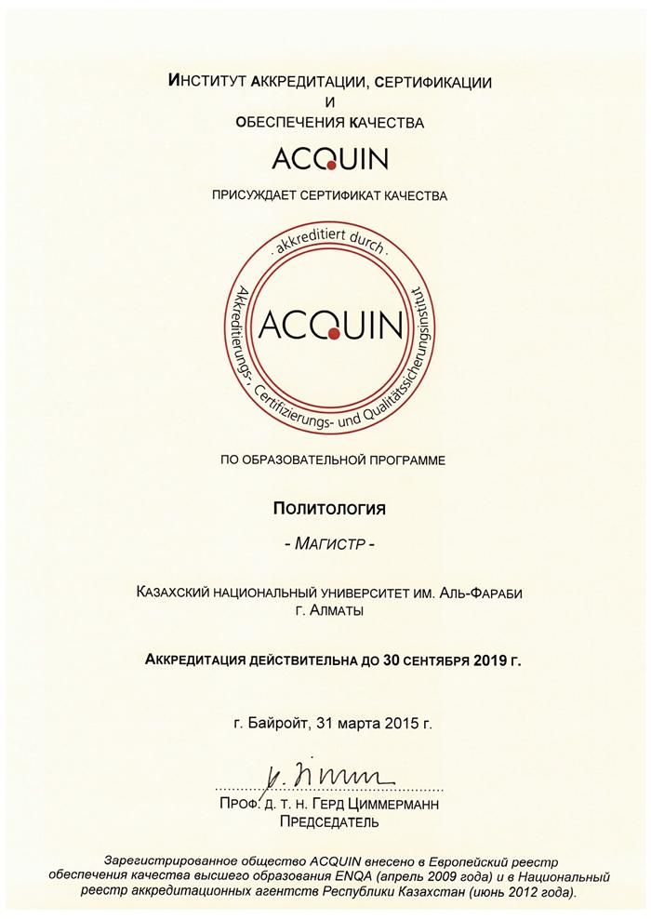
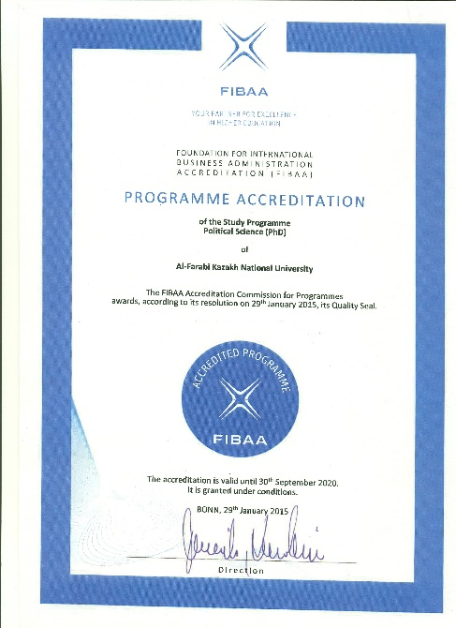
Department of Political Science and Political Technologies
Institute of Certification and Quality ACQUIN awarded a certificate of quality under the program "POLITICAL SCIENCE" in the areas of bachelor's and master's degrees. As well as the international commission for accreditation FIBAA awarded a certificate of quality under the program "POLITICAL SCIENCE" ( PhD)

Slide 9
Department of Political Science and Political Technologies
Academic mobility of students: Warsaw University (Poland, Warsaw) Urbino (Italy, Padua) University of Khanyang (Korea, Seoul) University of Kukmin (Korea, Seoul) Dongguk University (Korea, Seoul) University of René (France, Paris)
Foreign scientific internships for undergraduates and doctoral students:
University of Constantine the Philosopher (Slovakia, Nitra) Russian Academy of National Economy and Public Service (Russia, Moscow) University of Helsinki (Finland, Helsinki) Istanbul University. Center for Eurasian Studies "Farabi". (Turkey, Istanbul) University of Toronto (Toronto, Canada) University of St. Thomas (Fredericton, Canada) Pitzer College California, USA George Washington University, Washington, USA Berlin University of Humboldt (Germany) Kyrgyzstan, Bishkek, Polis Asia Research Center USA, New School for Social Research The Academy of Bundeswehr Pennsylvania, United States College Lafayette

Slide 10
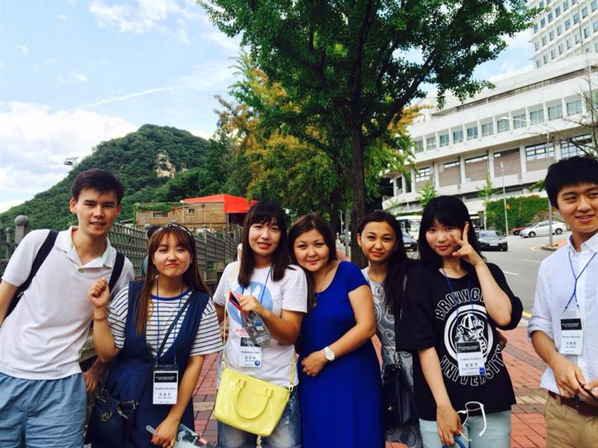

Slide 11
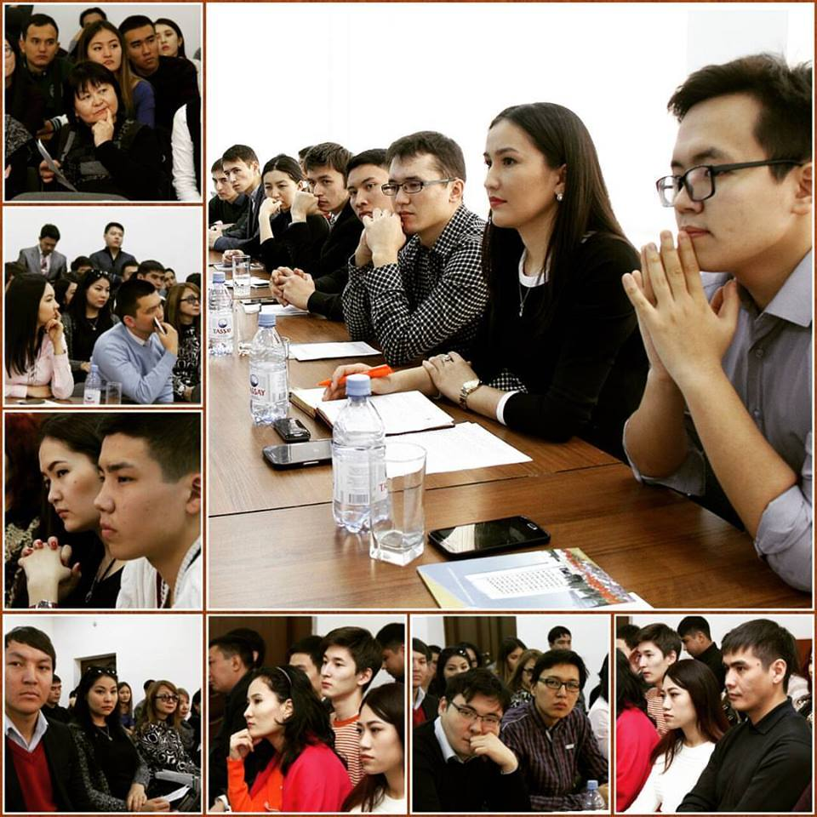

Slide 12
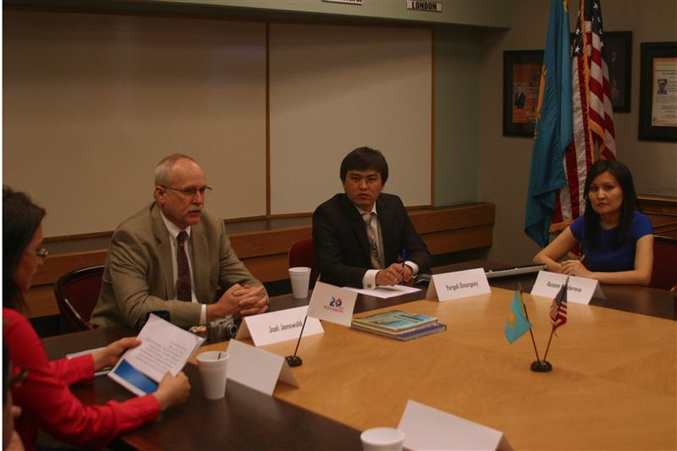
Department of Political Science and Political Technologies
Foreign internships at the Department of Political Science
Candidate of Political sciences Omargazy E.E. - University of Oklahoma. USA ("Bolashak" Fellowship program)
Candidate of Political sciences Akbolat D.E. - University of Oklahoma. USA ("Bolashak" Fellowship program) Doctor of Political lit.n Kaidarova A.S. - University of Oklahoma. USA ("Bolashak" Fellowship program) Candidate of Political sciences Seisebaeva R.B. - United Kingdom, London Brunel University. USA ("Bolashak" Fellowship program) Candidate of historical sciences Rakhimbekova BK - United Kingdom, London Brunel University. USA ("Bolashak" Fellowship program).

Slide 13
Department of Political Science and Political Technologies
The student debating club "Politolog“ at the Department of Political Science and Political Technologies has successfully functioned during 10 years of its existence. The guests of the club were political scientists, experts, scientists, public and political figures from the Central Asian countries, Germany, Korea, Russia, the USA, Poland, Japan.

Slide 14
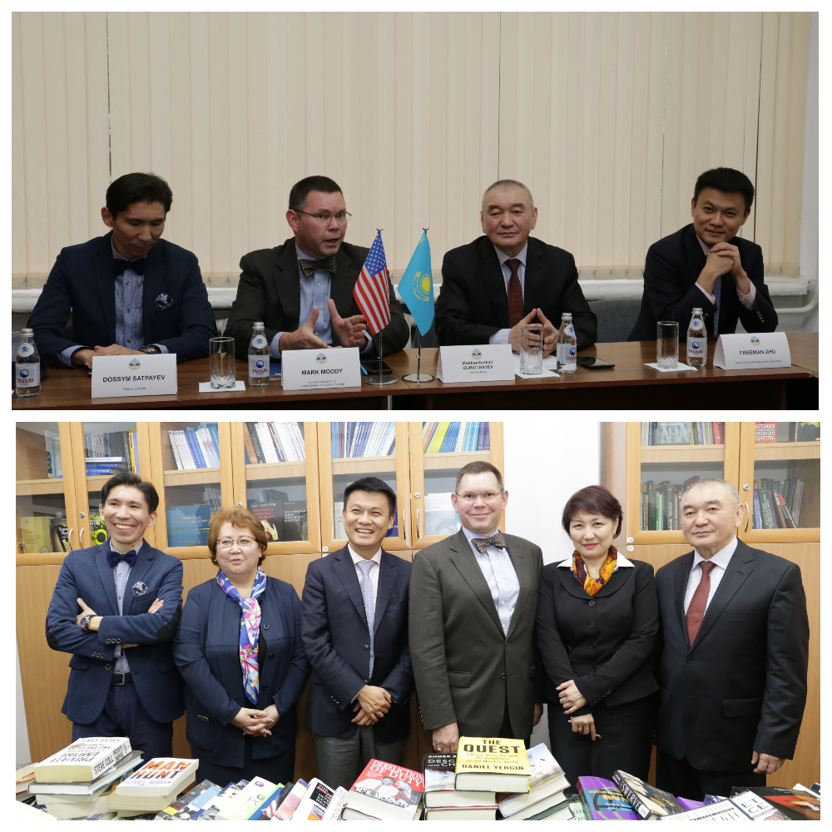

Slide 15
Department of Political Science and Political Technologies
In 2015, the Department of Political Science and Political Technologies opened a library. In current time, the library has over 3,500 books, which donated to the library from scholars and experts of Kazakhstan, as well as universities and experts from Uzbekistan, Germany, USA, Poland, Japan.

Slide 16
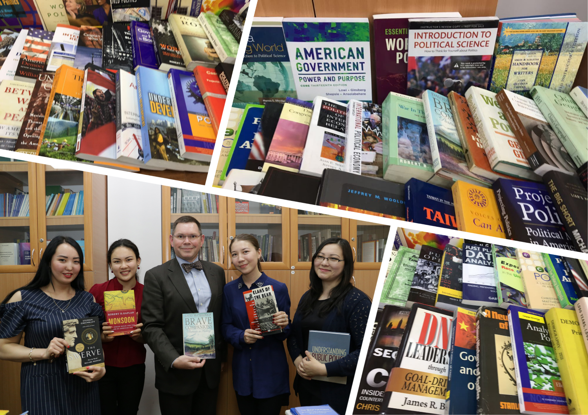

Slide 17
Department of Political Science and Political Technologies
Since 2010, the "Information Center for Policy Studies" has been operating on the basis of the Department of Political Science and Political Technologies.
Director of the Center is Doctor of Philosophy, Professor Abdigalieva G.K.

Slide 18
Department of Political Science and Political Technologies
The Department of Political Science and Political Technologies trains students, undergraduates and doctoral students from China, Afghanistan, South Korea, the United States, India, Romania and Uzbekistan.

Slide 19
Department of Political Science and Political Technologies
Students of the Department of Political Science and Political Technologies are winners of international scientific projects "One Asia", "Sumsung".

