Slide 1

Al-Farabi Kazakh National University
Faculty of Philosophy and Political Science
Department of general and applied psychology
2018-2019 academic year

Slide 2
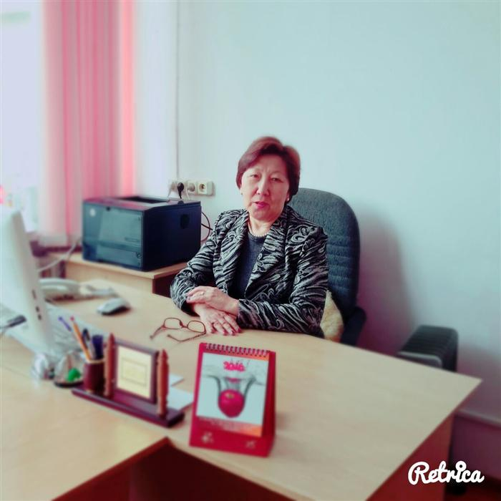
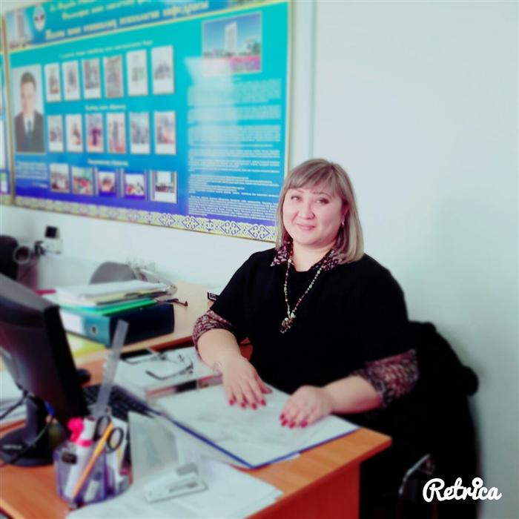
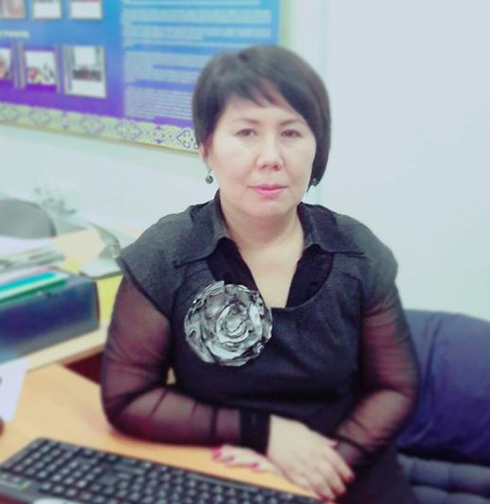
Managing Chair,
Doctor of Psychological Sciences, Professor
Madaliyeva Zabira Bekeshovna
Zabyra.Madalyeva@kaznu.kz
Deputy Head of Chair on Academic and Educational Issues,
PhD, associate professor
Baimoldina Laura Orazbekovna
Laura.Baimoldina2@kaznu.kz
Deputy Head of Chair on Academic and Educational Scientific-Innovational Activity and International Cooperation, candidate of Psychological sciences, associate professor
Kudaibergenova Sandugash Kansarovna
Sandugash.Kudaibergenova@kaznu.kz

Slide 3
Al Farabi Kazakh National University, http://www.kaznu.kz
Department of Philosophy and Political Science, Department of General and Applied Psychology

Slide 4
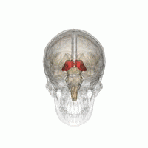

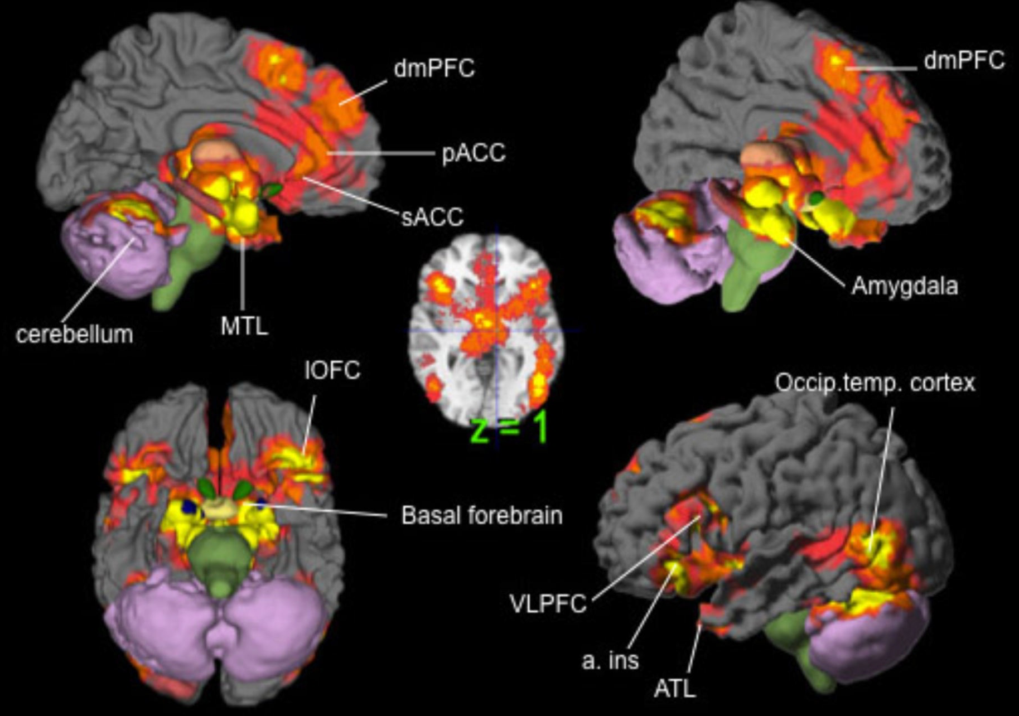
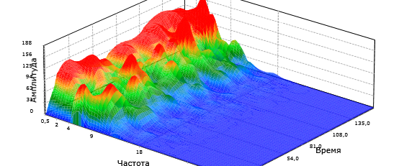
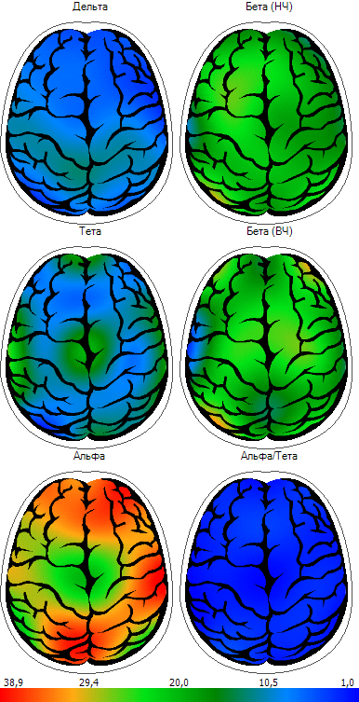
CENTER FOR COGNITIVE NEUROSCIENCE
Multidisciplinary research integrates neurophysiology, psychology, and engineering.
We study by using EEG, fMRI, genetic methods:
Emotion and Cognition
Depression and Brain
Cognitive ability and genes
Brain Computer Interface
Biofeedback training
Contact information: cogneurokaznu@gmail.com
Director of the CogNeuro: Almira Kustubayeva almkusto@kaznu.kz

Slide 5
Center of Psychological technologies and innovations.
Al-Farabi Kazakh National University

Slide 6
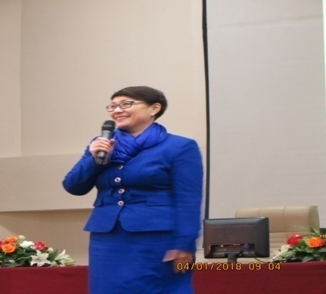
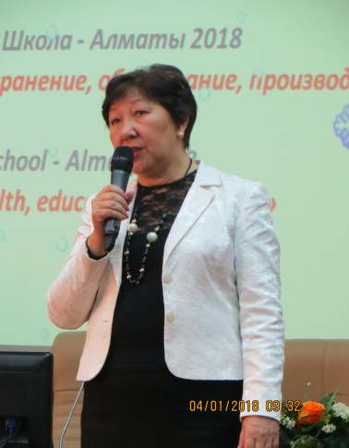
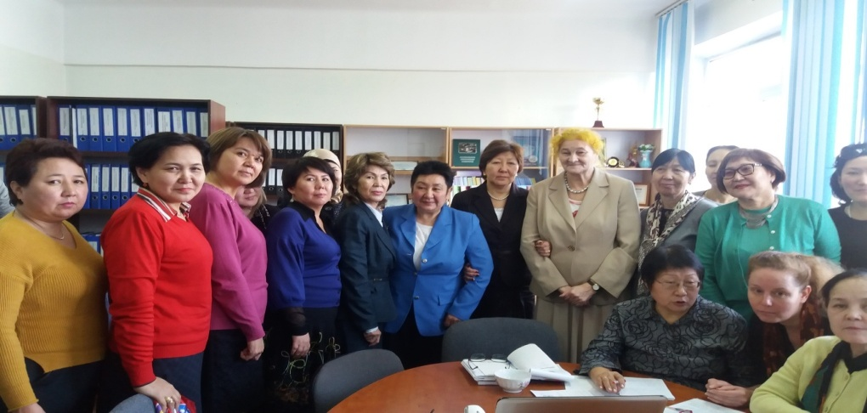
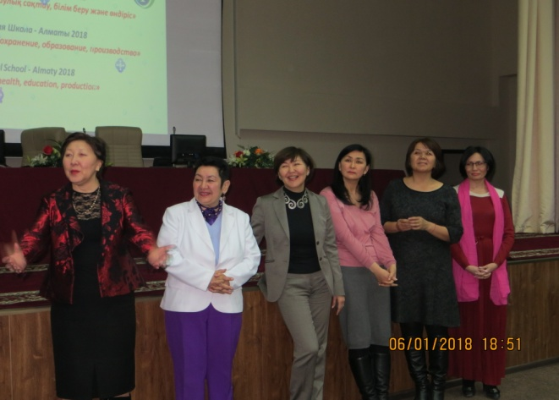
Was created by the order of university’s rector in April 2012.
The team is comprised of Kazakhstan leading doctors and candidates of sciences, implementing new technologies and practice-oriented training.

Slide 7

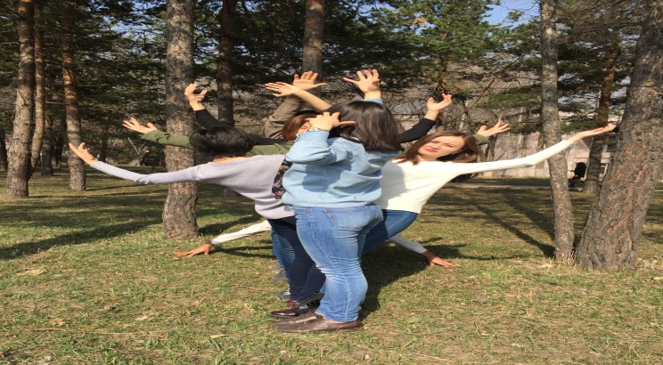
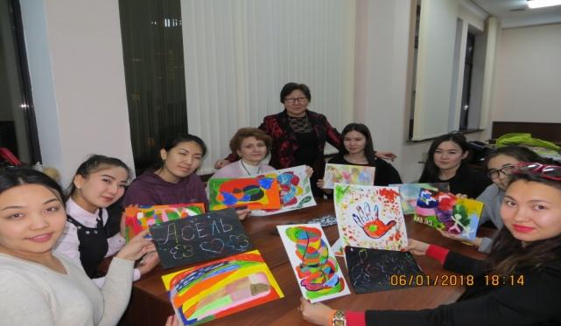
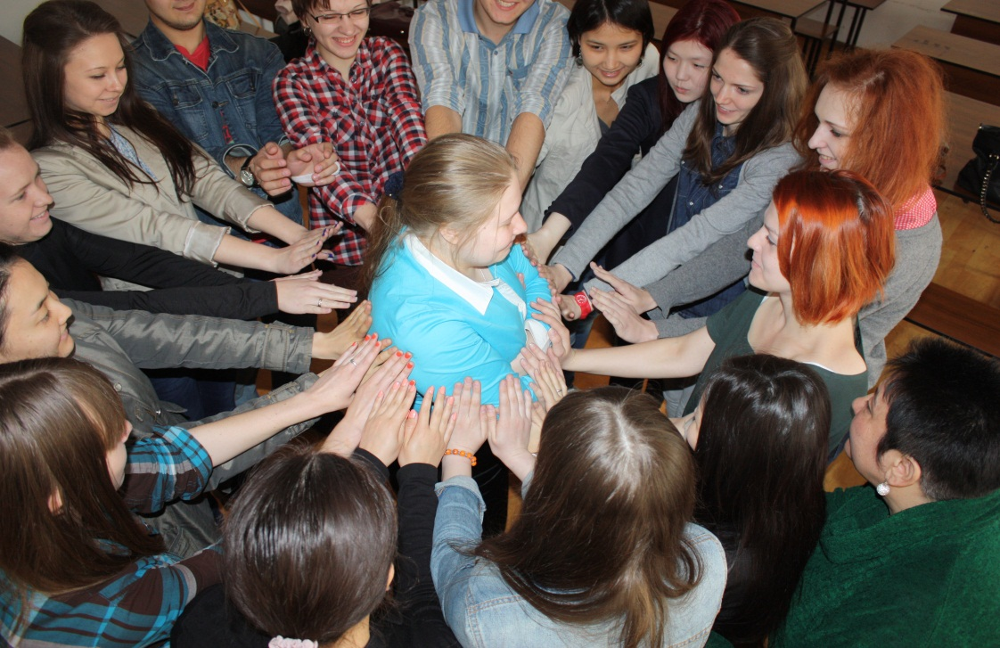
The main goal is the development, adaptation, approbation and introduction of new psychological technologies (methods, trainings), stimulating the improvement of human self-effectiveness in different spheres of life and in the education system as well.

Slide 8
Activity
Summer psychological school
Winter psychological
school
Directions of training program:
Team building;
Creativity training;
Training with deviant adolescents;
Stress resistance and becoming friend with stress;
Overcoming love dependence;
Recourses facilitation and self-efficacy;
Art-therapy;
cognitive behavioral therapy practices;
Leadership training
Dance and laugh therapy, and many more.
If you are interested in the trainings above do not hesitate to contact us:
Fatima Tashimova, doctor of psychological science, professor,
email: fatima_tashimova@mail.ru
arizulla@mail.ru

Slide 9
Educational programs on specialty “psychology”

Slide 10
BACHELOR EDUCATIONAL PROGRAM 5B050300 - PSYCHOLOGY
Duration of study – 4 years
Mode of education – full-time
Degree to award – Bachelor of Social Sciences in specialty Psychology
Educational program is conducted in Russian and Kazakh languages
Educational program is coordinated with the programs of leading foreign universities, such as Stanford and Cambridge
program coordinator – mmaria.876@gmail.com

Slide 11
Master's educational program 6M050300 – Psychology
Mode of education – full-time
Degree to award – Master of Social Sciences in specialty Psychology
MASTER’S EDUCATIONAL PROGRAMS OF PROFILE DIRECTION
- DURATION OF STUDY – 1YEAR
«6M050305-Psychology in Primary Health Care Organizations»
«6М050306- Psychology in Socially Significant Diseases»
«6М050307- Psychology in Organizations Providing Psychiatric and Narcological Assistance»
«6М050308 - Personality and Organizational Psychology»
«6М050309 – Consultative and Preventive Activities of Military Psychologist»
«6М050310 - Psychological aid in times of crisis and emergency»
«6М050311 - Child psychology»
program coordinator – sandugash04101971@gmail.com

Slide 12
MASTER’S EDUCATIONAL PROGRAM 6M050300 - PSYCHOLOGY
Mode of education – full-time
Degree to award – Master of Social Sciences in specialty Psychology
MASTER’S EDUCATIONAL PROGRAMS OF “SCIENTIFIC AND PEDAGOGICAL TRAINING” DIRECTION - DURATION OF STUDY – 2 YEAR
«6М050301 - Personality and Organizational Psychology» (in English language)
«6М050302 - Counselling Psychology» (in English language)
«6М050303 – Sport Psychology»
program coordinator – sandugash04101971@gmail.com

Slide 13
PHD EDUCATIONAL PROGRAM 6D050300 – PSYCHOLOGY
Duration of study – 3 years
Mode of education – full-time
Language of study: English
Degree to award: Doctor of Philosophy (PhD) in specialty Psychology
The present program in the specialty “6D050300 – Psychology” is compiled in accordance with the requirements of foreign universities. The educational program is built on a modular basis on the basis of a competence approach.
The following scientific directions in the specialty “6D050300 Psychology” are provided:
1. 6D050300 (01) Change, Development and Health
2. 6D050300 (02) Social Psychology of Personality
3. 6D050300 (03) Cognition and the Brain
program coordinator – mmaria.876@gmail.com

Slide 14
Science projects
A study of the ethnic and religious identify of Koreans (Koryo Saram) living in Kazakhstan
Aimaganbetova O.H.
o.aimaganbetova@gmail.com
Almira Kustubayeva almkusto@kaznu.kz
Aimaganbetova O.H.
o.aimaganbetova@gmail.com
Psychophysiological research of the diagnosis and correction of depression
Cross-cultural study of religious preferences and orientations of Kazakhstani youth in the context of the growing threat of religious terrorism and extremism

Slide 15
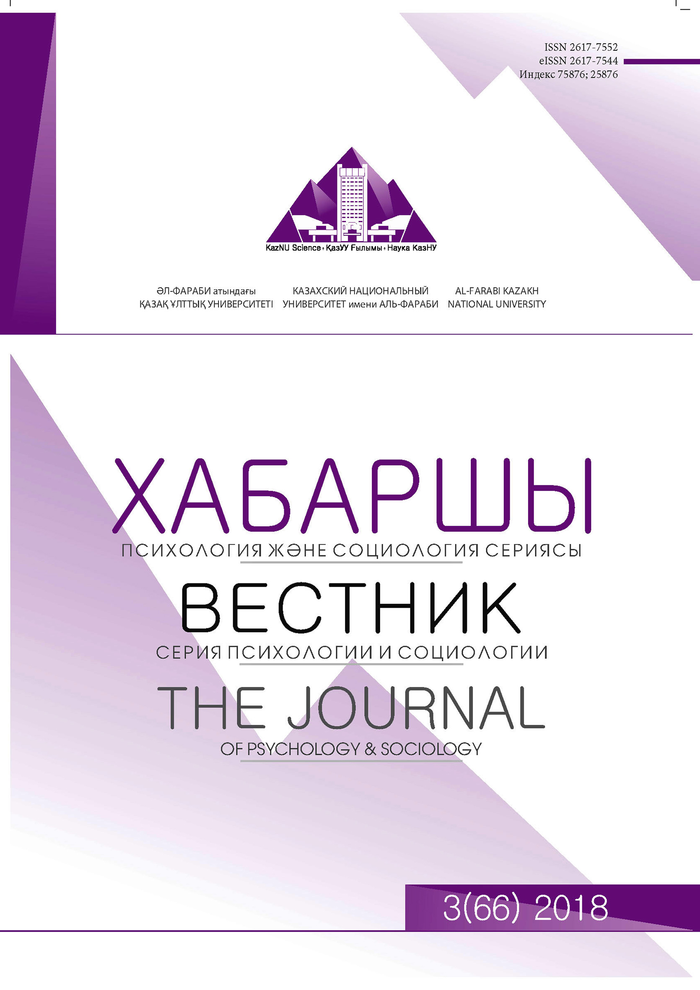
Bulletin “Psychology an Sociology Series”
Al farabi Kazakh National University The journal publishes scientific works on problems of fundamental and applied research in the field of psychology and sociology. The magazine is distributed within the Republic and in the CIS member states. Each release contains articles of foreign and domestic scientists, exploring issues in the above mentioned fields of science.
The composition of editorial board includes scientists from different countries, among which are: Bulgaria (Professor Irina Koleva, University of Sofia), Great Britain (Professor Sanghera Balihar, University of Kent, Department of Social Policy, Sociology and Social Research), USA (Professor Agadjanian Victor, Kansas University; Professor Fei Sun, College of Public Administration and Community Affairs of the Arizona University) and Russia (Associated Professor Olga Echevskaya, Department of General Sociology, Novosibirsk State University).
Periodicity of journal publication is 4 times a year. The journal distributed in the Republic of Kazakhstan, CIS member states and abroad.
KazNU Bulletin «Psychology and Sociology Series" publishes research articles since September 1993 in the publishing house "Kazakh University", in 1998 the journal was included in the list journals recommended for publication of the scientific research results by the authorized committee.
The articles go through the process of an external review made by scientific adviser, an internal review made by the editorial board and independent specialists who are not included in the editorial staff of the journal and conduct research in the similar scientific area.
All issues of the journal are posted on the al-Farabi KazNU electronic site.
Responsible secretary: Aidana Rizulla – general and applied psychology department’s teacher, Almaty, Kazakhstan.
Tel.: +7 775 884 98 57
E-mail: arizulla@mail.ru
Technical secretary: Rasul Tokhniyazov – PhD student of psychology specialty (“6D050300”), Almaty, Kazakhstan.
Tel.: +7 777 366 07 87
E-mail: rasul_march@mail.ru

Slide 16
We invite you to cooperation!
The address of the department: Kazakhstan, Almaty, Masanchi 39/47, block 4
Phone of the department: 8 (727) 292-57-17 (2131)
http://www.kaznu.kz/ru/1806/page/
https://web.facebook.com/psychologykaznu/?ref=ts&fref=ts

