Slide 1
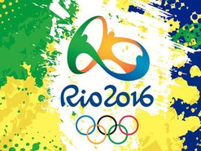
STUDENTS - PARTICIPANTS OF THE OLYMPIC GAMES 2016 IN RIO DE JANEIRO
KazNU. al-Farabi

Slide 2
5-21 August 2016

Slide 4
DMITRY BALANDIN Student Faculty of Medicine, the specialty of the FCC. The gold medal in swimming breaststroke at 200 meters distance.

Slide 5
Smet Eldos Student of the Faculty of Law, Master of Sport of International Class judo. Silver medal in the weight category 60 kg.

Slide 6
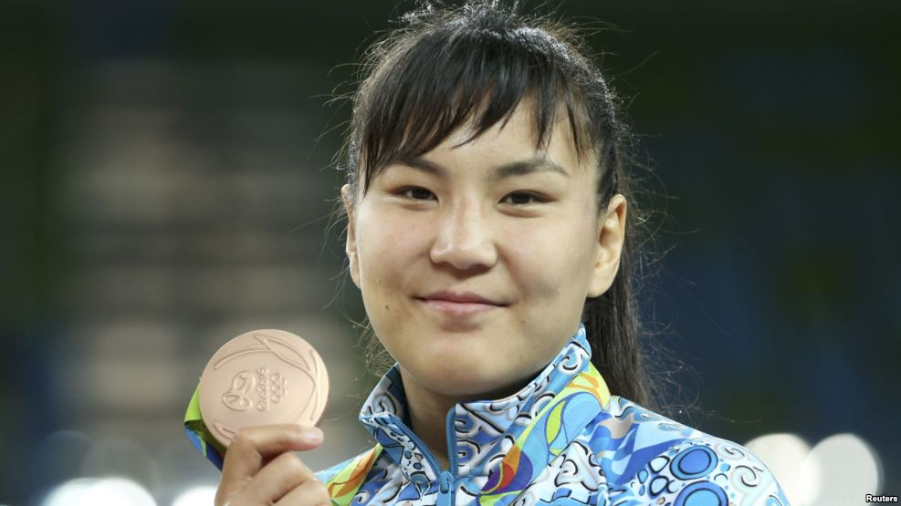
Syzdykova Elmira Student of the Faculty of Medicine, the specialty of the FCC. The bronze medal in the weight category up to 69 kg women's wrestling.

Slide 7
Vasiliy Levit Student Faculty of Medicine, the specialty of the FCC. Silver medal in boxing in the weight category up to 91 kg.

Slide 9
Ulanov Denis Student Faculty of Medicine, the specialty of the FCC. Weightlifting, world-class athlete, 4th place.

Slide 10
KEBISPAEV Almaty Student Faculty of Medicine, the specialty of the FCC. Greco-Roman wrestling, world-class athlete, 7th place.

Slide 11
Tynaliev Nurmakhan Student of the Faculty of Law, Honored Master of Sports, Greco-Roman wrestling.

Slide 12
Smagul Zhansaya Student of the Faculty of Law, Master of Sport of International Class, Judo.

Slide 13
URDABAEVA MARIAN Student of the Faculty of Law, Master of Sport of International Class, Judo.

Slide 14
Rakov Maxime Student Faculty of Medicine, the specialty of the FCC, Honored Master of Sports, Judo.

Slide 15
PILIPENKO ANASTASIA Student of the Faculty of Medicine, the specialty of the FCC, International Class Master of Sports, athletics.

Slide 16
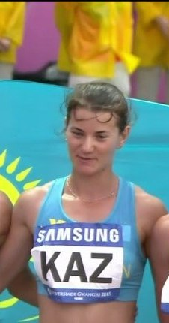
GOLENDOVA (IVANCHUKOVA) SVETLANA Student of the Faculty of Medicine, the specialty of the FCC, International Class Master of Sport of Athletics.

Slide 17
Zyabkina VICTORIA Student of the Faculty of Medicine, the specialty of the FCC, International Class Master of Sports, athletics.

Slide 18
Rakhmanov JULIA Student of the Faculty of Medicine, the specialty of the FCC, International Class Master of Sports, athletics.

Slide 19
SHEIKO GEORGE Student of the Faculty of Law, International Class Master of Sport of Athletics.

Slide 20
REPINA Pauline Student of the Faculty of Law, International Class Master of Sport of Athletics.

Slide 21
Zhanatbek GULZHANAT Student of the Faculty of Medicine, the specialty of the FCC, International Class Master of Sports, athletics.

Slide 22
Rudenko Ekaterina Student of the Faculty of Law, World-class athlete, swimming.

Slide 23
