Slide 1
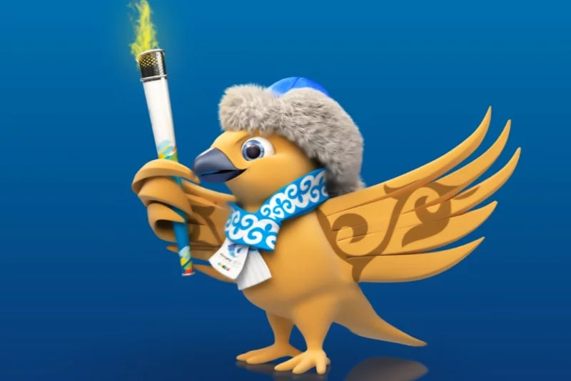
World Winter Universiade
Almaty, 28 January - 8 February 2017

Slide 3
ADYHANOVA JANSAYA The FofIR, 1 course, specialty "International relations", Figure skating, MS RK.

Slide 4
OLZHABAEVA AIDA GSofPH, 3 course, specialty FCandS, Ice Hockey, MS RK.

Slide 5
RYSPEKOV MERUERT Graduate of the FСandS, Ice Hockey, MS RK.

Slide 6
MOLDABAEV DARIA Graduate of the FCandS, Ice Hockey, MS RK.

Slide 7
MEZENTSEV FEDOR The FofIR, 1 second higher education course, Specialty "International law", Speed skating, MS RK.

Slide 8
SERGIENKO ARTHUR The FofIR, 1 second higher education course, Specialty "International law", Speed skating, MS RK.

Slide 9
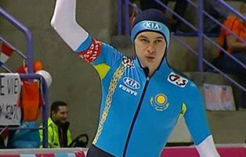
CRETCH ROMAN The FofIR, 1 course of the second higher education, Specialty "International law", Skating, MS RK.

Slide 10
MOROZOV DMITRY GSofPH, 1 course, specialty FCandS, Skating, MS RK.

Slide 11
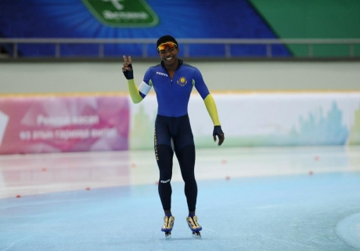
ESSAMAMBO DARSIL GSofPH, 1 course magistrates, Specialty FCandS, Speed skating, MS RK.

Slide 12
AHMETVALIEVA DAYANA GSofPH, 1 course, specialty FCandS , Ski jumping, MS RK.

Slide 13
Aibek ALI GSofPH, 3 course, specialty "International law", Nordic Combined, MS RK.

Slide 14
KALYUZHNOV NIKITA HSofEandB, 1 course second degree, Specialty – Marketing. Skiing, MS.

