Slide 1
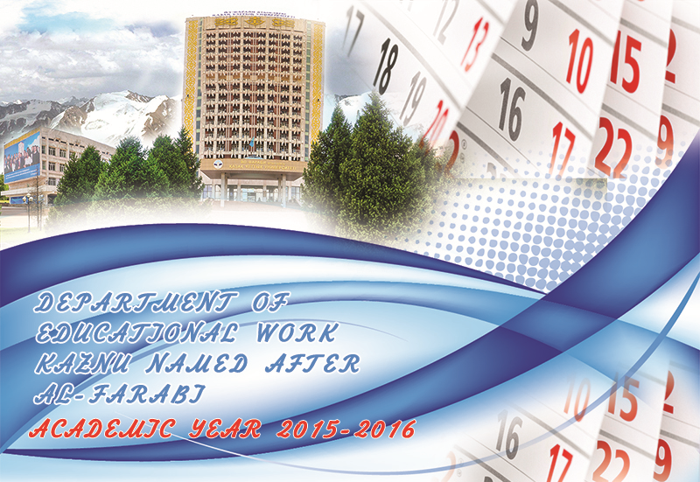

Slide 2
CALENDAR OF EVENTS
DEPARTMENT OF EDUCATIONAL WORK
KAZNU NAMED AFTER AL-FARABI
ACADEMIC YEAR 2015-2016
Implemented events | Date of the event
Events devoted to Constitution Day of RoK and The Knowledge Day | September 1, 2015
Activities of «Institute of advisers» on adapting the freshmen (familiarization with traditions and structure of the higher education institution, visits to a museums, libraries, Students Service Centre, dormitories, etc.) | September 2015
Discussion of President's article «Social modernization of Kazakhstan: Twenty Steps to Labor Society» on faculties, in dormitories | During the year
Events on identifying fundamental principles of «Kazakhstan–2050» Strategy and other statutory documents of RoK | During the year
«Departments Doors Open Day» in dormitories | During the year
Students Conventions with representatives of: educational and scientific institutions; law enforcement agencies; national centres; religious and social unions; experts, and other specialists in their fields | During the year
Traditional festal event «Matriculation» | September 2015
«Language Festival» devoted to Holiday of Languages of Kazakhstan Nations | September 22, 2015
Spartakiada Games among freshmen | September - October 2015
Traditional interdepartmental Spartakiada of students | During the year

Slide 3
Events on «100 books» project implementation | During the year
Festival devoted to artistic amateur performance among freshmen «Freshmen's talents» | September - October 2015
Aged People Day | October 1, 2015
«Donor's Day» jointly with Republican centre of blood transfusion | October 2015 г.
«Ana tili aruyi» Contest and «Zhigit sultany» | October 2015
«Rector» Cup Sporting Competition for students and Academic Teaching Staff | October 2015
Social Saturday work. «Labor» sales. «Clean week» Contest | During the year
«Tuski as tamak 81 tengeden» Charitable lunch of «Sunkar» student trade union committee | November 2015
Charitable events of «Komek» student organizations | November 2015
«Gold autumn» contest in faculties and dormitories | November 2015
Sporting competitions between «Kaznucityfest»dormitories | November 2015
КVN opening. Interdepartmental football «Sunkar» cup tournament among students | November 2015
International Students Day | November 17, 2015
Events devoted to «The Day of First President» | December 1, 2015
Events devoted to Independence Day of RoK. The meeting with 1986 December events participants. | December 16, 2015
Organization and implementation of republican patriotic festival among «Men zhastarga senemin» student youth devoted to Independence Day of RoK. | December 2015

Slide 4
The premiere of the dramatics of «Biz»student theatre | December 2015
New Year promenade | December 2015
«Health» Spartakiada among Academic Teaching Staff and employees | January 2016
Traditional meeting of Rector with students within «Ainalandy nurlandyr» project realization | February 2016
Organization and implementation of «Best student group» contest | February-May 2016
«Miss KazNU 2016» Contest | February 2016
«Best student family» Contest | February 2016 г.
Discussions of annual «Message of N.Nazarbayev President of republic of Kazakhstan to Kazakhstan Nation» | February -March 2016
March 8 – International Woman's Day | March 2016
«Nauryz Meiramy» | March 2016
Review of «Student spring» artistic amateur | March 2016
International youth forum | April 2016
«Tulip ball» Festival | April 2016
Farabi readings among students | April 2016
«Zhyr mushairasy» Young akyns contest | April 2016

Slide 5
Organization of events devoted to «Kozy Korpesh – Bayan Sulu» Day | April 15, 2016
Events devoted to Holiday of community of nations of Kazkahstan | May 1, 2016
Events devoted to May 9 VE Day Celebrations | May 9, 2016
Traditional meeting of Rector with students and instructors | May 2016
«Clean finals» sales | May 2016
KazNU named after al-farabi Alumnus Day | May 2016
Organization and implementation of events devoted to sacred to the memory of victims of political repressions | May 31, 2016
Graduation commencement | June 2016
Summary of Indicative plan (direction – Social activity), «Advisers' Ratings», «Clubs' Ratings» | June 2016
Opening of Construction Brigade Labor season | June 2016
National Day of Symbols of Republic of Kazakhstan | June 4, 2016
Events devoted to «World No Tobacco Day», «World Day to combat AIDS, drug addiction» | June 2016
Summer season opening. Best instructors and students going out to «KazNU» Health Improvement Camp in Issyk-Kul | June 2016

