Slide 1
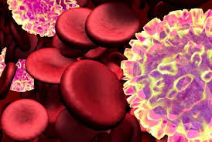
Joint participation in the project with the National Center for Biotechnology of the Republic of Kazakhstan
The title of the project "Study of the spread of different genotypes of the virus and the risk of infection of people with West Nile fever in Kazakhstan", 2018-2020.

Slide 2
Joint participation in the project "Center for Physical and Chemical Methods of Research and Analysis", KazNU. al-Farabi
Project title "Development and creation of high-performance gels based on pharmacopeia wild plants of Kazakhstan and their complex study", 2018-2020.

Slide 3
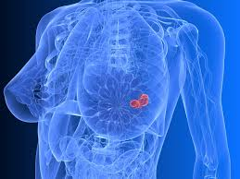
Joint participation in the project with the Kazakh Scientific-Research Institute of Oncology and Radiology
Title of the project "Development of protocols for a personified approach to the diagnosis and treatment of patients with colorectal cancer and breast cancer" for 2017 - 2019.

