Slide 1
College Kaznu
Al-farabi

Slide 2
Al-Farabi KazNU College was founded in 2002 in accordance with the resolution of the Academic Council of July 4, 2002 № 10 and on the basis of paragraph 4.1. The Charter of the University on the multilevel structure of education with the implementation of various educational and professional programs at the Kazakh national University named after al-Farabi, which has the highest rating in the domestic scientific and educational system. The idea of opening the College was caused by objective factors that have developed in the education system in an independent Kazakhstan and the need of society in a better and advanced continuing education "College-University". It is also legitimate that such an idea could be fully realized only with a large scientific and educational center, which has a long tradition and has great intellectual potential.

Slide 3
The main purpose of the College of al-Farabi Kazakh national University is the implementation of the principle of continuous professional education, training of modern specialists of technical and vocational education, who possess high professional and intellectual qualities.
The main objective of the College-the release of competent professionals, motivated to continuously improve their skills, sociable, ready to cooperate, able to quickly adapt to changing conditions, professionals, which is achieved:
modern educational technologies;
practical orientation of training;
highly qualified personnel;
the program of comprehensive development of students ' personality;
modern material base.

Slide 4
EDUCATIONAL ACTIVITY IN COLLEGE IS CARRIED OUT IN THE FOLLOWING SPECIALTIES:
№ | Faculty | qualifications | The standard period of study
1. | 0201000-Law | 0201023-Counsel | 1 y 10 mon. 2 y 10 mon.
2. | 0518000Accounting and audit (by industry) | 0518023-Accountant-auditor | 1 y 10 mon. 2 y 10 mon.
 |  | 0518033-Economist-accountant | 1 y 10 mon. 2 y 10 mon.
3. | 0516000-Finance (by industry) | 0516053-Economist for financial work | 1 y 10 mon. 2 y 10 mon.
4. | 0512000-«Interpretion» ( by industry) | 0512013-Interpreter | 1 y 10 mon. 2 y 10 mon.
 |  | 0512023-Guide Interpreter | 1 y 10 mon. 2 y 10 mon.

Slide 5
Analysis of teaching staff by years
Years | Ammount of teachers
 |  | Degreee | With higher qualification | With 1st qualification | Master degree | Share of teachers with high. and first qualification | With 2nd qualification | Full-time teacher | External Part-Time
2010-2011 | 43 | 6 (13%) | 8 (18%) | 9 (21%) | - | 17 (39%) | 7 (16%) | 32 (74%) | 11 (26%)
2011-2012 | 64 | 6 (13%) | 12 (19%) | 7 (11%) | - | 19 (29%) | 4 (6%) | 49 (77%) | 15 (23%)
2012-2013 | 49 | 2 (4%) | 13 (26%) | 4 (8%) | - | 17 (34%) | 4 (8%) | 46 (94%) | 3 (6 %)
2013-2014 | 20 | 2 (10%) | 2 (10%) | 1 (5 %) | 7 (35%) | 10 (50%) | 4 (20%) | 14 (70%) | 6 (30%)

Slide 6
Контингент студентов в разрезе специальностей, годам и языкам обучения
Шифр, наименование специальности | Учебный год
 | 2011-2012 |  |  | 2012-2013 |  |  | 2013-2014
 | Всего | С каз.яз. обуч | С рус.яз. обуч | Всего | С каз.яз. обуч | С рус.яз. обуч | Всего | С каз.яз. обуч | С рус.яз. обуч
0201000-«Правоведение» | 349 | 132 | 217 | 250 | 87 | 163 | 116 | 48 | 68
0516000-«Финансы (по отраслям)» | 58 | 17 | 41 | 21 | - | 21 | 21 | - | 21
0518000-«Учет и аудит (по отраслям)» | 82 | 44 | 38 | 81 | 44 | 37 | 40 | 24 | 16
0512000-«Переводческое дело (по видам)» | 81 | 27 | 54 | 52 | 21 | 31 | 24 | 11 | 13
1305000-«Информационные системы (по видам)» | 40 | 6 | 34 | 15 | - | 15
1304000-«Вычислительная техника и программное обеспечение (по видам)» | 10 | - | 10 | 7 | - | 7
ВСЕГО: | 620 | 226 | 394 | 426 | 152 | 274 | 201 | 83 | 118

Slide 7
Career guidance
№ | Areas | Number of schools | Number of visitors
1 | Bostandyk | 8 | 150
2 | Medeu | 9 | 93
3 | Turksib | 8 | 140
4 | Auezov | 10 | 160
5 | Almaly | 12 | 180
6 | Alatau | 5 | 25
7 | Zhetysu | 7 | 41
8 | Karasay district | 7 | 111
 | total: | 66 | 900

Slide 8
Information about graduates
№ | Year of graduation | Number of students who graduated from College (people)
 |  | total | With state language of instruction.
1 | 2011 | 124 | 65
2 | 2012 | 158 | 69
3 | 2013 | 216 | 83
4. | 2014 | 201 | 83
 | total: | 699 | 300

Slide 9
Number of graduates in 2014 | 201
Admitted to higher education institutions | 146
Covered by the work | 40
Drafted into the armed forces of Kazakhstan | 4

Slide 10
The results of the interim assessment of the years
Faculty | 2010-2011 % |  | 2011-2012 % |  | 2012-2013 % |  | 2013-2014 %
 | Academic performance | Quality of knowledge | Academic performance | Quality of knowledge | Academic performance | Quality of knowledge | Academic performance | Quality of knowledge
0201000-Law | 100 | 65 | 100 | 64 | 100 | 58 | 100 | 75
0518000 -Accounting and audit (by industry) | 100 | 56 | 100 | 72 | 100 | 76 | 100 | 89
0512000-«Interpretion» ( by industry) | 100 | 52 | 100 | 73 | 100 | 68 | 100 | 78
0516000-Finance (by industry) | 100 | 63 | 100 | 69 | 100 | 71 | 100 | 90

Slide 11
Final certification exam results by year and specialty
№ | Faculty | 2011-2012 % |  | 2012-2013 % |  | 2013-2014 %
 |  | Academic performance | Quality of knowledge | Academic performance | Quality of knowledge | Academic performance | Quality of knowledge
1. | 0201000-Law | 100 | 96,5 | 100 | 93 | 100 | 92
2. | 0518000 -Accounting and audit (by industry) | 100 | 98 | 100 | 98 | 100 | 98
3. | 0512000-«Interpretion» ( by industry) | 100 | 96 |  |  | 100 | 87
4. | 0516000-Finance (by industry) |  |  | 100 | 98,7 | 100 | 84
 | Total | 100 | 94,6 | 100 | 94,6 | 100 | 90

Slide 12
Results of independent assessment of the quality of knowledge and qualification for 2011-2012, 2012-2013, 2013-2014 academic years
Year of study | Number of students | Academic performance | Quality of knowledge
2011-2012 academic year | 137 | 100% | 86%
2012-2013 academic year | 200 | 100% | 91%
2014-2015academic year | 201 | 100% | 95,5%

Slide 13
Educational and methodical work
The main objectives of the educational and methodical work of the College and all its structural units (cyclic Commission) are:methodological support of the process of implementation of State educational standards, complex-target programs of development of educational institutions, content, forms, methods and means of training and education, as well as interaction and continuity of all levels of General and vocational education;assistance in development of creative potential of pedagogical workers, satisfaction of their information, educational needs; providing their scientific and educational-methodical support;organization and implementation of professional development of pedagogical and managerial staff of the College.

Slide 14
Educational and methodical work
Methodical Council of the College carries out work aimed at fulfilling the tasks set by the decisions of the academic Council of KazNU guided by the Law "on education", the government of Kazakhstan, orders of the Ministry of education and science, in accordance with the development Strategy of KazNU. al-Farabi in the light of instructions of the President of the Republic of Kazakhstan N. Ah. Nazarbayev, the Concept of educational work of KazNU. al-Farabi, the College's annual plan.
The College has a" School for a young teacher " under the guidance of a teacher of the highest category Kenbayeva, the training seminars for young teachers, mutual attendance of experienced teachers, consolidation of mentors.
Goals, objectives and content of methodical work in the College depends on its forms – a variety of meetings of subject-cycle commissions (CCP). They are determined by the structure of methodical work, the relationship of all its links.

Slide 15
Educational programs
Educational and methodical work in the College of KazNU. al-Farabi is organized in accordance with the law of the Republic of Kazakhstan "on education", the Rules of organization and implementation of educational and methodical work and other normative documents regulating educational and methodical activities of educational institutions.
All of the specialty provided by the State obligatory standards of formation of RK, standard plans, programs, regulatory guidance letters, training-methodical AIDS.
On the basis of SES RK compiled working curricula and programs. Working curricula are available in all specialties and are available in two languages.

Slide 16
Scientific and methodical work
Research activities are carried out in two directions:
Research work of the teaching staff.
Research work of College students.
Scientific and methodical work of the teaching staff is conducted within the framework of the General theme "Modernization of continuing education in the conditions of sovereign Kazakhstan".
Research projects and researchOn April 8-11, 2014 students and teachers of al-Farabi Kazakh national University College took an active part in the international scientific conference of students and young scientists "Al-Farabi Alemi" dedicated to the 80th anniversary of al-Farabi Kazakh national University.
Competitions/contestsCollege students took part in the IV city competition of scientific works among College students "Turan Umiti - 2014".

Slide 17
Conferences
On January 17-18, 2014 teachers took an active part in the 44th scientific-methodical conference "Competence-oriented system of knowledge assessment". There were articles at the round table. All articles were published in the conference proceedings.On January 23-24, 2015 teachers took an active part in the 45th scientific-methodical conference "Integration of education, science and business as the basis of innovative development of the economy". All articles are recommended for publication in the conference proceedings. International activityEvery year, a group of College students have an introductory practice in Malaysia in the specialty of Translation.

Slide 18
Educational work
Educational work in the College is focused on the formation of civil–Patriotic consciousness, moral position, the development of cognitive interests, creative activity of students.The main priority of the educational work Of the College of KazNU. al-Farabi is the creation of conditions for self-realization of the student in various fields of educational and extracurricular activities.
Educational work is carried out both in the classroom and in extracurricular activities.
A certain role in the organization of the educational process is played by the Council of curators of the College, which operates on the basis of the relevant Provision, which includes curators of educational groups.
In order to prevent crime among students in the College formed a Council on ethics. The functions of the ethics Council include consideration of violations by students of the "internal regulations of the College."

Slide 19
Educational work
Importance in the educational work of the College is the work of student government-student maslikhat.
Student maslikhat is an Executive body of self-government, a public Association of students who carry out their work, guided by the principles of legality, freedom, equality, democracy and publicity. Maslikhat consists of students-activists.
Students of our College traditionally take part in the preparation of holidays, such as teacher's Day, language Day, day of the elderly, health Day and a number of other events. In addition, the student maslikhat monitors the cleaning of the territory, offices, thereby monitoring the level of sanitary conditions.

Slide 20
College awards & achievements
College in student festivals of youth creativity "Student spring" -in 2011 and 2012, the College took the Grand Prix and in 2013, 2014 took 1st place.
in 2011 Ishmuhambetova Malik - 2nd year student became the winner of the Grand Prix in the national contest "student of the year".
In the international scientific conference of students and young scientists "Farabi Alemi" April 8-11, 2014, College students won prizes.
College students took part in the IV city competition scientific works among students of colleges "Turan Umiti-2014" and won prizes.

Slide 21
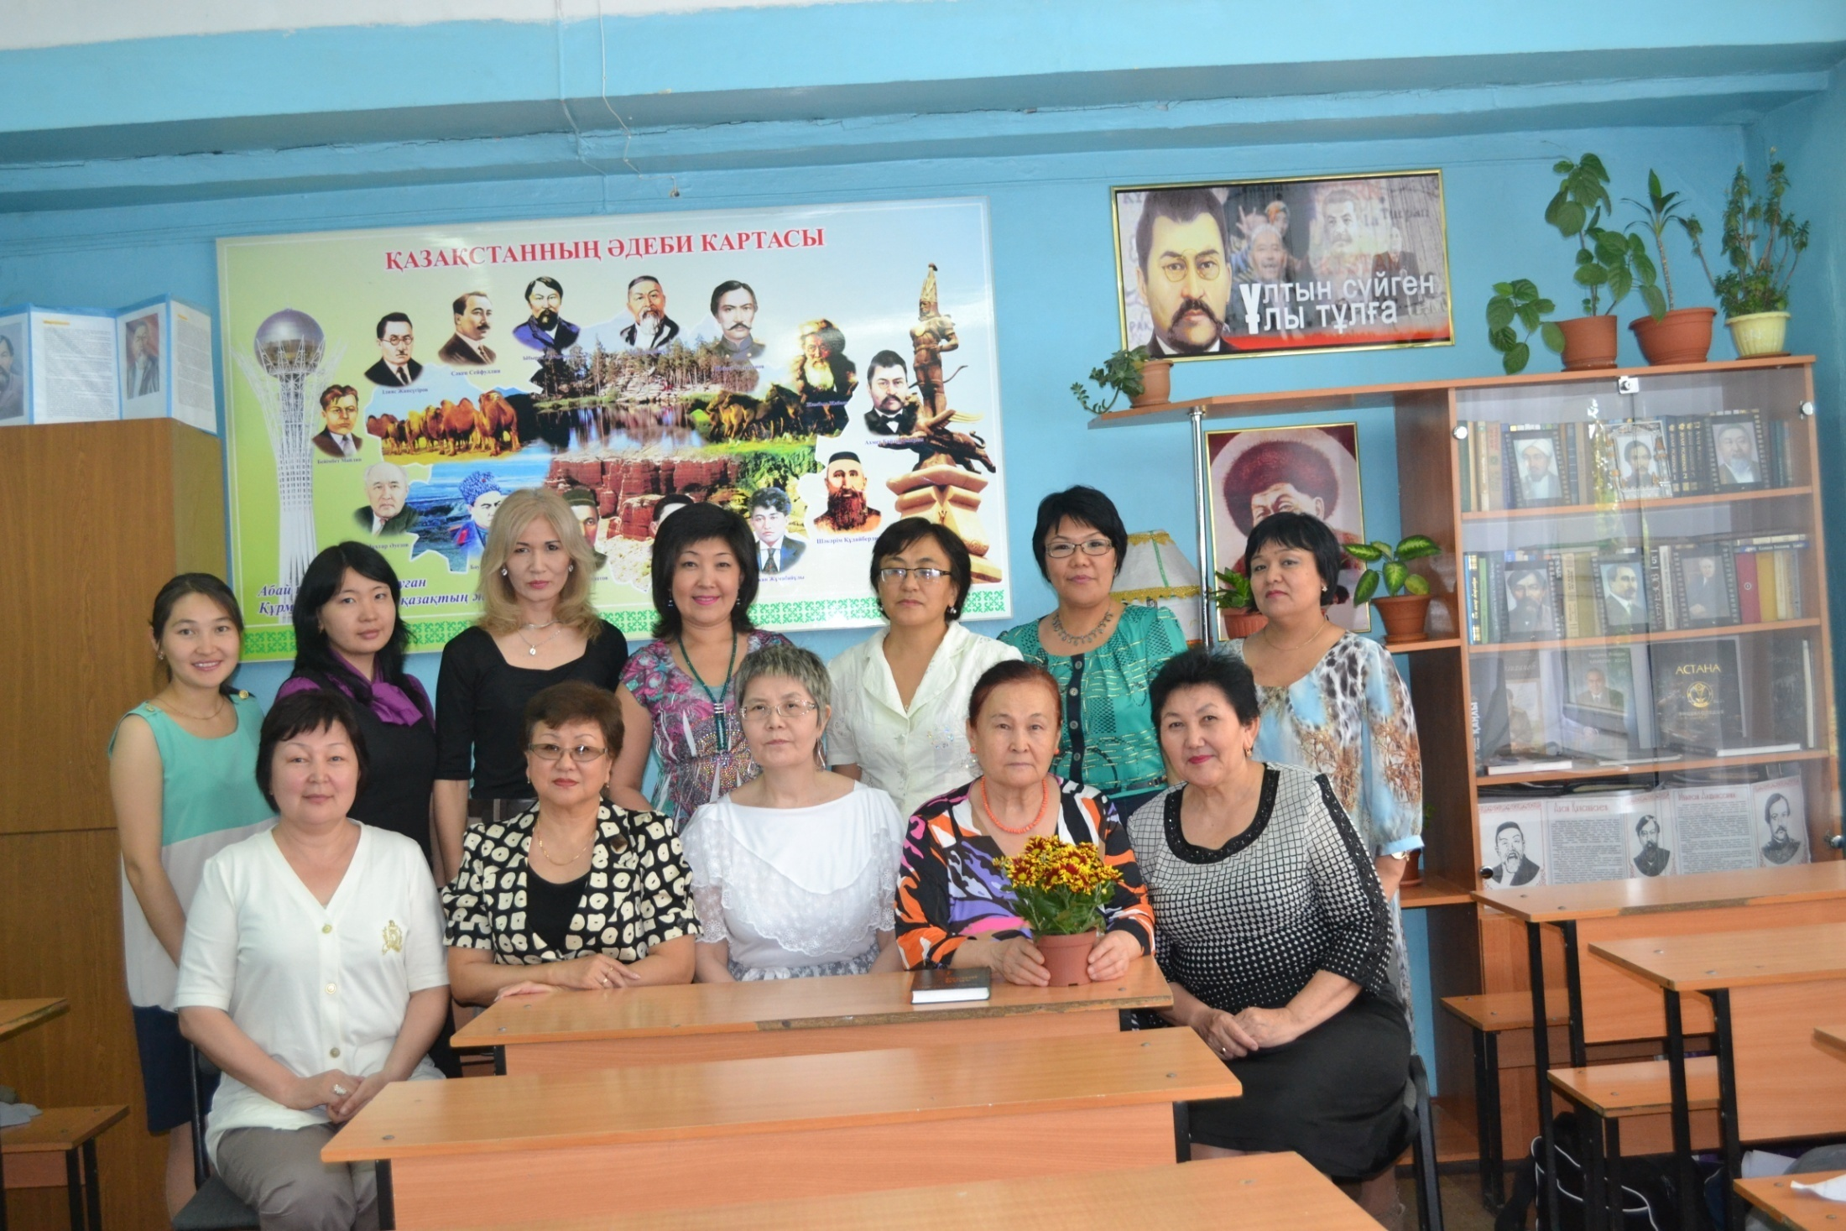

Slide 22
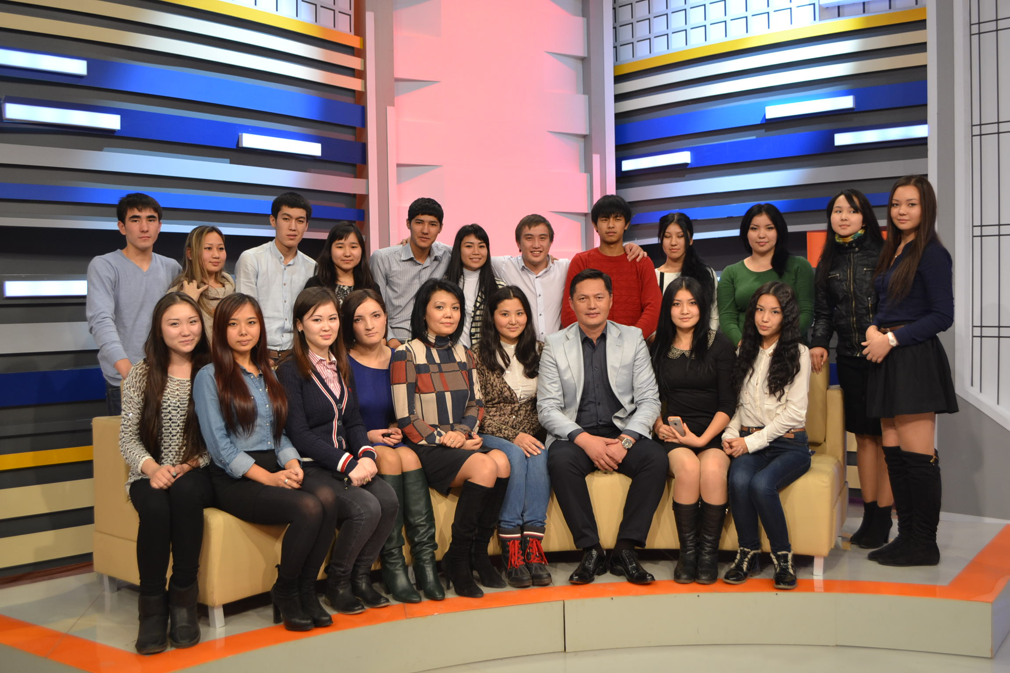

Slide 23
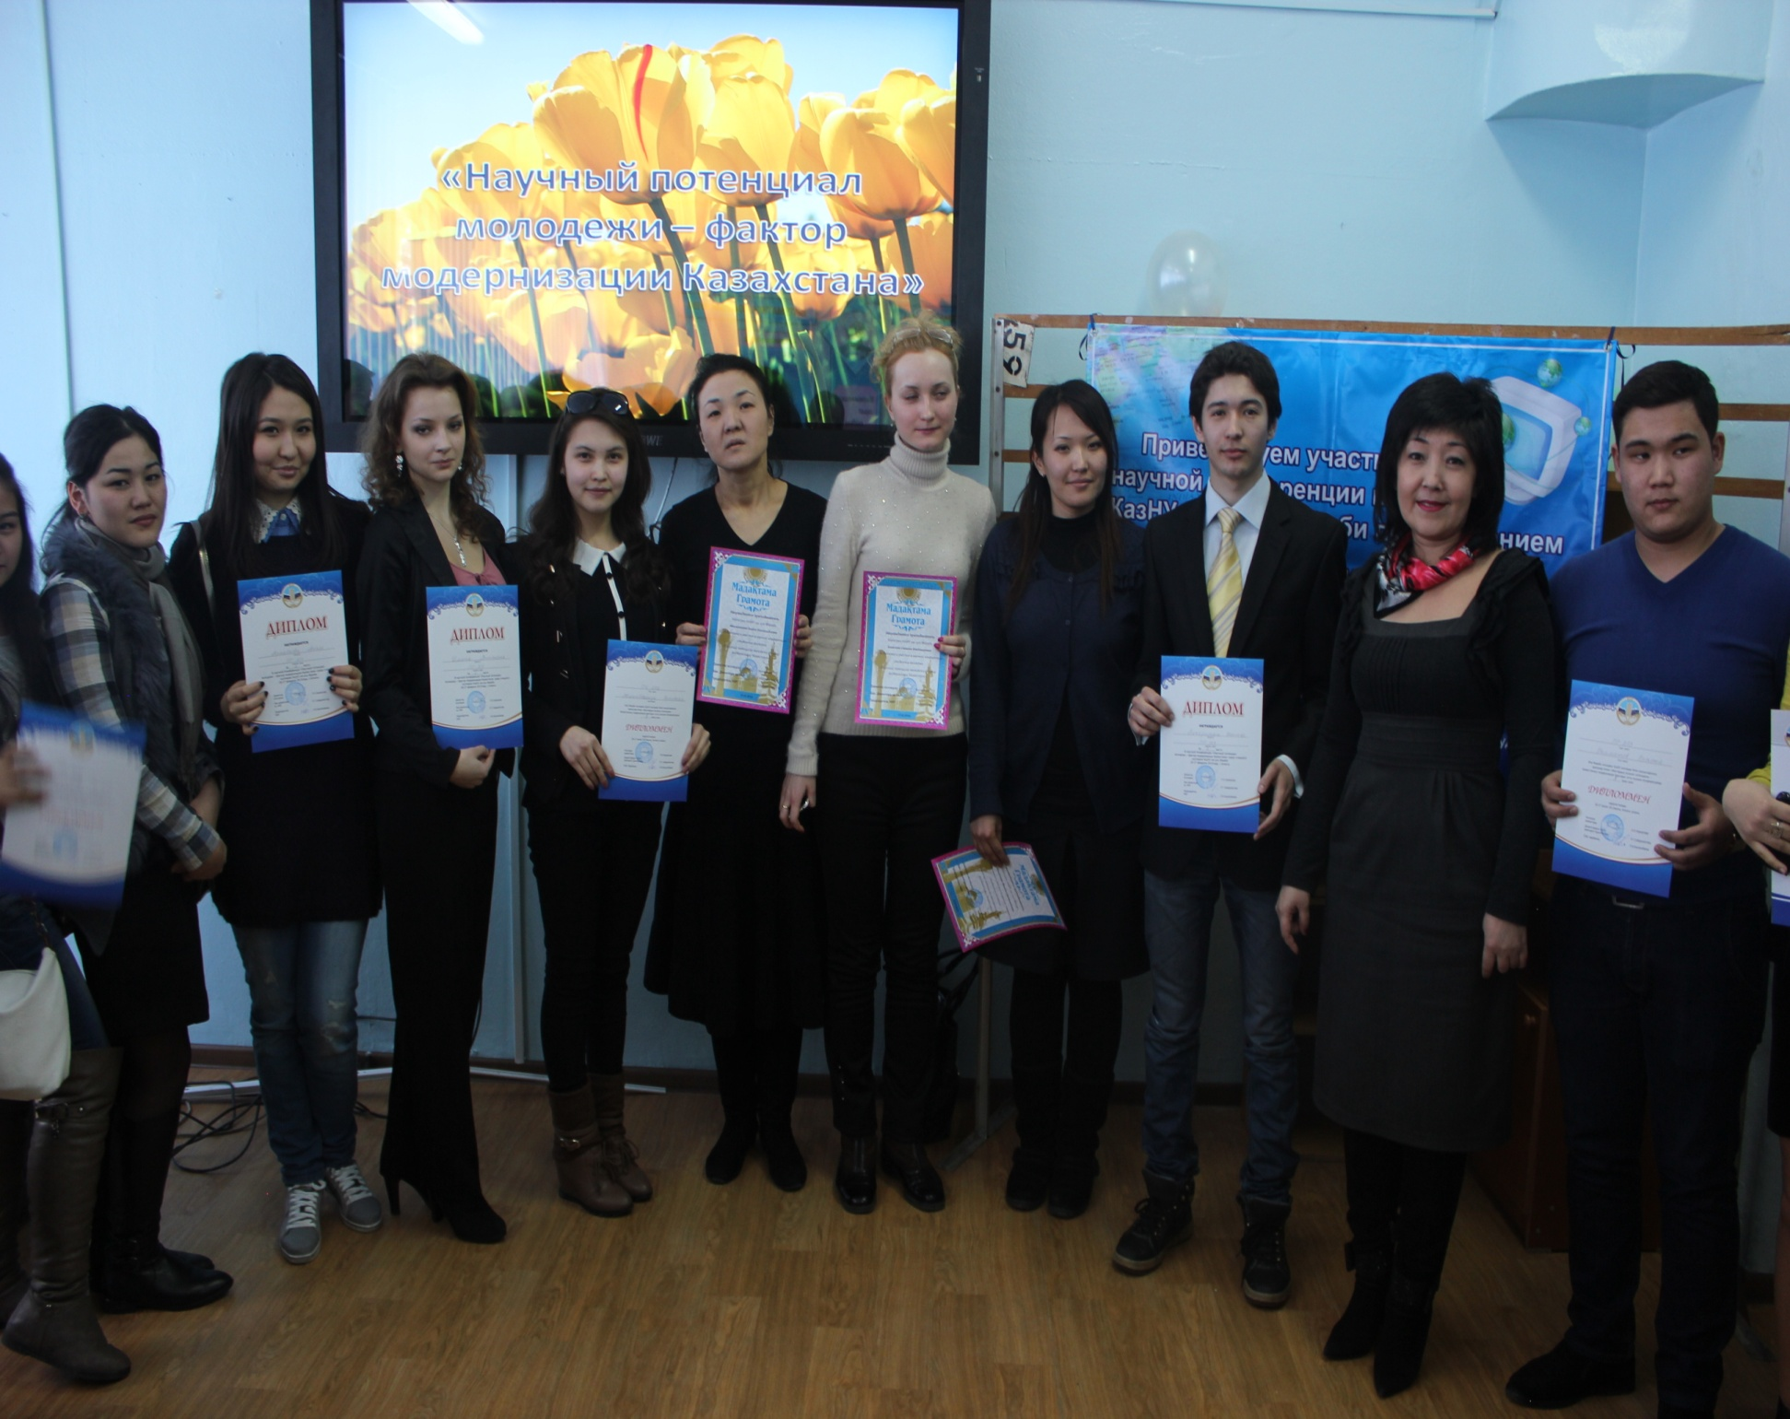

Slide 24
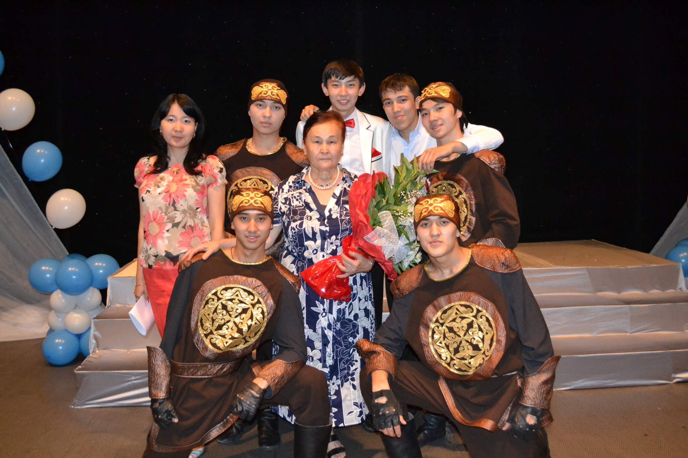

Slide 25
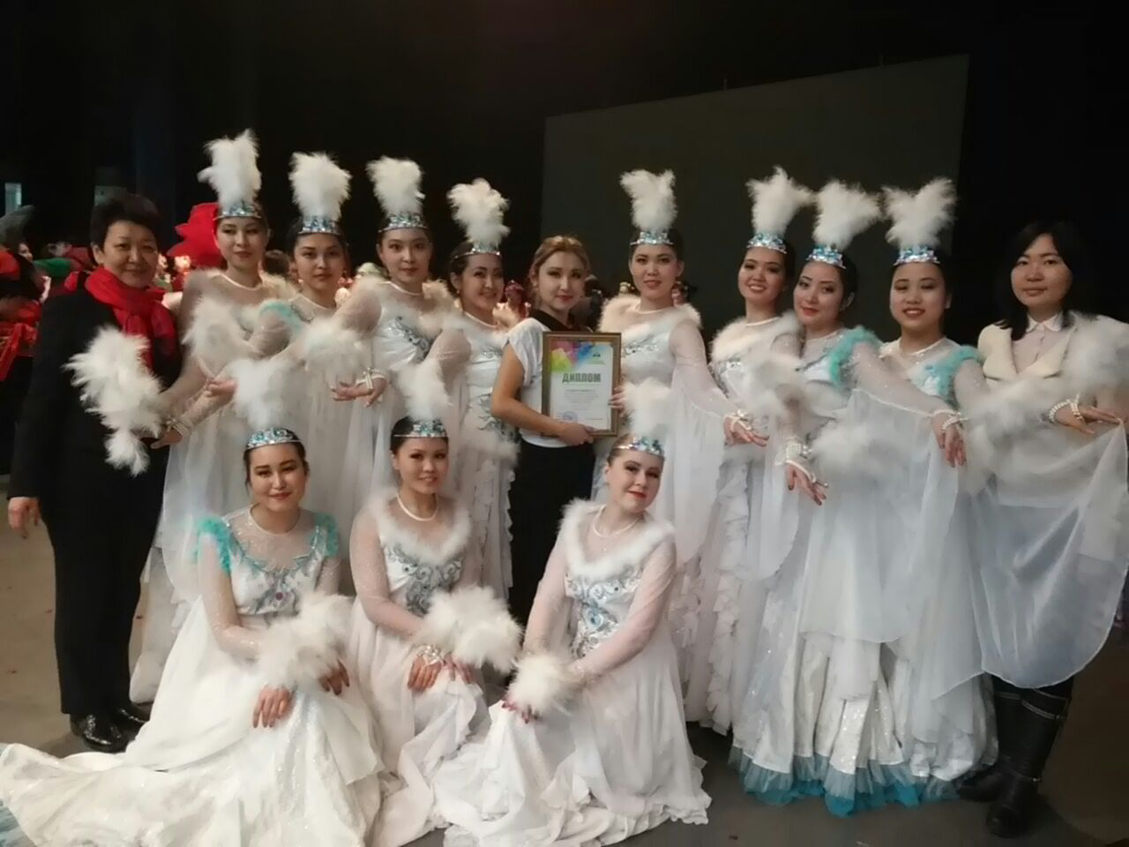

Slide 26
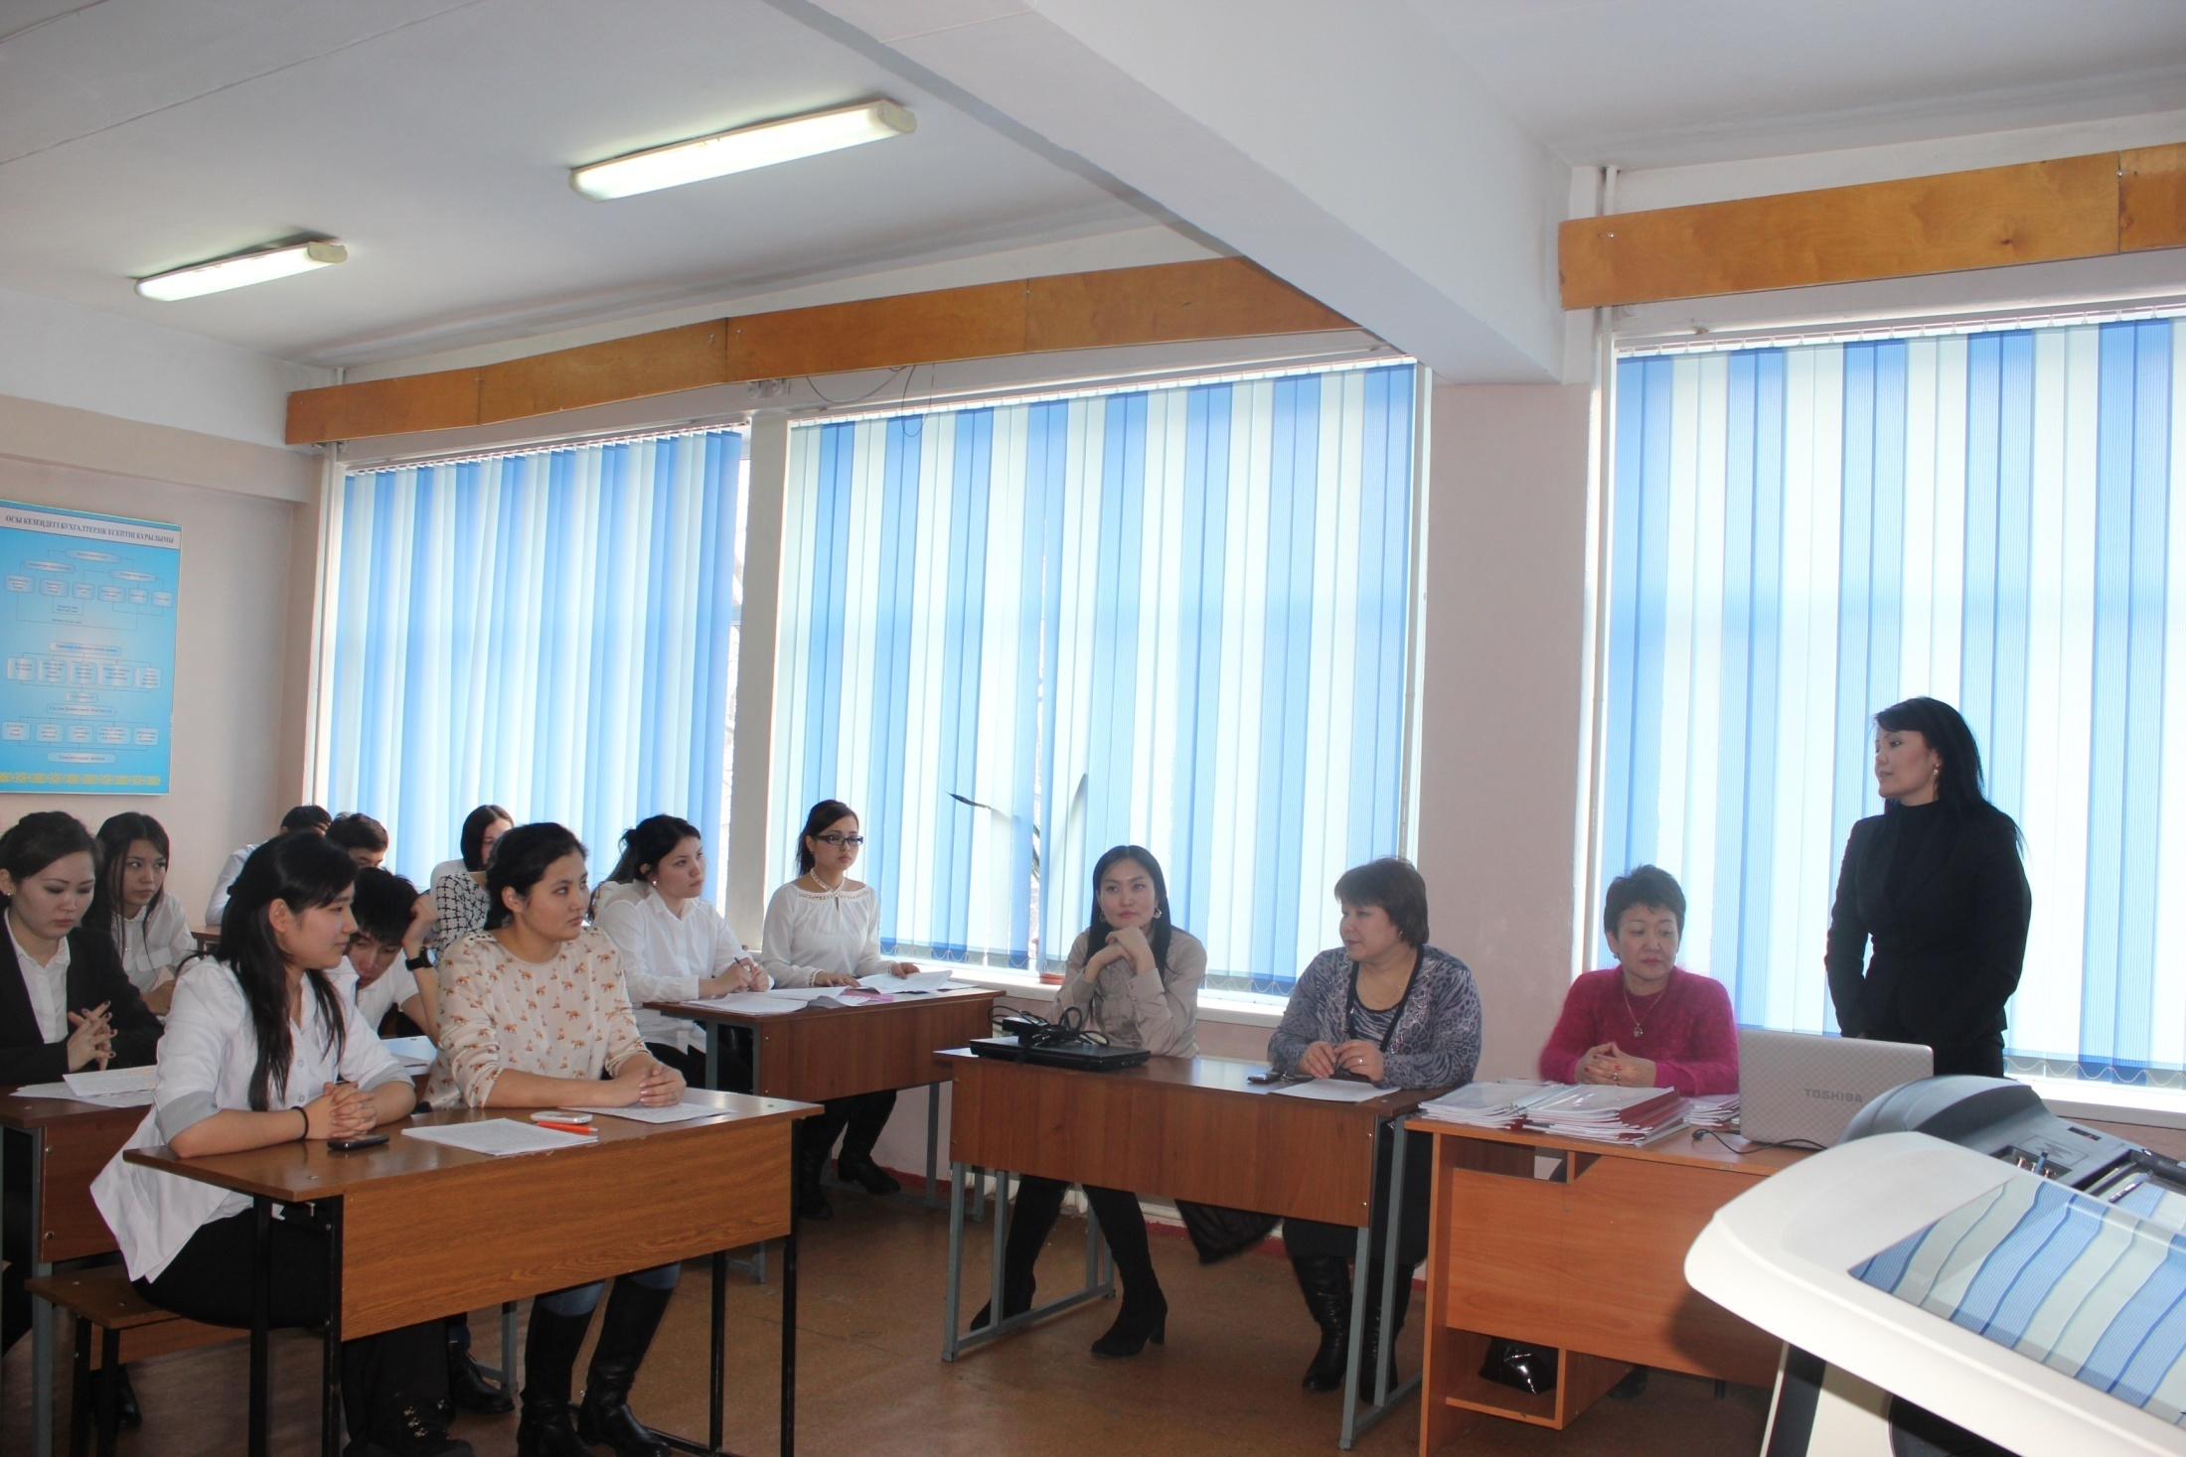

Slide 27
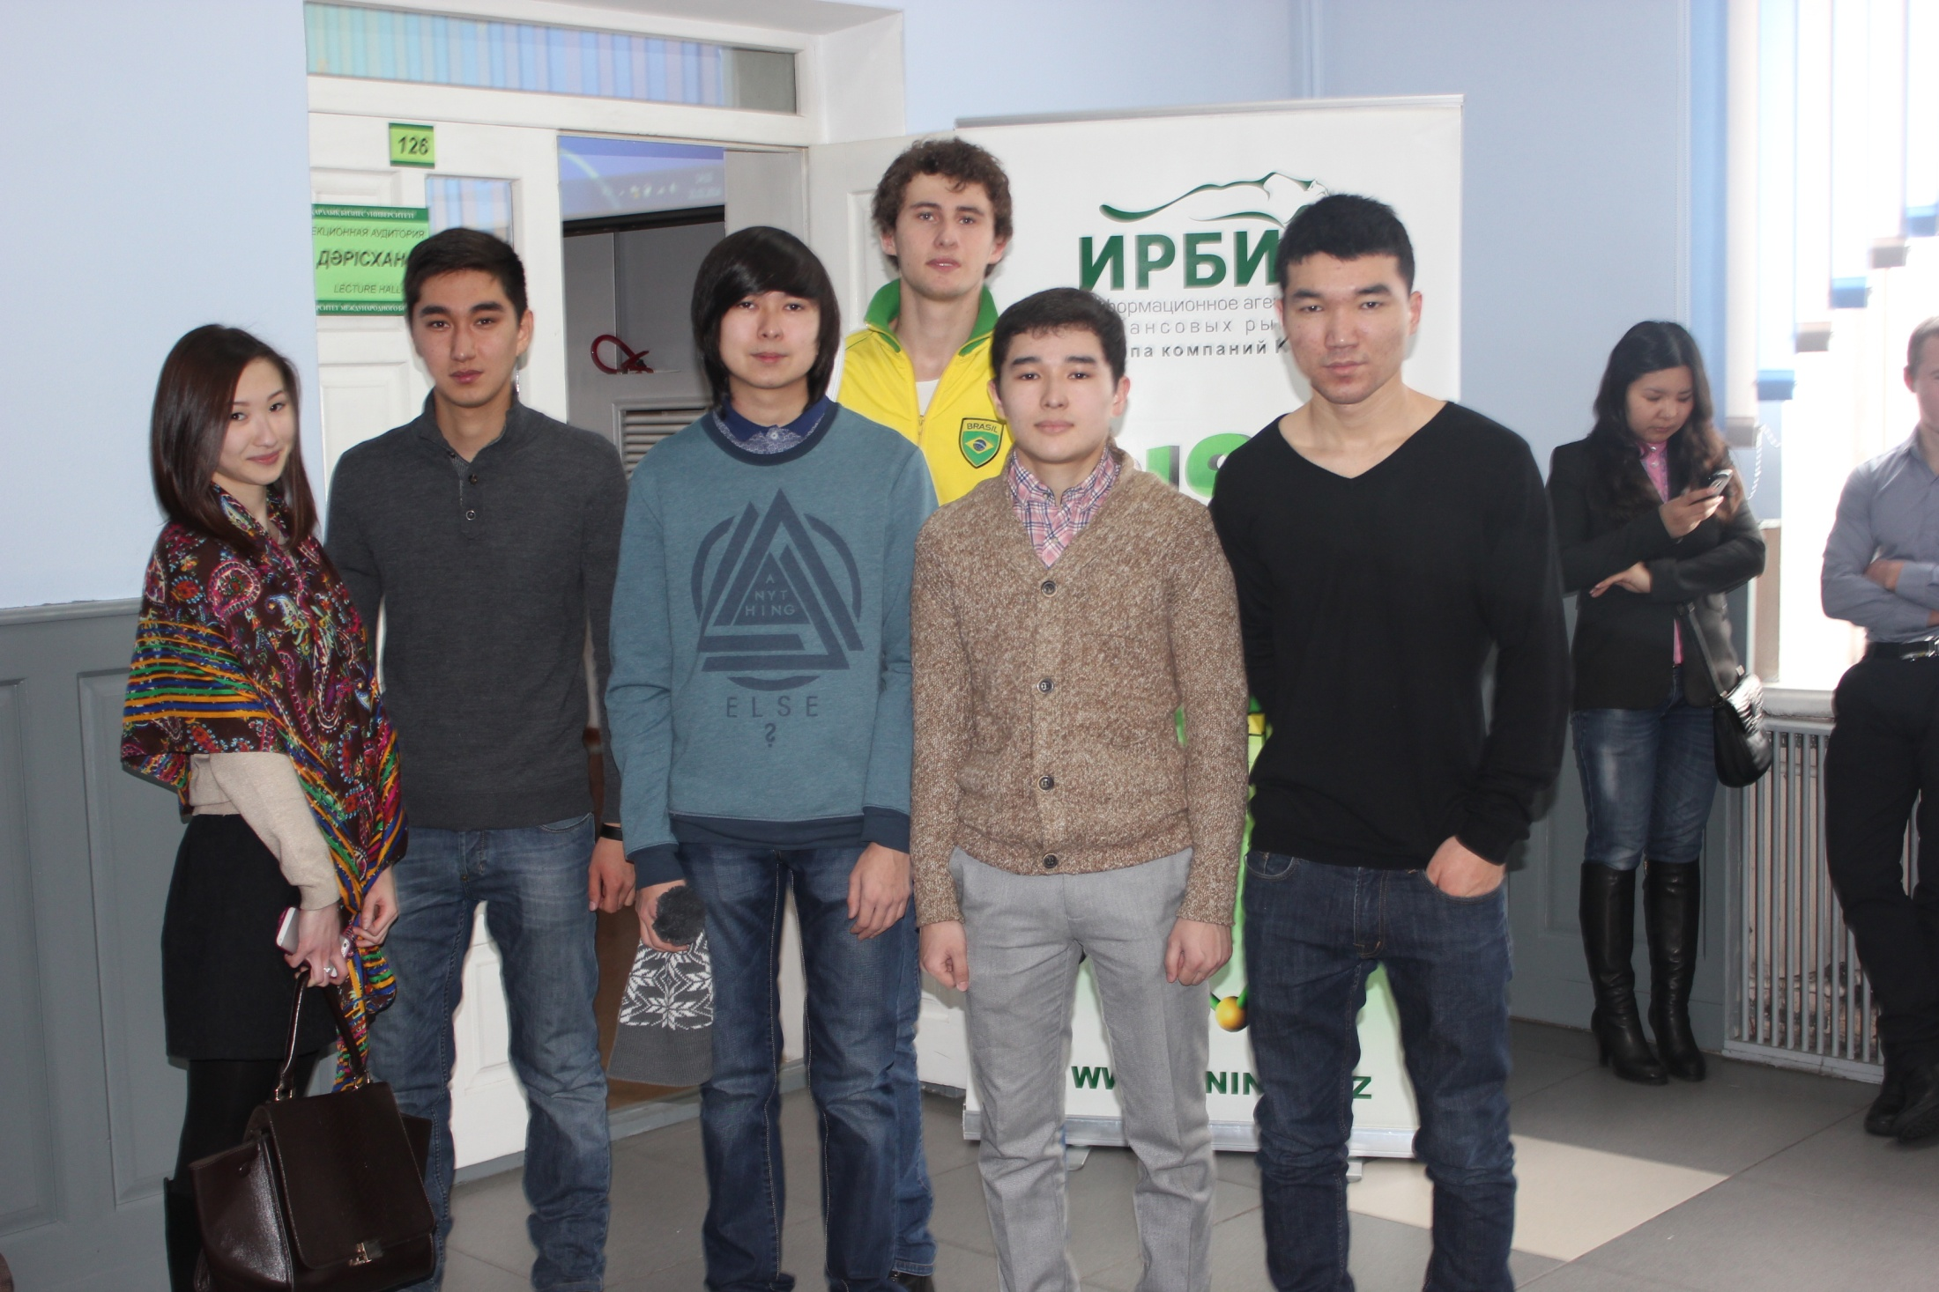

Slide 28
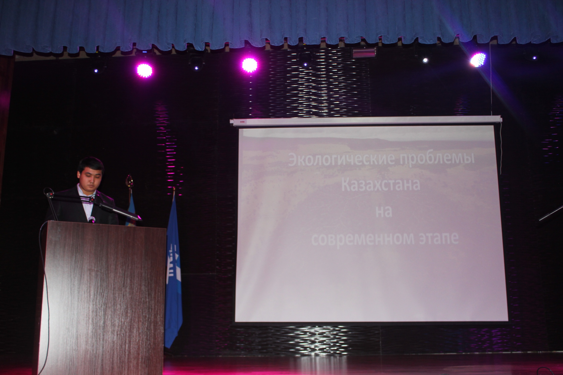

Slide 29
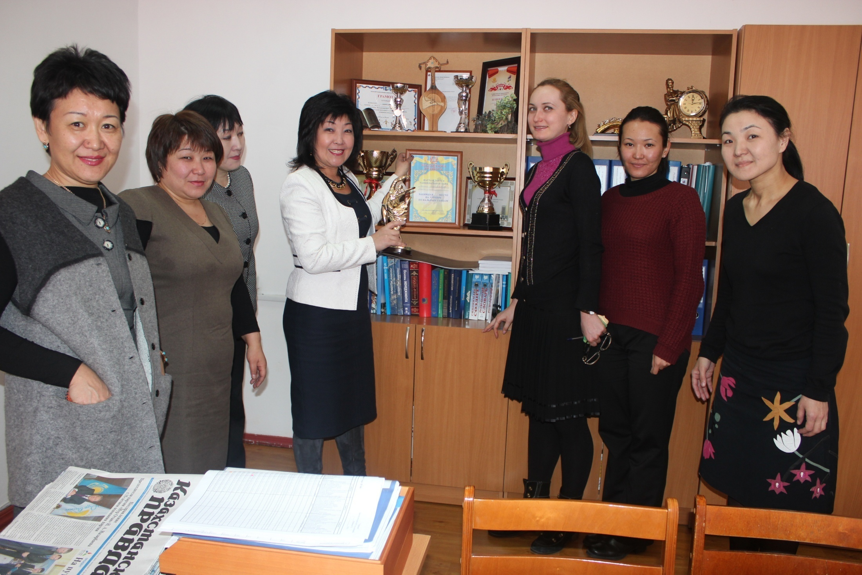

Slide 30
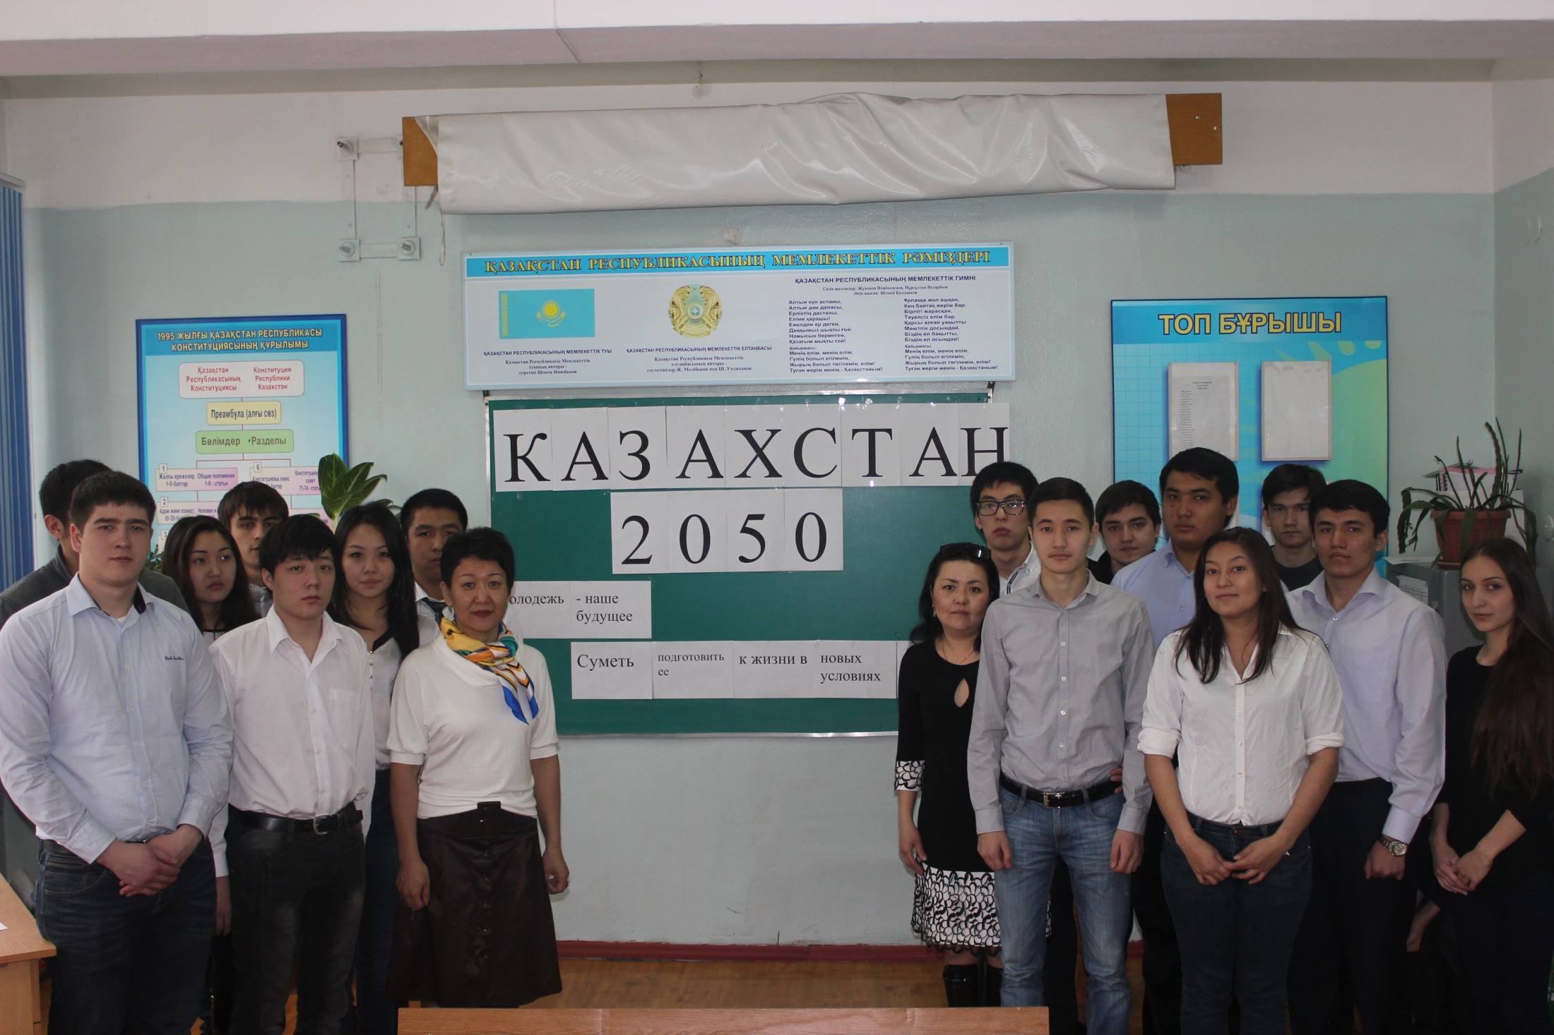

Slide 31
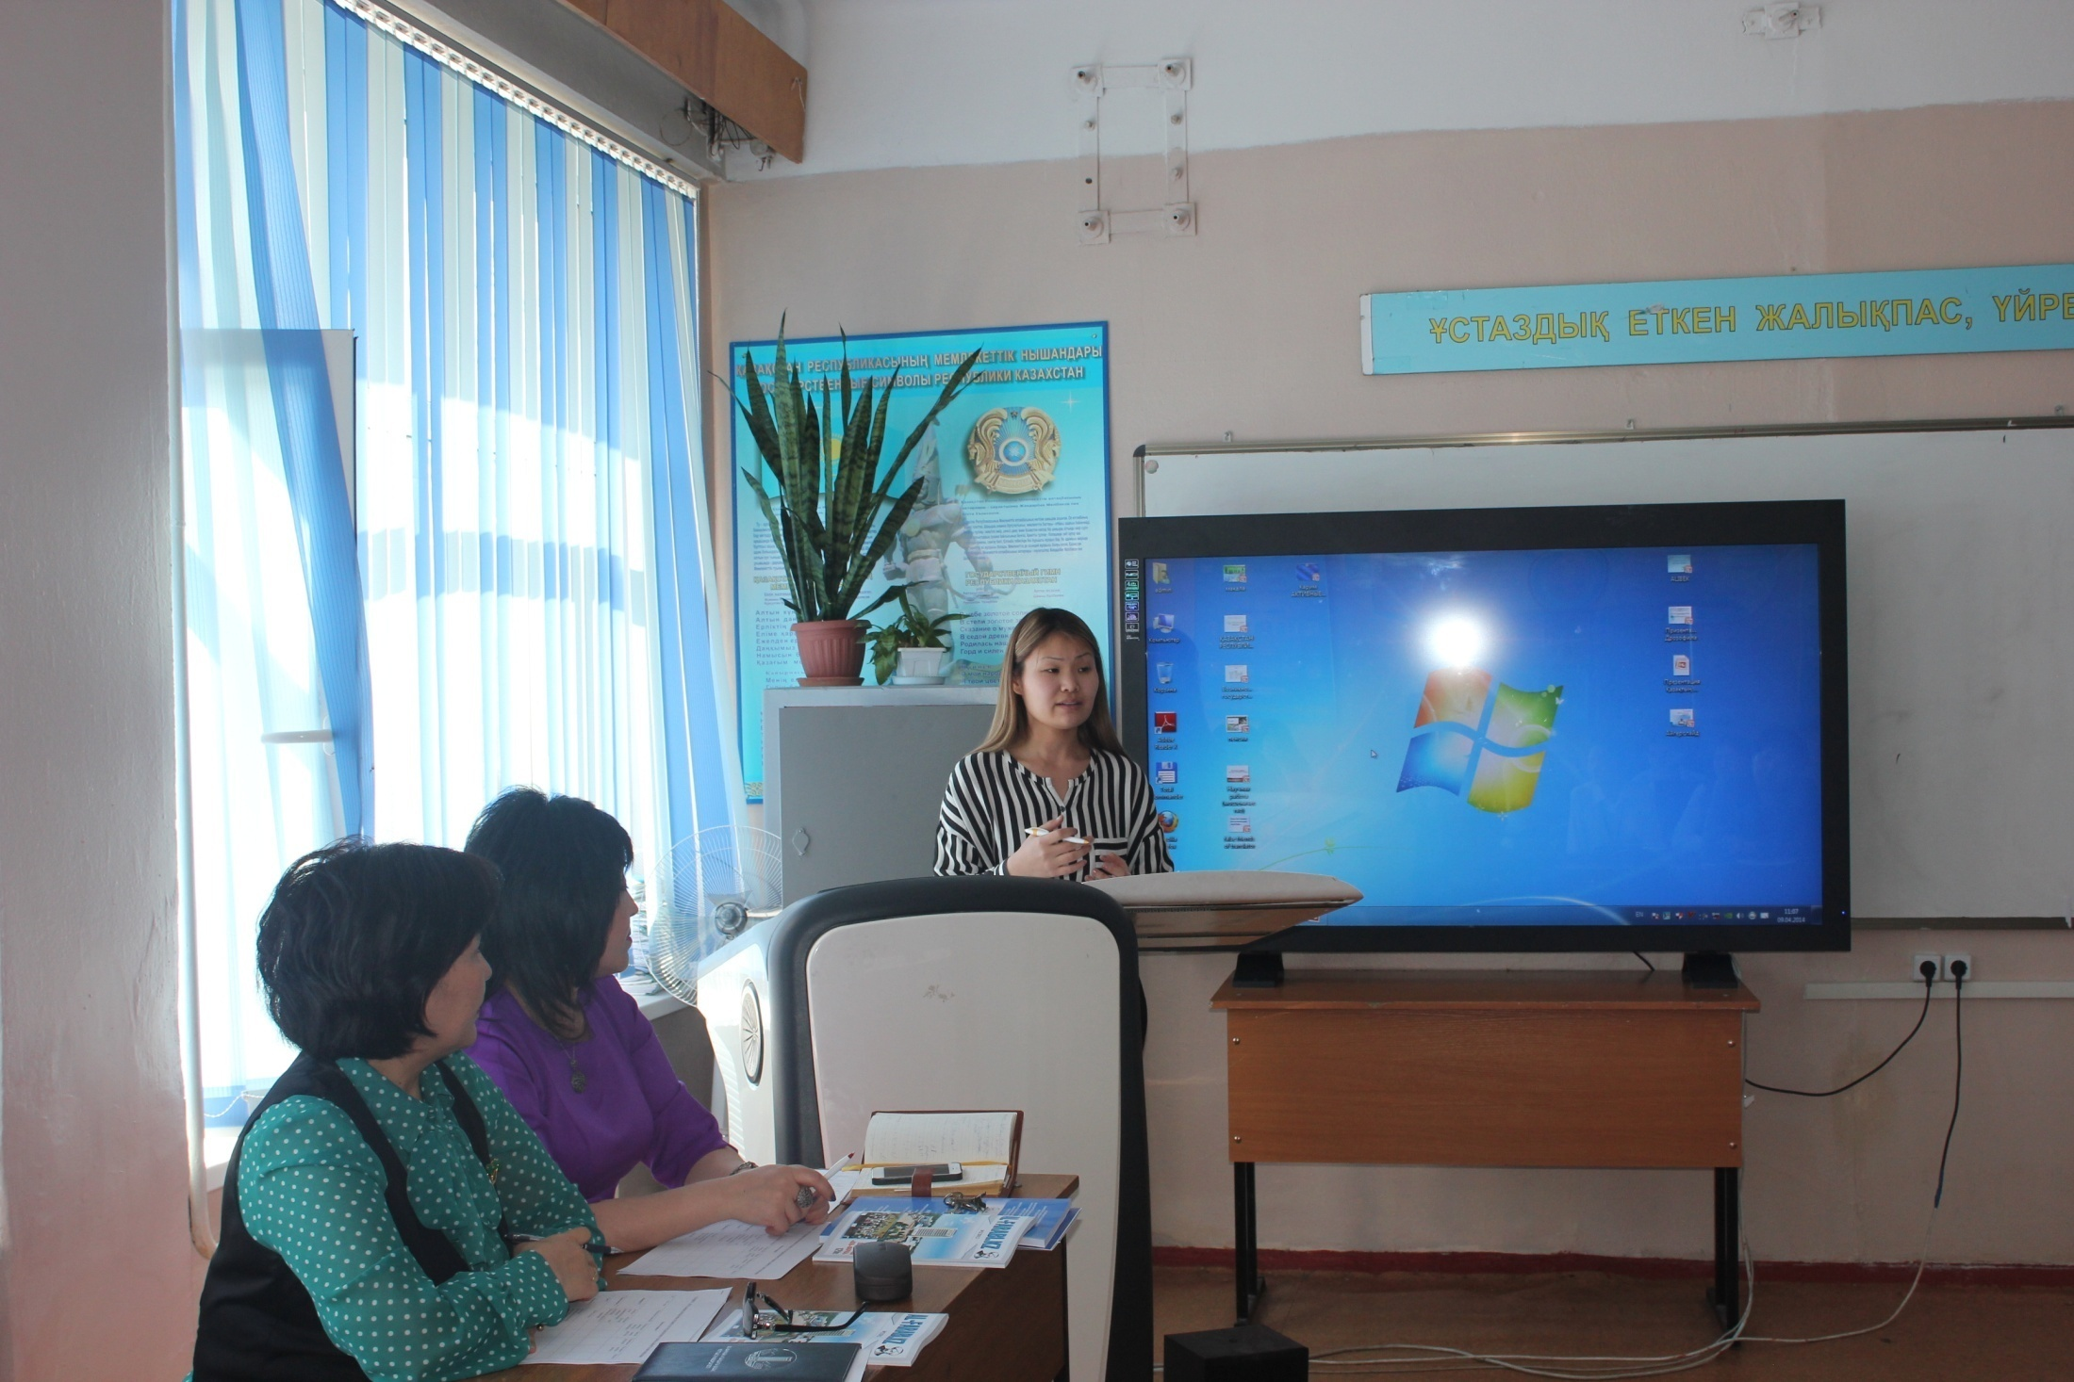
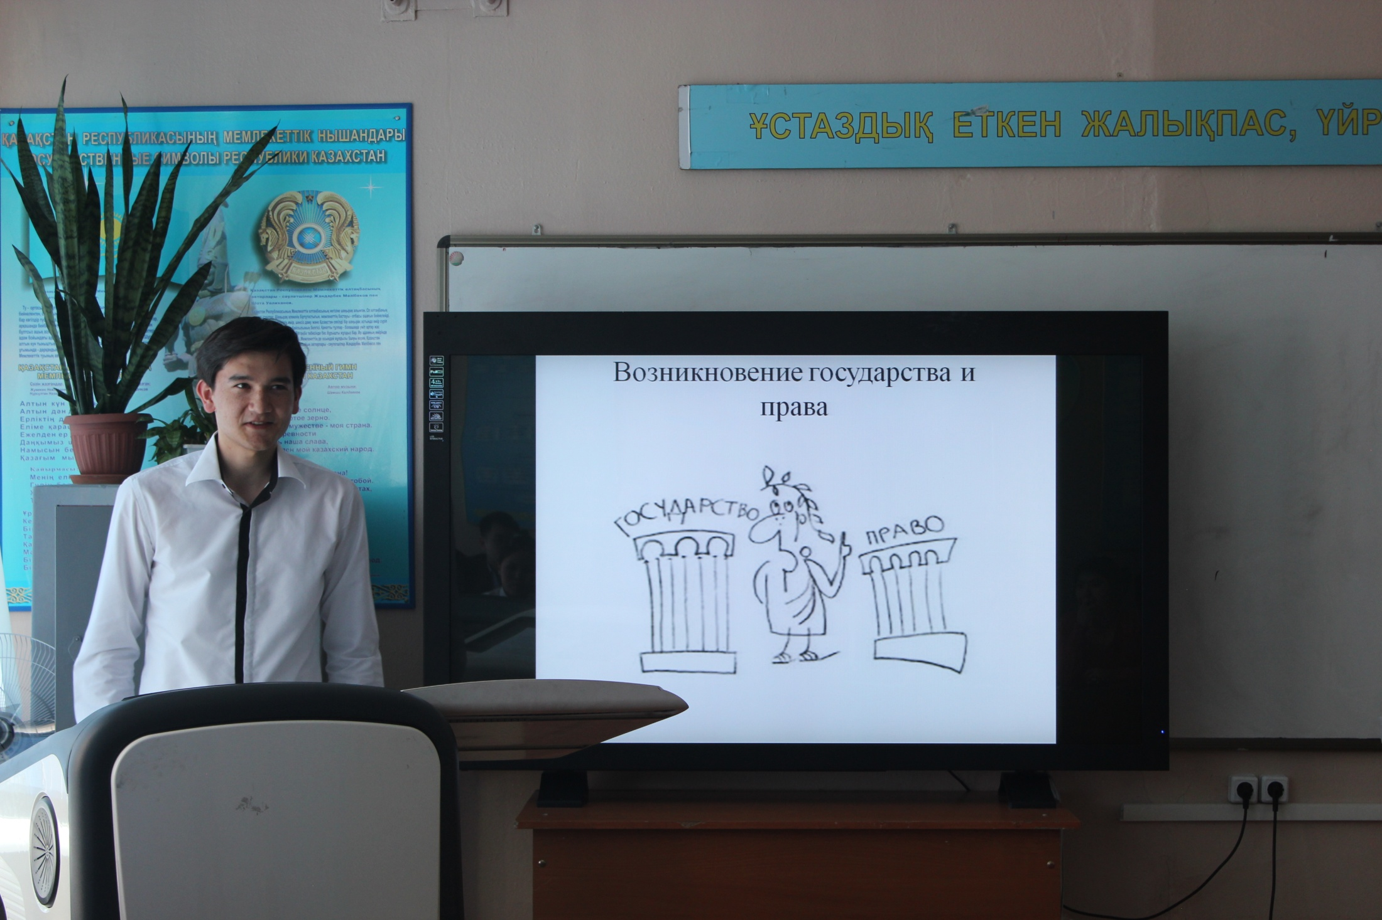
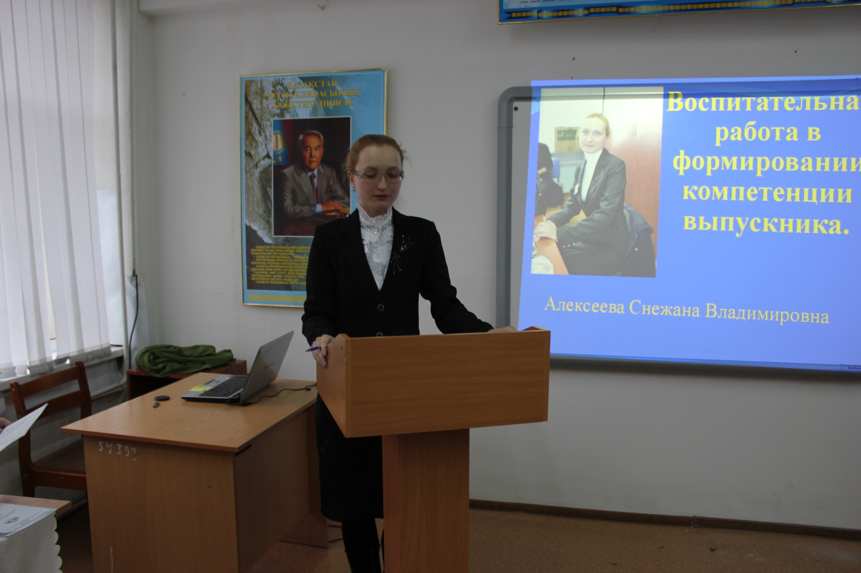

Slide 32
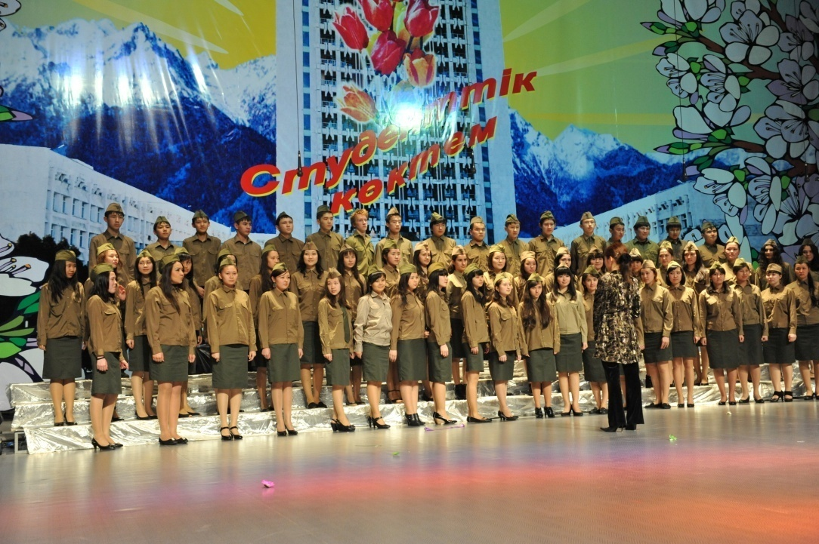
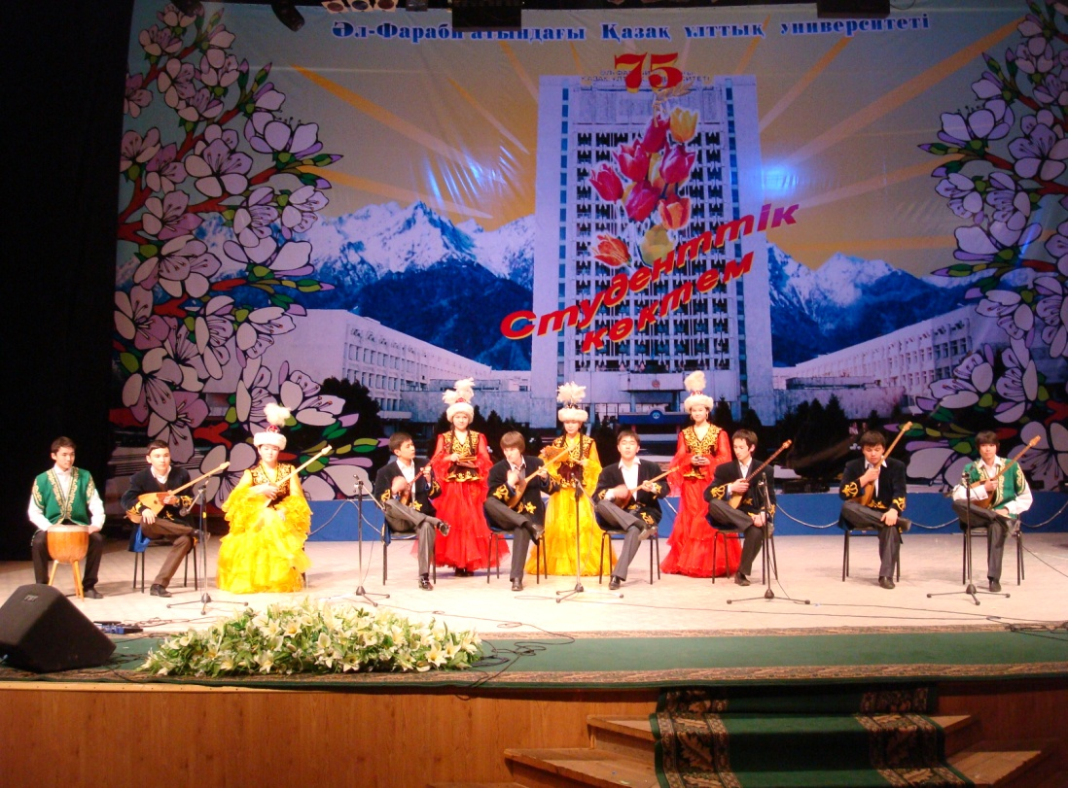
слайд №20
College Choir
Folk instruments ensemble

Slide 33
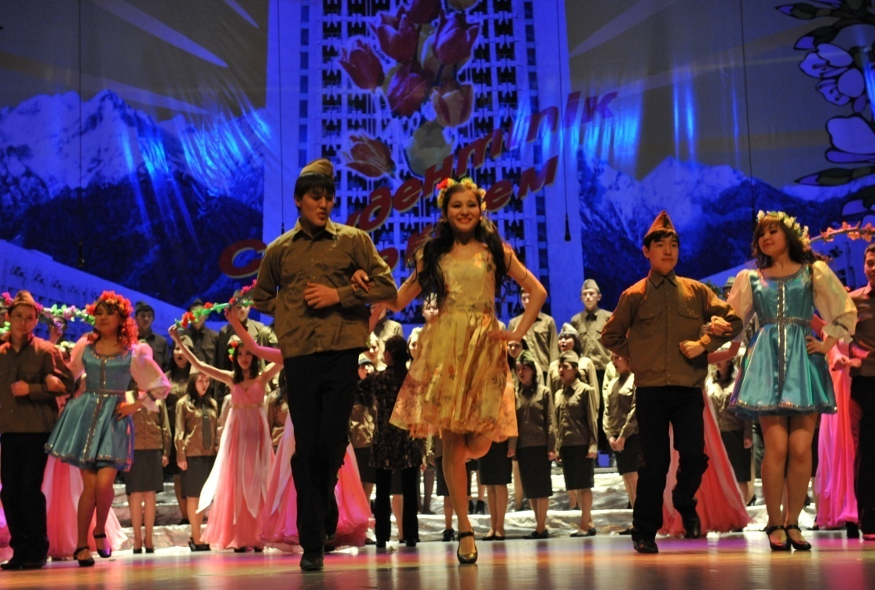
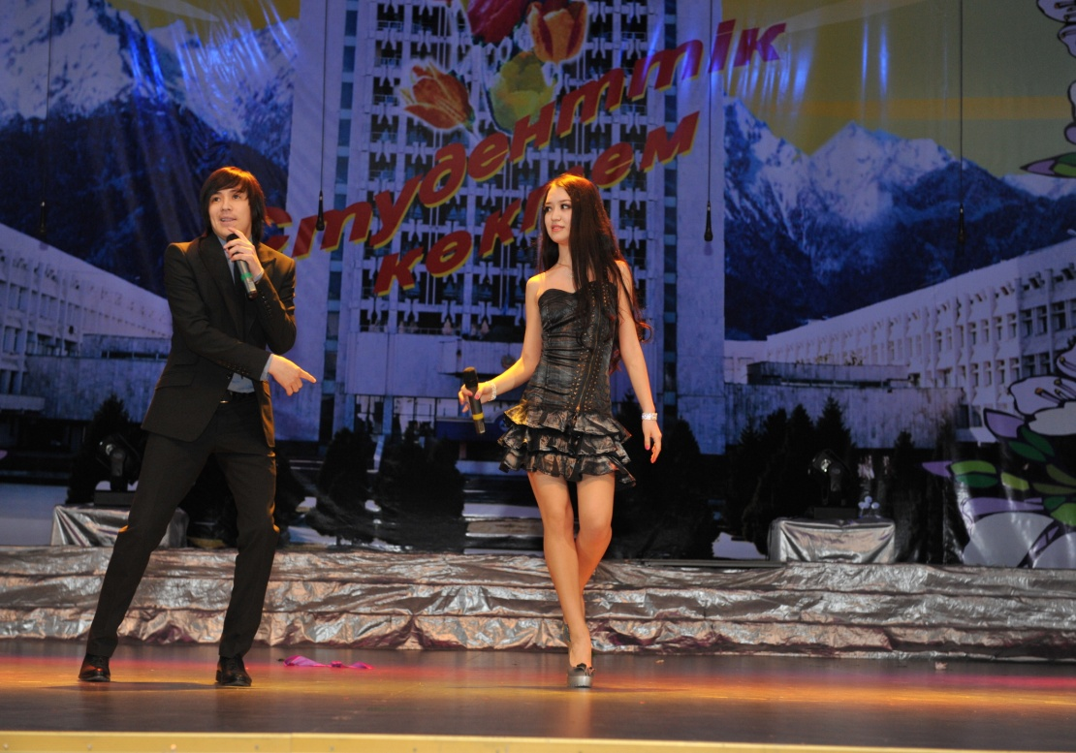
слайд №21
Dance ensemble “Symbat”

