Slide 1

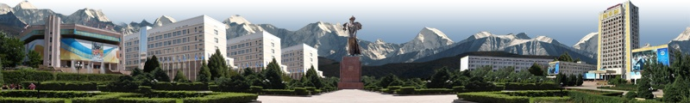

Kazakh National University named after al-Farabi
Profile School
named after al-Farabi

Slide 2

Kazakh National University named after al-Farabi
Qualitative consist of teachers of Profile school
№ п/п | Teacher’s qualification | Teacher’s quantity 2014-2015 y.y. | %
1 | The highest category | 8 | 32%
2 | І- category | 5 | 20%
3 | ІІ -category | 4 | 16%
4 | Magister | 3 | 12%
5 | Without category | 8 | 32%
 | Итого | 25

Slide 3
Kazakh National University named after al-Farabi
Contingent of puples of Profile School
Academic Year | Grade | Quantity of pupiles |  | Totally
 |  | Kazakh | Russian
2014-2015 | 10 | 12 | 7 | 19
 | 11 | 24 | 15 | 39
 | Total puples: at the beginning |  |  | 60
 | At the end of 1st |  |  | 58
 |  |  |  | 19 – 10 gr. 39 - 11 gr.

Slide 4

Kazakh National University named after al-Farabi
Pupile’s Progress
Academic Year | Grade | Quantity of pupiles |  |  |  | КУ | КЗ
 |  | Excel-lent. | Good | Satisfac. | Not satis.
2014-2015 | 10 | 0 | 4 | 15 | 0 | 100% | 33,3%
 | 11 | 1 | 9 | 29 | 0 | 100% | 25,6%
QP- quality performance
QK - quality of knowledge

Slide 5


Kazakh National University named after al-Farabi
Statistics of trial testing

Slide 6
Kazakh National University named after al-Farabi
Статистика пробного тестирования в разрезе предметов
 | Каз.яз | Математ | Ист.Каз | Рус.яз | Физика | Химия | Географ. | Биолог. | Всемир.история | Литерат | Англ.яз | Итого
11 А каз | 18,00 | 7,17 | 13,33 | 15,17 |  | 10,50 |  |  | 9,00 | 13,00 | 14,00 | 64,67
11 Ә каз | 19,11 | 14,00 | 15,33 | 14,56 | 9,00 |  | 13,75 | 13,00 |  | 10,00 |  | 74,67
11 Б каз | 15,89 | 12,33 | 13,56 | 12,89 | 8,29 |  |  |  | 13,00 | 16,00 |  | 64,33
11 В рус | 18,80 | 13,40 | 10,80 | 17,60 |  |  | 16,00 |  | 9,00 | 15,00 | 19,00 | 76,20
11 Г рус | 19 | 14 | 14 | 14 | 10 |  | 19 | 12 |  |  | 18 | 72,38

Slide 7
Statistics putting trial testing
Kazakh National University named after al-Farabi

Slide 8


OUR ACHIVEMENTS

Slide 9

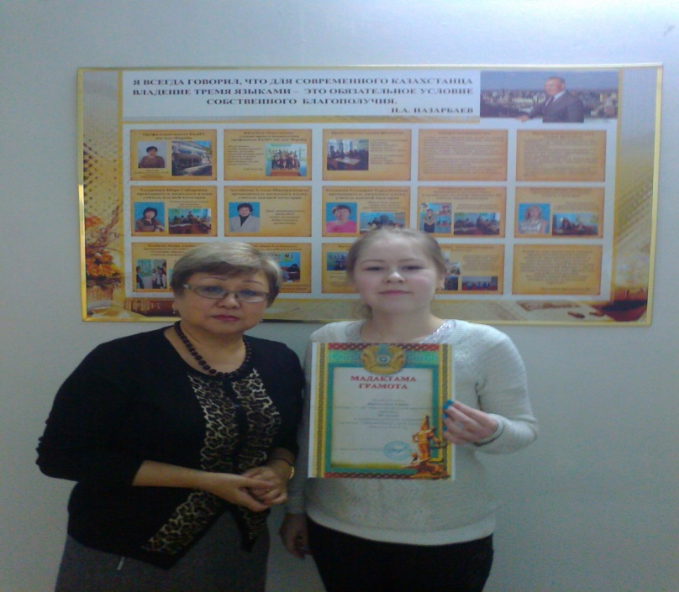
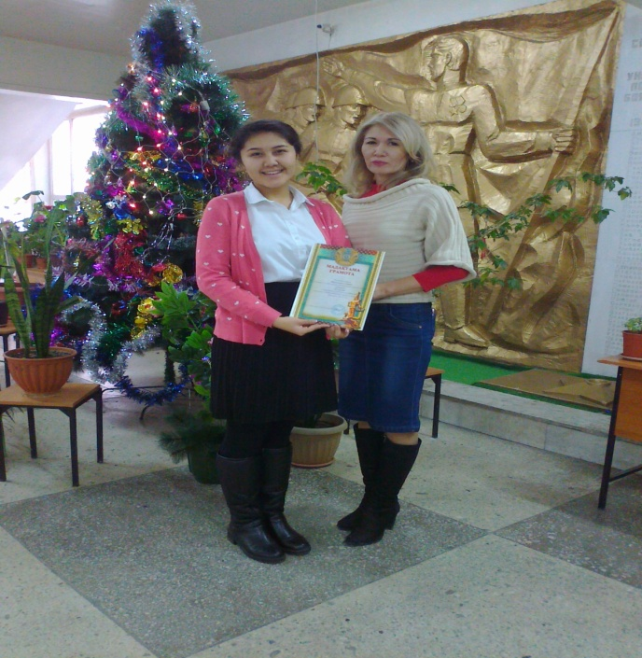
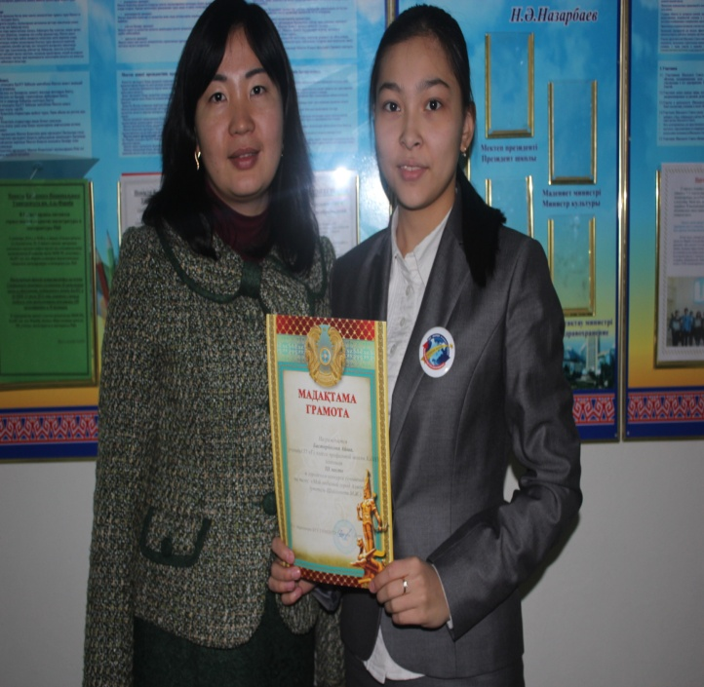
September 12, 2014 the Department of Education and Culture Centre was announced an essay contest on the theme "My favorite city of Almaty!" In schools in Almaty..
student of 11th grade
Saida Ibragimova,
took 3rd place
teacher- Khan R.A.
student of 11th grade
Aisha Bastarbekova,
took 3rd place
teacher- Shaihynova M.Zh.
student of 10th grade
Symbat Zholshibek,
took 3rd place
teacher- Hamitova M.N.
.

Slide 10
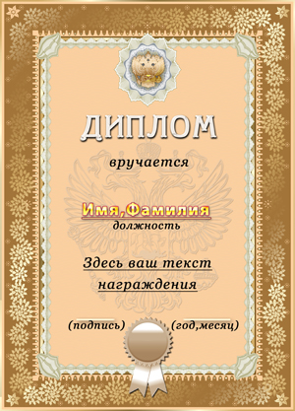
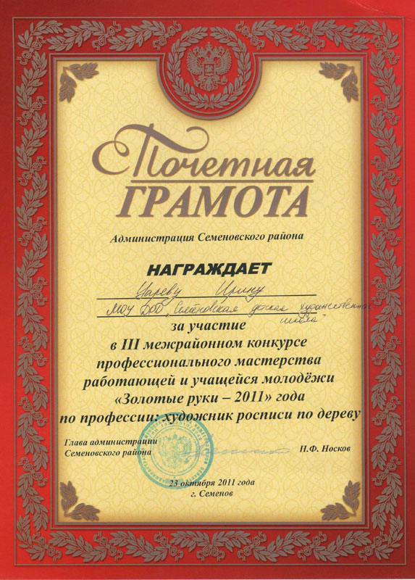
December 11-12, held district, city stage competitions in general subjects, which was attended by 29 students. According to the results, the following regional competitions winners are :
On the subject of geography Nurdylda Aruzhan awarded the Diploma of the 3rd degree (teacher Kuanbaev N.Sh.)
On the subject of the Kazakh language Satyyualdiev Kuat, Sayida Ibragimova marked Honourable mention (teacher Udurimova Sh.S.)
On the subject of the history of Kazakhstan Alibek Ramazan was awarded a Diploma 3rd degree
(Teacher Zulkapyl.D.)

Slide 11
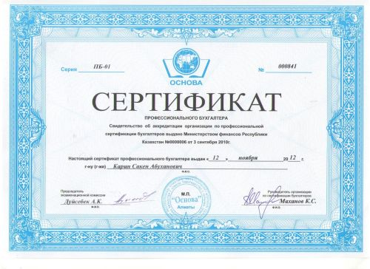
Pupiles of profile school actively participated in the intellectual marathon "Akbota", held among pupiles of 10 classes. All participants of 11 pupiles were awarded certificates

Slide 12

Tournament "Business - Shark"
Pupiles of 11 classes applied to take part in a tournament for high school students "Business shark." Total participated 6 students.
The results of the tournament will be determined in the 2nd half
(January).

Slide 13


At city competition of research projects were presented 5 works in the following sections: 1. Biology 2. Physics 3. Mathematics 4. Applied Mathematics 5. Mechanics
Science World

Slide 14
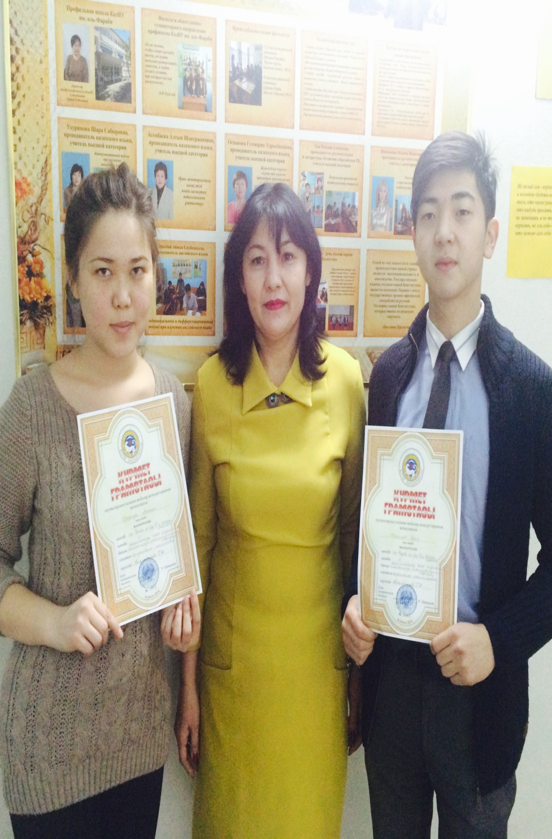
In the qualifying round were 4 works which participated in the city competition of research projects. Students Nurdylda Aruzhan and Adil Karimov awarded the Diploma in Management Education Almaty city sections: Applied Mathematics. Superviser- Atambekova GK
Science World

Slide 15
About educational activity

Slide 16

Educational work was conducted in the following branches:
1. Civil and patriotic, social and political education.
2. Organizational and coordinating work with the class teacher, her class, student council
3. Spiritual and moral education.
4. Mass cultural education.
5. Physical education, promotion of healthy lifestyles.
6. Legal education.
7. Professional education.

Slide 17
Civil and patriotic, social and political education.

Slide 18

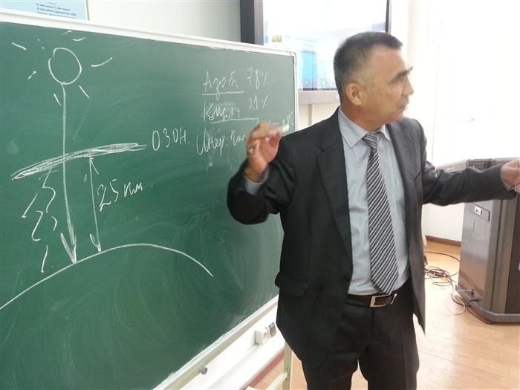
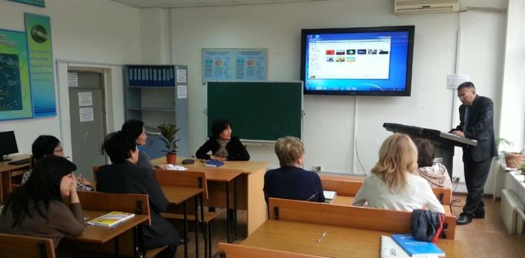
Seminar of the forum "The new paradigm of sustainable human development G-Global - global dialogue format" prepared by Geography teacher Kuanbaev N.Sh.

Slide 19
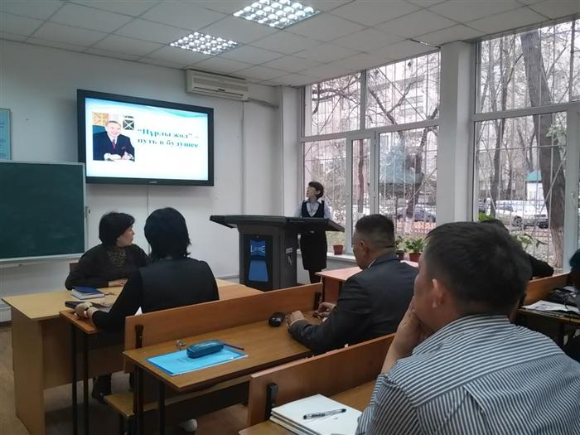
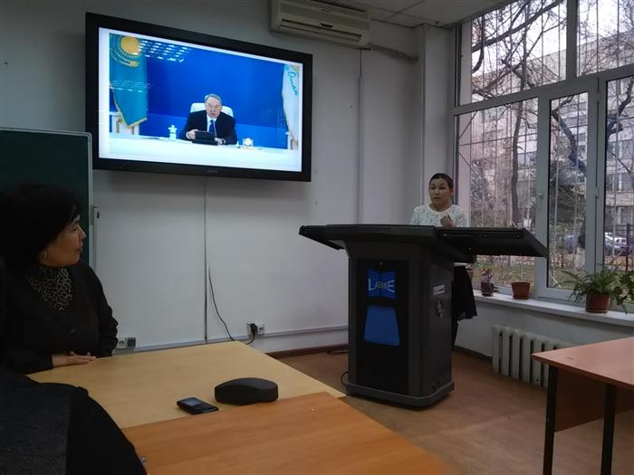
November 18, 2014 at profile school KazNU named after al-Farabi was discussed Address to the Nation "Nurly Zhol - way of the future," the President of our country Nursultan Nazarbayev.
"Nurly Zhol - Way to the Future"

Slide 20
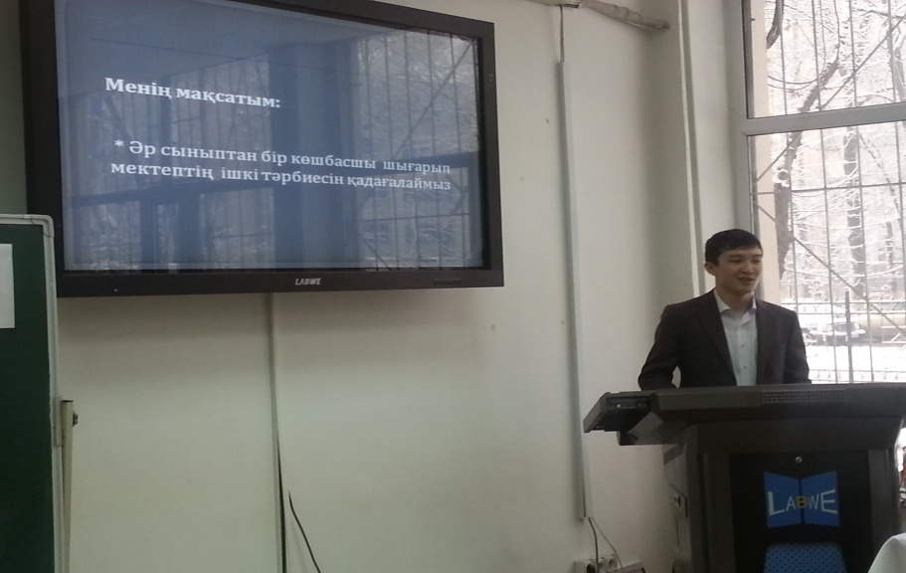
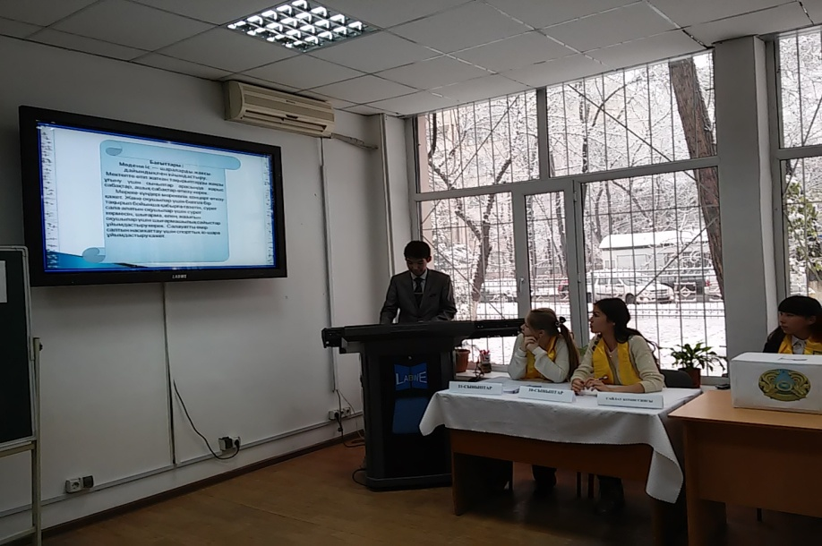
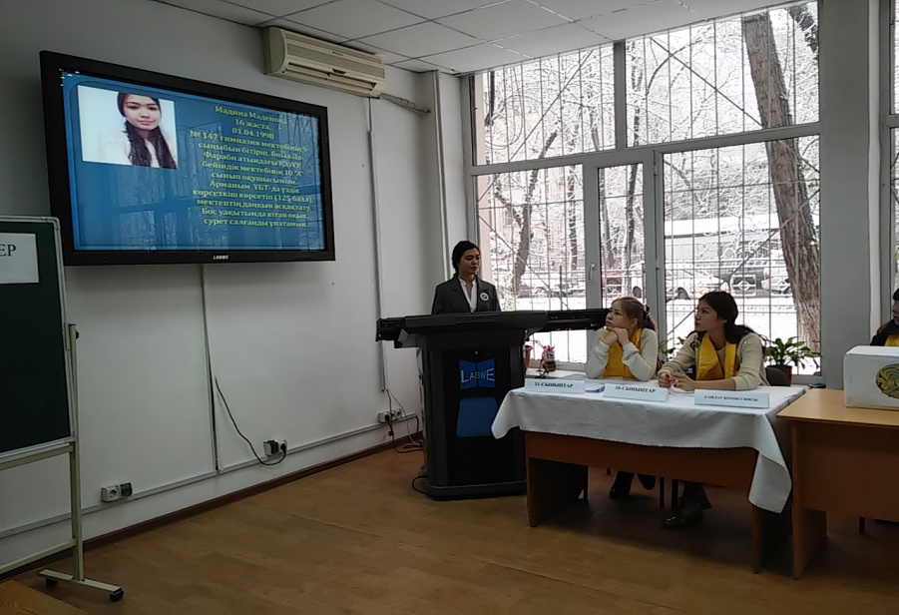
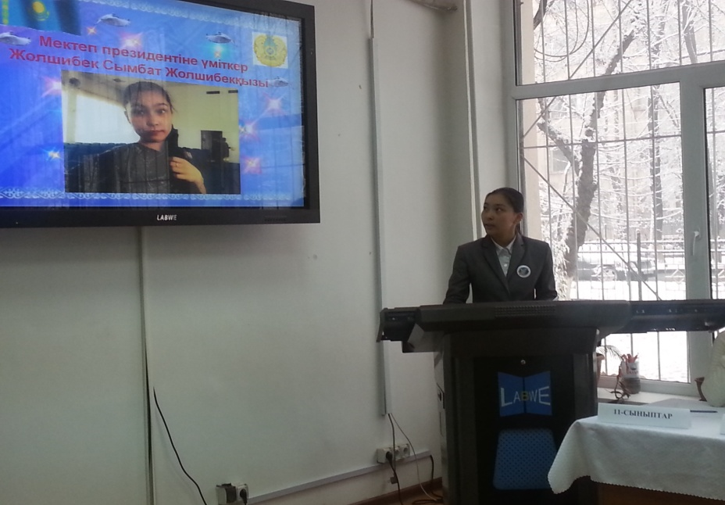

25th of November profile school chose the presidential elections of the school.

Slide 21
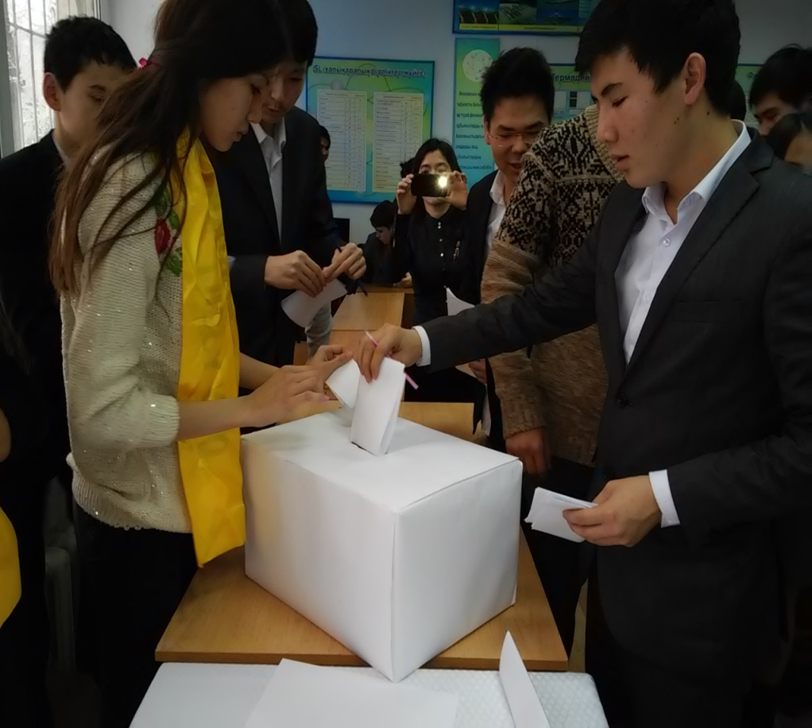
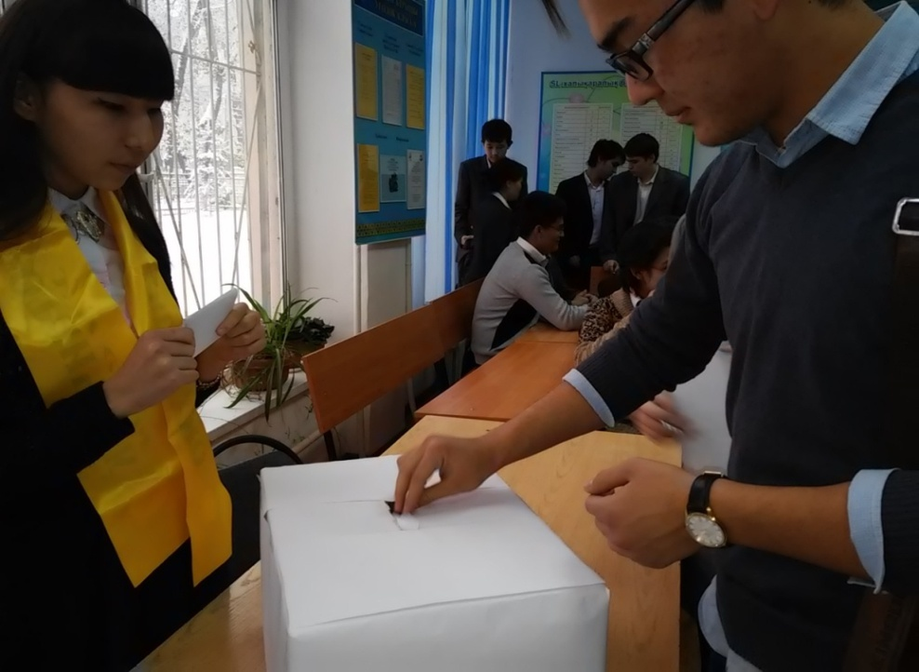
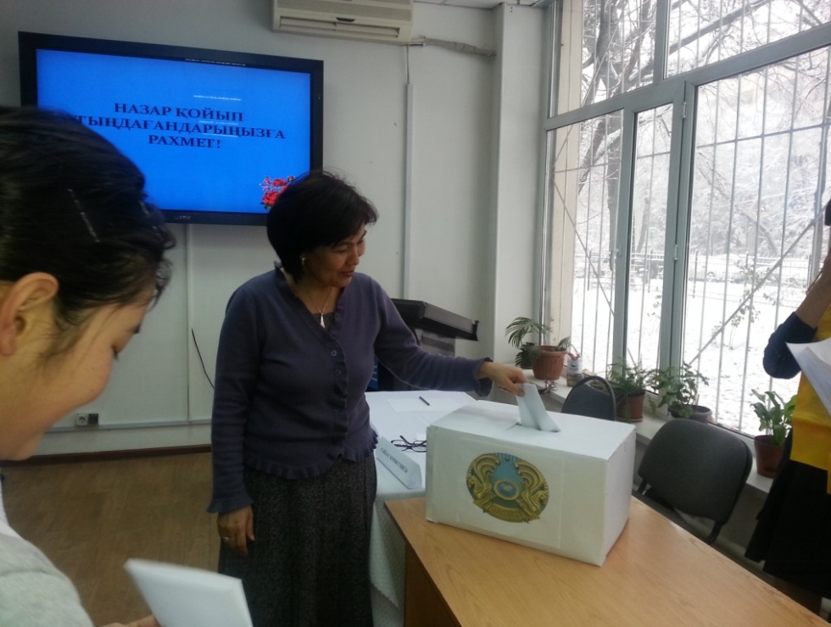
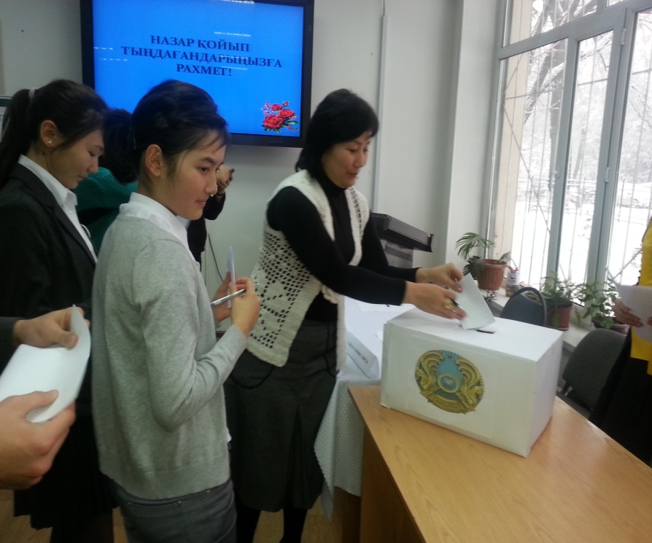
Teacher and student vote school’s presidential candidates

Slide 22
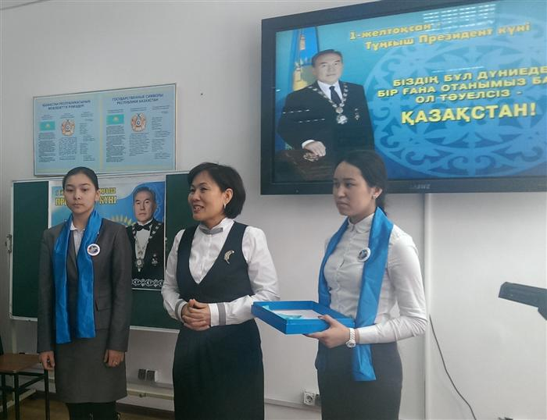
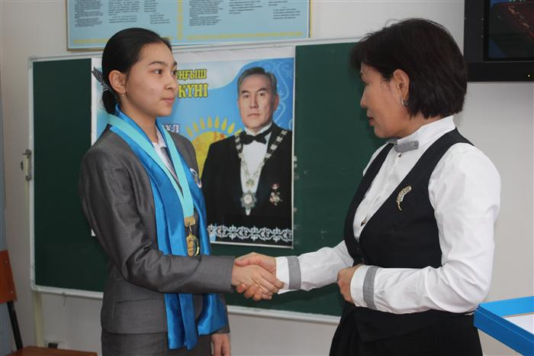
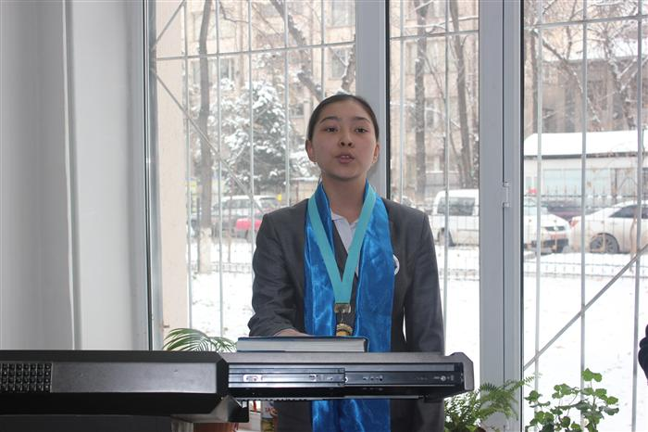
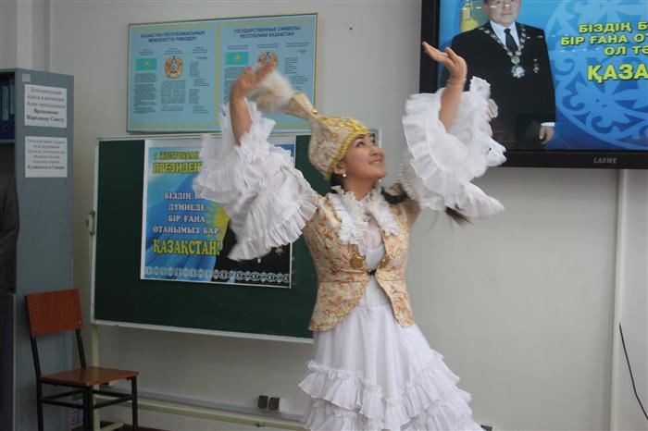
28. 11.2014- the inauguration of the president of the school.

Slide 23
Spiritual, moral and
mass cultural education.

Slide 24
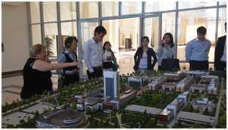
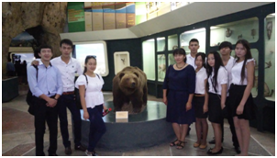
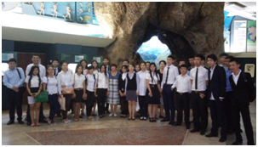
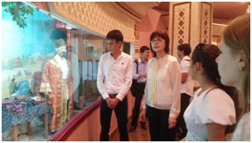
Tour to the campus of KazNU named after al-Farabi

Slide 25
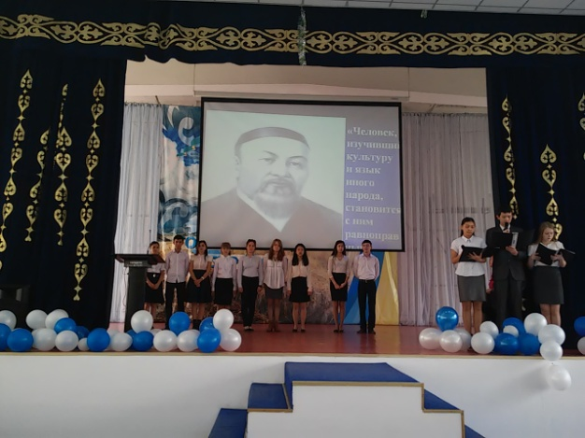
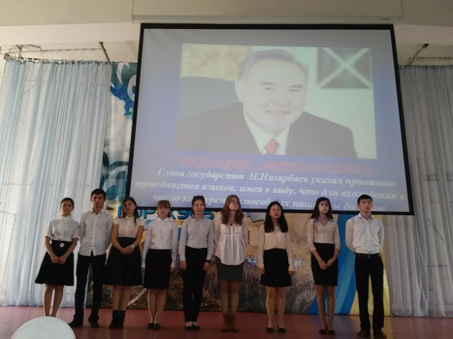

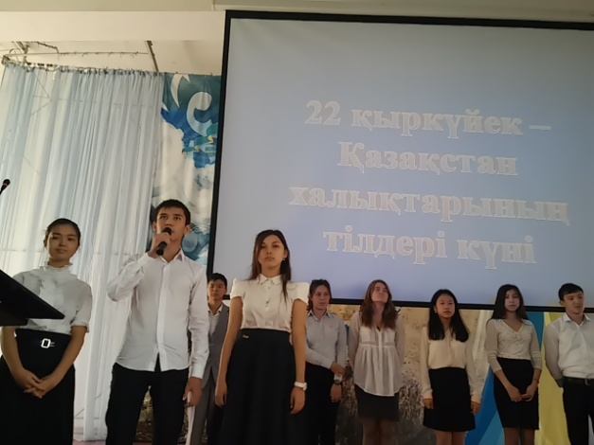
Day of Languages of Peoples of Kazakhstan

Slide 26
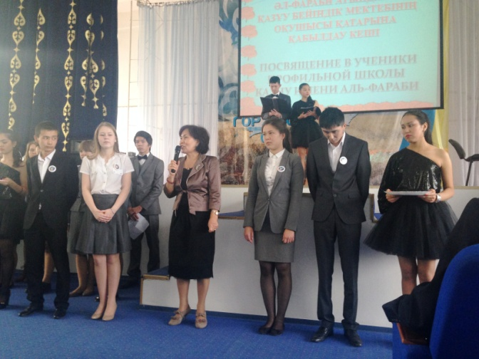
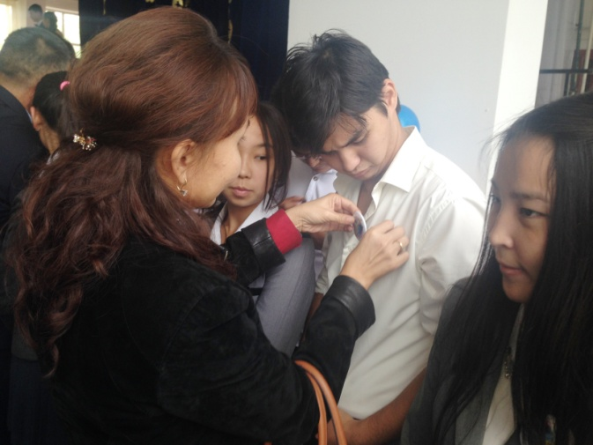
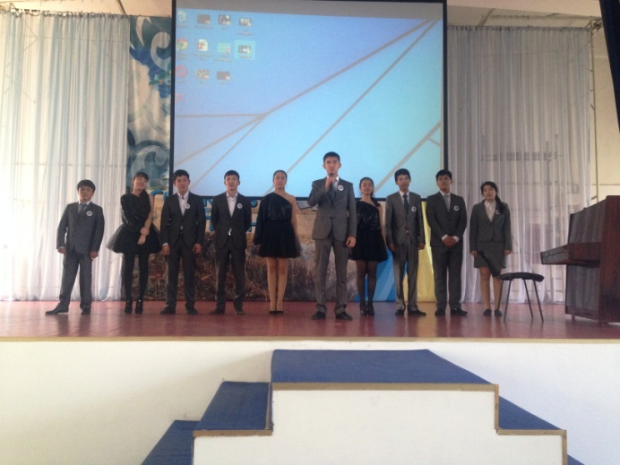
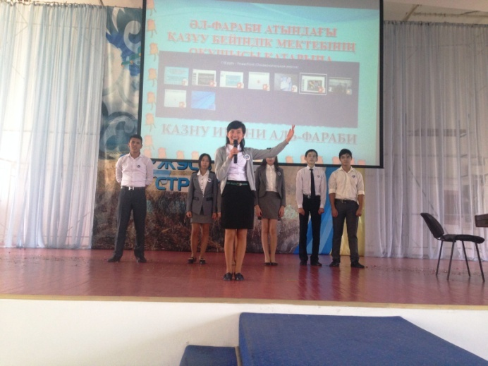
30th September profile school held a festive event of "Dedication to students KazNU"
Congratulations of director profile school
Students are awarded badges with the logo of the school

Slide 27
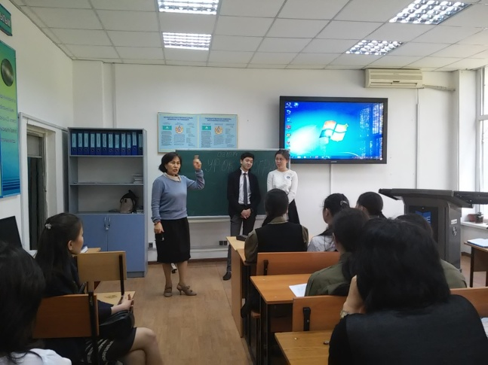
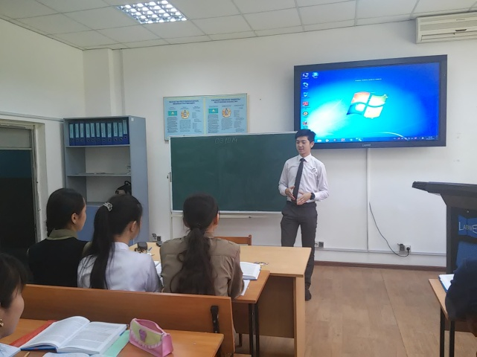
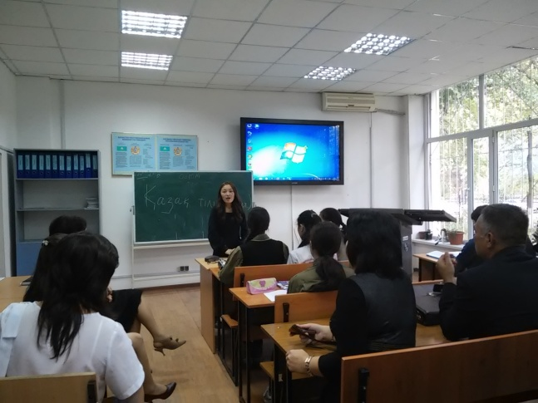
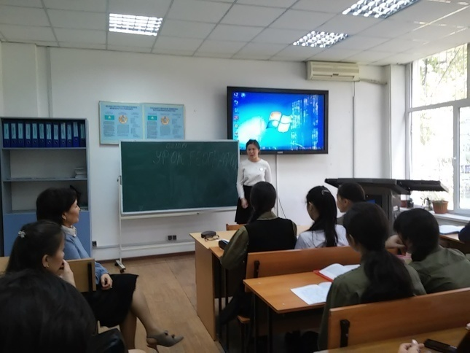
October 3, 2013 at profile school of Kazakh National University named after Al-Farabi, in celebration of the Teacher’s Day was day of Understudy.

Slide 28
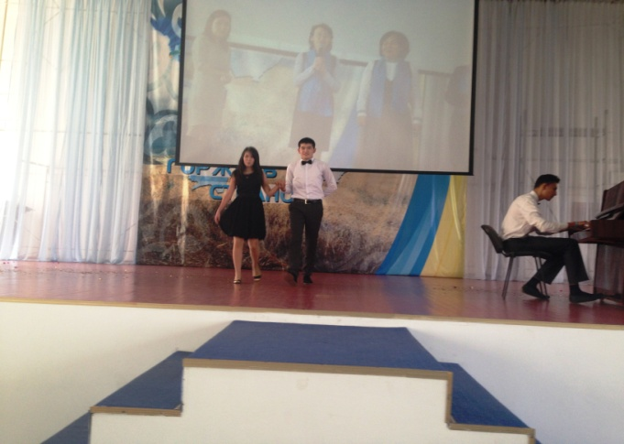
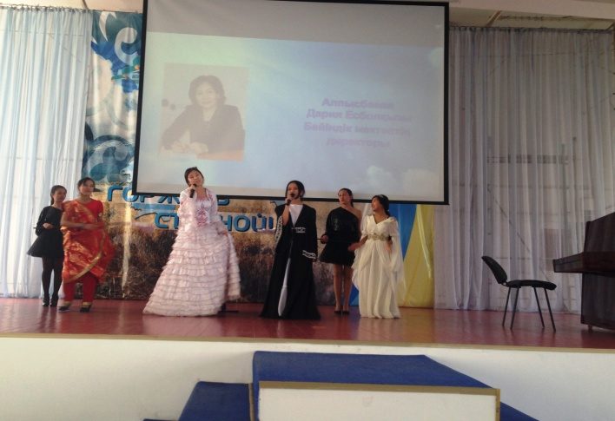
October 3, 2013 a festive concert dedicated to the Day of the Teacher.
Musical composition of 11th grade
Stage Greetings from
11th A class

Slide 29
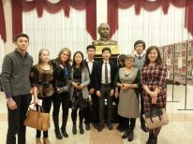
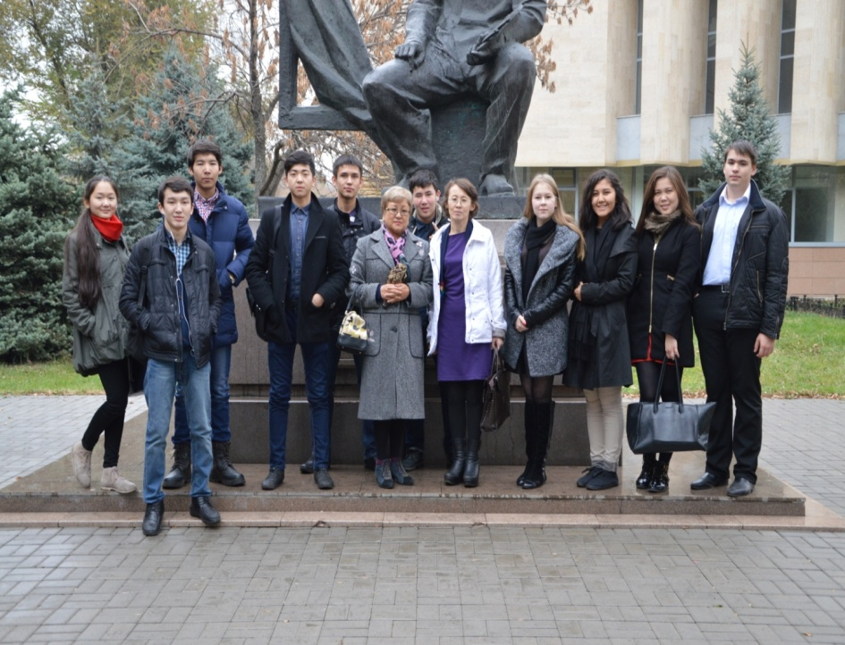
October 10, 2014 profile school students together with teachers visited Lermontov’s Theatre. The play "The Government Inspector" Nikolai Gogol

Slide 30
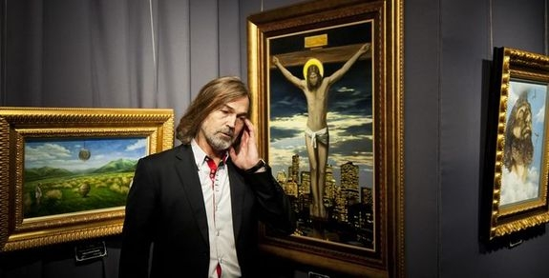
Touch the eternal! November 4, 2014, students and teachers visited the exhibition of Honored Artist of the Russian Federation - Nikas Safronov called "Favorites" in the State Museum of Art Kasteyev.

Slide 31

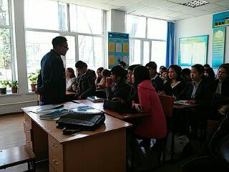
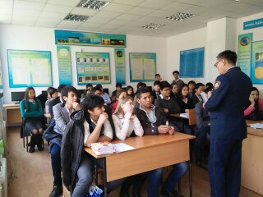
On October 31, a meeting was held profile school police captain Utegenova Chingiz Kuanyshbekovicha with students in grades 10-11.
Legal education

Slide 32
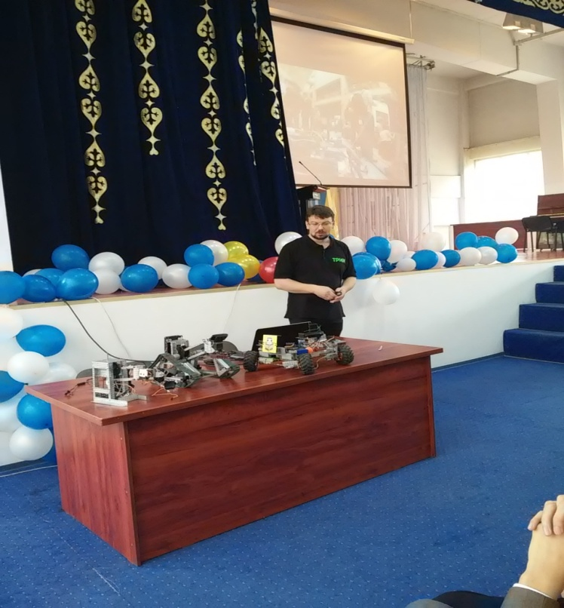
professional education
Cybernetic designer TRIC
18.09.14 at profile school Kazakh National University named after Al-Farabi was held a meeting with experts in robotics from St. Petersburg State University. Listen to information about cyber constructor new generation - TRIC

Slide 33

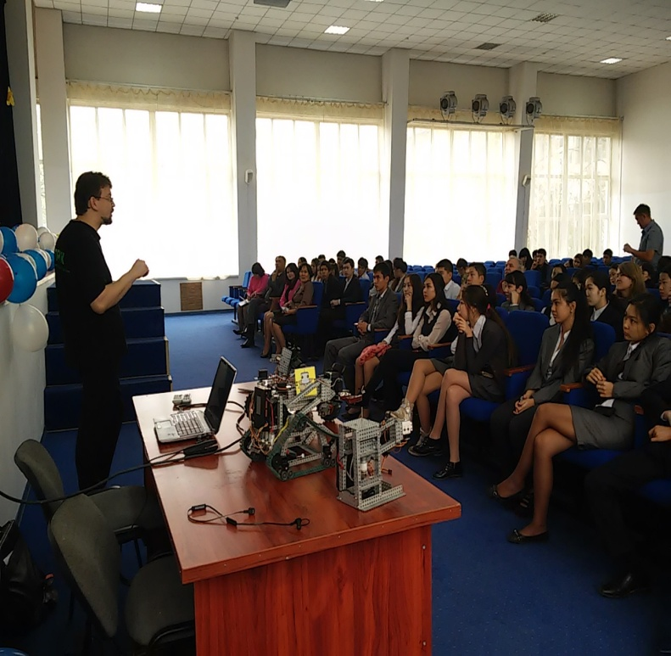
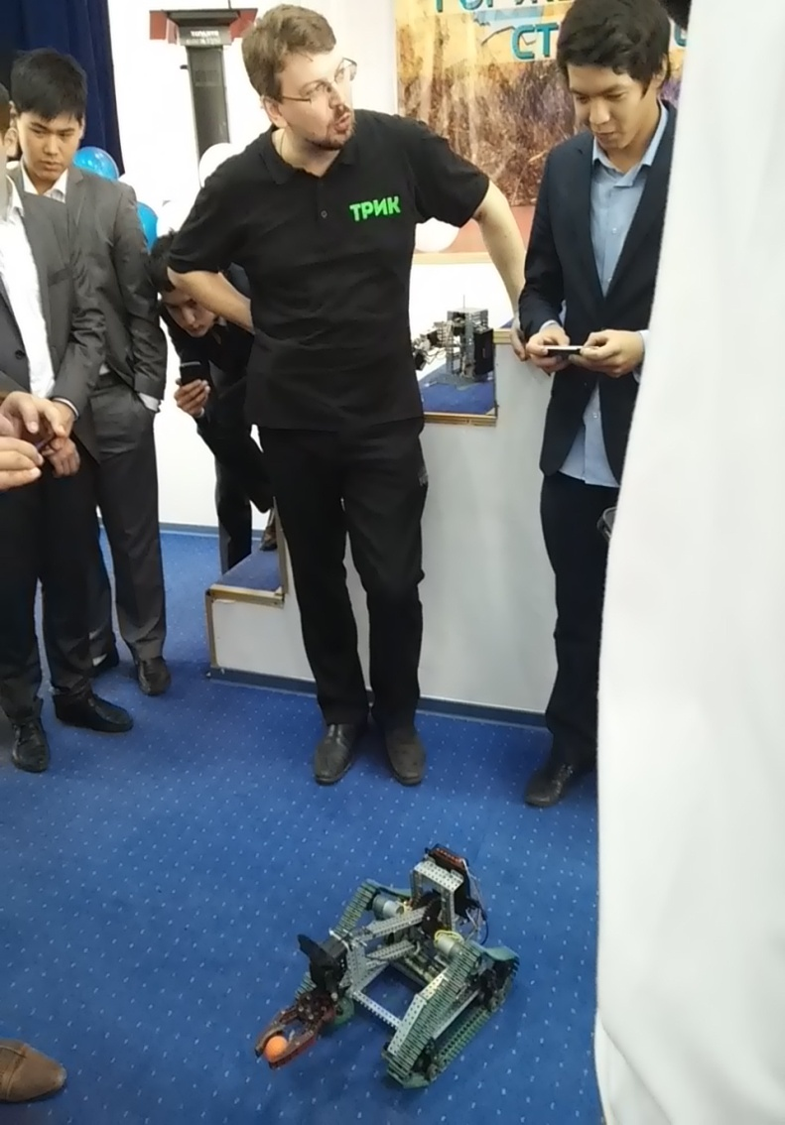
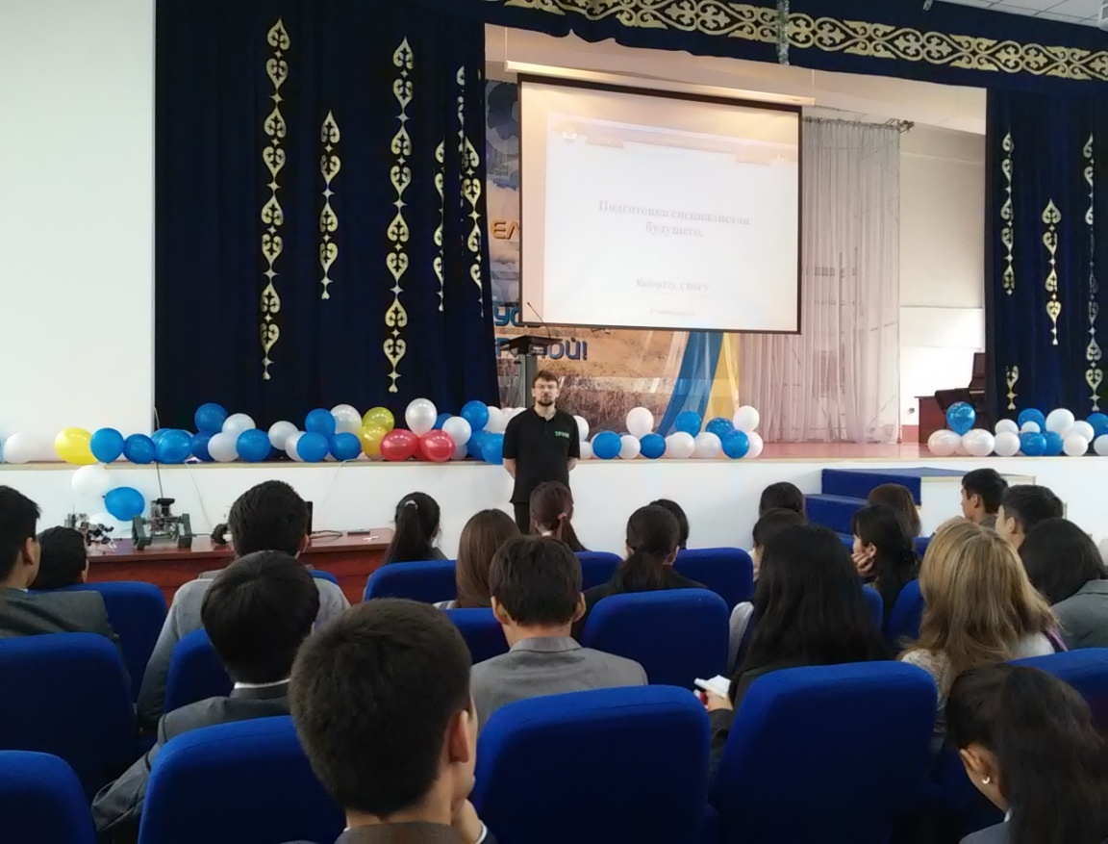
Informative lecture conducted Doctor of Physics and Mathematics, Professor. Terekhov AN; Filippov SA, teacher, methodologist of Physics and Mathematics Lyceum of the Central District of St. Petersburg.

Slide 34

Physical education, promotion of healthy lifestyles.
December 1, 2014 at profile school passed the open class hour on World AIDS Day.

Slide 35


In the profile school of the al-Farabi passed Olympics dedicated to the Day of Independence of Kazakhstan.

