Slide 1
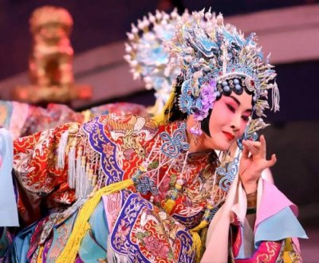


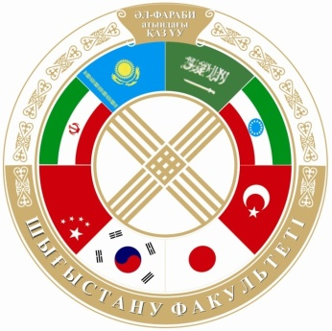
DEPARTMENT OF CHINESE STUDIES

Slide 2
Educational-methodical activity
The department conducts training in the following areas of higher and postgraduate education
Bachelor degree
(4 years of study)
«5В020900 –Oriental studies»
«5B020700 - Translation studies»
«5В021000 –Foreign philology»
«5B050500- Regional Studies»
Master degree
(2 years of study)
«6M020900 -Востоковедение»
«6M020700 - Translation studies»
«6M021000 - Foreign philology»
«6M050500- Regional Studies»
PhD-doctorate
(3 years of study)
«6D020900 - Oriental studies»

Slide 3
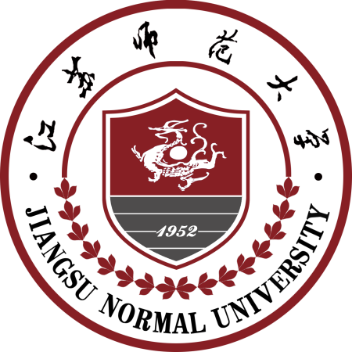


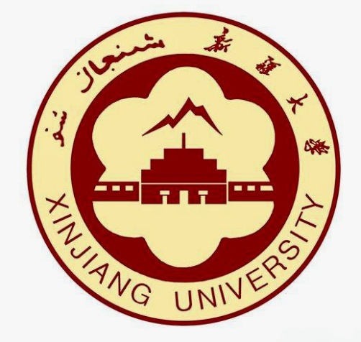



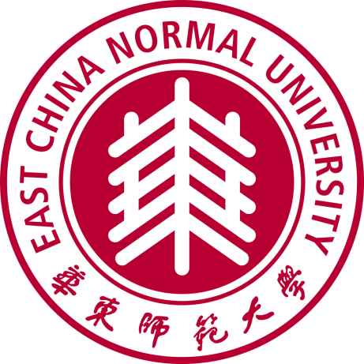
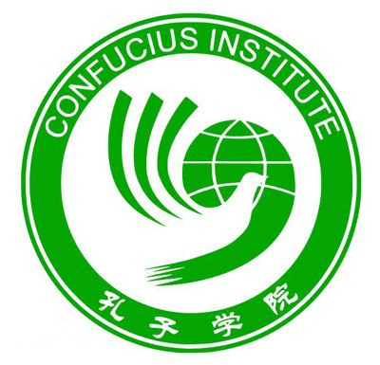

The main foreign partners of the department

Slide 4
Dual diploma program (diploma of domestic university and of a university of the People's Republic China)
2+2 | Within the program of the "2 + 2" students are taught two years in the country, and the next two years - in China and get a double diploma.
1+1 | Undergraduates can get a double diploma in a similar program of "1 + 1", signing a contract for training the last year in the universities of China and Taiwan.

Slide 5
Research and innovation work

Slide 6
Number of student who had overseas training

Slide 7
Degrees of the teaching staff of the department of Chinese Studies

