Slide 1


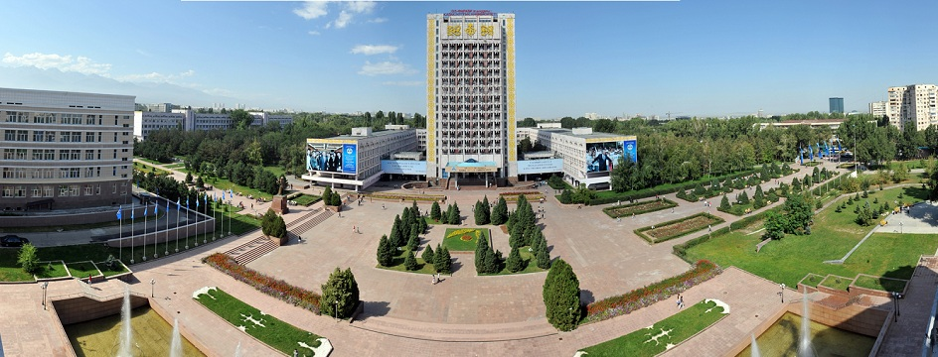

Slide 2

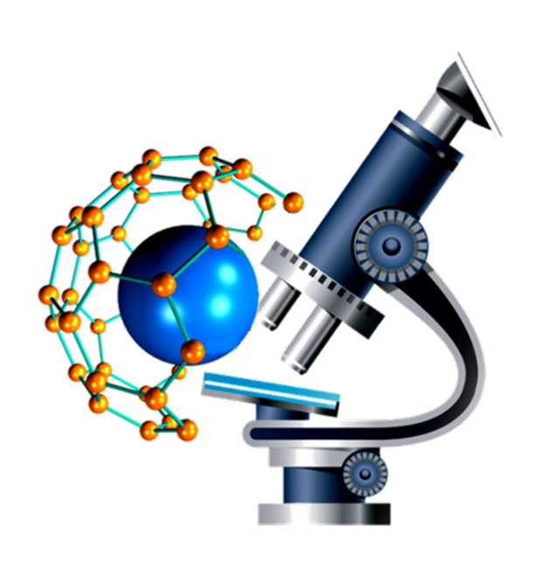
Department of Biotechnology

Slide 3

Educational Programs of Biotechnology Department
BSc, MSc, PhD
SPECIALITIES: 5B070100 – Biotechnology BSc,
6М070100 – Biotechnology MSc,
6D070100 – Biotechnology PhD.
BSc: 5B070100 - Biotechnology
Specialization "Cell and Molecular Biotechnology"
Specialization "Food Biotechnology"
Specialization "Biotechnology of Microorganisms"
Specialization "Environmental Biotechnology"
MSc: 6М070100 – Biotechnology
Specialization "Cell and Molecular Biotechnology"
Specialization "Food Biotechnology"
Specialization "Biotechnology of Microorganisms"
Specialization "Ecological Biotechnology"
PhD: 6D070100 – Biotechnology
Specialization "Cell and Molecular Biotechnology"
Specialization "Food Biotechnology"
Specialization "Biotechnology of Microorganisms"
Specialization "Ecological Biotechnology"

Slide 4
Educational Programs of Biotechnology Department
BSc, MSc, PhD
SPECIALITIES: 5B060700 – Biology BSc,
6M060700 – Biology MSc,
6D060700 – Biology PhD.
BSc: 5B060700 – Biology
Specialization "Microbiology"
Specialization "Ecology of Microorganisms"
MSc: 6M060700 – Biology
Specialization "Microbiology"
Specialization "Ecology of Microorganisms"
PhD: 6D060700 – Biology
Specialization "Microbiology"
Specialization "Ecology of Microorganisms”

Slide 5
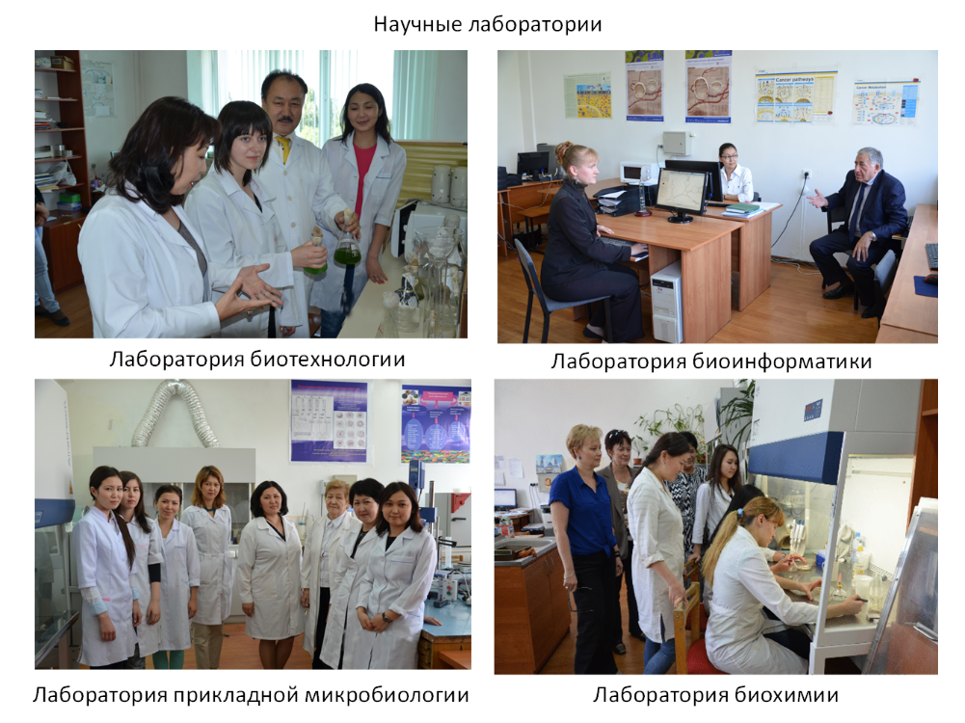
Research Laboratories
Laboratory of Biotechnology
Laboratory of Bioinformatics
Laboratory of Applied Microbiology
Laboratory of Biochemistry

Slide 6
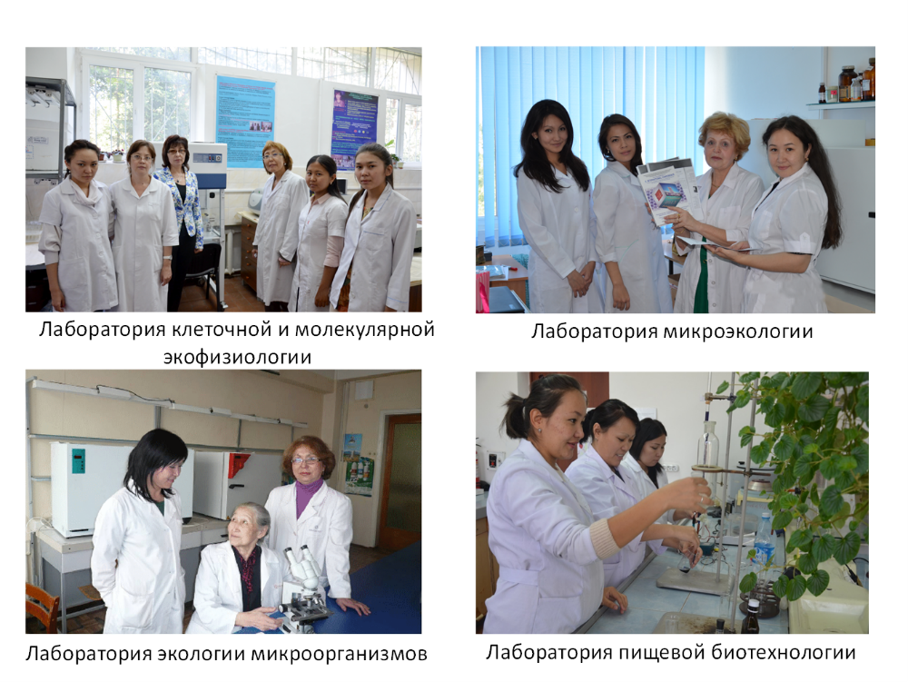
Laboratory of Cell and Molecular
Ecophysiology
Laboratory of Microecology
Laboratory of Microbial Ecology
Laboratory of Food Biotechnology

Slide 7
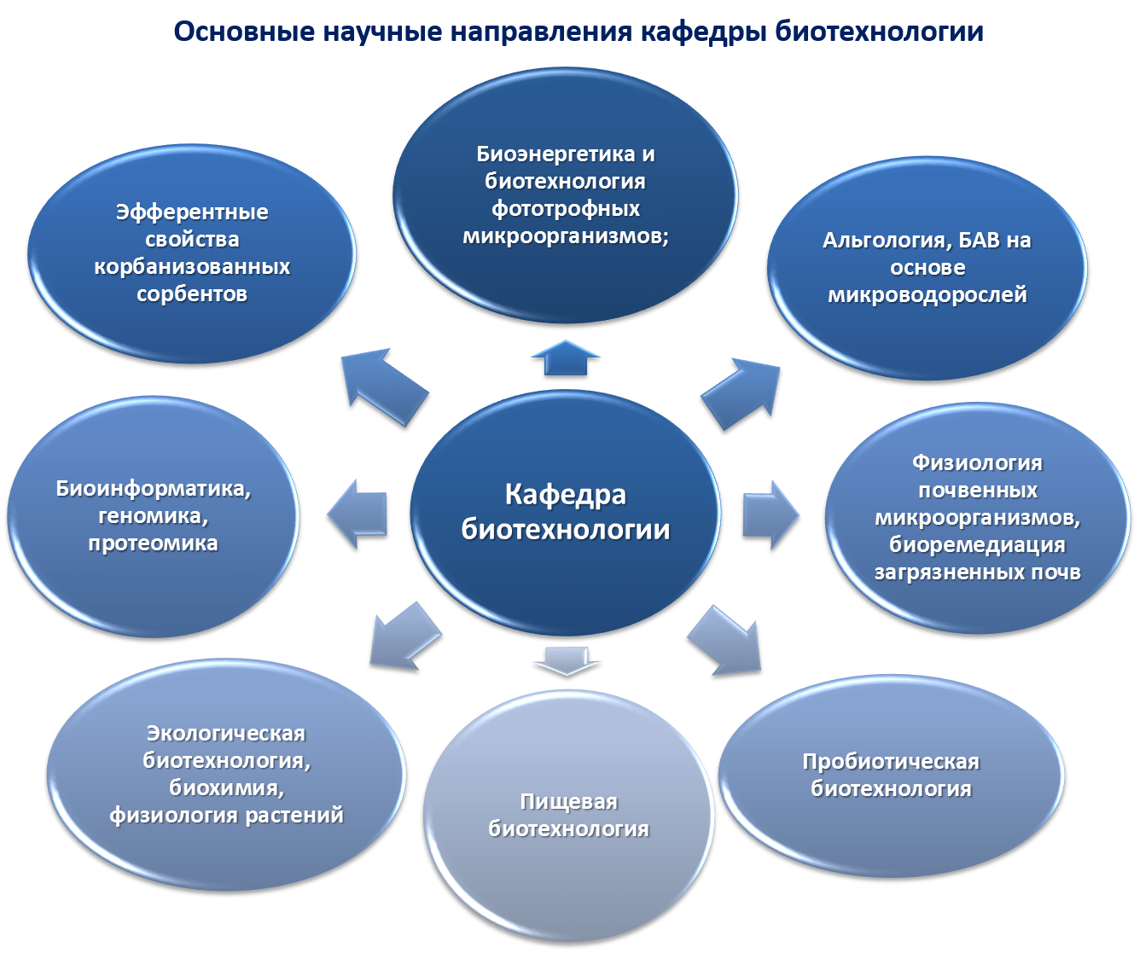
Main Research Interests of the Department
Bioenergetics and Biotechnology of phototrophic microorganisms
Heterogeneous Bio composites
Algology, Food Additives
Bioinformatics, genomics and proteomics
Department of Biotechnology
Physiology of Soil Microorganisms, Bioremediation
Ecological Biotech, biochemistry and Physiology of Plants
Probiotic Biotechnology
Food Biotech

Slide 8
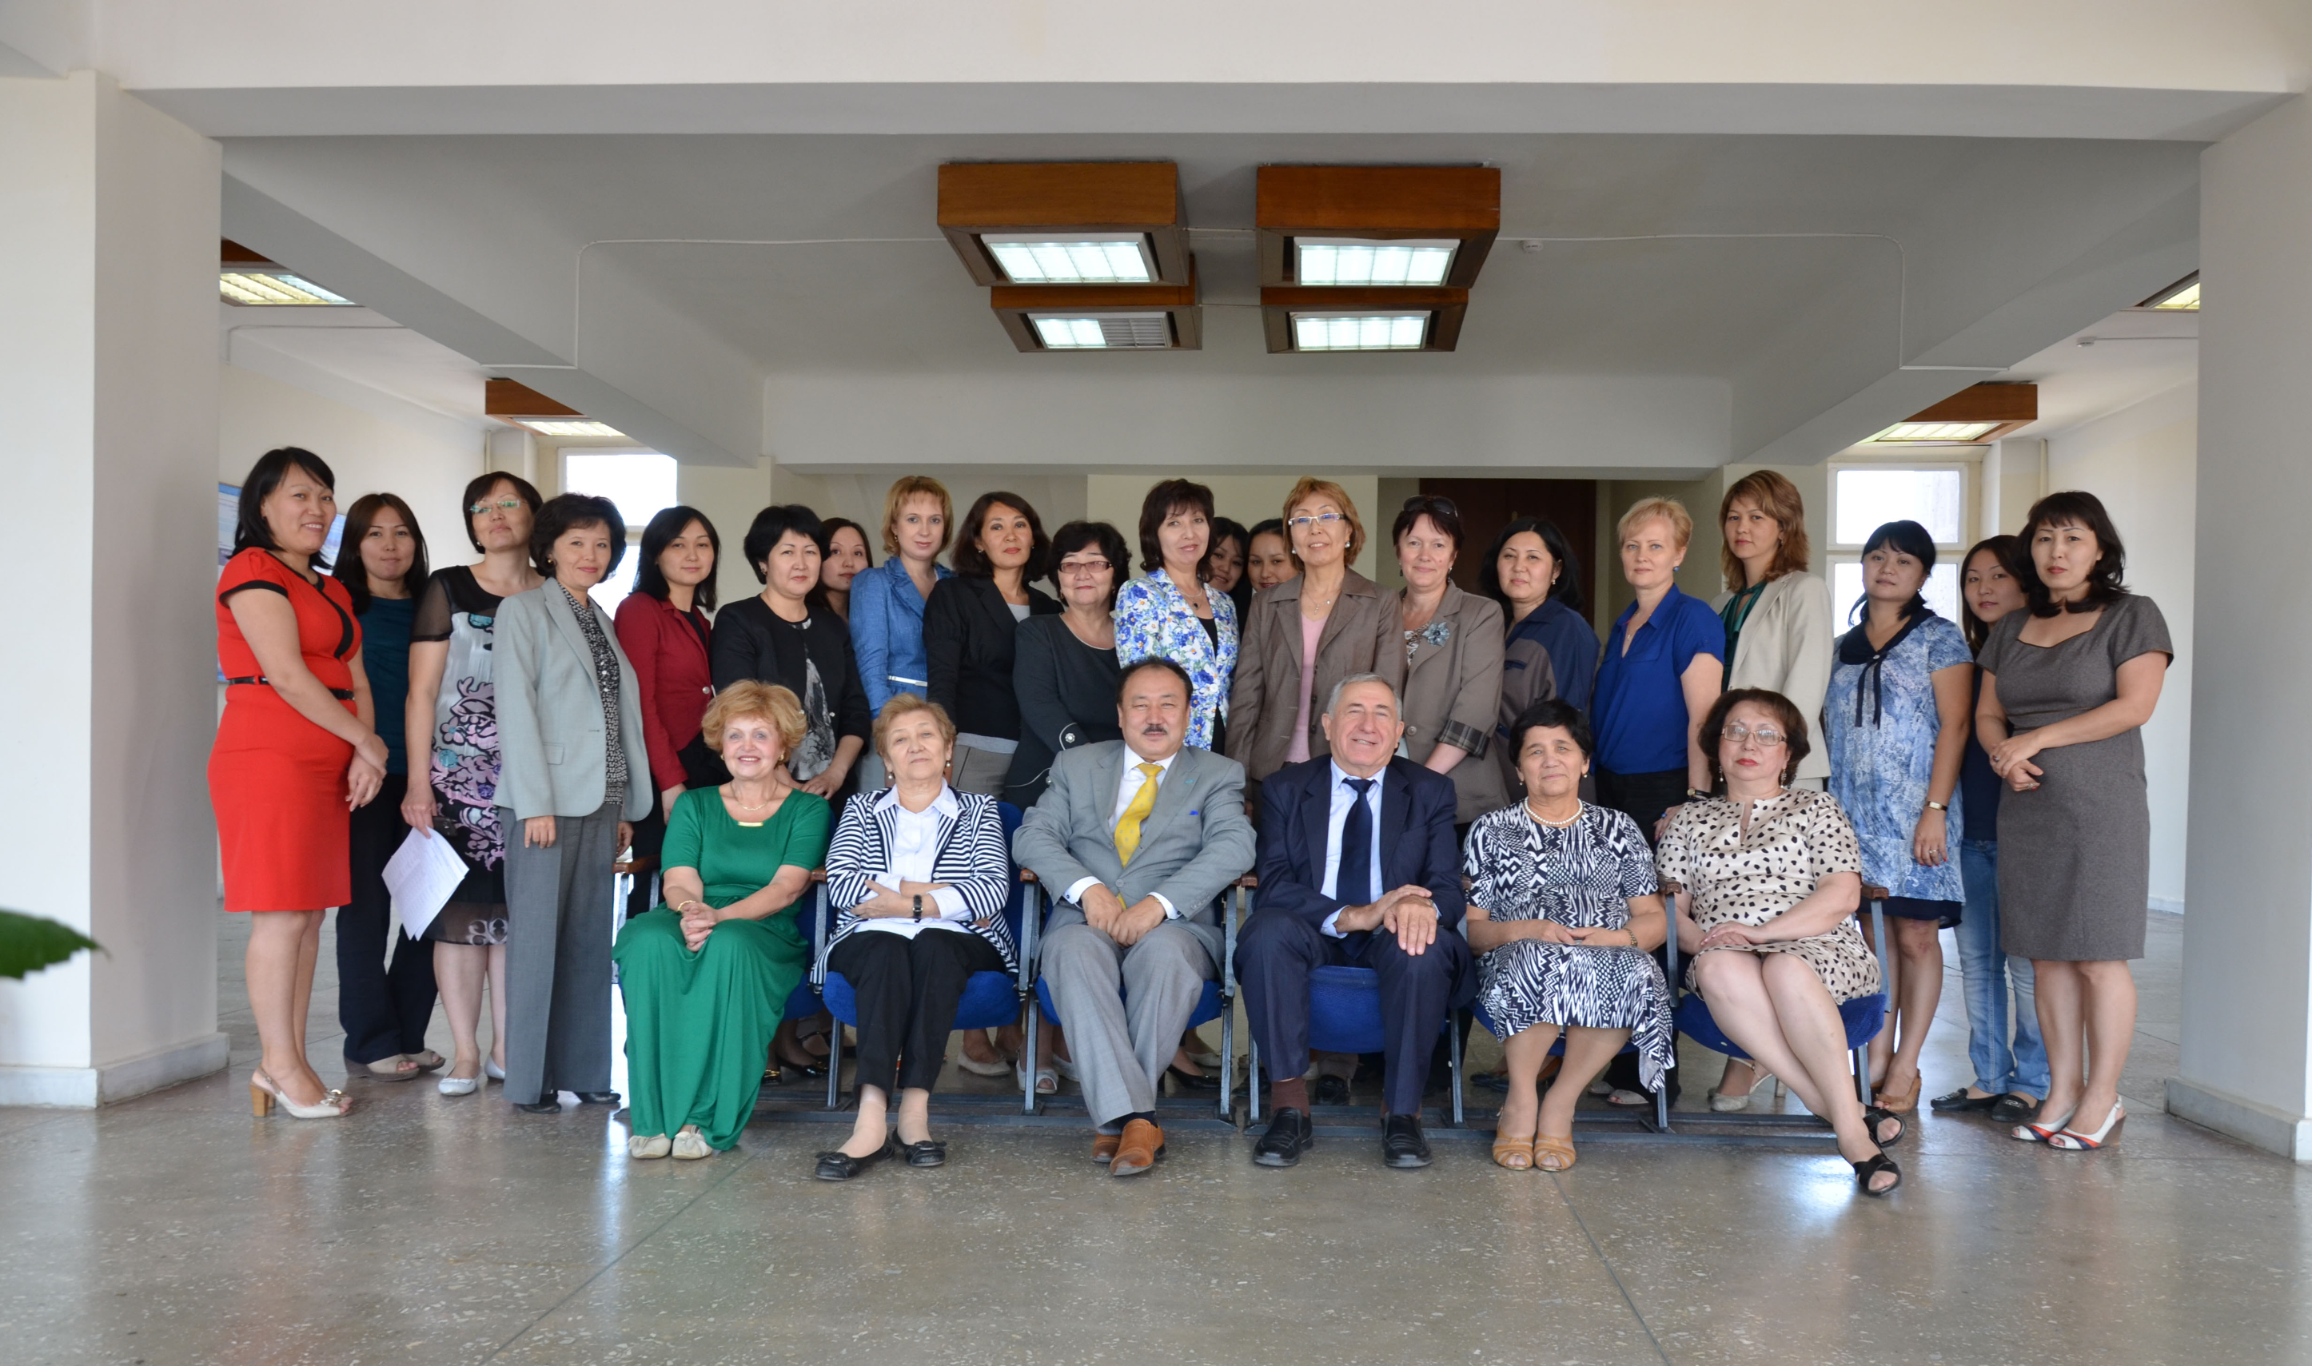
Our Teaching Stuff

