Slide 1
кафедра
Scientific-research activity
Department of foreign languages for natural sciences
Educational-methodical activity
Socio-educational activity

Slide 2
Educational-methodical activity
1
2
3
Number of open lessons-13
Number of educational-methodical book-6
Number of project works- 15

Slide 3
Scientific-research activity
1
2
3
Methodical articles
«Messenger» - 4
Number of articles published in CIS- 14
Number of articles published in the materials of conferences- 10

Slide 4
Socio-educational activity
Articles
Scientific-methodical: 10
Image: 12

Slide 5
Projects of educational character
«Brighten the corner where you are! » - 49 events
«100 – books» - 27 events
«Healthy lifestyle» - 10 events
«greencampus» - 11 events

Slide 6
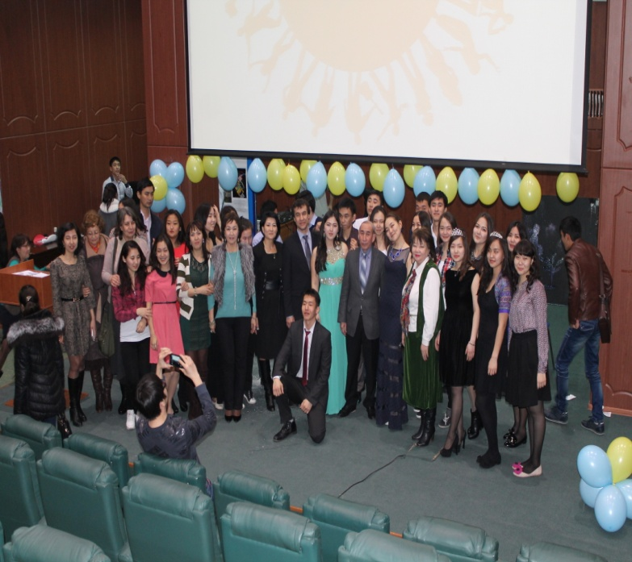
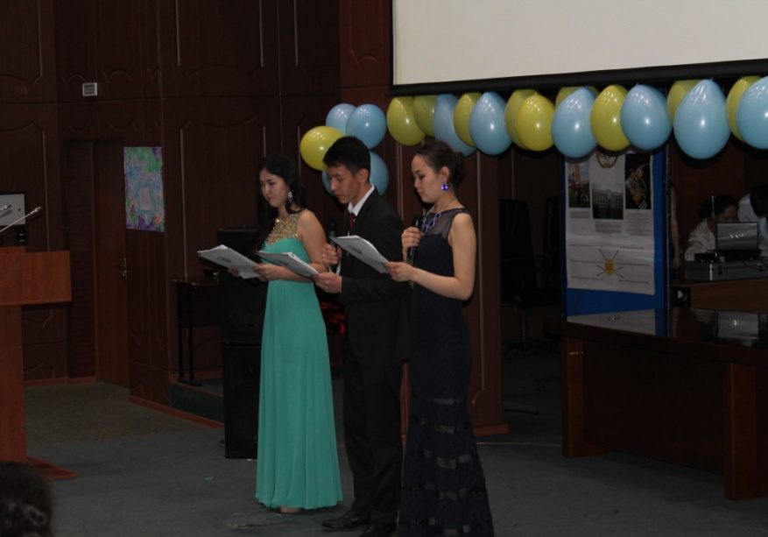
«Brighten the corner where you are! »

Slide 7
«Brighten the corner where you are!»
Education of civil liability, dignity, respect for the history, culture and traditions of the country, develop a sense of pride and love for the motherland.
Development of musical, poetic abilities of children, aesthetic taste.

Slide 8
Center of «iLC KazNU»
Aims and objectives:
English language center "iLC KazNU" for students, undergraduates, doctoral PhD. The objectives of the Center is to organize and conduct workshops, counseling, testing, training, lectures, seminars, conferences, publication of scientific and methodological articles and implementation expertise developed instructional materials for teaching foreign languages.
The purpose of the Center is to implement additional educational activities, namely teaching of foreign languages ​​in line with the language policy of the Republic of Kazakhstan, aimed at the formation of multilingual societies to the application of modern techniques and advanced technologies.

Slide 9
Center of«iLC KazNU»
Obligations:
To organize English courses for Kaznu teachers, workers, students, masters and PhD doctors;
At the moment, the Centre employs qualified teachers. As well as the Centre organizes international IELTS and TOEFL exams together with Interpress;
To organize English courses for business;
Training English courses to pass exams of Graduate school, PhD doctorate;

