Slide 1
L.1 IT Infrastructure: Overview: Basic definitions and concepts, IT infrastructure requirements

Slide 2
Plan:
Brief description of the discipline
The concept of "IT infrastructure of the organization“.
IT infrastructure tasks.
Information technologies in the activities of organizations of various directions.

Slide 3
Purpose: Teaching theory, methods and technologies in the development and management of IT infrastructure, management and development of IT infrastructure of various profiles and scales, as well as the formation of practical skills for the effective construction and modernization of IT infrastructure.

Slide 4
Tasks:
- Training in modern technologies, methods and tools used in IT infrastructure management;
- Organization of training for students on the design of the IT infrastructure of the enterprise;
- Modeling the business architecture of the enterprise;
- Basic techniques for modeling business processes of the IT department;
- Training to optimize the work of the IT department

Slide 5
Competencies:
- Determination of the compliance of the goals and objectives of the IT organization with the business goals and strategies of the enterprise or company;
- Consulting on the organization of IT management;
- Analysis and assessment of IT enterprise management processes;
- Justification of the value of work to improve IT management processes.

Slide 6
Learning outcomes:
- able to determine the requirements for the IT infrastructure of the enterprise;
- able to justify the choice of technical and software equipment for the IT infrastructure of the enterprise;
- able to optimize IT processes;
- able to identify the resources necessary to ensure the reliability of information systems;
- able to analyze the performance indicators of information systems.

Slide 7
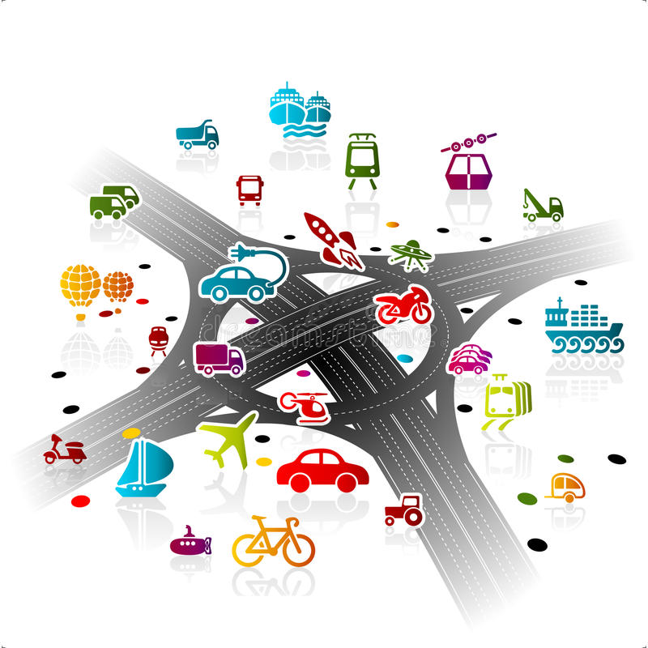
What is infrastructure?

Slide 8
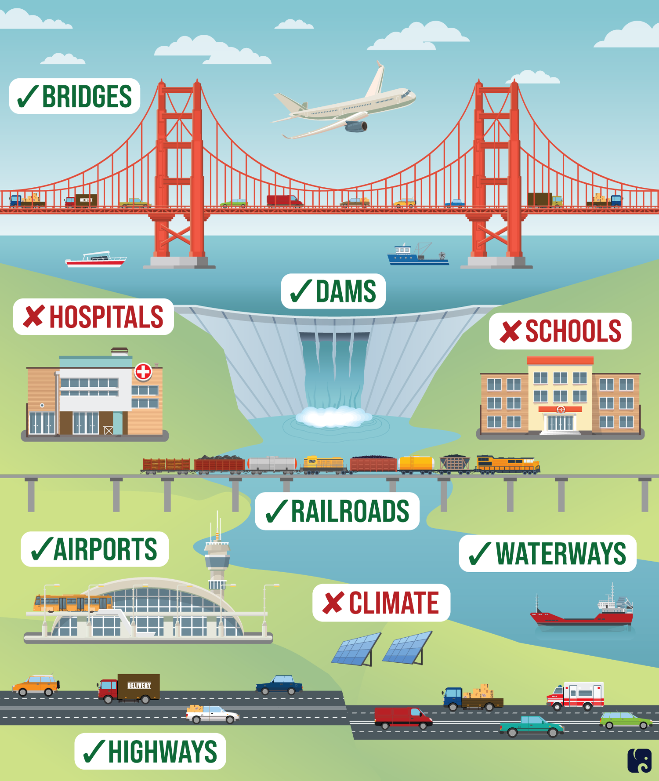
Infrastructure
Infrastructure is a term used to refer to a set of interconnected structures, industries or objects that serve for the normal functioning of any system as a whole.

Slide 10
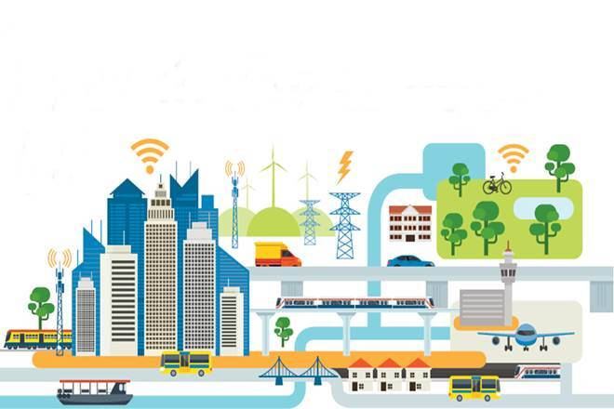
Infrastructure can include:
– Road & railway systems, tunnels, and bridges.
– Mass-transit systems, including buses, subways (UK: underground trains), elevated trains, etc.
– Energy-generating facilities including power stations, wind farms, hydro-electric plants, etc.
– The national power grid; electrical power lines and connections.
– Telephone cables and mobile phone towers.
– Reservoirs and dams.
– Pumping stations and levees.
– Ports, airports, waterways and canals.
– Hurricane barriers.
– Fire-fighting equipment and personnel.
– Health services, hospitals, clinics, and emergency response systems.
– Education, including schools, colleges, universities, and other adult education facilities.
– Police and prisons.
– Waste removal and sanitation facilities.

Slide 11
Types of infrastructure:
social
engineering
information
military
financial market infrastructure
economic infrastructure

Slide 12
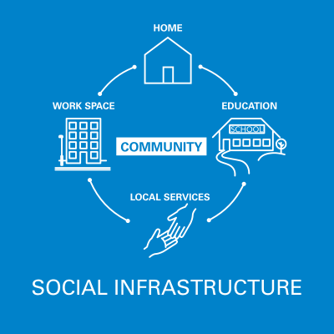

Slide 13
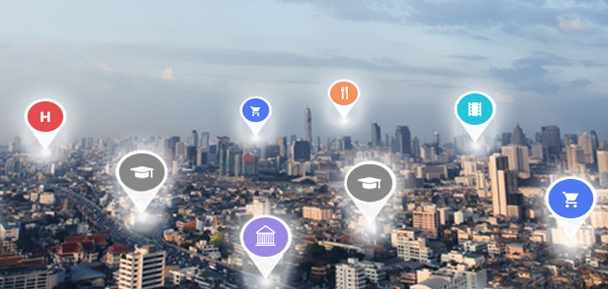
Social infrastructure is a group of service industries and activities designed to meet the needs of people, guarantee the necessary level and quality of life, ensure the reproduction of human resources and professionally trained personnel for all spheres of the national economy.

Slide 14
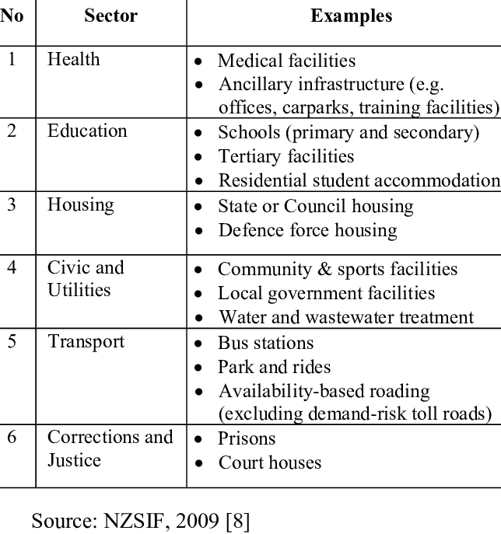

Slide 15
Engineering, transport and social infrastructure is a complex of structures and communications of transport, communications, engineering equipment, as well as objects of social and cultural services for the population, ensuring the sustainable development and functioning of settlements and inter-settlement territories.

Slide 16
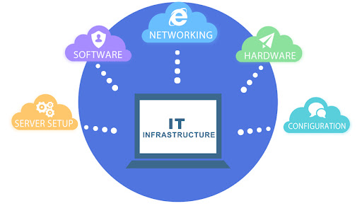
What is IT Infrastructure?
IT infrastructure refers to various components required to run IT and IT-enabled operations. These include software, composite hardware, network services, and resources. The infrastructure enables organizations to deliver services and solutions to customers, partners, and employees.

Slide 17
IT infrastructure components
Computer hardware platforms
Software applications
Operating system platforms
Data management and storage
Networking and telecommunications platforms
Internet platforms
Consulting and system integration services

Slide 18
IT Infrastructure
IT infrastructure is a system of organizational structures that ensure the functioning and development of the country's information space and means of information interaction.
IT infrastructure is a set of technical means, communication lines, procedures, regulatory documents, etc., providing the basis for the functioning of information services.
The IT infrastructure of the company is a set of means for creating, storing and processing information, combined into computer and communication networks.

Slide 19
IT infrastructure is a complex structure that combines all information technologies and resources used by a particular organization or company.

Slide 20
The main task of the IT infrastructure is to ensure stable access to the relevant resources of the company for a certain range of users.

Slide 21
The quality of the IT infrastructure:
availability;
security;
reliability.
The advantage of a properly built IT infrastructure is the optimization of enterprise costs and an increase in the productivity of the IT services used.

Slide 22
Military
Financial market infrastructure
Economic infrastructure
Urbanization & infrastructure
Kazakhstan's infrastructure sector

