Slide 1
Lec#5
Enterprise IT infrastructure management systems: MOF (Microsoft), ITSM (HP)

Slide 2
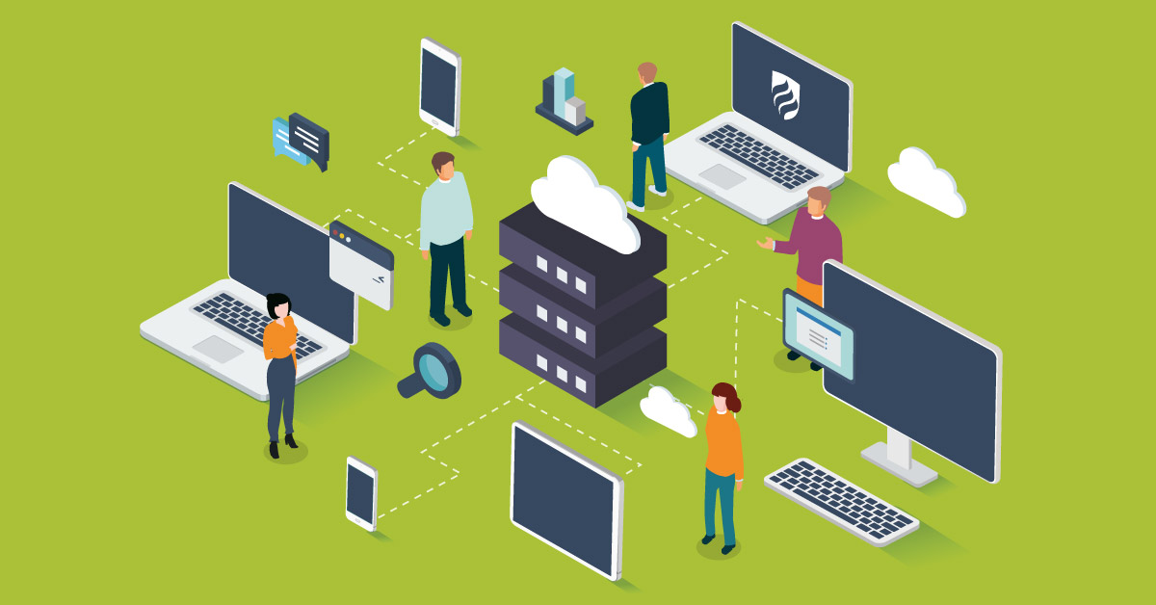
Information Technology (IT) has been serving the enterprise as a technology provider helping businesses to perform more efficiently and to expend into new directions since its early stages.

Slide 4
Information Technology Standards
ITIL (Information Technology Infrastructure Library)
COBIT (Control Objectives for Information and related Technology)
MOF (Microsoft Operations Framework)
ITSM HP Reference Model
ITPM (IT Process Model)

Slide 5
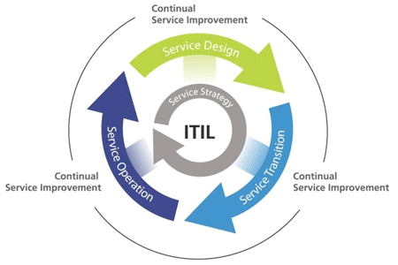

Slide 6
COBIT (Control Objectives for Information and related Technology)
COBIT is a set of control objectives that helps IT management and governance professionals manage IT operations regardless of the organization’s size. It was released in 1996 and is researched, developed, maintained and published by the Information System Audit and Control Association (ISACA).

Slide 7
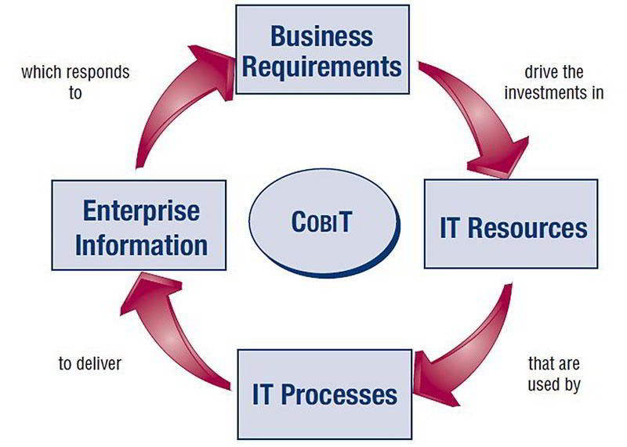

Slide 8
The four specific domains of COBIT:
Planning & Organization
Delivering and Support
Acquiring & Implementation
Monitoring & Evaluating

Slide 9
The Various COBIT Components
Framework
Process Descriptions
Control Objectives
Maturity Models
Management Guidelines

Slide 10
Benefits of COBIT
COBIT is primarily a business framework for managing enterprise IT. It is a globally recognized open standard that works on business IT processes and in keeping IT and business goals aligned. It is a comprehensive suite of tools, procedures, guidelines and principles in IT governance and management. COBIT helps organizations in benefiting from their information systems and IT assets, while having enterprise-wide control over enterprise IT.

Slide 11
MOF (Microsoft Operations Framework)
The Microsoft Operations Framework (MOF) is an open source framework derived of best practices, principles, and activities that provide a focus on reliability in IT solutions and services.

Slide 12
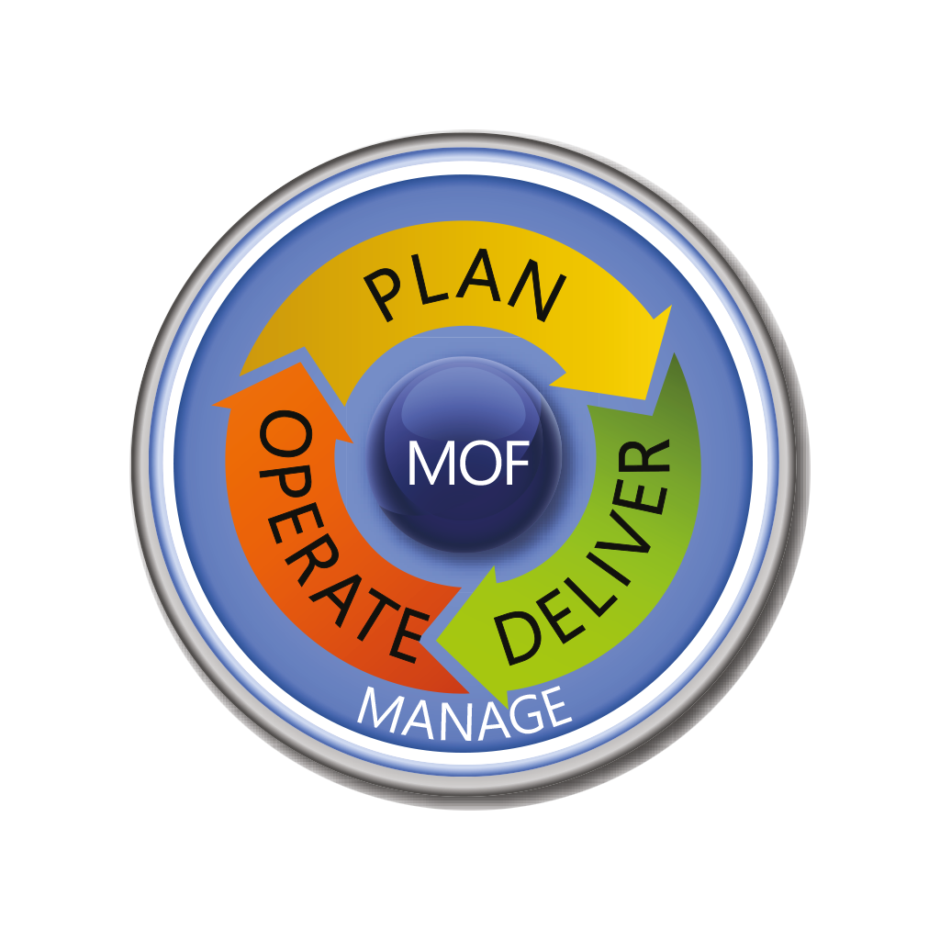
MOF is composed of three phases—Plan, Deliver, and Operate—with an underlying Management Layer.

Slide 13
The MOF encompasses all processes involved in managing IT services:
Conception
Development
Operation
Maintenance
Retirement

Slide 14
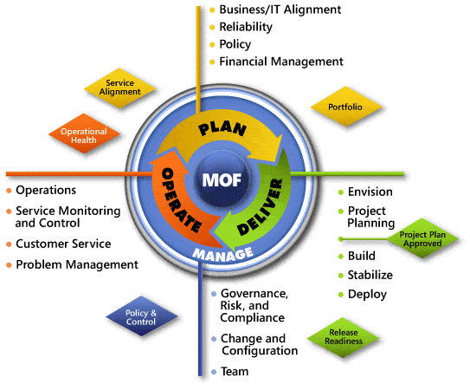

Slide 15
IT Service Management (ITSM)
IT service management (ITSM) is the process of designing, delivering, managing, and improving the IT services an organization provides to its end users. ITSM is focused on aligning IT processes and services with business objectives to help an organization grow.

Slide 16
There is a common line of thinking in the IT industry that posits that a proper approach to ITSM should follow three steps in this order:
Build and implement IT technology.
Bring in and enforce the right process.
People can learn the technology and abide by the process.

Slide 17
ITSM processes
Process Focus
Prevention
Proactive
Customers
Distributed, sourced
Integrated, enterprise-wide
Repeatable, accountable
Formal best practices
Business perspective
Service orientation

Slide 18
Benefits of ITSM
Better understanding of what the business needs and why (i.e. “business alignment”)
Repeatable and scalable processes
Defined roles and responsibilities
Increased productivity
Satisfied end users with realistic expectations
Shorter gaps between detecting incidents and solving them

Slide 19
Benefits for the Business:
IT can react quickly to change and innovation in the market
Better IT availability and performance means employees get more done
IT issues are less common, less impactful, and less costly
Employees know what services are available and how to use them
IT provides better service at a lower cost

